Slide 1
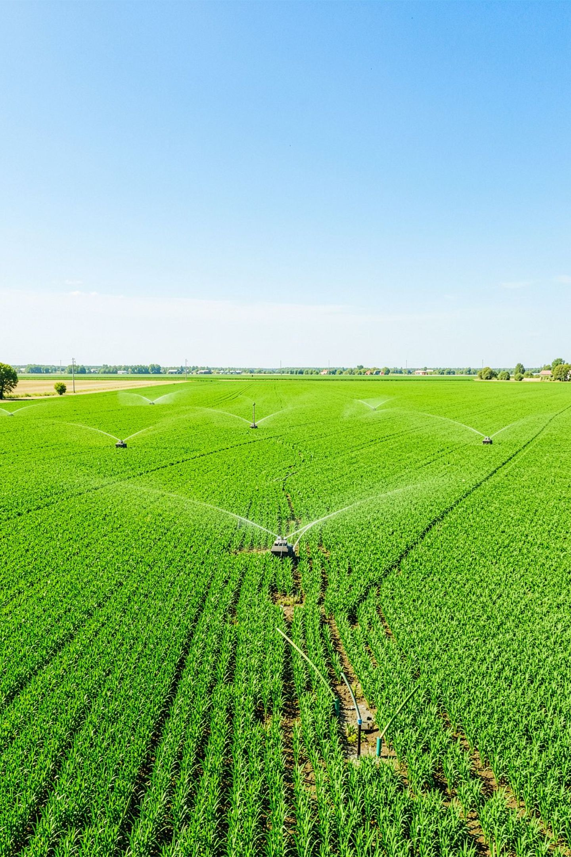
IoT-Based Smart Irrigation System for Automated Water Supply Control Using Soil Moisture Monitoring
An IoT-enabled agricultural irrigation management system designed to automate water supply based on real-time soil conditions.
KUVALA SIVA KUMAR
323129520010

Slide 2
Problem Statement
Water Management Challenge
Manual Monitoring Dependency
Over-Irrigation Risk
Fixed watering schedules may result in over-irrigation, wasting water and potentially harming crops.
Efficient water management is essential for agricultural productivity and water conservation.
Traditional irrigation often depends on manual monitoring, making it labor-intensive and error-prone.
Insufficient Watering Risk
Need for Intelligence
Farmers need an intelligent system that monitors soil conditions in real time and automatically regulates irrigation according to crop requirements.
Insufficient watering can also occur when soil conditions change unexpectedly between scheduled cycles.

Slide 3
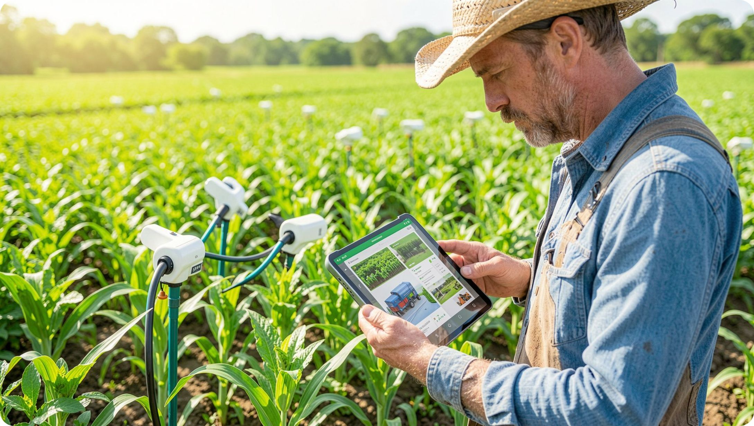
Proposed Solution
An Intelligent, Automated Irrigation Platform
Automates water supply using soil moisture monitoring
Uses IoT technologies to monitor field conditions continuously
Continuously observes soil and environmental conditions
Automatically regulates irrigation based on predefined soil moisture thresholds
Provides a centralized and user-friendly monitoring platform
Allows farmers to monitor and control irrigation operations remotely

Slide 4
System Components
Soil Moisture Sensors
Temperature Sensors
Monitor soil water content in real time
Collect environmental and atmospheric data
IoT Communication Modules
Automated Water Pumps
Transmit sensor data to the central system
Control water supply based on system commands
Monitoring Platform
Connected Devices
Process, analyze, and display real-time sensor data and system metrics
Enable remote monitoring and control from anywhere
These components work together to create an integrated system where sensors collect field data, IoT modules transmit information, the platform processes it, and automated controls respond to field conditions.

Slide 5

System Architecture and Working
Monitor Moisture
Collect Data
Transmit IoT
Evaluate Thresholds
Soil moisture sensors continuously monitor soil conditions while temperature sensors collect environmental information. Sensor data is transmitted through IoT communication modules, and the system compares moisture levels with predefined thresholds. When moisture falls below the required level, the automated water pump is activated and irrigation continues until the required soil condition is met. The system continuously monitors the field and updates the dashboard in real time.

Slide 6
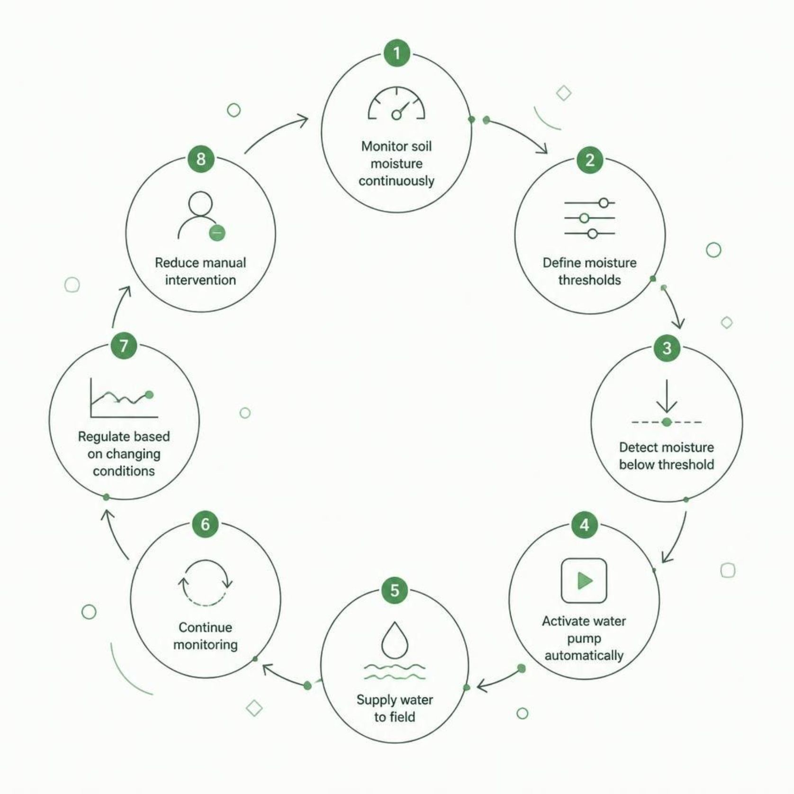

Automated Irrigation Control
Dynamic, Condition-Based Control
Monitor soil moisture continuously
Define appropriate moisture thresholds
Detect when soil moisture falls below the threshold
Automatically activate the water pump
Supply water to the field
Continue monitoring moisture conditions
Regulate irrigation based on changing soil conditions
Reduce unnecessary manual intervention
This automated approach prevents both over-irrigation and insufficient water supply by responding dynamically to actual soil conditions rather than relying on fixed schedules.

Slide 7
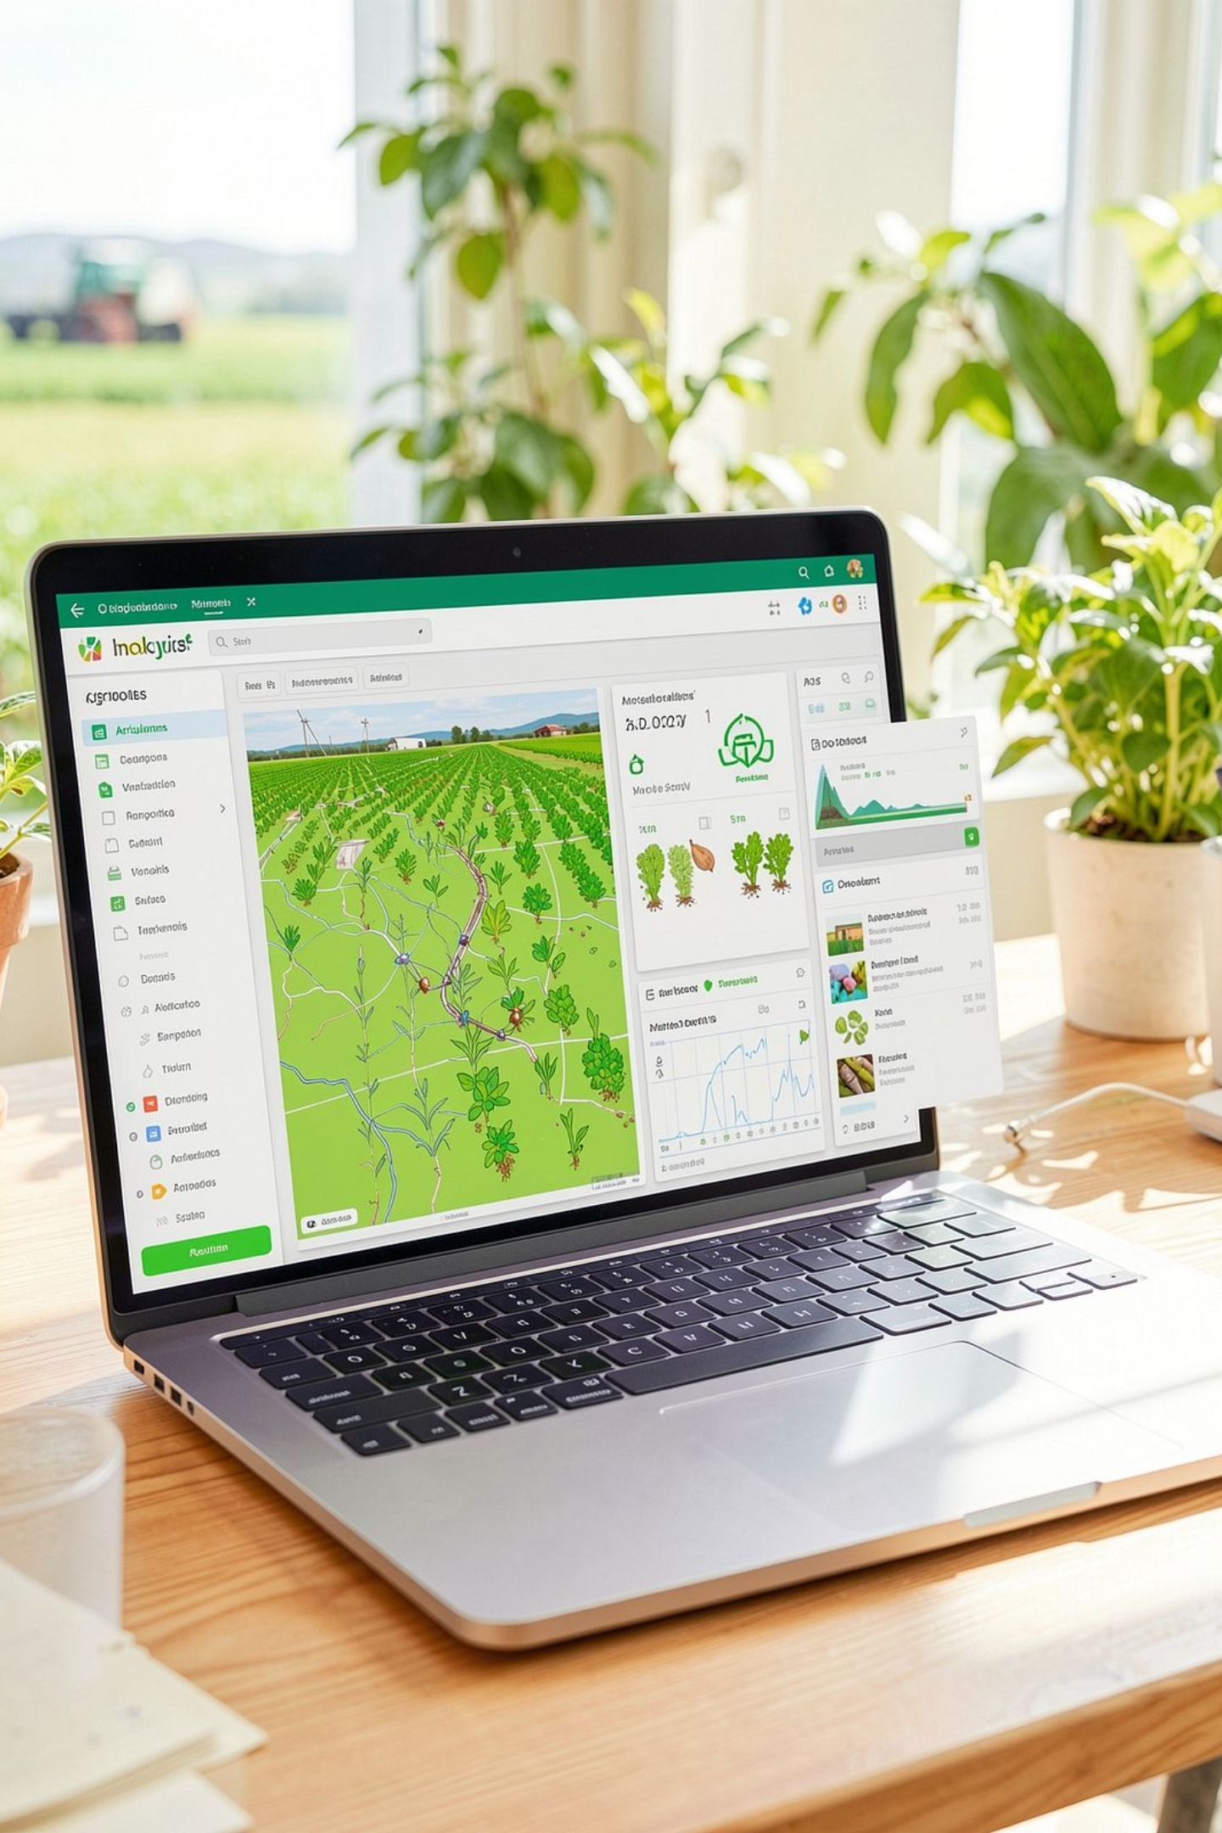
IoT Monitoring and Dashboard
Real-Time Monitoring
Data & Analytics
Soil condition monitoring
Temperature monitoring
Irrigation status tracking
Water pump activity tracking
Environmental data recording
Irrigation reports and analytics
Interactive dashboards for data visualization
Remote Capabilities
Remote field monitoring
Remote irrigation control through connected devices
The dashboard provides farmers with comprehensive information about field conditions, system performance, and irrigation history, enabling informed decision-making and remote management of irrigation operations.

Slide 8
Benefits and Impact
Water Conservation
Improves water conservation through efficient usage and reduces unnecessary water consumption and associated costs.
Optimized Crop Irrigation
Optimizes crop irrigation based on actual soil conditions, enhancing agricultural productivity and crop yield.
Reduced Labor
Reduces manual effort and labor requirements by providing automated irrigation control without human intervention.
Remote Management
Enables real-time monitoring of field conditions and helps farmers monitor and manage operations remotely.
Sustainable Farming
Supports efficient water management practices and promotes sustainable farming for long-term agricultural health.

Slide 9
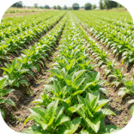
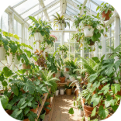
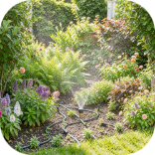
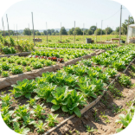
Applications and Scalability
Scalability
Adaptable Environments
Applications
Can be adapted to different agricultural environments and crop types
Agriculture & Crop Farming
Greenhouses & Controlled Environments
Gardens & Landscaping
Large-scale field crops and precision agriculture
Efficient water management for ornamental and residential use
Multi-Sensor Support
Precise climate and moisture control for protected cultivation
Can support monitoring of multiple field conditions through connected sensors
Research & Experimental Farms
Multi-Location Integration
Can integrate automated irrigation control with centralized monitoring across multiple locations
Controlled irrigation for scientific study and smart farming trials
Smart Farming Foundation
Provides a foundation for scalable smart farming solutions

Slide 10
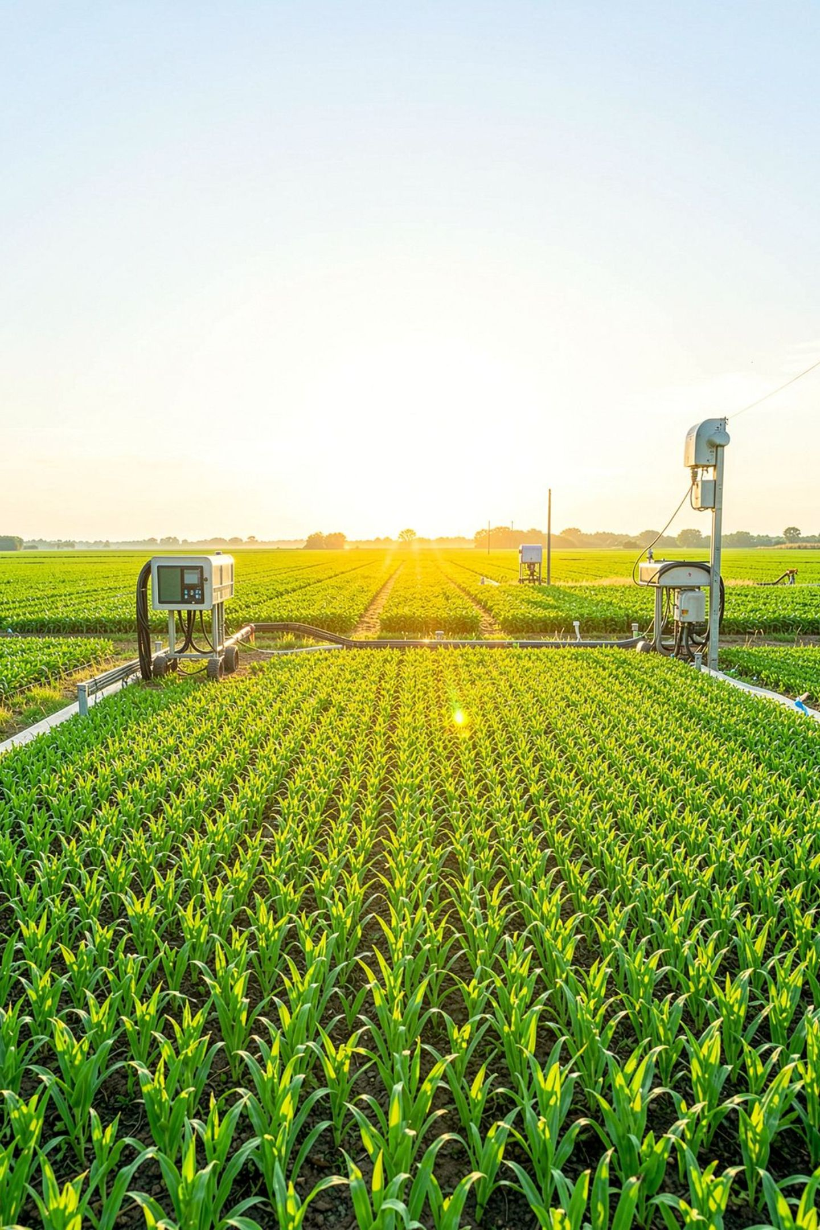
Conclusion and Future Perspective
Project Summary
Key Objective
The system provides intelligent and automated irrigation management
Soil moisture monitoring enables irrigation based on actual field conditions
IoT communication supports real-time monitoring and remote control
Automated pumps reduce unnecessary manual intervention
Environmental data and irrigation reports support better monitoring
The system improves water conservation and crop irrigation efficiency
It enhances agricultural productivity and supports sustainable farming
To deliver a modern, intelligent, and sustainable irrigation management solution that optimizes water usage while improving agricultural productivity.
SMART IRRIGATION
IOT TECHNOLOGY
SUSTAINABLE FARMING

