Slide 1
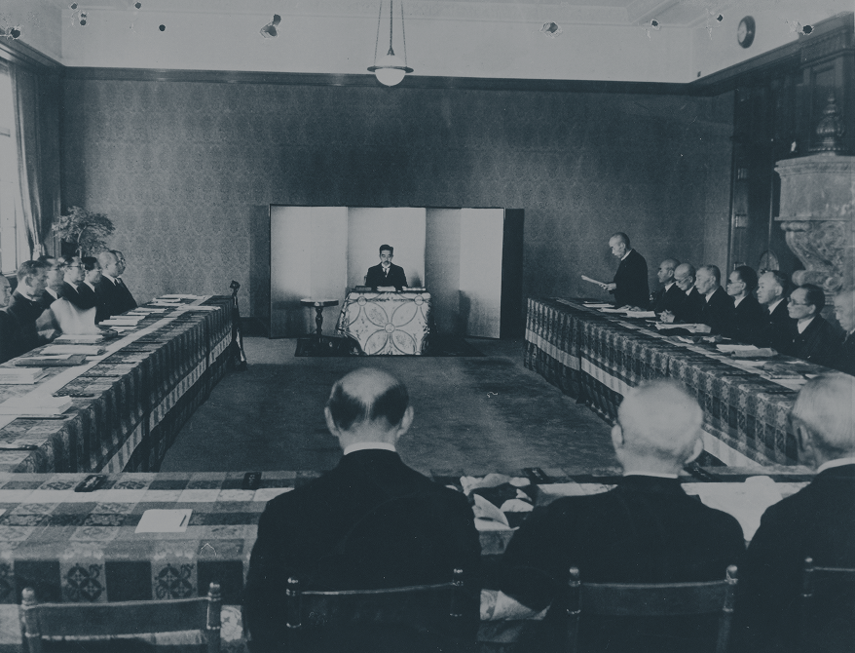
LEGITIMATION CRISIS
OF THE
JAPANESE CONSTITUTION
Keren Wang
Penn State University | Department of Communication Arts & Sciences
Tomonori Teraoka
University of Pittsburgh | Department of Communication

Slide 2
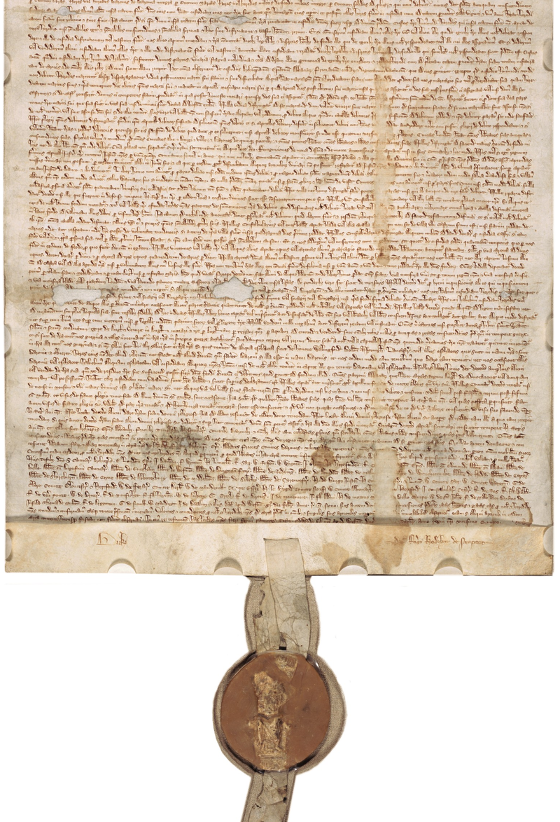
Two Questions on Constitutional Legitimacy:
Internal implementation of written constitution?
Conformity to the prevailing transnational standards of constitutionalism?

Slide 3
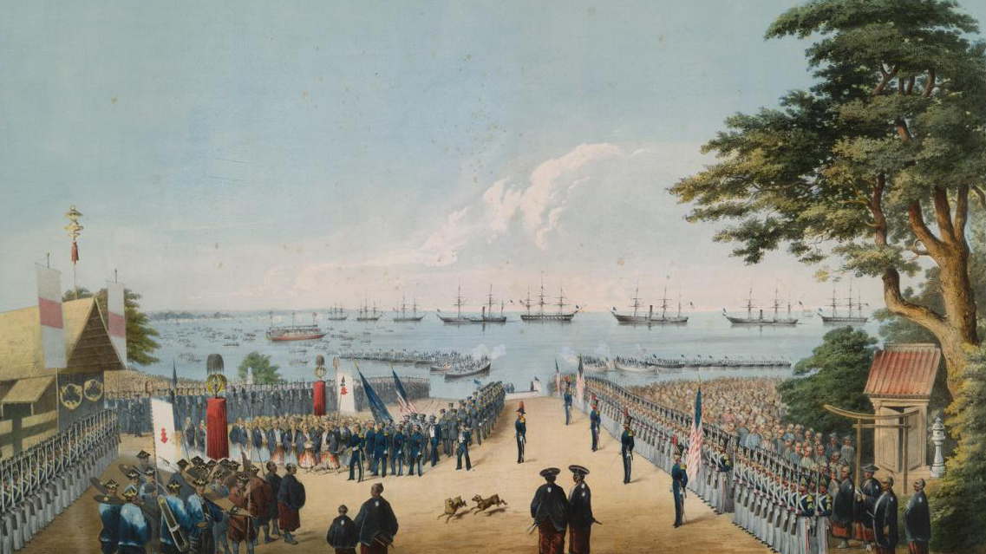
Historical Background

Slide 4
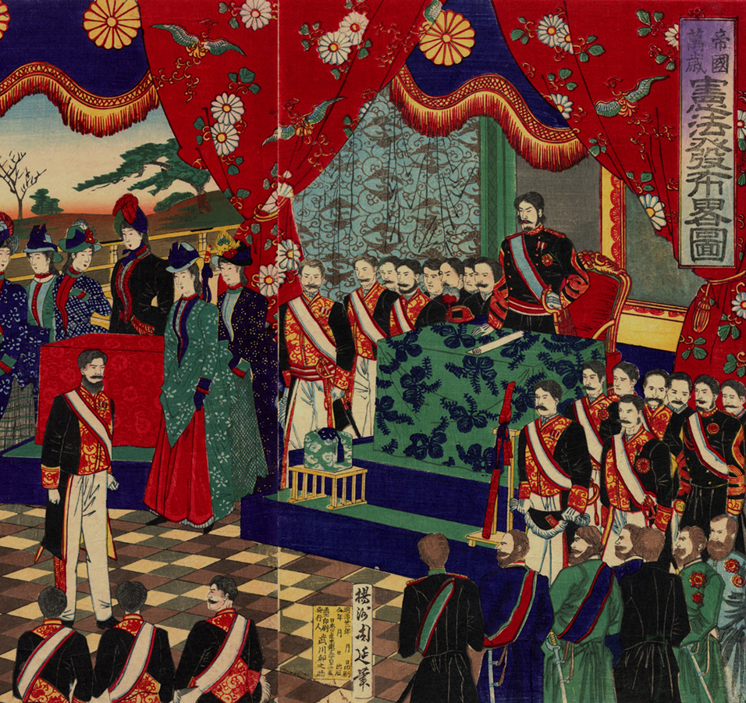
“Meiji Constitution” 大日本帝国憲法
Introduced in 1889
“God-Emperor” sovereignty
No judicial review

Slide 5
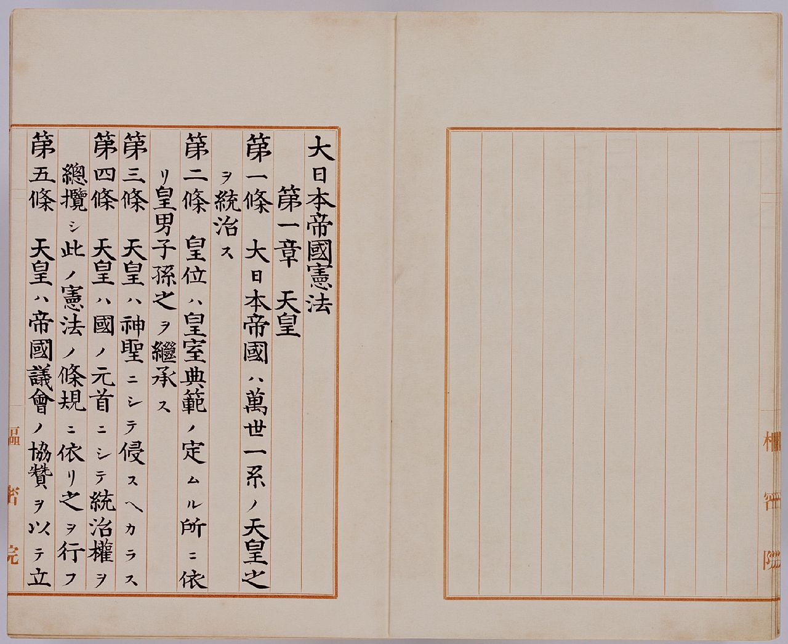
Meiji Constitution
Chapter 1 vested both legislative and executive power to the emperor
天皇ハ國ノ元首ニシテ統治權ヲ總攬シ
天皇ハ帝國議會ノ協贊ヲ以テ立法權ヲ行フ
Meiji government was marked by the absence of Western-style multi-party system
Substantive political power was in the hands of oligarchs from former feudal clans (藩閥)

Slide 6
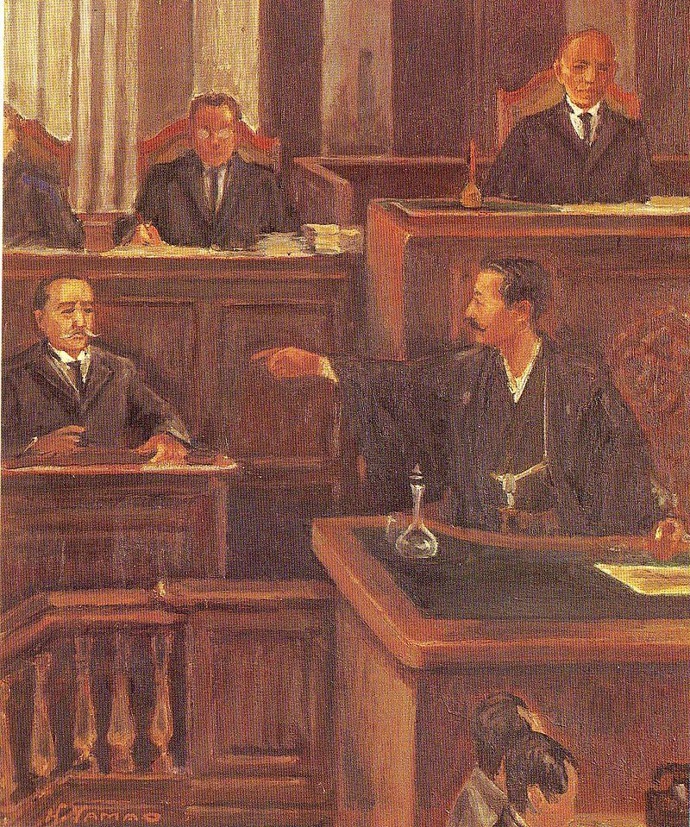
“Taisho Democracy” 1914-1926
Brief period of democratic advancement
Multi-party parliamentary government began to take shape
Quickly displaced by the rise of military hard-liners by the 1930s
大正政変: 1913年（大正2年）2月5日、尾崎行雄の桂内閣弾劾演説

Slide 7
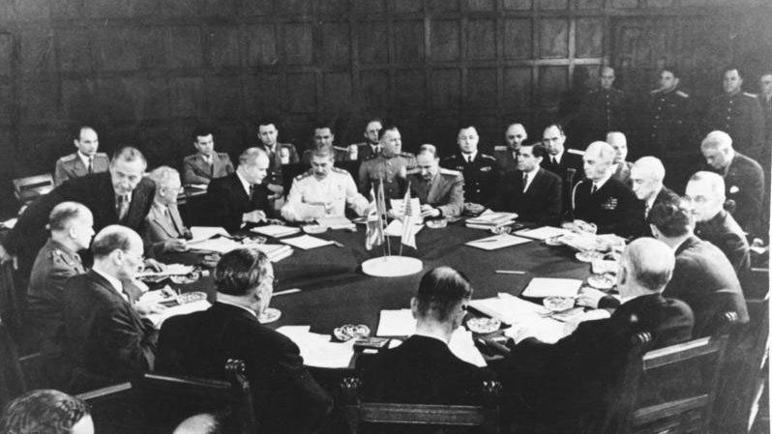
Post-war Constitution
戦後憲法

Slide 8
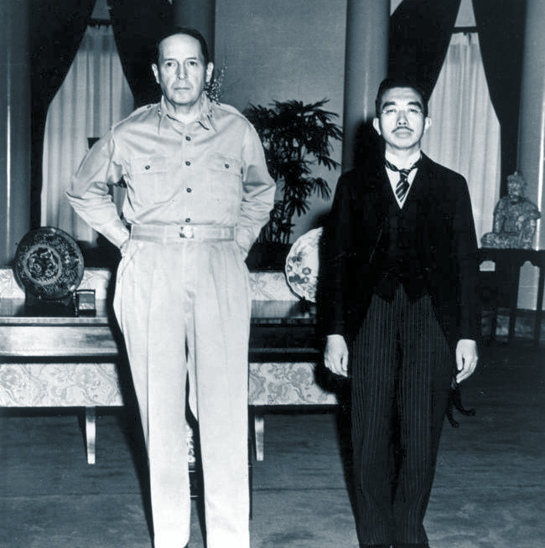
“So long as the constitution fixed sovereignty in the Emperor, it was impossible for any party to come forward with the doctrine that sovereignty resided in the people...”
– Joseph Grew, USUnder Secretary of State, Dec. 29 1943
“The Japanese Government shall remove all obstacles to the revival and strengthening of democratic tendencies among the Japanese people. Freedom of speech, of religion, and of thought, as well as respect for the fundamental human rights shall be established.”
– Potsdam Declaration, 1945

Slide 9
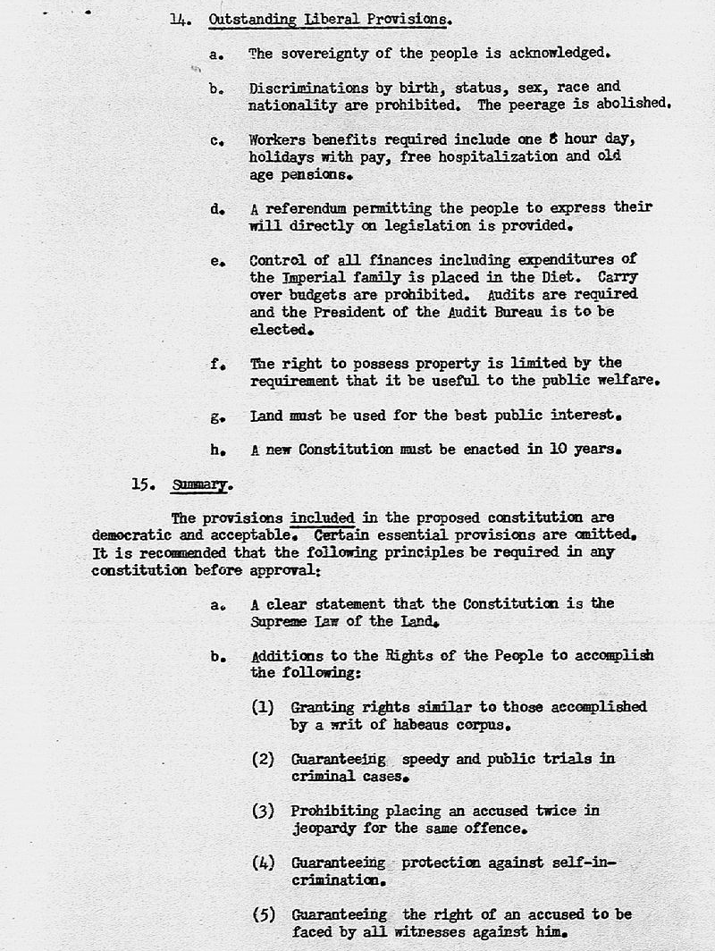
Post-war Constitution
Gen. Douglas Macarthur and his SCAP staff: headed by two private-practice U.S. lawyers: Milo Rowell and Courtney Whitney
No amendment has been made to it since its adoption in 3 May 1947

Slide 10
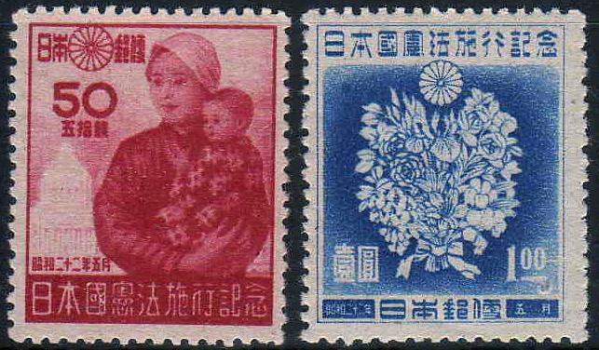
Three Stages of Constitutionalization

Slide 11
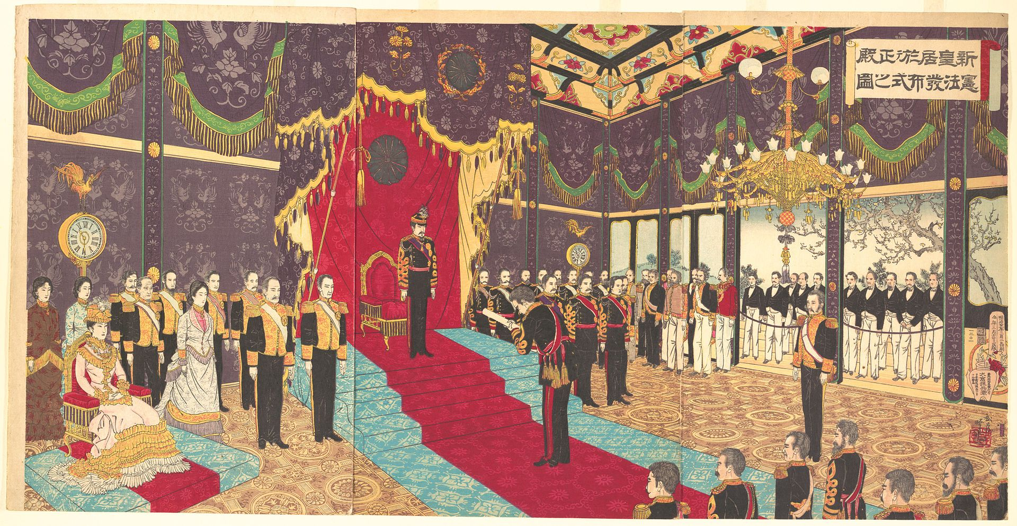
Incarnation
Formal introduction and adoption of a constitution
De Jure “birth” to an autonomous and self-referencing political body
Marked by the enactment of the Japanese Meiji Constitution on November 29, 1890

Slide 12
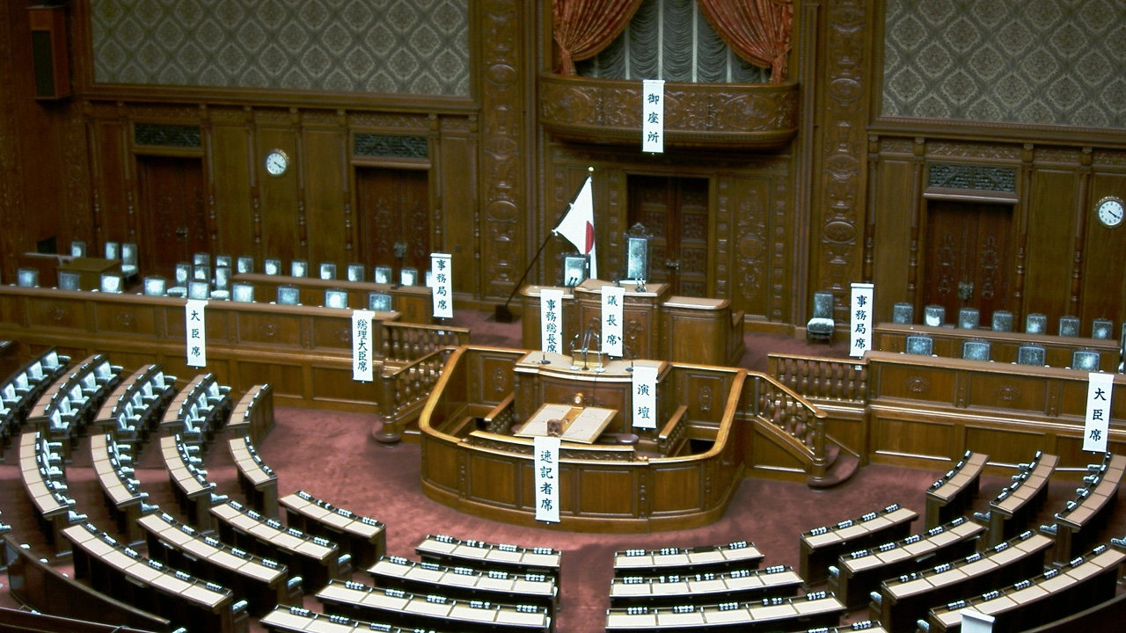
Ensoulment
Democratization of the constitutional normative structure
Towards transnationally accepted norms of democratic governance
Marked by the introduction of Post-war Constitution on 6 March 1946

Slide 13

Ecclesia
Ecclesia (ἐκκλησία) - Organized faith community
Full-fledged constitutional society
Interdependent presence of constitutional doctrines and practicing believers of constitutionalism

Slide 14
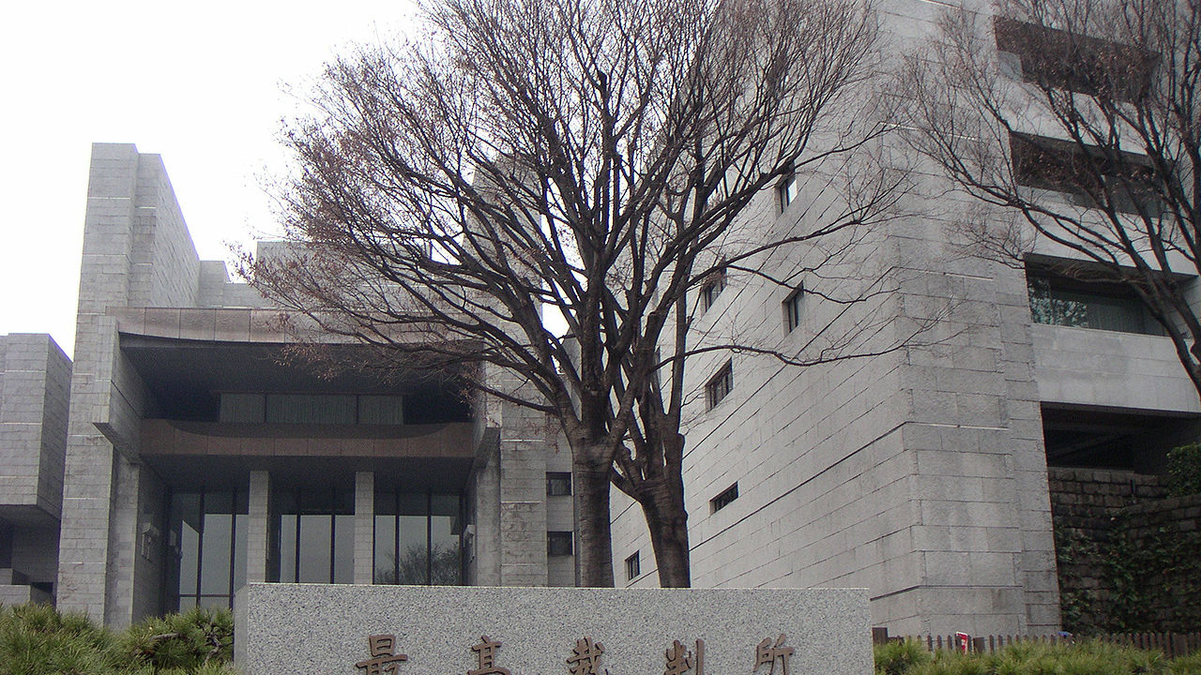
The Problem of Judicial Passivity

Slide 15
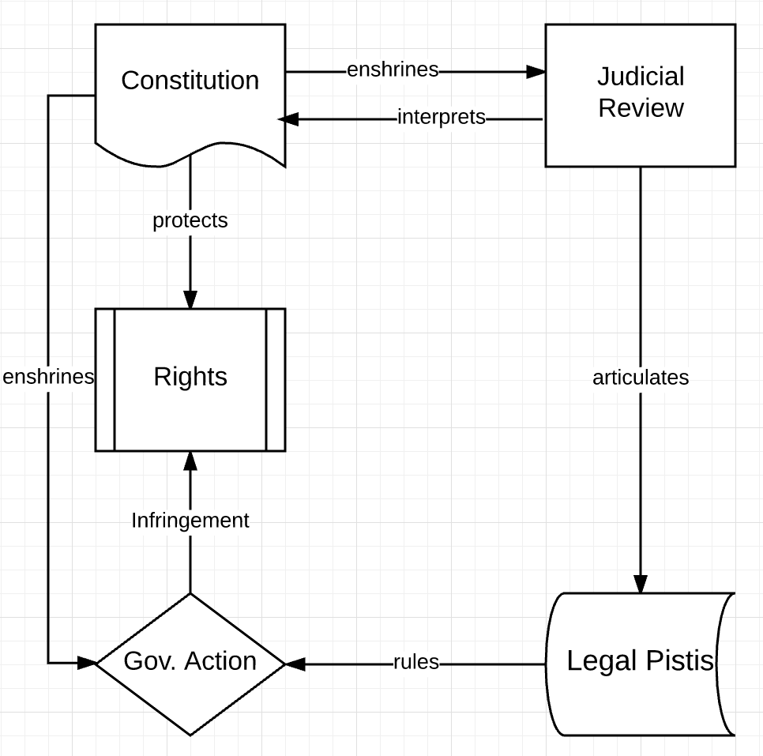
Judicial review according to the written Japanese Constitution:

Slide 16
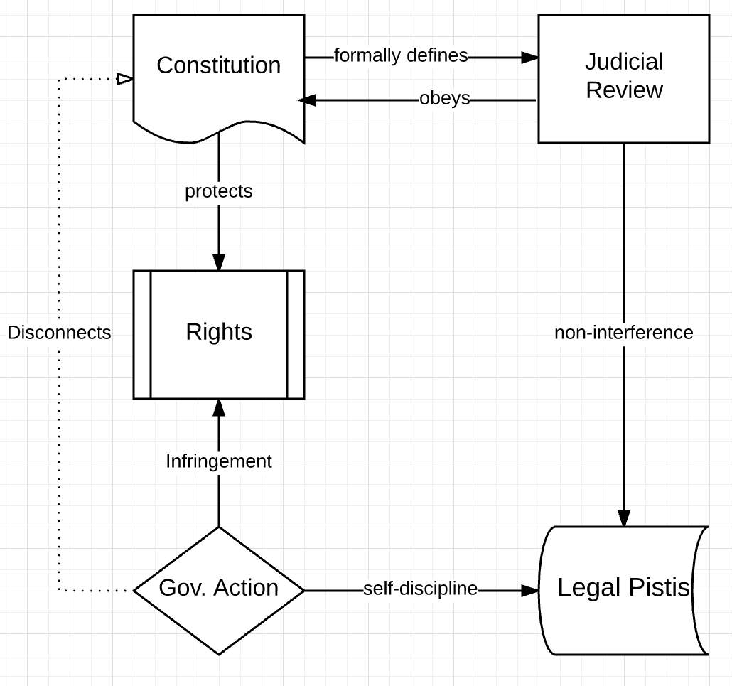
Japanese judicial passivism in practice:

Slide 17

Cabinet Legislation Bureau
内閣法制局

Slide 18

Conclusions
Post-WWII Japan has been trapped in the ensoulment stage of constitutionalization.
While the language in the Japanese Constitution adheres to the transnational standard of constitutional democracy, its persistent lack of implementation implies that post-war Japan has yet to develop itself into a full-fledged constitutional society.

Slide 19
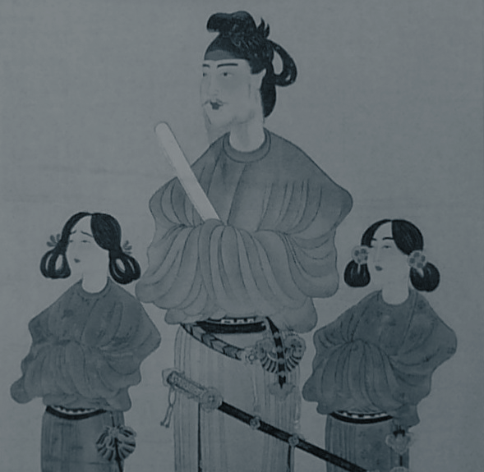
Thank You!

