Slide 1
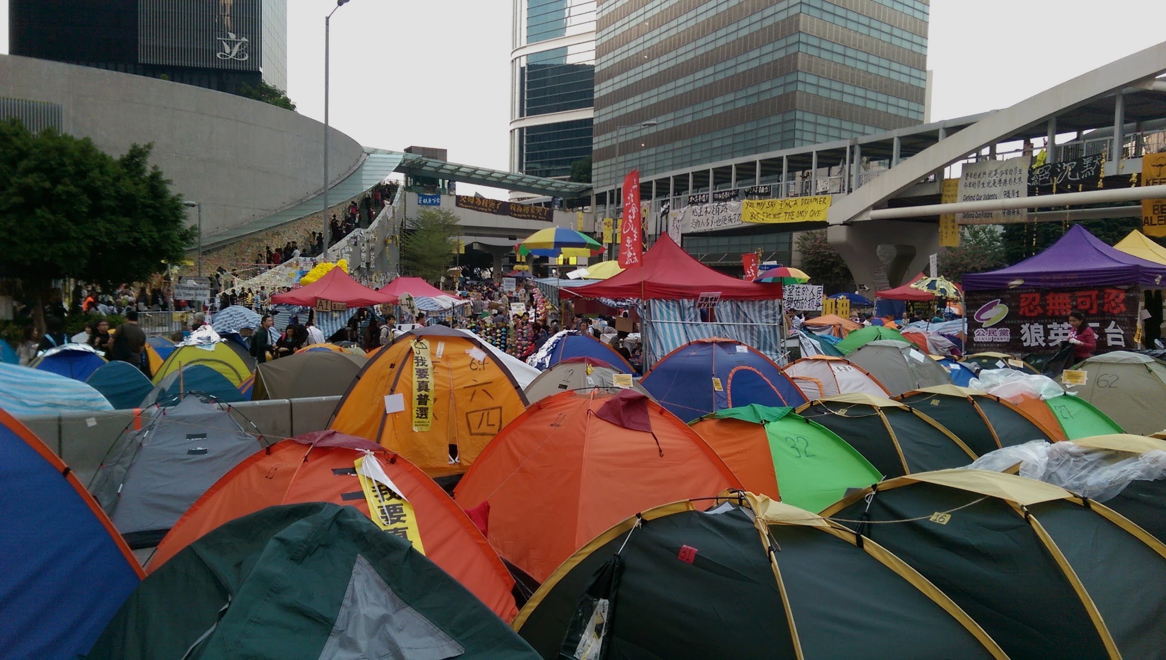
CHN 375W: Chinese Political Thought & Propaganda
Social Movements and Social Change
Admiralty protest site" Admiralty, Hong Kong . Digital photography by Keren Wang, Nov. 15, 2014.

Slide 2
Research Constraints for Modern Chinese Social Movements
Difficulty to obtain accurate, unbiased facts
Impossible for post-Cultural Revolution events
Censorship
Access
Politicization
Domestic
International: geopolitical environment; legacy of the Cold War; emerging “new” Cold War b/w US & China
Media bias & information filters:
Technological Filters
Ownership & Sponsorship Interests
Media bias & information filters:
Vestibulum congue
Market Bias
Sourcing Bias
Social, cultural & institutional Biases

Slide 3
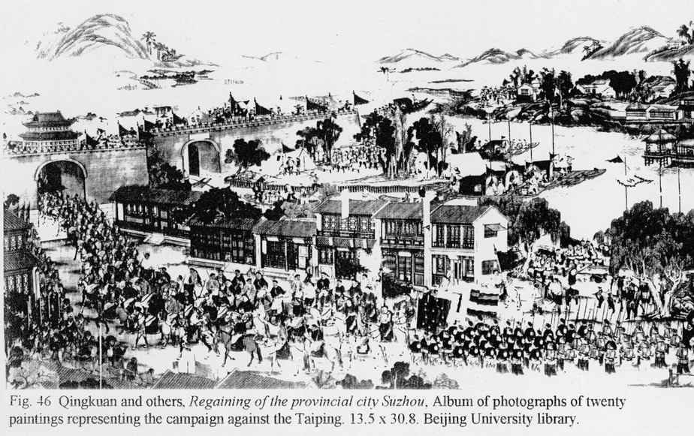
Taiping Heavenly Kingdom Rebellion (1851-1864)
Yang, CK - Religion in Chinese Society: "Chapter IX, Religion and Political Rebellion" [Tangyi]
Meyer, What Remains Coming to Terms with Civil War in 19th Century China: Introduction to the Taiping Rebellion [Guanqi]
Hong Kong Coastal Defence Museum-Taiping Heavenly Kingdom Educational Pamphlet [Ruichen]

Slide 4
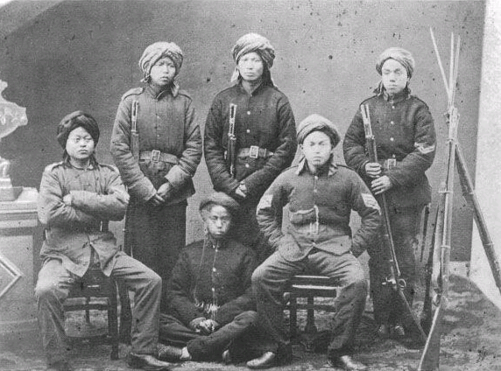
Taiping Heavenly Kingdom Rebellion (1851-1864)
Pretext: Opium Wars, Unequal Treaties w/ Colonial Powers
One of the bloodiest civil wars in human history
Est. 20–30 million deaths
Comparable to total casualties of World War I
Beginning: God Worshipping Society
Popular millennialist cult in Southern China
Mix of Christianity and Chinese folk religions
Led by a charismatic populist figure, Hong Xiuquan
Peak: Controlled most of the Southeastern China, 30+ million population
Promoted egalitarian ideals under a theocratic absolute monarchy
Proposed reforms: wealth redistribution, railways & steamships, electrical telegraphs, modern banking, intellectual property protection
Photo of the Qing “Ever Victorious Army” during the Taiping Rebellion [Source]

Slide 5
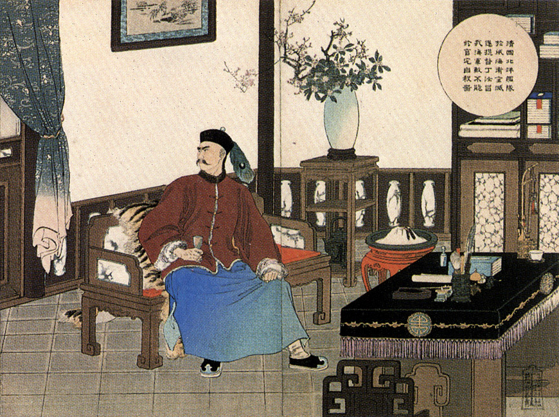
百年國恥 “Century of Humiliation”
Trade imbalance b/w China and colonial powers
First Opium War (1839–1842)
Treaty of Nanking: Cession of Hong Kong
Second Opium War (1856–1860)
Treaty of Tientsin: forced opium legalization
Convention of Peking: Cession of Kowloon & Outer Manchuria
“Admiral Ding Ruchang of Beiyang Fleet Committing Ritual Suicide (北洋艦隊遂提督丁汝昌於官宅自殺啚)” by Mizuno Toshikata, 1895

Slide 6
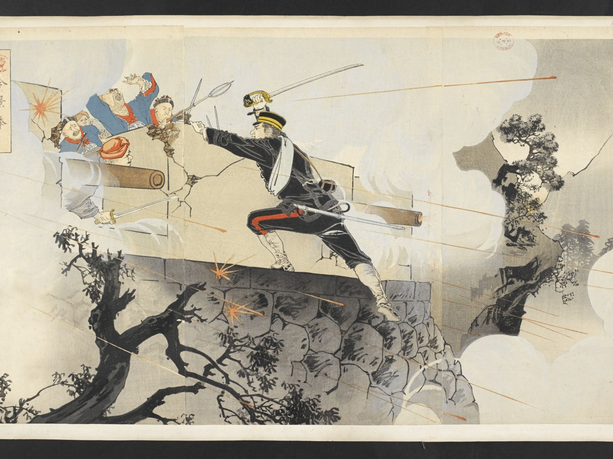
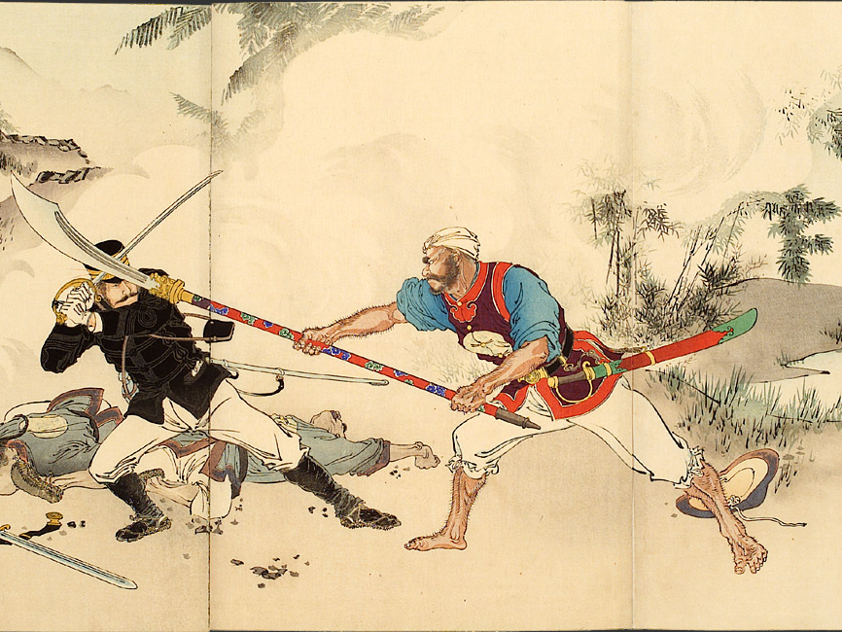
百年國恥 “Century of Humiliation” post Taiping Rebellion
First Sino-Japanese War (1894 – 895)
Russian occupation of Liaodong (1898)
Boxer uprising (1899–1901)
Russian invasion of Manchuria (1900)
British invasion of Tibet (1903–1904)
Japanese invasion of Manchuria (1931–1932)
Soviet invasion of Xinjiang (1934)
Second Sino-Japanese War (1937–1945)
Battle of Pyongyang by Sekiguchi Masajiro (1895)
Captain Awata by Mizuno Toshikata (1895)

Slide 7
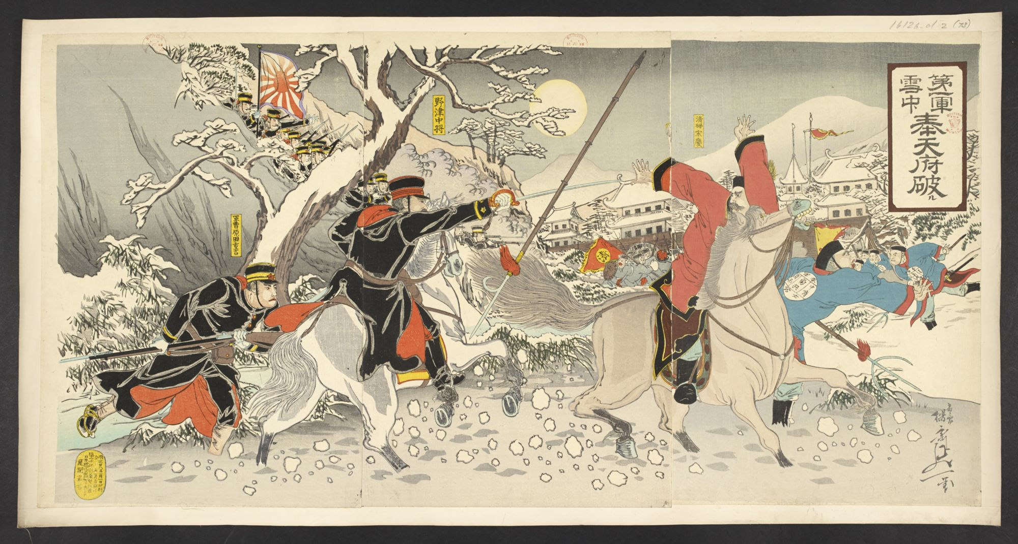
“The Japanese 1st Army Destroys Fengtian Army” by Ozeki Iwakichi, Sino-Japanese War, 1895

Slide 8
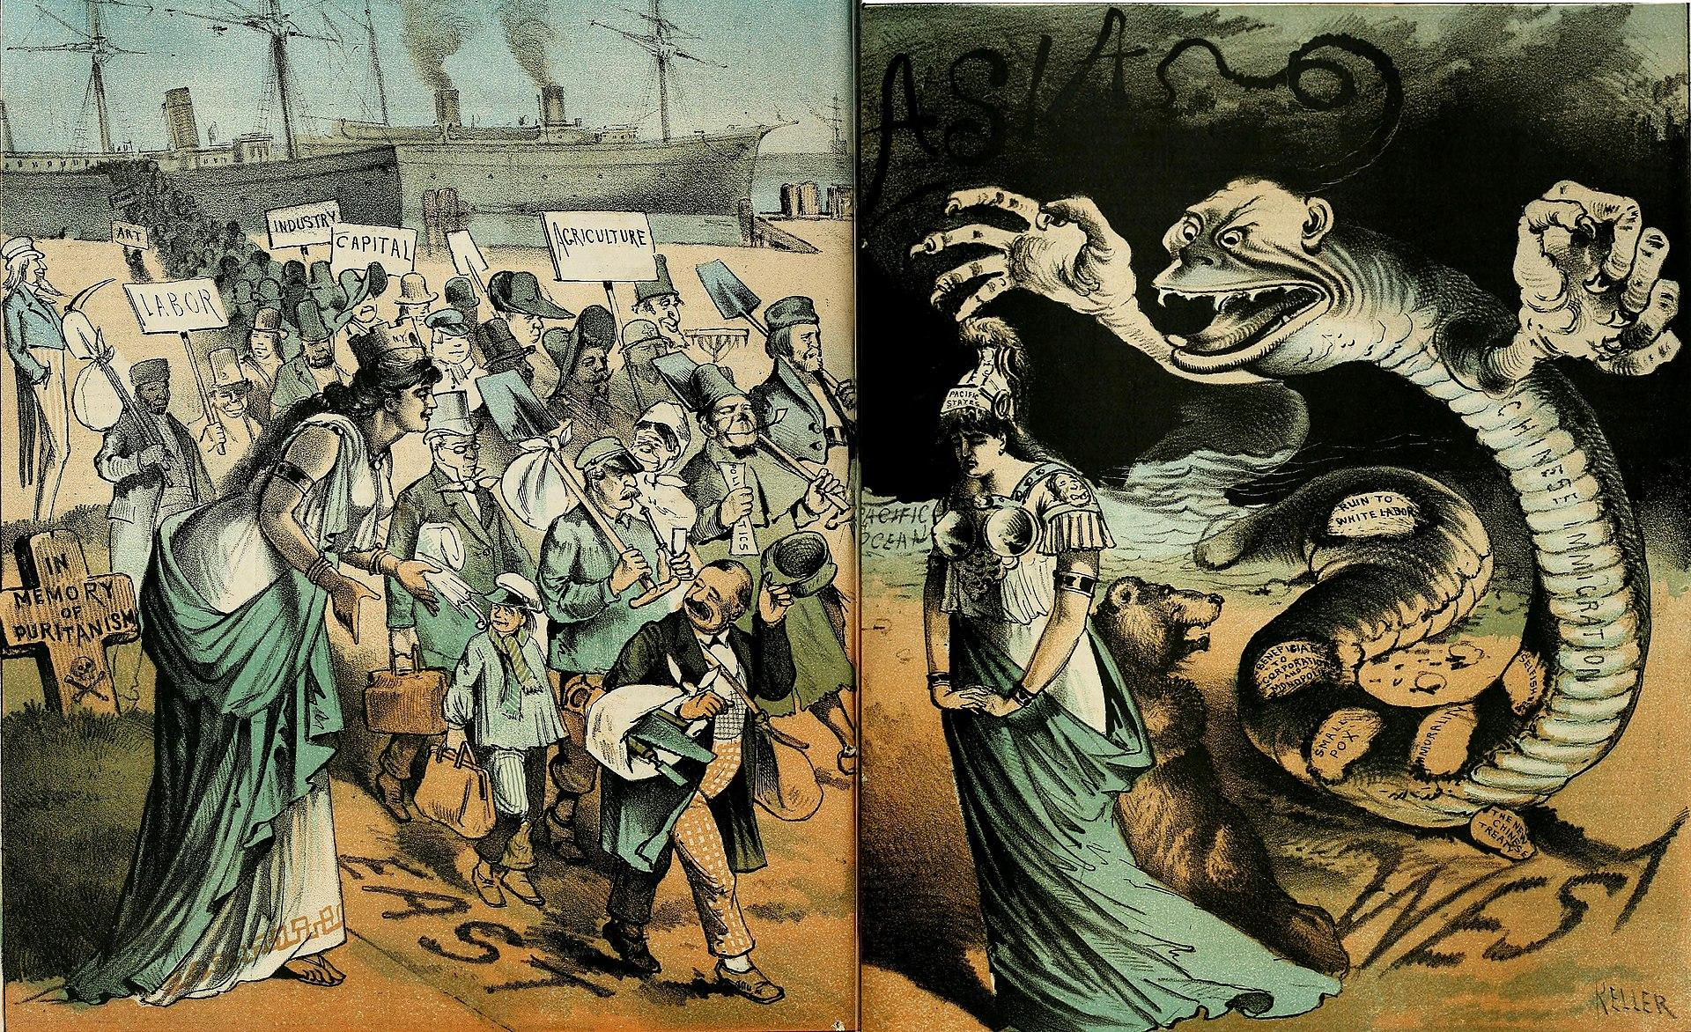
EAS190 Lecture Slides by Keren Wang, SP 2023, all rights reserved
The 1881 piece titled "Immigration East and West" published in Wax Magazine portrays contrasting views of immigration in the United States. The left panel illustrates European immigrants as bringing valuable qualities such as "art," "industry," "capital," and "politics" to the country as it expands westward. In contrast, the right panel portrays Chinese immigration as a menacing serpent, with negative impacts such as the spread of "smallpox," "immorality," and a threat to "white labor," contributing to the perception of national decay moving eastward.

Slide 9
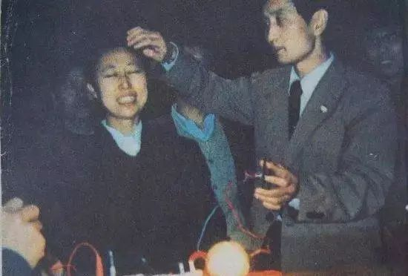
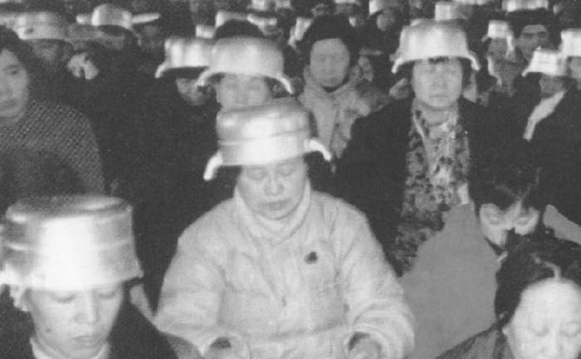
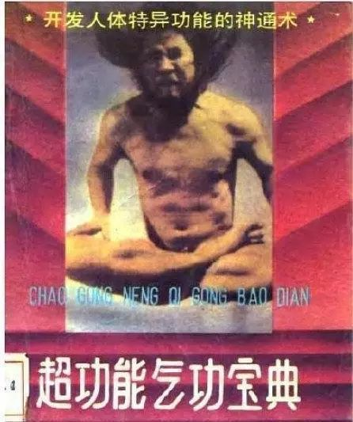
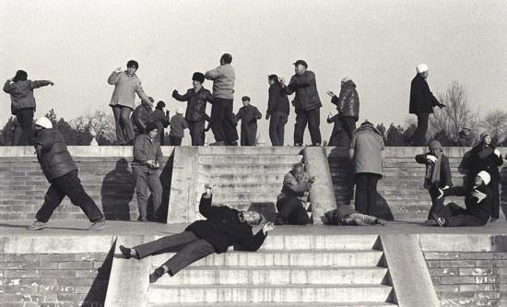
“Falun Gong in the media: What can we believe?”
“Propaganda war” b/w Western & Chinese media
“Qigong fever (气功热)”: 1980s & 90s
Neoliberal anomie
Outburst of new age religious movements and pseudoscientific narratives
Top left: Yan Xin conducting “Qigong electrification” on believers (Shenyang, 1987)
Top right: Followers of Zhang Xiangyu wearing the iconic “Information Pot” to “receive cosmo energies” during a meditation session in Beijing, 1990
Bottom left: a typical new age / pseudoscientific popular magazine from the 1980s
Bottom right: Qigong practitioners at Beijing Ditan Park, 1986

Slide 10
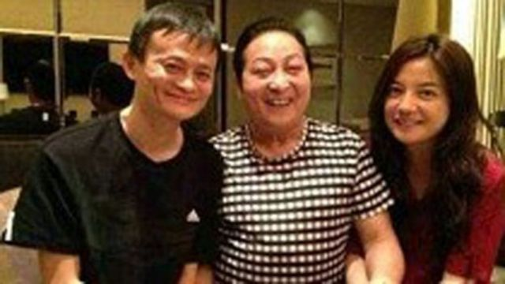
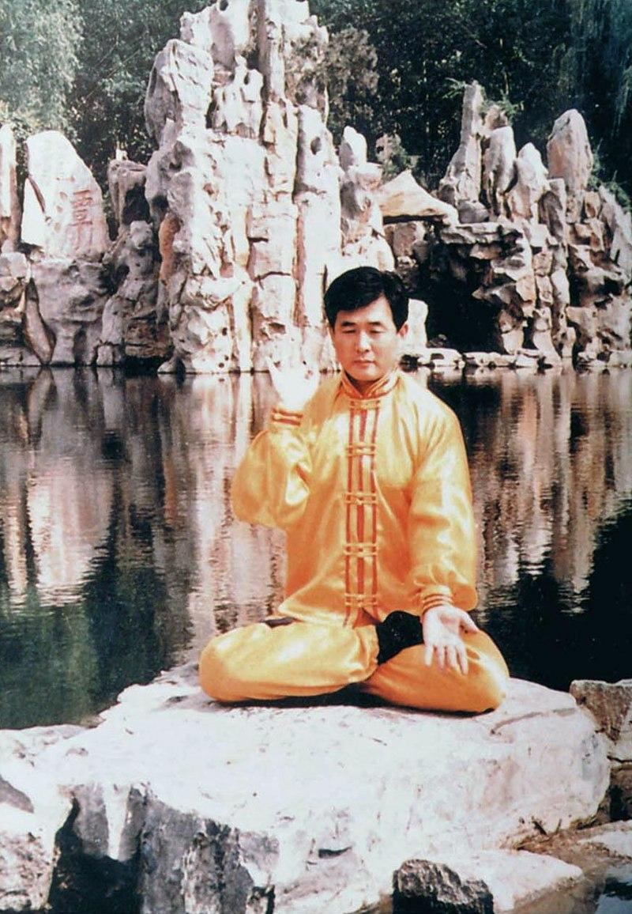
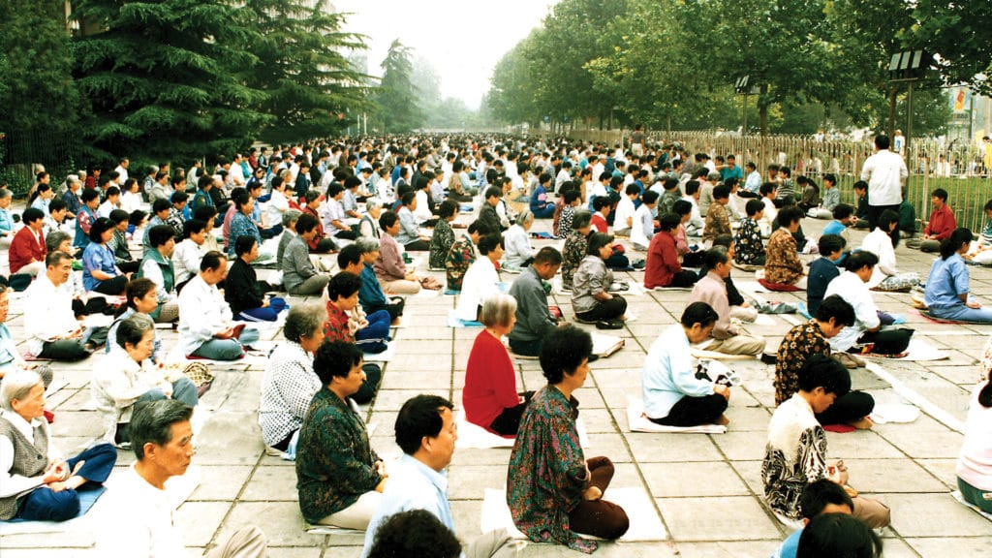
Top left: 2012 photo of “Qigong master” with Alibaba founder Jack Ma and Hong Kong actress Vicky Zhao. By the time of his death in 2017 Wang facing multiple criminal charges for unlicensed medical practice, fraud, tax evasion, bribery, and illegal possession of firearms.
Middle left: Falun Gong practitioners in Beijing, 1995
Right: Li Hongzhi, founder of Falun Dafa

Slide 11
Quiz 4 & Reading Discussions
How did cult propaganda spread so quickly before modern mass media?
Palmer - Heretical Doctrines Reactionary Secret Societies Evil Cults Labeling Heterodoxy in 20th Century China
Pp. 1-14 Sectarian rebellion paradigm and the problem of the White Lotus - End of the Empire and of the discourse on heretical doctrines - Alliances between revolutionaries and “secret societies” - Secret societies become “reactionary sects” [Jessica Luo]
Pp. 14-32 Return of xiejiao via Christianity and the West - New Chinese discourse on xiejiao - End of modern ideology and the elevation of Religion [Jiahao Liu]
Yang - Sprouts of Religious Civil Society Temples Localities and Communities (case study) [Jerry Tan]

Slide 12
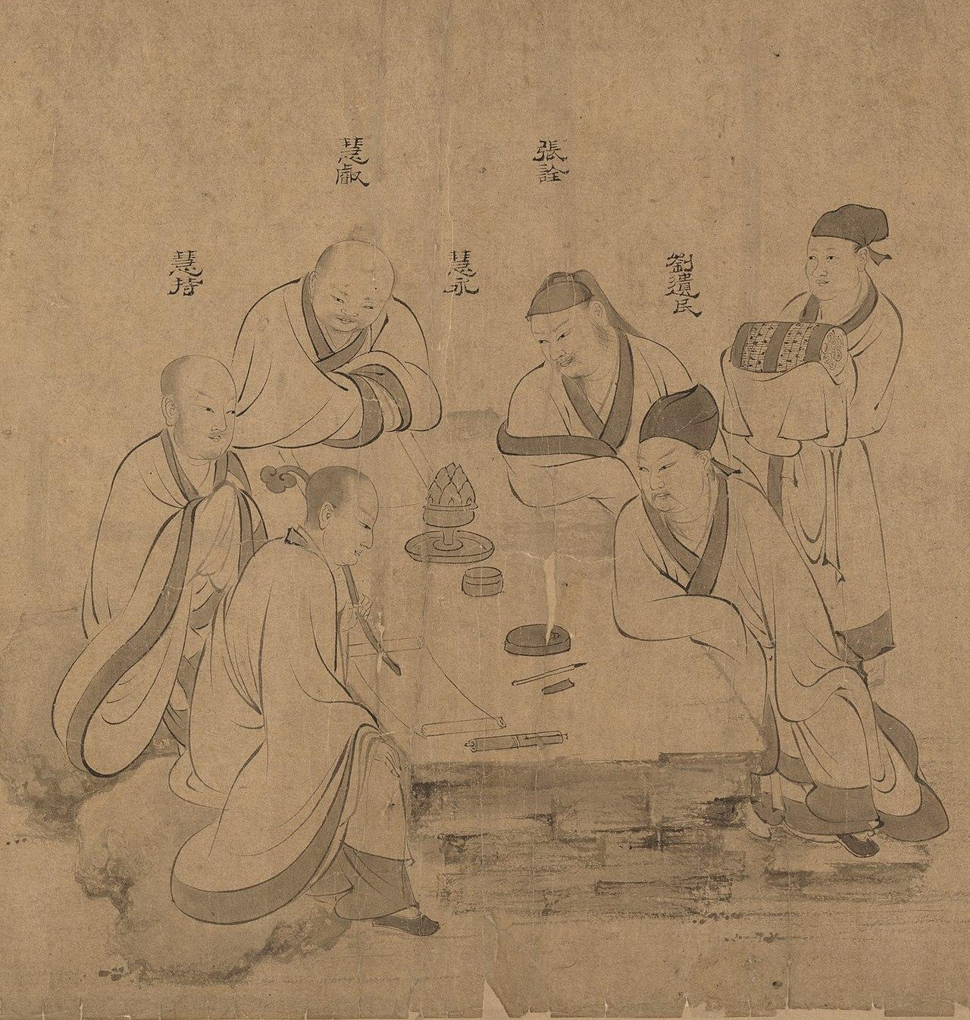
Heretical Doctrines, Reactionary Secret Societies, Evil Cults
Xiejiao 邪教 - heterodox teachings or “evil cults”
“Reactionary secret societies” (反動會道門)
The sectarian rebellion paradigm
Recurring theme for 2000+ years
Yellow Turban (184 AD), Faqing (515), Han Shantong (1351), Xu Hongru (1622), Wang Lun (1774), White Lotus (1796), Taipings (1851-1864)
Banned from Ming dynasty to Republic era: White Lotus Society, White Cloud Society, Maitreyanism (彌勒教), Manicheism (摩尼教)
War time: alliances between revolutionaries and “secret societies”
Peace time: secret societies become “reactionary sects”
Blurred lines between cults, secret societies, civil society organizations, armed militias, and organized crimes

Slide 13
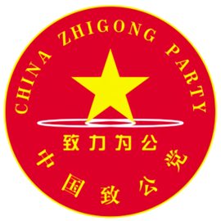
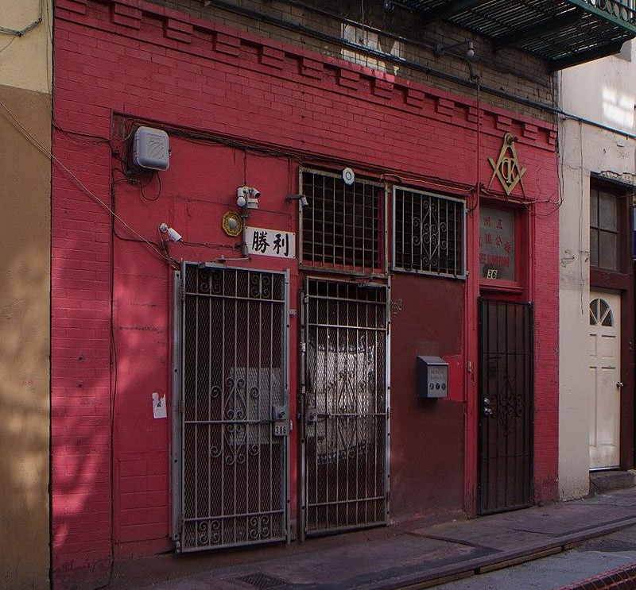
Case of China Zhi Gong Party 中国致公党
Currently one of the one of the officially sanctioned non-CCP political parties in PRC
Established by North America based Chee Kung Tong (left: historical HQ of Chee Kung Tong in San Francisco Chinatown)
Chee Kung Tong being a subsidiary of North American Hongmen, also called Heaven and Earth Society,
Hongmen a “fraternal organization” formed by former members of White Lotus Society fleeing persecution

Slide 14
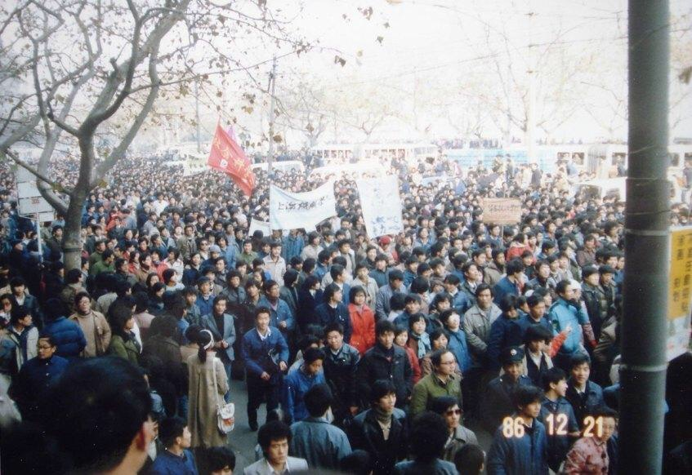
Prelude: 1986 Student demonstrations 八六学潮
Summer 1986: Liberal faction’s unsuccessful election reform
Direct nomination & election of NPC members rather than selecting from government-approved list of candidates.
Resisted by local officials
December 1986: student protests throughout China
Intensifying conflict b/w Liberal and Hardliner factions
Hardliners accuse Hu of instigating student protests
Deng Xiaoping brokered a compromise b/w two factions
Jan 1987: Hu Yaobang forced to resign as CCP General Secretary, replaced by his close ally Zhao Ziyang
Hu Yaobang and Zhao Ziyang supported by pro-democracy student groups
Power struggle b/w Liberals and Hardliners continued behind the scene, until 1989
Student protests in Shanghai, 1986-12-21 [Image source]

