Slide 1
Matlab Essentials 2
The Fundamentals (next and end)

Slide 2
A Little Spoiler !
Refer to the Final Project Module of the MATLAB Onramp free self-paced course on the Online Learning platform of MathWorks !
This webinar serves as a companion to help you better understand the concepts.
Enjoy the workshop !

Slide 3
Another one before the start !
>> For this course, we absolutely need the MATLAB environment (if not yet installed / opened on your Web Browser since our previous sessions).
>> Here you can find a step-by-step guide to downloading, installing and configuring your environment. Let's go!

Slide 4
Course Outline
Project I – Stellar Motion
Project II – Compare Stellar Spectra

Slide 5
Project I – Stellar Motion
>> Background
In this project, you'll use MATLAB to find the observed wavelength of the hydrogen alpha line of HD 94028 and compare it to the known wavelength of the hydrogen absorption to determine how fast the star is moving away from the Earth.

Slide 6
Project I – Stellar Motion
>> The main property of the observed stars ( = 357) is the star spectrum data, which was collected at evenly spaced wavelengths (lambda).
>> You are given the starting wavelength (lambdaStart), the spacing (lambdaDelta), and the number of observations (nObs)*
*nObs = 357
lambdaStart = 630.02 (in nm)
lambdaDelta = 0.14

Slide 7
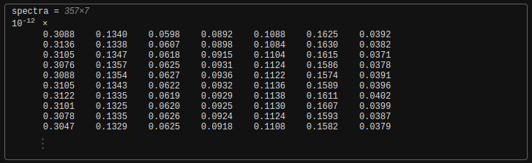
Project I – Stellar Motion
>> Each column of spectra is the spectrum of a different star. The 6th column is the spectrum of star HD 94028.

Slide 8
Project I – Stellar Motion
PRACTICE
Create a variable named lambdaEnd that contains the value of the last wavelength in the recorded spectrum. Think about how you would calculate the last element of a series of numbers if you knew the first and the total of numbers you have.
Use lambdaEnd to create a vector named lambda that contains the wavelengths in the spectrum, from lambdaStart to lambdaEnd, in steps of lambdaDelta.

Slide 9
Project I – Stellar Motion
PRACTICE
Extract the sixth column of spectra to a vector named s
Plot the spectra(s) as a function of wavelength (lambda). Use point markers (.) and a solid line (-) to connect the points.
Add the x-label "Wavelength" and the y-label "Intensity" to the plot.

Slide 10
Project I – Stellar Motion
PRACTICE
Create two variables, sHa and idx, that contain the minimum values of s and the index of that minimum value.
Find the wavelength of the hydrogen-alpha line by using idx to index into lambda. Store the result as lambdaHa.
Add a point to the exsting axes by plotting x = lambdaHa, y = sHa as a red square ("rs") with a merker size (MarkerSize) of 8.

Slide 11
Project I – Stellar Motion
PRACTICE
Zoom in on the plot and compare lambdaHa to the laboratory value of 656.28 nm.
Calculate the redshift factor* and the speed** (in km/s) at which the star is moving away from Earth. Assign the redshift factor to a variable named z and the speed to a variable named speed.
Perform the redshift calculation on the second star (HD 94028 was the 6th) in spectra.
Try using a numeric slider to automate all these tasks (self study)

Slide 12
Project I – Stellar Motion
*The redshift factor is the speed of a star relative to the Earth. It is calculated using the formula :
z = (wavelength / 656.28) – 1
**You can calculate the speed by multiplying the redshift factor (z) by the speed of light ( 299,792.458 or ~ 300,000 km/s).

Slide 13
Project II – Compare Stellar Spectra
>> Background
In the previous project, you calculated the speed (in km/s) of a star relative to Earth by using its spectrum. In this project, you will calculate all the stars' speeds at once. Then you'll create this plot of the star spectra.

Slide 14
2. Project II – Compare Stellar Spectra
>> Background
In the previous project, you calculated the speed (in km/s) of a star relative to Earth by using its spectrum. In this project, you will calculate all the stars' speeds at once. Then you'll create this plot of the star spectra.

Slide 15
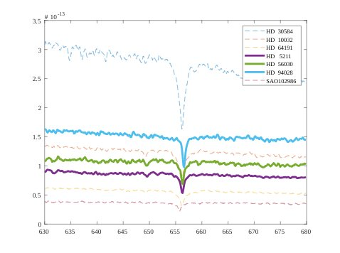
2. Project II – Compare Stellar Spectra

Slide 16

2. Project II – Compare Stellar Spectra
>> Line 2 of the script extracts the spectrum data for the second star in the matrix spectra.
>> Lines 3–5 calculate the speed based on that data.

Slide 17
2. Project II – Compare Stellar Spectra
PRACTICE
Modify the line 2 of the script, so that you can calculate the speed of all the stars by deleting (:,2).
Create a for loop with a loop index named v. How would the loop index progress through spectra ?
Extract the vth column of spectra to a variable named s.
Add an if statement to the for loop body. Implement the following logic/conditions : If speed(v) is less than or equal to 0, create a plot of s against lambda using the dashed line (--).

Slide 18
2. Project II – Compare Stellar Spectra
PRACTICE
Add an else statement. If speed(v) is greater than 0, create a plot of s against lambda using a line width of 3.
After the for loop, enter hold off.
Add a legend to the plot using the array starnames.*
Create a variable moveaway that contains the elements in starnames corresponding to where speed is greater than 0.
*The string array starnames contains the name of each star in spectra.

Slide 19
THANK YOU !

