Slide 1
Matlab Essentials 3
Data Processing and Visualization

Slide 2
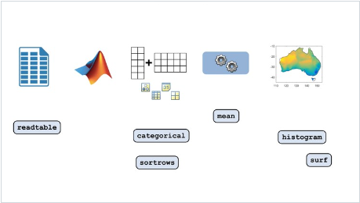
An image is worth a 1000 words !

Slide 3
Steps to processing Data
>> Data Analysis typically requires following steps in that order :
Reading data from file > Cleaning and Organizing it > Performing calculations > Visualizing the results

Slide 4
Course Outline
Import Data
Clean and Organize Data
Key Takeaways

Slide 5
Import Data
>> Working with irregularly formatted (unstructured) data can be overwhelming and non-productive
>> A best practice is to convert given unstructured data to structured data - its regular formatting is easier to work with and more efficient
>> Examples of unstructured data are csv-, unformatted Excell-, hand-written files
>> Structured data could be well organized spreadsheets.
>> One of the most important functions to work with spreadsheets in Matlab is readtable.

Slide 6

Import Data

Slide 7
Import Data
>> You can import tabular data into MATLAB using the readtable function
e.g. : table = readtable("filename", options) reads the data stored in the file named filename and imports it as a table into the MATLAB Workspace.
Filename : name of the file you want to import into the Workspace
Options : consists of various tuning parameters (options) that range from the Text Type (char, string, …), over NumHeaderLines (indicates the number of header lines in the file –l when the file has headers, variable names can be imported incorrectly) to Delimiter (comma, point, semi-colon, …) and many more...

Slide 8
Import Data
PRACTICE
Import the data from the file hurricaneData90s.txt, and store the result in a variable named hurricanes.
Use additional inputs as importing options to limit the number of header lines and store the newly imported data in hurricanes.
Import once again the data from the same file so that comment lines will be ignored. Save the data into hurricanes.
Save the table as a file named hurricanes_processed.csv

Slide 9
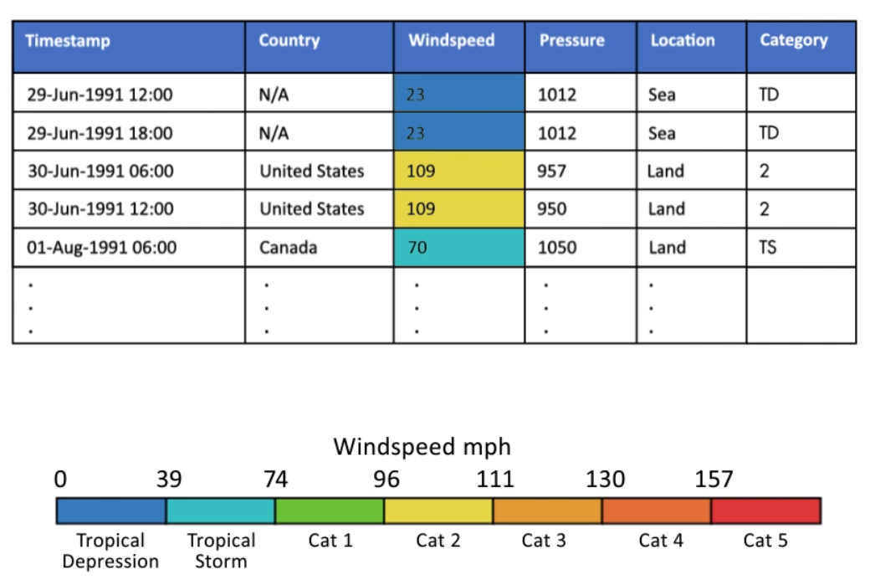
2. Clean and Organize Data
>> Cleaning and organizing data usually take advantage of the preprocessing techniques of combining and discretizing categorical data

Slide 10
2. Clean and Organize Data
Discrete Data
Continuous Data
Countable (number of students in a classroom, number of cars in a parking lot, …)
Visualized on bar charts or pie charts
Finite points – summation, counting, ….
Range values (height of basketball players, amount in sugar in milk)
Displayed on histograms or line graphs
Infinite values– integration and differentiation

Slide 11
2. Clean and Organize Data
>> To group similar data into categories, you can use the categories function in MATLAB.
e.g. : groups = categories(cat_array) returns the unique categories within the categorical array cat_array.
>> You can also remove a category of your choice from the array, using the setdiff function.
e.g. : d = setdiff(a,b) performs a set difference between a and b. The output has values in a that are NOT present in b. The result is stored in a variable named d.

Slide 12
2. Clean and Organize Data
>> You can merge different categories in a categorical array
e.g. : a = mergecats(a, ["b1" "b2" "b3"], "b") merge categories b1, b2, b3 to a single category, b and stores the result in a.

Slide 13
2. Clean and Organize Data
PRACTICE
Given the categorical array x = categorical(["medium" "large" "large" "red" "small" "red" "medium"])
Find the categories in x and assign them to a variable named x_cats.
Remove the category "red" from x_cats and store the result in x_set. What type is the output of ?
Merge the categories "small", "medium", and "large" that are contained in the variable x into a single category, x_size. Store the result back into x.

Slide 14
2. Clean and Organize Data
PRACTICE – SELF-STUDY
Exercise yourself with the Hurricane Exercise on the Matlab Online Learning Platform !

Slide 15
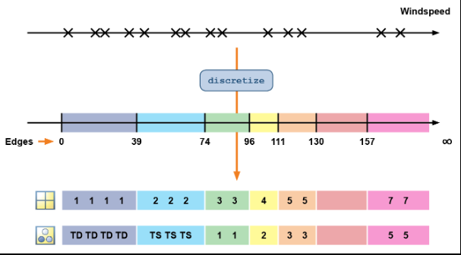
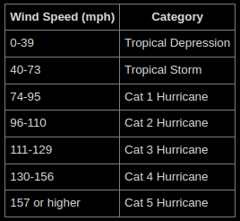
2. Clean and Organize Data

Slide 16
2. Clean and Organize Data
binNum = discretize(x, 0:0.2:1) categorizes (discretizes) each element of x into bins (or bin numbers) based on the edges (6 in total) specified in the array 0:0.2:1 (this array creates bins with edges at 0, 0.2, 0.4, 0.6, 0.8, and 1).
binNum is determined as follows : % 0.82 falls between 0.8 and 1 -> 5 % 0.69 falls between 0.6 and 0.8 -> 4 … % 0.03 falls between 0 and 0.2 -> 1
binNum is [5, 4, 2, 5, 1]

Slide 17
2. Clean and Organize Data
>> You can categorize continuous data into discrete bins using the discretize function
e.g. : Given the array x with the values [0.82, 0.69, 0.31, 0.95, 0.03]
Given the array corner with the values (edges) 0:0.2:1
There will be one fewer bin than the number of edges specified, because the edges define the boundaries between the bins, NOT the number of bins themselves.

Slide 18
2. Clean and Organize Data
>> Binning into categories works practically the same way it does with discretized data or infinite ranges. To discretize data into categories, use the categorical option
e.g. : Given the vector status with the values ["on", "off"] binNum = discretize(x, 0:0.5:1, "categorical", status) categorizes (discretizes) each element of x into bins (or bin numbers) based on the edges (3 in total) specified in the array 0:0.5:1 (this array creates bins with edges at 0, 0.5, and 1).

Slide 19
2. Clean and Organize Data
PRACTICE – DISCRETIZED
Given the vector price = [34.17 26.71 7.92 27.17 36.30 24.88 30.34 27.26 16.96]
Create a vector, levels, that contains the edge values of the desired bins. The lowest edge value should be 0, the highest should be 40 and the difference between the adjacent edge values should be 10.
Bin (discretize into bin numbers using the edge values) the values in the price vector using levels as the bin edges and store the result in price_bin_numbers.

Slide 20
2. Clean and Organize Data
PRACTICE – INFINITE RANGES
Given the vectors binedges = [0 0.2 0.6 0.9] and x = [ 0.90 0.32 0.95 NaN 0.87 0.71 0.42 0.60]
Discretize x using the bin edges binedges and store the result in x_bin_numbers.
Update binedges so that there is one more category that extends the range to infinty (-Inf or Inf).
Update x_bin_numbers which contains the bin nuber for each value in x using the new edge values.
Compare the two vectors x_bin_numbers from questions 1 & 3.

Slide 21
2. Clean and Organize Data
PRACTICE – CATEGORIES
Given the following vectors binedges = [0 0.2 0.6 0.9 Inf], x = [ 0.90 0.32 0.95 NaN 0.87 0.71 0.42 0.60], and colors = ["red","green","blue","black"]
Discretize x to create a variable x_cat that contains the bin category, as defined by colors.
Create a variable named less_Green that contains the number of vaues in x_cat that are less than or equal to "green".
Exercise further with the Discretizing Windspeeds into Categories section on the Matlab Online Learning Platform

Slide 22
2. Clean and Organize Data

Slide 23
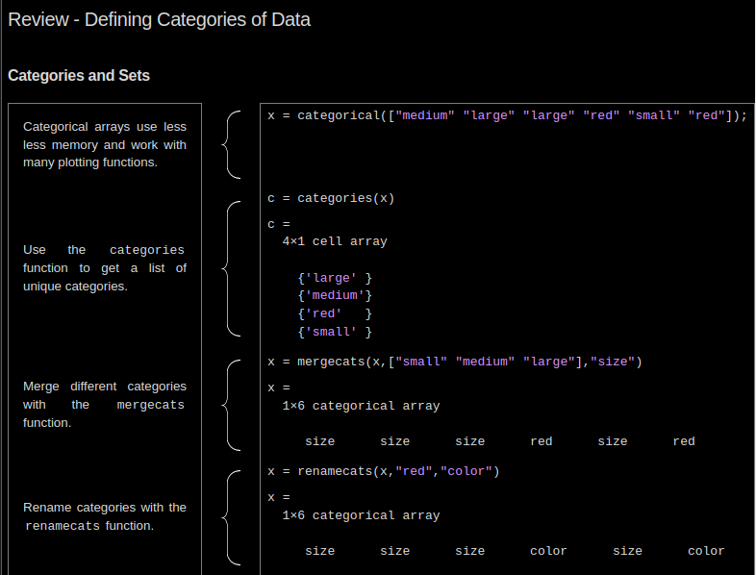
3. Key Takeaways

Slide 24
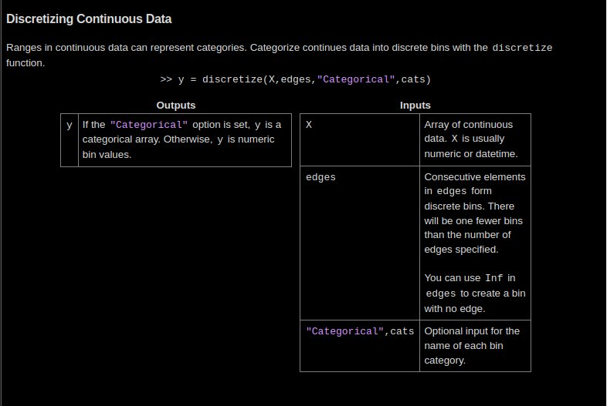
3. Key Takeaways

Slide 25
THANK YOU !

