Slide 1
Matlab Essentials 2
The Fundamentals

Slide 2
Course Outline
Logical Arrays
Functions
Loops
Final Project

Slide 3
Logical Arrays
>> Just like in math, Matlab allows you to use following relational operators :
Less than (<)
Greater than (>)
Equal to (==)
Not equal to (~= or != in Python)
>> The outcome of a comparison for equality / not equality is either 1 (true) or 0 (false).

Slide 4
Logical Arrays
>> You can also perform a comparison between an array and a single scalar value with relational operators. The result is a logical array of the same size as the original array.
>> Indexing can also be done using logical arrays
e.g. : v = v1(v1 > 6) extracts all elements of v1 that are greater than 6.
>> Logical indexing can also be used with two different arrays
e.g. : v = sample(v1 > 6) extracts the elements of sample corresponding to where v1 is greater than 6.

Slide 5
Logical Arrays
>> You can reassign values in an array using logical indexing.
e.g. : x(x == 999) = 1 replaces the values in array x that are equal to 999 with the value 1.
>> You can combine logical comparisons by using the logical operators AND (&) and OR (|).

Slide 6
Logical Arrays
PRACTICE
Test if π is less than 4 by using the relational operator <. Assign the result to a variable named x.
Create a vector v1 with the values 3 5 7 1 2 9 0.
Test the vector v1 for elements that are less than 4.
Assign the output to a variable named y.

Slide 7
Logical Arrays
PRACTICE
Create a variable z that contains all the elements of v1 that are less than 4.
Create a vector sample with following values 10 25 6 5 18 4 23.
Create a variable a that contains the elements of sample corresponding to where v1 is less than 4.
Modify Create a variable z that contains all the elements of v1 that are less than 4.
Create a vector sample with following values 10 25 6 5 18 4 23.

Slide 8
Logical Arrays
PRACTICE
Create a variable a that contains the elements of sample corresponding to where v1 is less than 4 so that any value less than 4 is replaced with the value 0.
Find the values less than 6 and greater than 5, use &.
Find the values greater that 6 or less than 2, use the |.
Extract the values in sample that are between 10 and 20 and store it in a vector named bet.

Slide 9
2. Functions
>> MATLAB has many built-in functions that make it easier to write and code. One of the frequently used is the size function.
>> The size function is used to retrieve the array size (in a two-element row vector*) of a vector / matrix.
e.g. : s = size(x) stores the size of the vector x in a variable named s.
*The first element is the number of rows and the second is the number of columns (row x column).

Slide 10
2. Functions
>> You can request two separate outputs from the size function : one for the number of rows and the other one for the number of colums.
e.g. : [xrow,xcol] = size(x) delivers the number of rows (xrow) and the number of columns (xcol).
>> To find the maximum value of a vector and its corresponding index, you can use the max function with two arguments : one for the actual maximum value and the other one for the corresponding index.
e.g. : [xMax,idx] = max(x) is an example of the syntax to output the maximum value o the x vector and its index.

Slide 11
2. Functions
PRACTICE
Create a variable named data B (7 x 4 matrix) with values of your choice.
Create a variable named dsize containing the size of the data variable.
Create the variables dr and dc that respectively contain the number of rows and columns of the variable data.
Create the variables vMax and ivMax containing the maximum value of the v2 vector (all rows of the 4th column of the data matrix) and the corresponding index value, respectively.

Slide 12
3. Loops
>> Like in many other programming languages, instructions can be condition-defined using different decision-branching blocks or loops to automate code :
if branch
if-else branch
for loop

Slide 13
3. Loops
If-block
>> The body of an if block executes only if the condition is true:
x = rand
if x > 0.5 % condition
y = 3 % body
end*
*if and end are keywords - Matlab interprets them as the start and end of the block, respectively.

Slide 14
3. Loops
b. If-else-block
>> To execute some other code if the condition is not met, you can use the else keyword:
x = rand
if x > 0.5 % condition
y = 3 % executes this if condition is true
else % keyword that introduces the second part
y = 4 % executes this if condition is not met
end

Slide 15
3. Loops
c. For loop
>> To automate the execution of your code, the for loop is essential
for c = 1:3*
disp(c) % body
End
*c is the loop counter

Slide 16
3. Loops
PRACTICE
Given the following script :
vector = data(:,1);
plot(vector)
title("Elements of vector")
Create a random number doPlot using the following syntax: doPlot = randi( [0 1])
Modify the script so that the plotting code executes only if doPlot is 1.

Slide 17
3. Loops
PRACTICE
Given the following script :
plot(idx,vector(idx), '*')
drawnow
Wrap the code in a for loop so that the code executes 10 times.
Name your loop counter idx.

Slide 18
4. Final Project
Stellar Motion
>> Background
In this project, you'll use MATLAB to find the observed wavelength of the hydrogen alpha line of HD 94028 and compare it to the known wavelength of the hydrogen absorption to determine how fast the star is moving away from the Earth.

Slide 19
4. Final Project
II. Compare Stellar Spectra
>> Background
In the previous project, you calculated the speed (in km/s) of a star relative to Earth by using its spectrum. In this project, you will calculate all the stars' speeds at once. Then you'll create this plot of the star spectra.

Slide 20
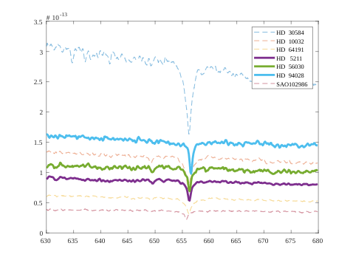
4. Final Project

Slide 21
THANK YOU !

