Slide 1
MatLab
Introduction and Basics

Slide 2
What is Matlab?
MATLAB stands for Matrix Laboratory. It is a tool to perform mathematical complex computations. In MATLAB, simplified C is used as the programming language. MATLAB has various inbuilt toolboxes and these toolboxes are mathematical toolbox, drag and drop based GUI, Image processing, Neural networks etc. MATLAB is generally used to implement algorithms, plotting graphs and design user interfaces. MATLAB is used to simulate networks due to availability of high graphics.

Slide 3
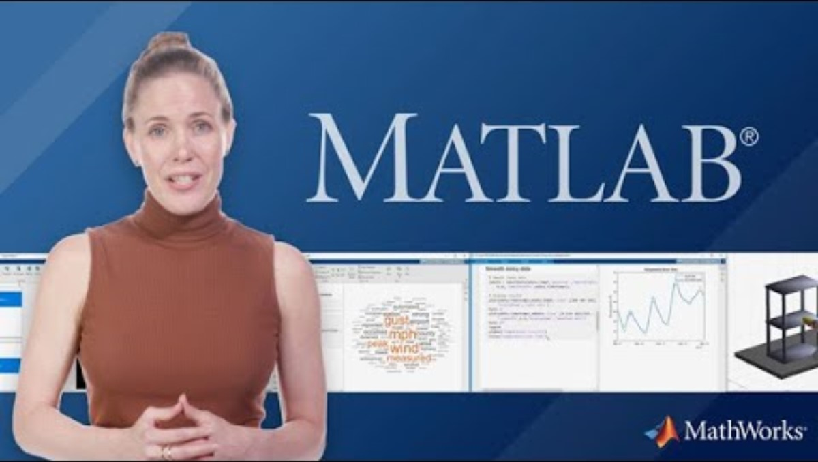
What is Matlab?

Slide 4
Components of MATLAB Interface
Following are the main components of default MATLAB interface:
Command Window - The Command Window is the first important part of MATLAB which is used to show output of already saved code and to execute MATLAB codes temporarily.
Workspace - The workspace is the second part of MATLAB which is used to show allocation and reallocation of MATLAB variables.

Slide 5
Components of MATLAB Interface
Command History - The command history is the third part of MATLAB in which MATLAB commands are shown which are executed previously.
Current Folder Path - The current Folder path shows that path of the folder in which MATLAB codes are saved.
Current Folder Data - The Current Folder Data shows that data which is in the folders whose path is given in Current Folder Path.

Slide 6
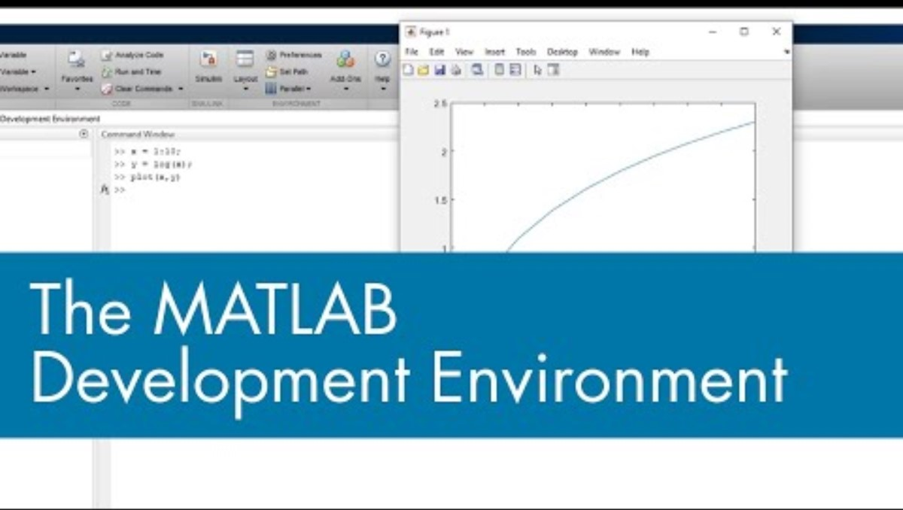
Components of MATLAB Interface

Slide 7
Frequently Used Commands in MATLAB
There are three commonly used commands in MATLAB:
CLC – This command is used to clear all input and output from display window.
Clear All – This command is used to clear all objects from workspace.
Close All – This command is used to close all the interfaces and return to the default interface.

Slide 8
Features of MATLAB
Here are the main features of MATLAB:
MATLAB is a high-level language used for complex numerical based computations, visualization, and for the development of different applications.
For exploration and solving problems, MATLAB provides an open-end environment.
MATLAB provides tools for to build applications using custom graphical interfaces.

Slide 9
Features of MATLAB
MATLAB provides an extensive library of certain mathematical functions to perform operations on Linear Algebra, Fourier series, statistics, and for other mathematical computations.
For improving code quality, MATLAB provides certain development tools along with built-in graphics for data visualization.
MATLAB can be integrated with external applications and programming languages like C, Java.

Slide 10
MATLAB Syntax
For working with basics of MATLAB, firstly you have to setup the MATLAB environment on your system. After the MATLAB environment is set, you can execute commands after >> operator.
Example:
Enter an expression like 10 + 10 and then press enter.
MATLAB will execute this expression and return the result as:
ans = 10

Slide 11
MATLAB Syntax
Semicolon in MATLAB - Semicolon is used as a terminating point of the statement.
Example:
x = 7;
y = x + 8
MATLAB will return the answer as:
y = 15
Comments in MATLAB - Comments can be added in MATLAB using symbol %
Example:
y = 5 % value 5 is assigned to y

Slide 12
Special Variables and Constants in MATLAB
There are some special variables and constants used in MATLAB:
Ans – For most recent answer
Inf – To indicate infinity
Eps – To depict accuracy of floating point precision
NaN – For undefined numerical result
i,j – Represent imaginary unit

Slide 13
Common Commands used in MATLAB
There are various commands used in MATLAB:
cd – To change current directory
dir – To list all files in a current directory
what – To list all MATLAB files
format – To control format of the display screen
fsanf – To read formatted data from a file
fprintf – To perform formatted write to a file

Slide 14
Common Commands used in MATLAB
lookfor – To search help for a keyword
cat – To concatenate arrays
prod – To find product of each column
eye – To create an identity matrix
num2cell – To convert numeric array to cell array

Slide 15
Program Files in MATLAB
> There are two types of program files in MATLAB :
Scripts
Functions
> Description :
Scripts - In these types of program files, series of commands are written which are required to be executed together.
Functions - Unlike script files, function files accept inputs to return output.

Slide 16
Operators Used in MATLAB
Following are the different types of operators used in MATLAB:
Arithmetic Operators
Relational Operators
Logical Operators
Bitwise Operators
Set Operators

Slide 17
Arithmetic Operators - Arithmetic Operators include the operators used in linear algebra including +, -, *, /, ^. Arithmetic Operators also include Array and Matrix arithmetic operators.
Relational Operators - Following are the types of relational operators used:
1. Less than <
2. Greater than >
3. Less than or equal to <=
4. Greater than or equal to >=
5. Equal to ==
6. Not equal to ~=

Slide 18
Operators Used in MATLAB
Logical Operators - There are two types of logical operators used in MATLAB:
Element-wise – To perform operations on elements of logical arrays
Short-Circuit wise – For operation on scalar and logical expressions
Bitwise Operators - These operators are used to perform bitwise operations on bits and work bit-by-bit using truth table for operations.
Set Operators - These operators perform functions like union, intersection, and testing.

Slide 19
Loops in MATLAB
1. Loop Types
While loop
For loop
Nested loop
2. Loop Control Statements:
Break
Continue

Slide 20


Slide 21
Practice : Write and execute a basic MATLAB program
Basics :
Task 1 : Open MatLab and hover to the Command Window - place your mouse cursor after the ">>" sign
Task 2 : Create a vector x that contains numbers from 1 to 10
Task 3 : Create a vector y that is equal to the square root of x

Slide 22
Practice : Write and execute a basic MATLAB program
Task 4 : Plot y against x
Do you recognize this function ?
Task 5 : Switch to the Live Script Editor
What differences with the normal Script Editor can you notice ?
Task 6 : Investigate the display settings

Slide 23
Practice : Write and execute a basic MATLAB program
Yay ! You are doing well !
Now a bit more complex :
Task 1 : Add comments to your code
Task 2 : Add sections to your code
Task 3 : Run the code with your new formatting
What do you notice ?

Slide 24
Uses of MATLAB
MATLAB finds its application in signal processing and communication.
MATLAB is used to perform complex matrix operations which is useful in case of image and video processing.
Matlab provides certain graphical and statistical functions along with our such interesting features which makes it popular for a wide range of use.
Matlab is used in computational biology and computational finance.

Slide 25
Advantages of MATLAB
Being an interpreted language, Matlab is easy to use.
Matlab provides built-in integrated development environment using which programs can be written easily.
Matlab is platform independent in the sense that it can run on different platforms.
Matlab has a vast library of predefined functions that provide solutions to various technical problems.

Slide 26
Disadvantages of MATLAB
The main disadvantage of Matlab is that it is an interpreted language which means that it takes more time to execute than other compiled languages i.e. its execution speed is slow.
The second disadvantage is the cost. It is more expensive than the regular C or Fortran compiler. Therefore, individuals find it expensive to purchase.

Slide 27
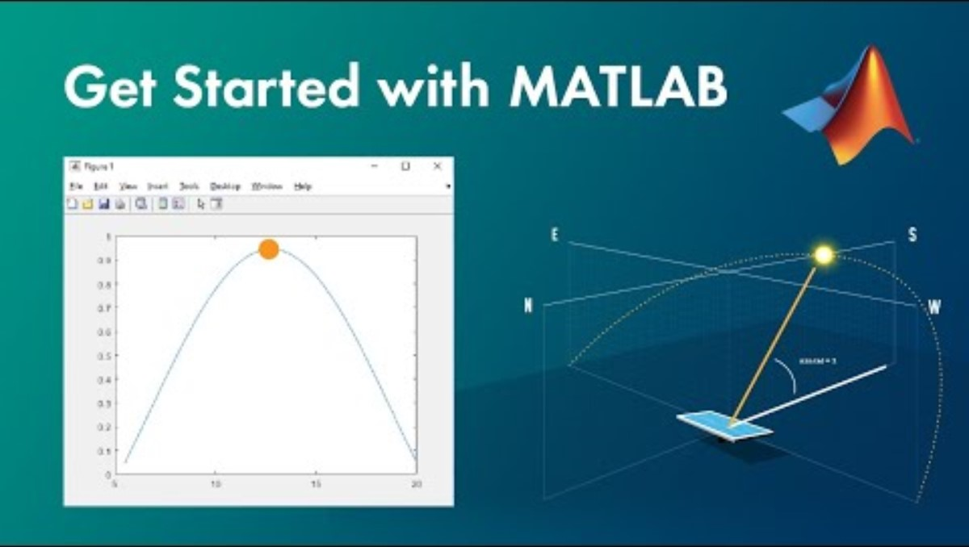

Slide 28
Before you go
Additional resources
MATLAB Documentation and Community are
Very helpful if you need some assistance
MATLAB Documentation
MATLAB Community
MATLAB Blogs
Self-Study
Complete this self-paced course for FREE to get started
MATLAB Onramp

Slide 29
THANK YOU !

