Slide 1



Automated, Georeferenced, and Adaptive platform for Predictive flood rescue by analyzing voice distress to pinpoint and report critical emergencies in real-time.

Slide 2

Imagine you are trapped in your home as floodwaters rapidly rise.

Slide 3
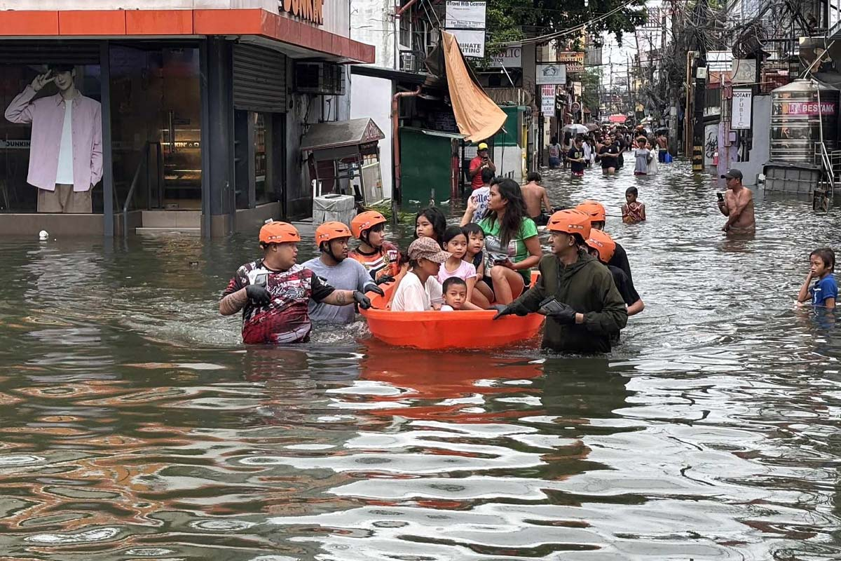
200 to 500 deaths per year

Slide 4
In a crisis, your voice is your only tool. But who is listening?

Slide 5
Automated, Georeferenced, and Adaptive platform for Predictive flood rescue by analyzing voice distress to pinpoint and report critical emergencies in real-time.

Slide 6
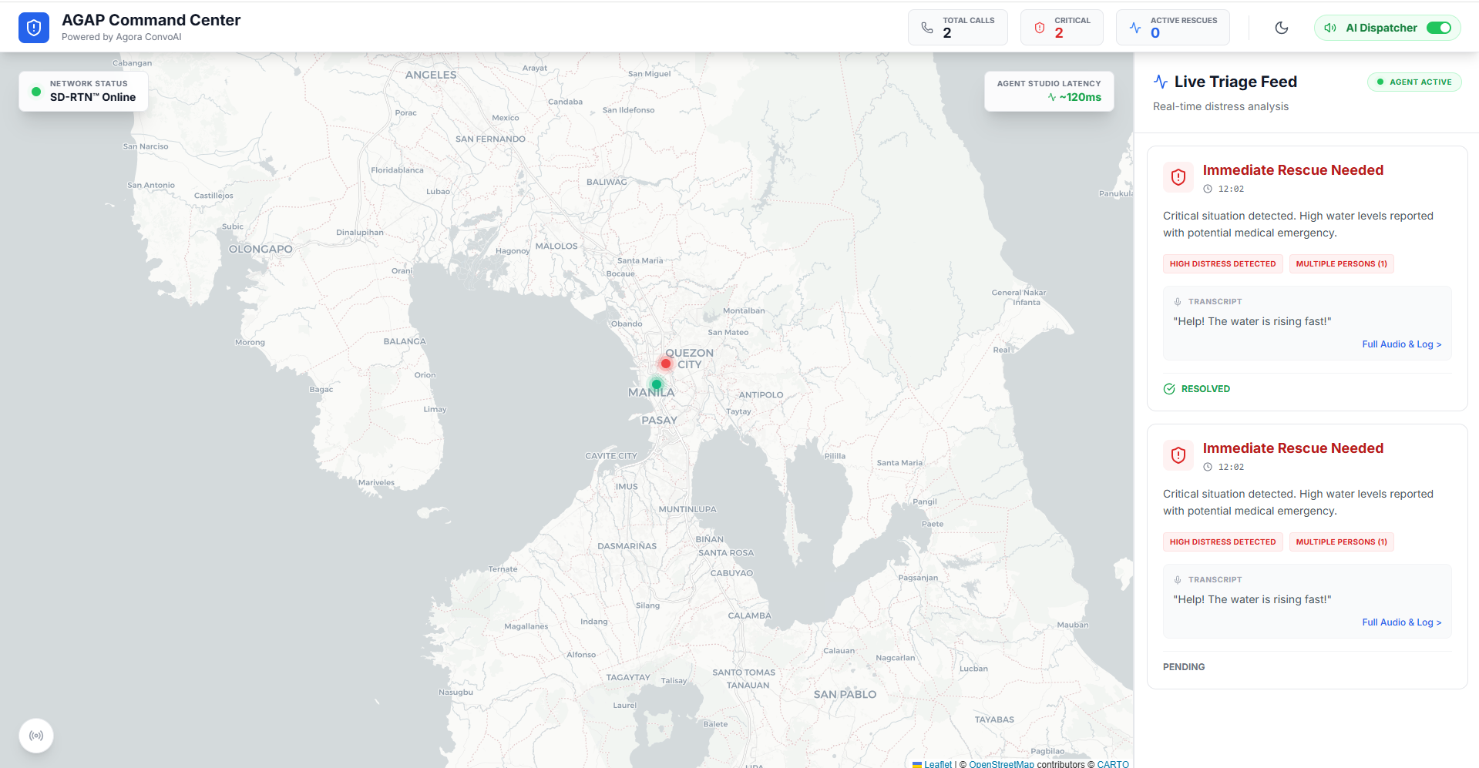
SOLUTION

Slide 7
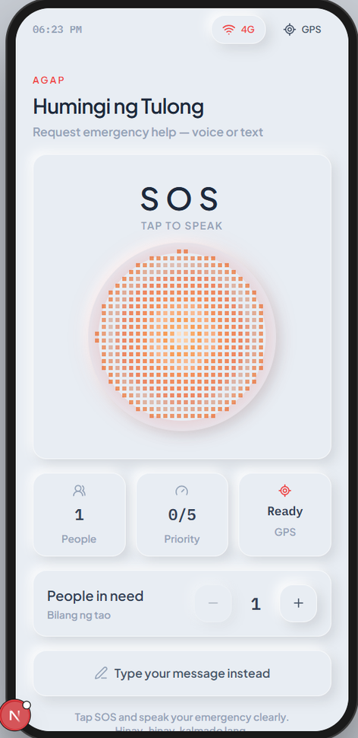
SOLUTION

Slide 8
FUNDING
National Disaster Risk Reduction and Management Council
Department of Information and Communications Technology
Department of Science and Technology

Slide 9
BENEFICIARIES
The citizens
First responders & LGU’s
National Government Agencies

Slide 10
THANK YOU

