Slide 1
Group 5
Merge Sort
Barrera | Cuarte | Pasia | Roque

Slide 2














































00. Idea

Slide 3
01. Actual Prompt
Create a Java console application for a DSS (Decision Support System) e-commerce analytics dashboard. The system should have 3 dashboards: Product Analytics, Consumer Loyalty, and Supplier Metrics.
Use ANSI escape codes throughout for colors, bold text, and screen clearing.
TUI Design Requirements: Use a full bordered ASCII box layout using `╔ ═ ╗ ║ ╠ ╚ ╝` characters for all panels.
Every dashboard must have a header bar showing the dashboard title and current sort criteria with direction (e.g. `PRODUCT ANALYTICS | PRICE-DESC`).
Column headers must be separated from data rows by a divider line.
All columns must be strictly padded and aligned using `String.format` with fixed widths so nothing ever shifts or breaks alignment.
Long text must be truncated with `...` to preserve layout. The rightmost border `║` must always land on the same column - calibrate each row carefully with a visual length offset.

Slide 4
01. Actual Prompt
Keybindings: All input must be single-key, no Enter required where possible. Each dashboard must show a keybinding hint bar at the bottom only when the system is idle (not sorting).
* Product dashboard: `[P]` Price, `[R]` Rating, `[S]` Sales, `[T]` Stock, `[A]` Ascending, `[D]` Descending, `[Q]` Back.
* Consumer dashboard: `[A]` Ascending, `[D]` Descending, `[Q]` Back.
* Supplier dashboard: `[P]` Min Price, `[T]` Total Stock, `[A]` Ascending, `[D]` Descending, `[Q]` Back.
* Main menu uses `[1]`, `[2]`, `[3]`, `[Q]`.
Sorting Animation: Use merge sort. During sorting, re-render the full dashboard on every comparison and placement step with a short `Thread.sleep` delay so the animation is visible.

Slide 5
01. Actual Prompt
Highlight the two elements being compared in yellow and the placed element in green using ANSI codes. Hide the keybinding bar while sorting is in progress. The `isBusy` flag on the engine must gate this.
Bar Chart Column: Every dashboard must include a proportional bar chart column rendered with `█` (filled) and `░` (empty) characters.
Bar width is fixed at 30 characters.
Each bar scales relative to the current maximum value in the dataset.
The bar color must match the highlight color of that row during animation, and reset to default otherwise.
Class Structure (strictly modular):
* `User` (abstract) with `id` and `name` => subclasses `Supplier` (adds `company`) and `Consumer` (adds `points`)
* `Product` with `name`, `price`, `rating`, `sales`, `stock`, and a linked `Supplier`

Slide 6
01. Actual Prompt
* `AnalyticsEngine` - holds the data array, sort criteria, direction flag, busy flag, and animation speed. Contains `mergeSort`, `merge`, `compare`, `getVal`, and `sleep` methods. `getVal` must dispatch by criteria string.
* `Dashboard` (abstract) - holds engine reference, title, and total width constant. Contains `printFrameHeader`, `buildBar`, and `pad` helper methods. Abstract `render(int a1, int a2, boolean merged)` method.
* `ProductDashboard`, `ConsumerDashboard`, `SupplierDashboard` - each implements `render` with their own column layout
* `Main` - seeds data, owns the three engine instances and the static `activeDashboard` reference, runs the main menu loop, and has a `handleLoop` method for per-dashboard input handling. Also has a static `getSupplierStat` method for computing per-supplier aggregates across the product list.
Data: Seed in JSON format 20 products, 20 consumers, and 20 suppliers with randomized values. Suppliers rotate across 10 company names. Products link to suppliers.
Documentation: Use JavaDocs

Slide 7
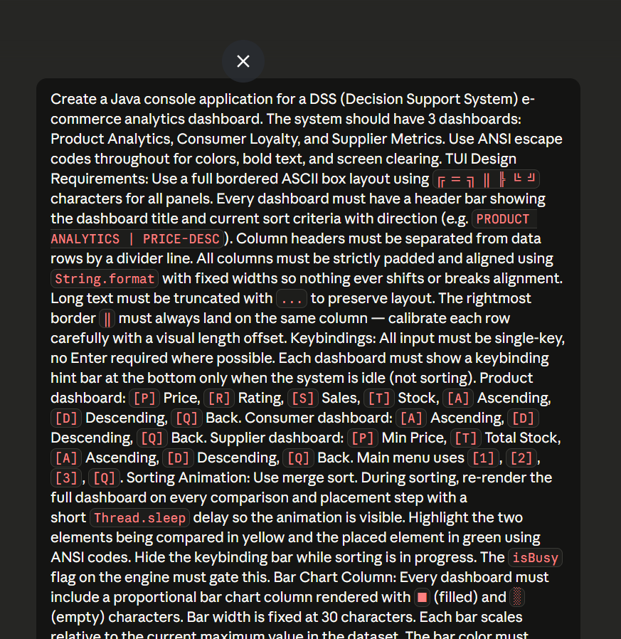
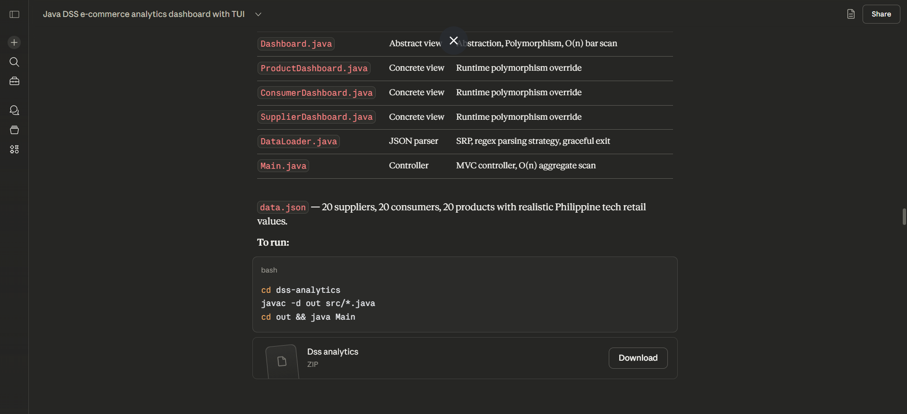
01. Actual Prompt
Used: Claude Sonnet 4.6

Slide 8
02. Implementation (Sorting)
Assume that we open the Products Dashboard and we check the product price from lowest to highest
AnalyticsEngine
The class in program that handles mergeSort

Slide 9
02. Implementation (Sorting)
{“Laptop Pro 15”, 58,999.00},
{“Smartphone X12”, 32,500.00},
{“Wireless Mouse”, 1,299.00},
{“Mech Keyboard”, 4,750.00}
{“Laptop Pro 15”, 58,999.00},
{“Smartphone X12”, 32,500.00}
{“Wireless Mouse”, 1,299.00},
{“Mech Keyboard”, 4,750.00}
Base Case Reached
Divide
`mergeSort()` recursively splits the the Product[] array in half
Conquer
The element reach its base case and sorted then the `merge()` is ready to be called

Slide 10
02. Implementation (Sorting)
{“Smartphone X12”, 32,500.00},
{“Laptop Pro 15”, 58,999.00}
{“Wireless Mouse”, 1,299.00},
{“Mech Keyboard”, 4,750.00}
{“Wireless Mouse”, 1,299.00},
{“Mech Keyboard”, 4,750.00},
{“Smartphone X12”, 32,500.00},
{“Laptop Pro 15”, 58,999.00}
Merging
Comparing elements and the smaller element (focus: Price) will be placed first

Slide 11
03. Program as Object-Oriented
Supplier
Abstraction & Inheritance
Base class User contains shared id and name
User
Consumer
Product Dashboard
Dashboard
Supplier Dashboard
Consumer Dashboard
Encapsulation
The program uses private access modifier and have getters (required) such as Products, Consumer, Supplier, and AnalyticsEngine

Slide 12
03. Program as Object-Oriented
Polymorphism
Same method name `render()` in 3 different classes
public static Dashboard activeDashboard;
Main.activeDashboard.render()
↓ (runtime decision)
├─→ ProductDashboard.render()
├─→ ConsumerDashboard.render()
└─→ SupplierDashboard.render()

Slide 13
04. Program being “Data Structured”
How the System Organizes and Stores Data?
JSON
Data Loader
Objects
Arrays
public static Product[] products; public static Consumer[] consumers; public static Supplier[] suppliers;

Slide 14
04. Program being “Data Structured”
How the System Manages and Structures Data
Load Arrays
Access
Prompt
Render
User Choice
Object Relationship Product <=> Supplier
Dashboard &
AnalyticsEngine
User Options
(Dashboard View)
(Functionality)

