Slide 1
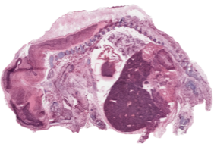


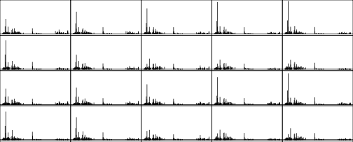

Cardinal
MS imaging
mass spectrometry imaging tools
Scan with laser/spray
Collect mass spectra
Reconstruct ion images
Date “cube”
Kylie A. Bemis
Provides MSI infrastructure
Website at cardinalmsi.org
Available on Bioconductor
CardinalWorkflows data pkg
Google user/help group
2015 John M. Chambers Statistical Software Award
K. D. Bemis, A. Harry, L. S. Eberlin, C. Ferreira, S. M. van de Ven, P. Mallick, M. Stolowitz, O. Vitek. “Cardinal: an R package for statistical analysis of mass spectrometry-based imaging experiments”. Bioinformatics, 31:2418, 2015

Slide 2
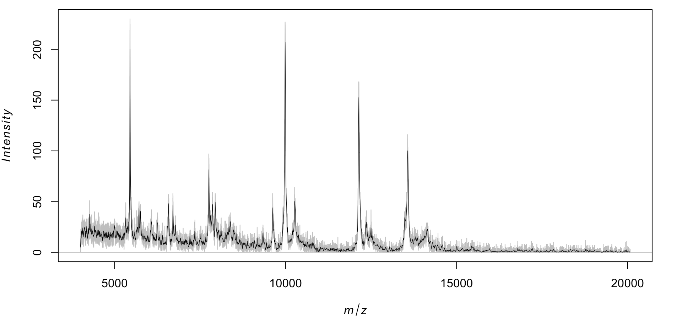
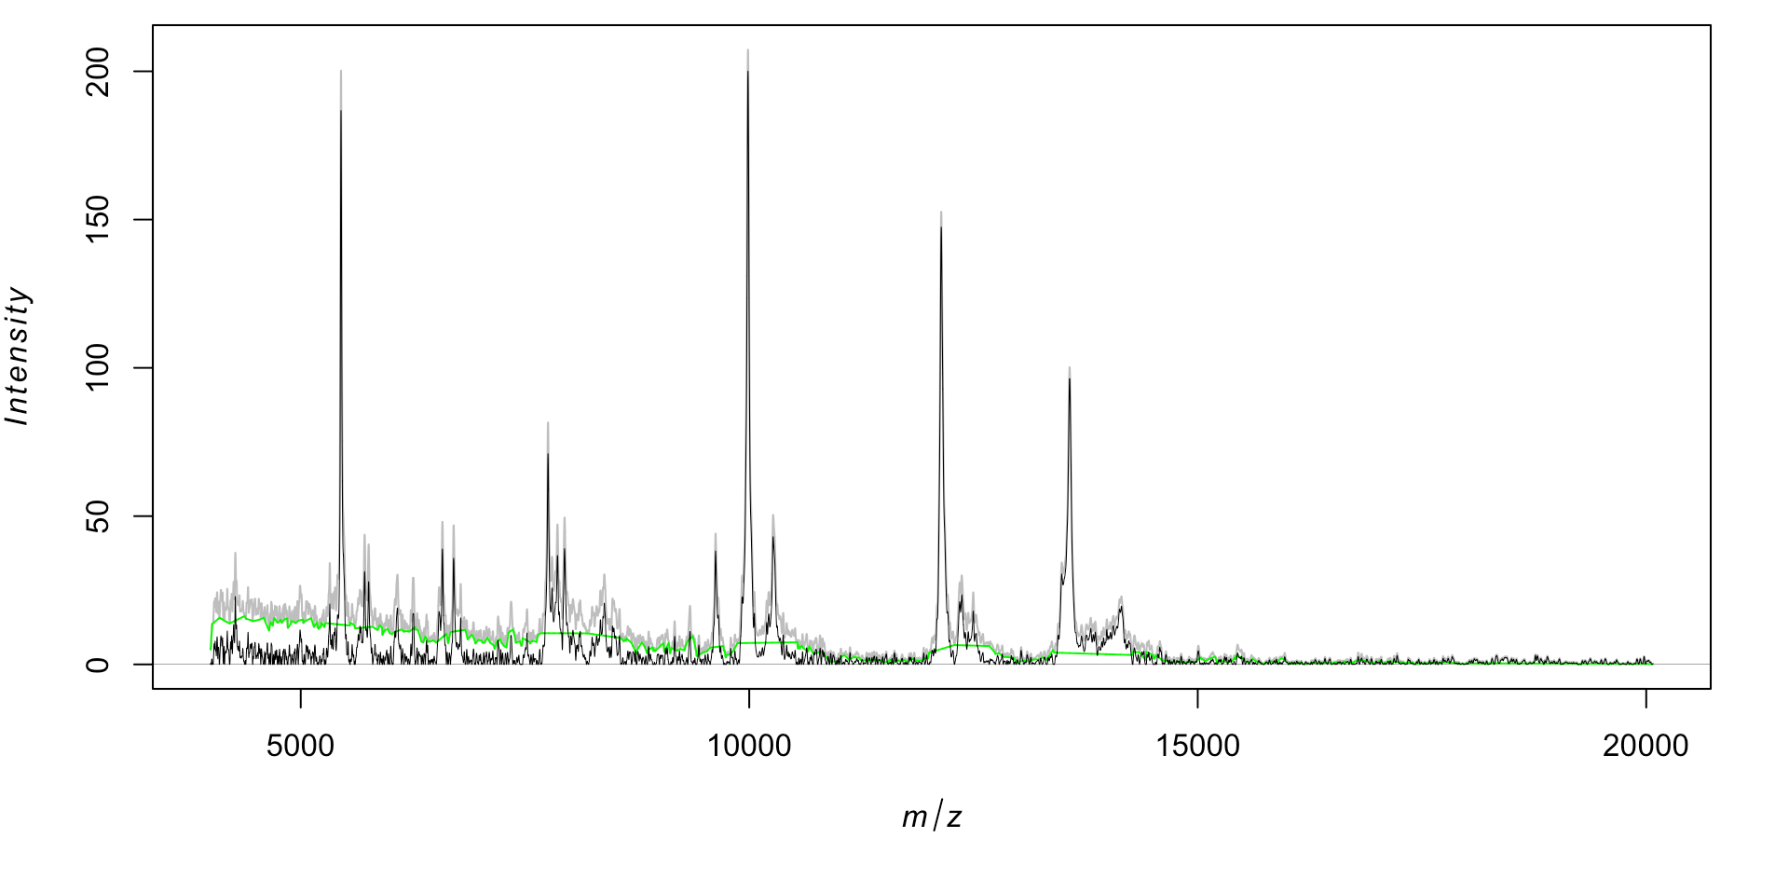
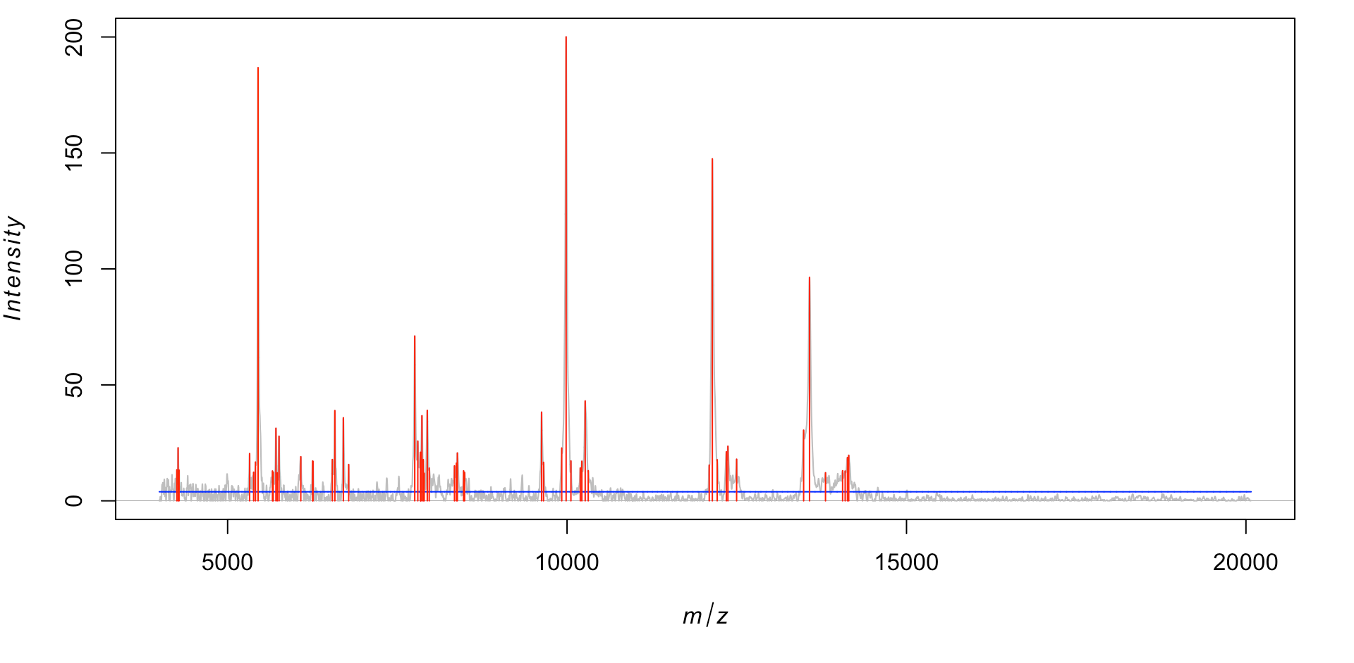
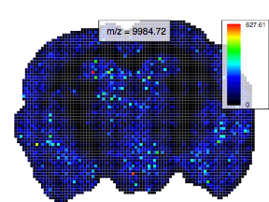
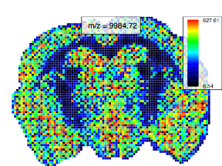
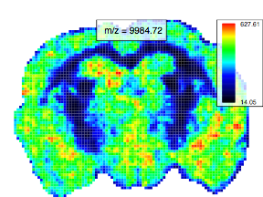
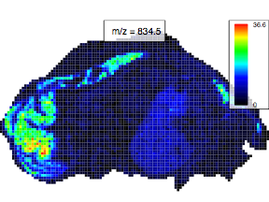
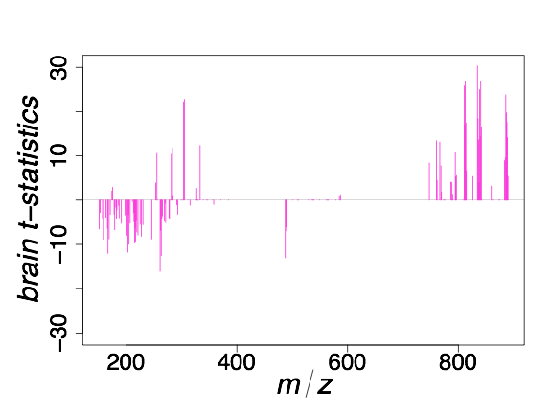

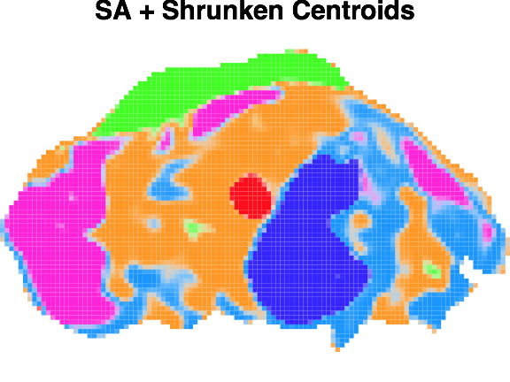
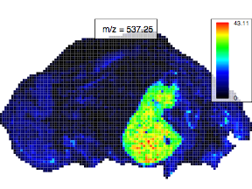
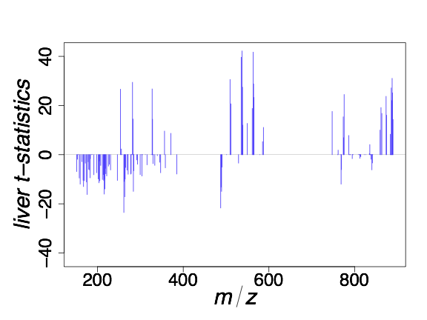
Full experimental workflows
smoothSignal(Brain_1)
reduceBaseline(Brain_1)
peakPick(Brain_1)
Spectral processing
image(Brain_1, mz=9984.7, …)
contrast.enhance=“histogram”
smooth.image=“gaussian”
Image processing
spatialShrunkenCentroids(pig206, …)
Statistical analysis
2￼

Slide 3
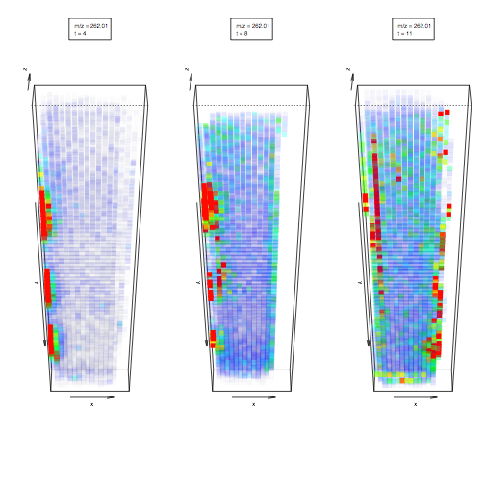
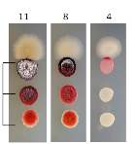
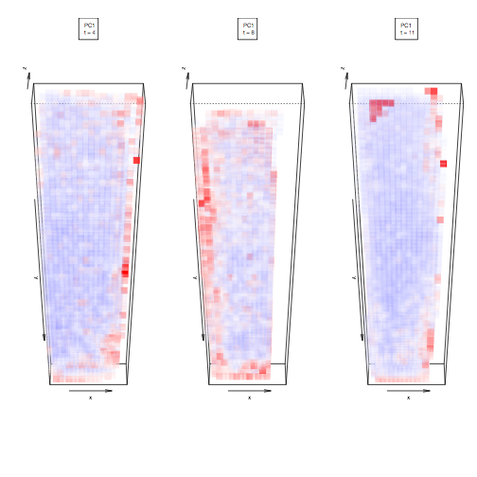
Future development
Cardinal
matter
More statistical methods needed!!!
Contribute, or write new packages
Support for more formats
Support for large datasets
Support for 3D experiments
More infrastructure for developers (e.g., traverse neighborhoods)
New package in development at github.com/kuwisdelu/matter
Disk-based computing similar to bigmemory, ff, and HDF5Array
Focus on flexibility of on-disk data
Focus on minimal memory
User-specified file structure
Future backend for Cardinal
Oetjen et al, Gigascience, 2015
t = 11
t = 8
t = 4
3D microbial time-course
2.85 GB on disk
17,672 pixels
40,299 features
m/z 262
t = 11
t = 8
t = 4
PC1 scores
234 MB to compute 3 PC
79 MB memory overhead
3￼

