Slide 1
Analysis goal: class comparison
Analyze one m/z at a time
Class 1
Class 2
Sample 1
Sample 2 …
Sample n
Sample 1
Sample 2 …
Sample m
What to compare:
Average ion intensity across tissue: between groups
Statistical methods:
T-test, ANOVA, linear regression
Limitations:
loss of spatial information

Slide 2
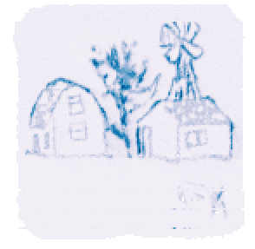
Spatial-DGMM model
Spatial-DGMM is a Dirichlet Gaussian mixture model with spatial dependence
Assumptions:
k subgroups per ion image
The intensities of pixels are from k Gaussian components with unique means and variances
The component membership of a pixel ~ Dirichlet process
The component memberships of pixels are spatially correlated
K = 2
~N (μ₁, σ²₁)
~N (μ₂, σ²₂)
Input
Output
Single ion image (ion intensities of one m/z across the sample)
Number of Gaussian components and their means and variances
Component membership of each pixel

Slide 3
Spatial-DGMM uncovers differences in ion abundance between conditions
Goal: class comparison
Spatial-DGMM overcomes the limitation of average ion intensity across tissue
Absolute intensity
Relative intensity
4 replicates
3 replicates

Slide 4
Spatial-DGMM uncovers differences in ion abundance between conditions
Goal: class comparison
Spatial-DGMM overcomes the limitation of average ion intensity across tissue
Absolute intensity
Relative intensity
K = 3
(μ₁, σ²₁)
(μ₂, σ²₂)
(μ₃, σ²₃)

Slide 5
Spatial-DGMM uncovers differences in ion abundance between conditions
Goal: class comparison
Spatial-DGMM overcomes the limitation of average ion intensity across tissue
Absolute intensity
Relative intensity

