Slide 1
Page Rank
A Random Walk Interpretation
Web model
Transition matrix
Compute page ranks by simulation
Compute page ranks by power method

Slide 2
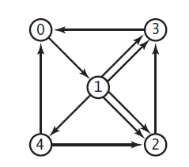
Which page a random surfer is most likely to visit?

Slide 3
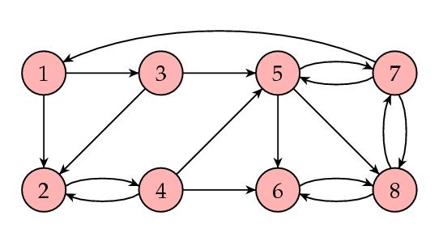
Which page the surfer is most likely to visit?

Slide 4
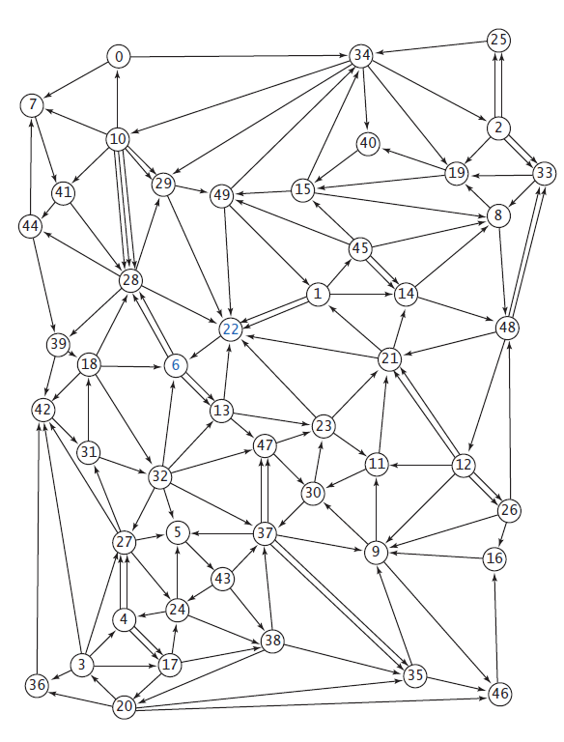
Which page the surfer is most likely to visit?

Slide 5
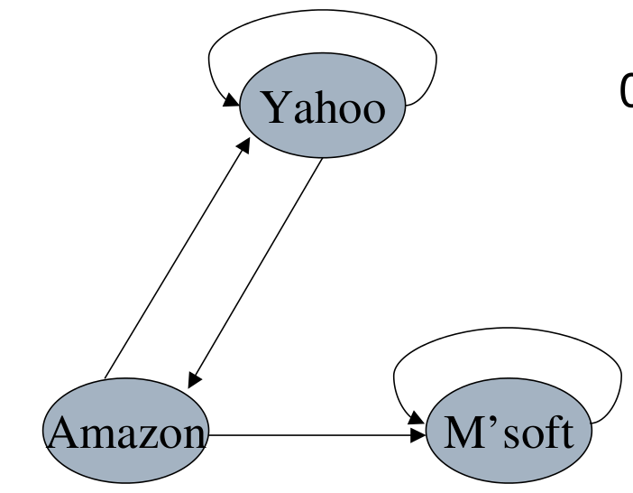
Web model
3
0 0 0 1
1 0 1 2
2 2

Slide 6
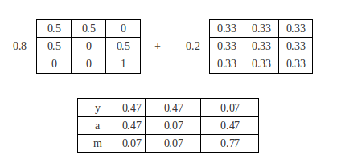
Transition matrix
Assume the surfer at page i at time t
The probability p(i,j) in the transition matrix define the likelihood the suffer ends up at page j at time t+1.

Slide 7
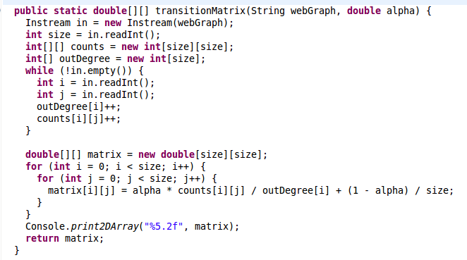
Transition matrix

Slide 8
Compute page ranks by simulation
Simulate the behavior of a random surfer
Surfer starts on a random page (e.g. page 0)
Repeatly
  choose next page, according to transition matrix
Calculate how many times surfer visits each page
The frequencies of each page is the page rank

Slide 9
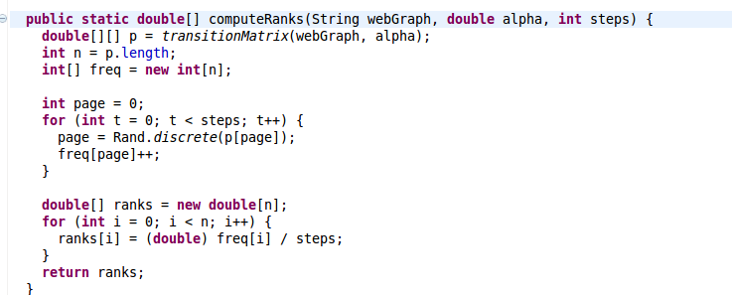
Compute page ranks by simulation

Slide 10
Simulating random clicks
Surfer is on page i. How to choose next page j?
Row i of transition matrix gives probability distribution.
Compute cumulative probabilities for row i.
Math.random() generate random number r between 0.0 and 1.0.
Choose page j corresponding to interval where r lies.

Slide 11
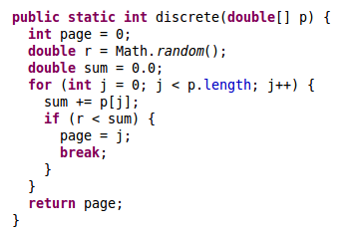
How to choose next page j?

Slide 12
Compute page ranks by power method
  If the surfer starts on page 0, what is the probability that surfer ends up on page i after one step?
  What is the probability that surfer ends up on page i after 2 steps?
Algorithm
  Inititalize r⁰ = [1, 0,... 0]
  Repeatly update, until converse
    r^{k+1} = r^{k} * P

Slide 13
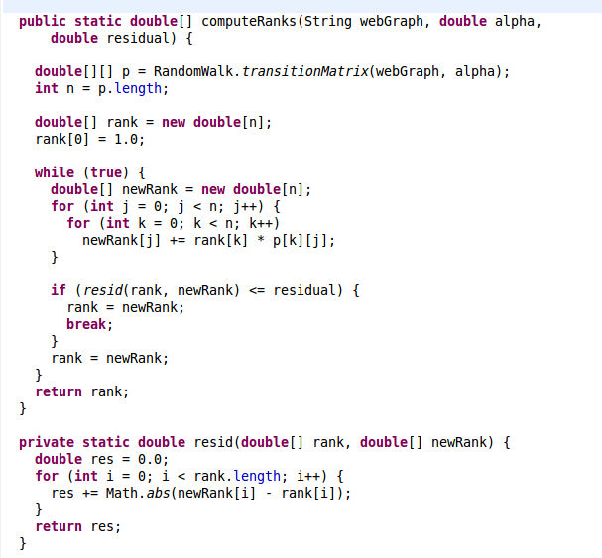
Compute page ranks by power method

Slide 14
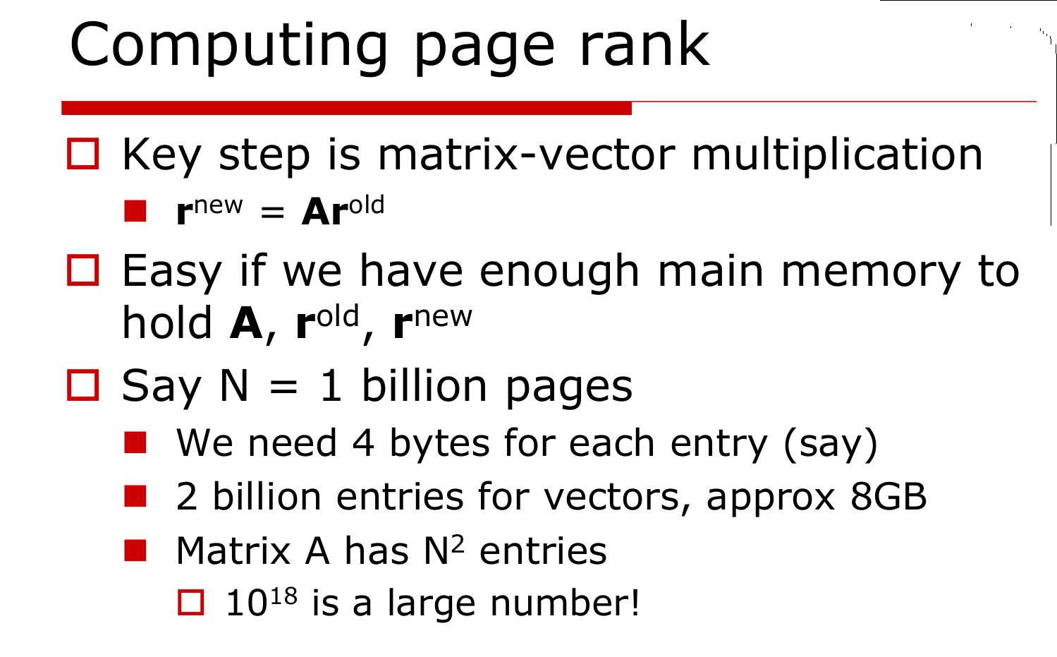
Compute page ranks for large dataset

Slide 15
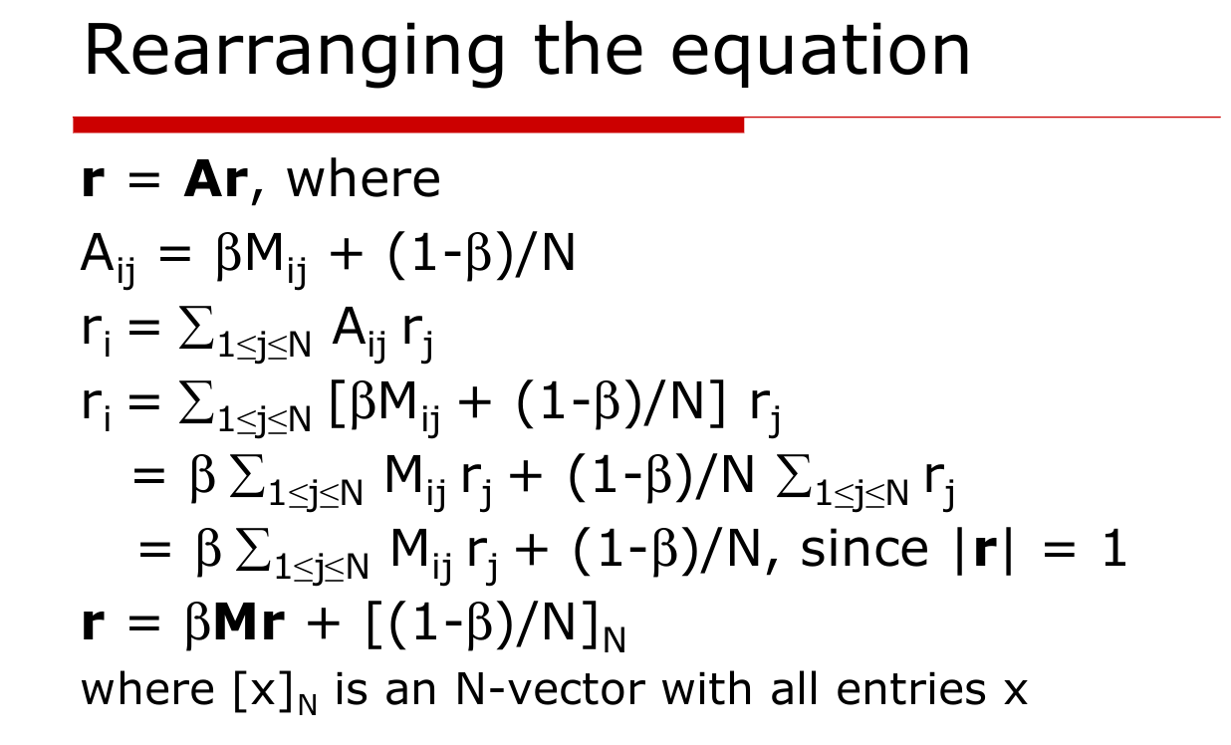
Compute page ranks for large dataset

Slide 16
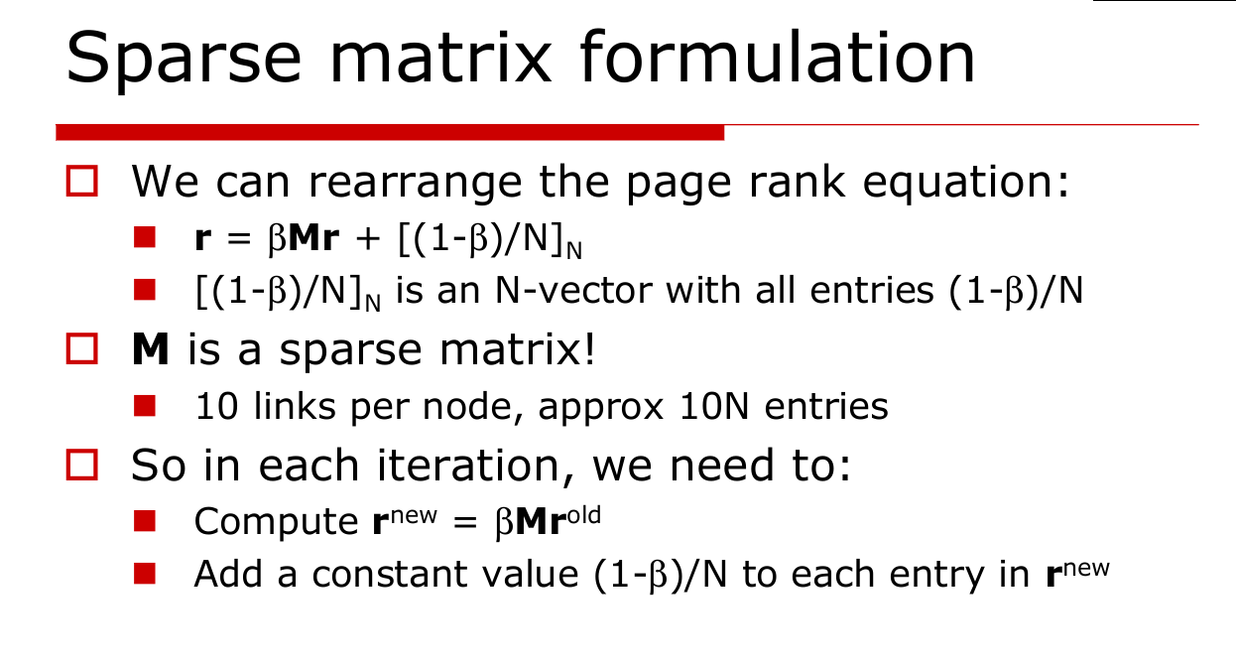
Compute page ranks for large dataset

Slide 17
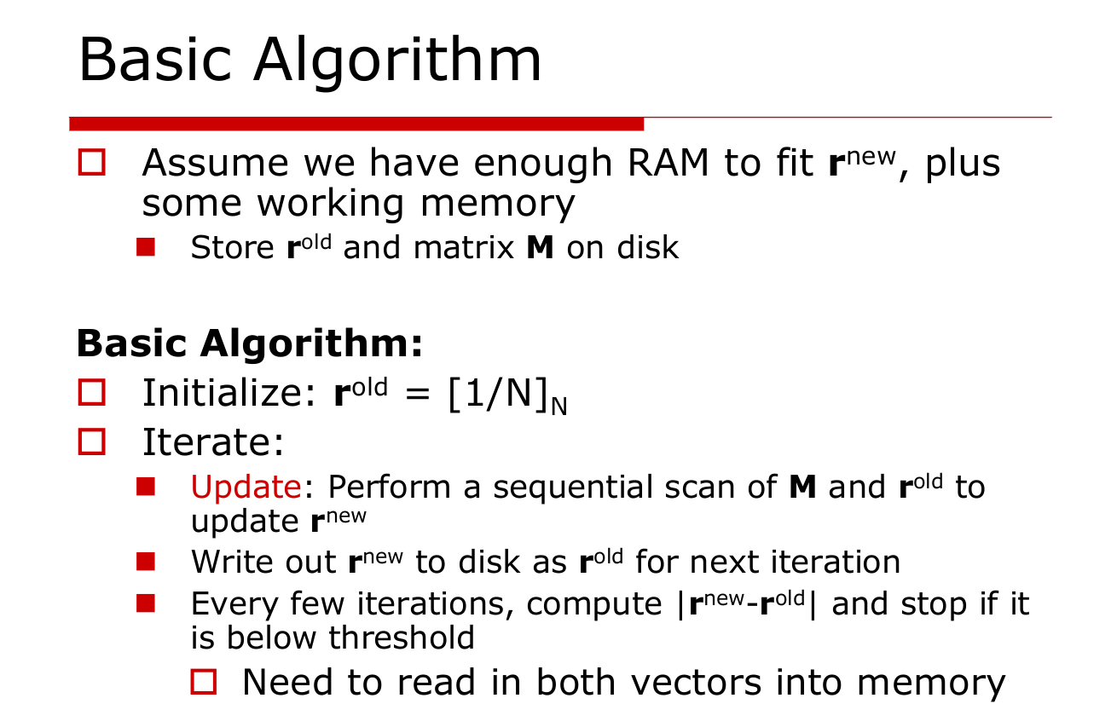
Compute page ranks for large dataset

Slide 18
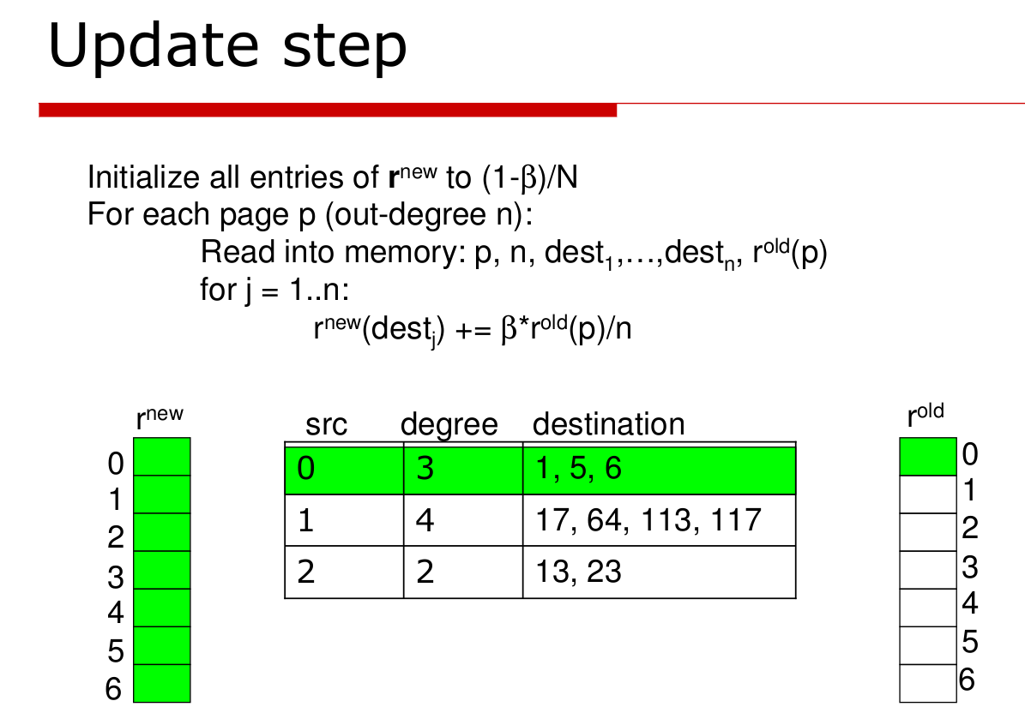
Compute page ranks for large dataset

Slide 19
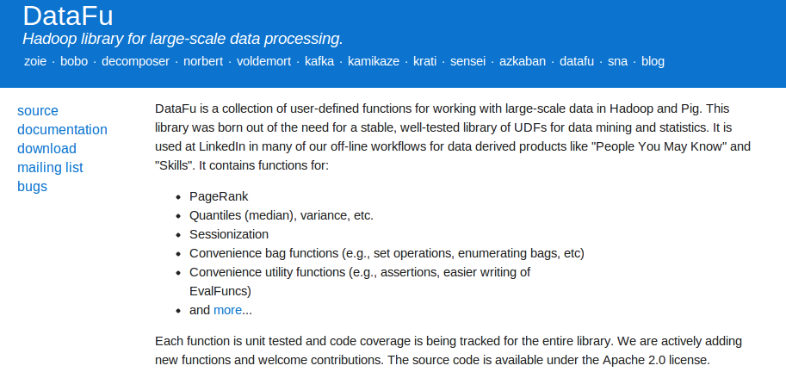
Compute page ranks for large dataset

