Slide 1
Eclipse Vert.x
Subramanian Murugan

Slide 2
Agenda
What is Eclipse Vert.x

Slide 3
What is Eclipse Vert.x

Slide 4
Open Source Project started in 2012 By Tim fox under Eclipse/Apache licensing To build modern distributed Application on JVM

Slide 5
Eclipse Vert.x is polyglot - languages language Interoperability Vert.never preaches which language is best

Slide 6
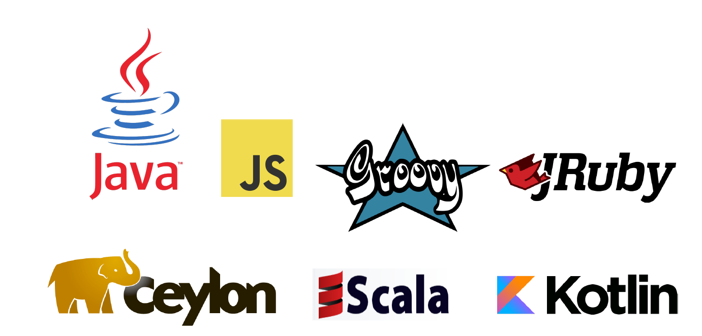

Slide 7
Vert.x created to build non blocking io applications on JVM using functional style, Reactive, declarative,event driven paradigms

Slide 8
IO Demystification

Slide 9
IO
Input/output (IO) refers to interaction with devices such as a hard drive, network
Generally anything that is not happening in the CPU is called IO
When you call an API that requests data from IO, you will not get a response instantly, but with some delay
This delay can be very small for requesting a file on a hard drive, and much longer when requesting data from a network

Slide 10
File Descriptors It is table of information About io resources(hardware)

Slide 11
File Descriptor Table
Integer value | Name | <unistd.h> symbolic constant^{[1]} | <stdio.h> file stream^{[2]}
0 | Standard input | STDIN_FILENO | stdin
1 | Standard output | STDOUT_FILENO | stdout
2 | Standard error | STDERR_FILENO | Stderr
3 | Socket | SCOCKET_REL | HardDrive
4 | Socket | SOCKET_NET | NEC

Slide 12


Slide 13
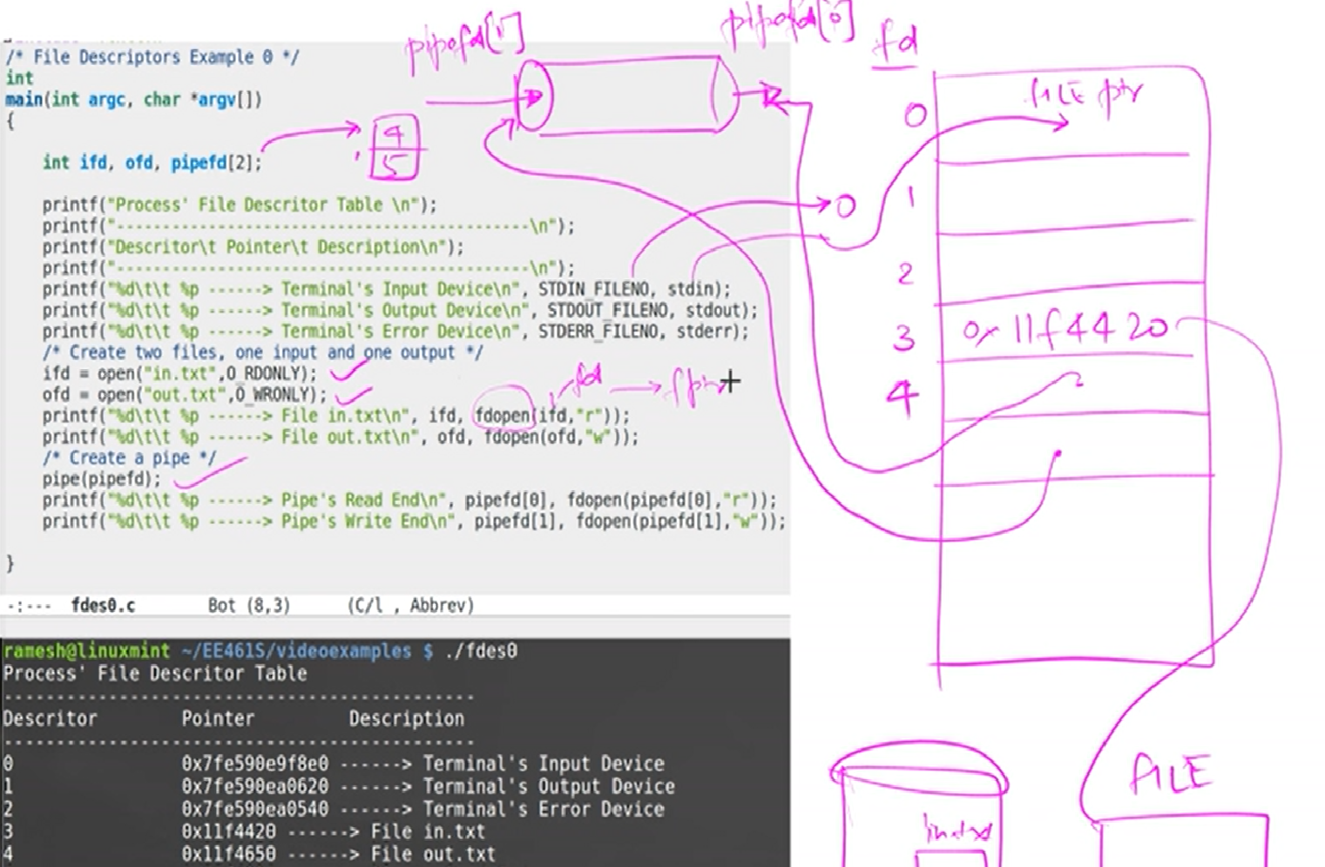
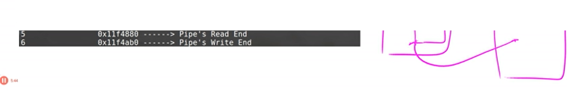

Slide 14
Two distinct phases for an input operation
Waiting for the data to be ready. This involves waiting for data to arrive on the network. When the packet arrives, it is copied into a buffer within the kernel.
Copying the data from the kernel to the process. This means copying the (ready) data from the kernel's buffer into our application buffer

Slide 15
IO Models
Only we are going to discuss Blocking IO and IO Multiplexing
Blocking I/O
Nonblocking I/O
Signal driven I/O (SIGIO)
Asynchronous I/O (The POSIX aio_ functions)
I/O multiplexing
Select
Poll
Epoll / Kqueue/IOCP

Slide 16
Blocking IO

Slide 17
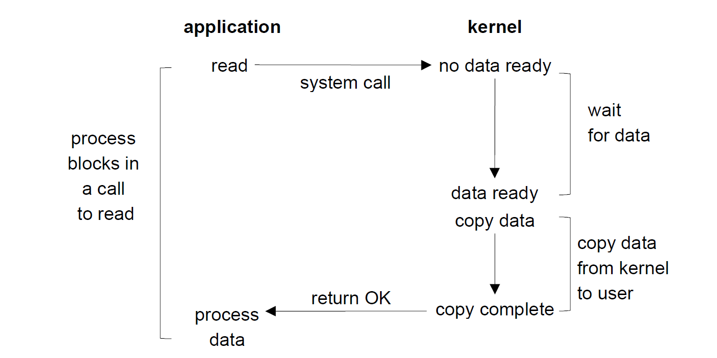

Slide 18
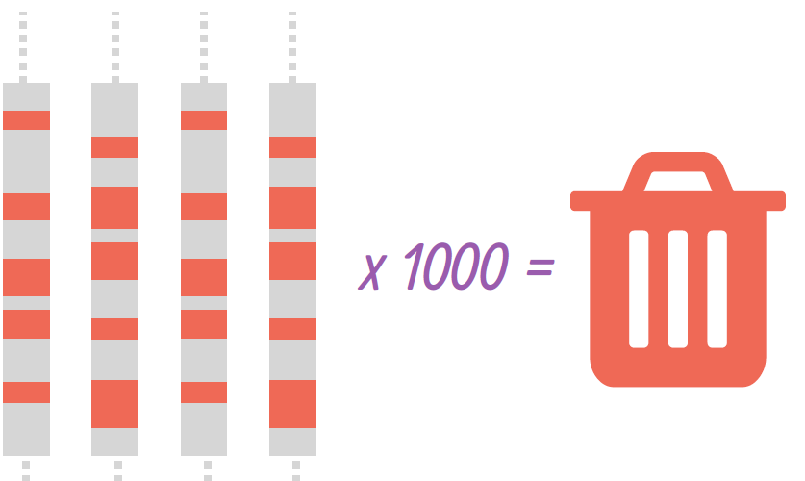
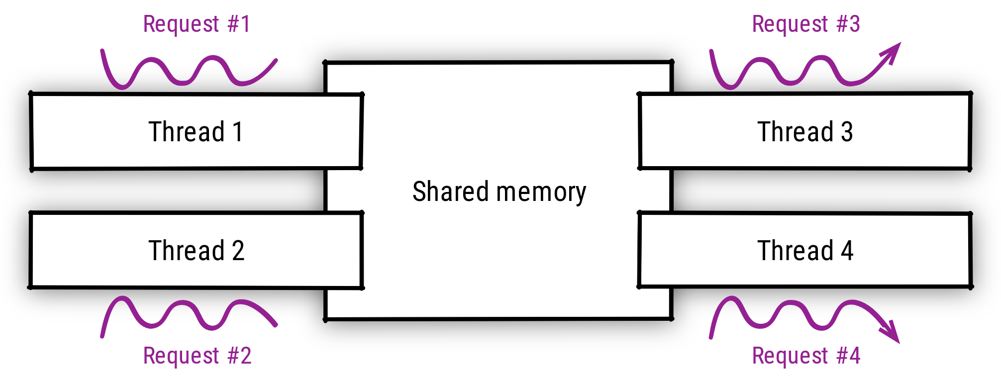
Networking IO In Java : Tomcat
How does Tomcat handles http request for a client?
Tomcat creates or allocates a thread per Client

Slide 19
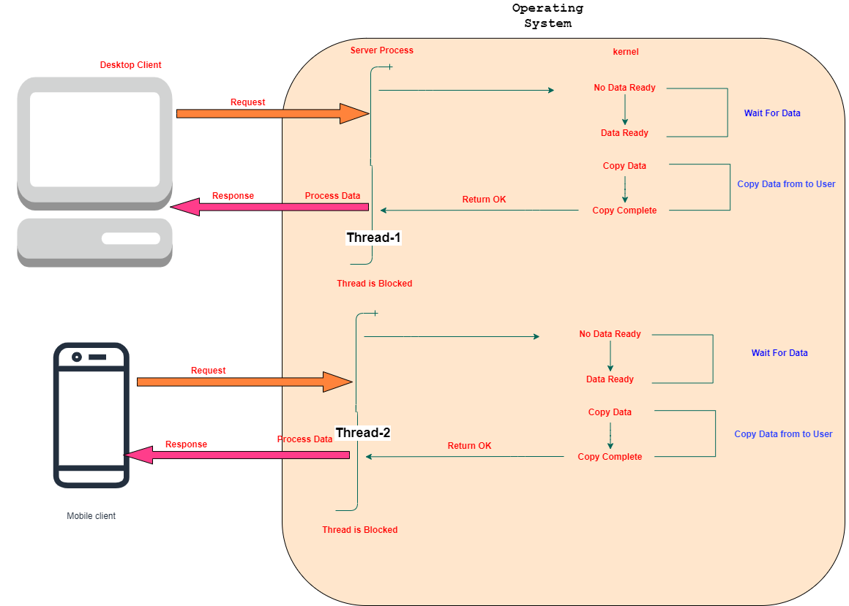
Multi Threading and Blocking io

Slide 20
Multi-threading is “simple” but limited
What hap­pens as the work­load grows be­yond mod­er­ate work­loads? (see the C10k prob­lem)
you start mak­ing your op­er­at­ing sys­tem ker­nel suf­fer be­cause there is too much con­text switch­ing work with in-​flight re­quests.
Calling an API that requests data from IO will cause the running thread to “block”, i.e. it is waiting until the requested data has returned to the caller.
When a thread is blocked in Linux, it will be put in a Sleep state by the kernel until data has returned to the caller.

Slide 21
Multi-threading is “simple” but limited
Threads in sleep state immediately give up its access to the CPU, so to not waste CPU time.
After IO is ready, the thread is taken out of the Sleep state and put in Runnable state.
Threads in this state are eligible to be executed on the CPU again.
The thread scheduler will put the thread on a CPU when one is available. The process of taking threads on and off the CPU is called context switching.

Slide 22
Multi-threading is “simple” but limited
Some of your threads will be blocked be­cause they are wait­ing on I/O op­er­a­tions to com­plete, some will be ready to han­dle I/O re­sults, and some will be in the mid­dle of doing CPU-​intensive tasks.
Mod­ern ker­nels have very good sched­ulers, but you can­not ex­pect them to deal with 50 000 threads as eas­ily as they would do with 5 000. Also, threads aren’t cheap: cre­at­ing a thread takes a few mil­lisec­onds, and a new thread eats about 1MB of mem­ory.

Slide 23
Blocking IO is default
Every Operating system by default provides blocking io calls.
The Programming languages follows the same io calls.
C10K Problem changed way of thinking about concurrency in application development.

Slide 24
Blocking system calls – Linux OS
Accept
 | accept a connection on a socket
open
 | open for reading and writing
read / readv / pread
 | read from a file
write / writev / pwrite
 | write on a file
send / sendto / sendmsg
 | send a message from a socket
recv / recvfrom / recvmsg
 | receive a message from a socket

Slide 25
IO Multiplexing IO With many Sources

Slide 26
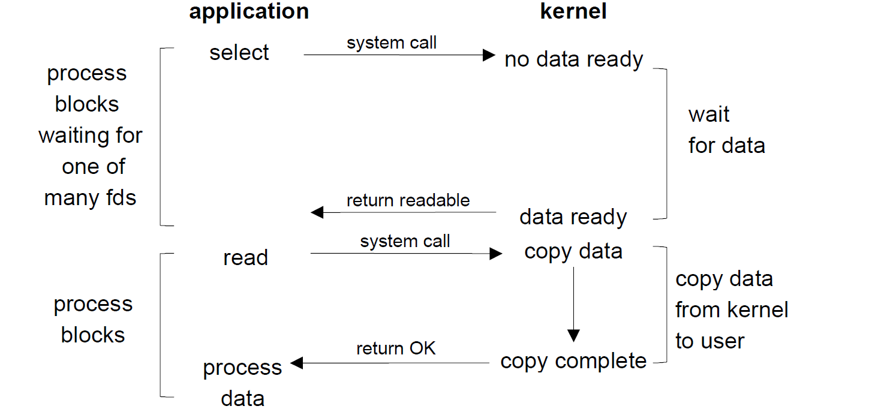

Slide 27
Watching multiple file descriptors and choose among them which fd is ready for reading or writing in socket

Slide 28
IO Monitoring calls
Select
Poll
Epoll, kqueue, IOCP

Slide 29
select
Suppose one Server connected to multiple clients. Server is waiting in a queue to read multiple client data from socket. But in Queue 1 read function has no data and 2nd function has data. Then select function monitors all file fds, permits to server read data from second file descriptor.
select() allows a program to monitor multiple file descriptors, waiting until one or more of the file descriptors become "ready" for some class of I/O operation (e.g., input possible).
A file descriptor is considered ready if it is possible to perform a corresponding I/O operation (e.g., read(2), or a sufficiently small write(2)) without blocking.

Slide 30
poll
poll( ) does not require that the user calculate the value of the highest- numbered file descriptor +1
poll( ) is more efficient for large-valued file descriptors. Imagine watching a single file descriptor with the value 900 via select()—the kernel would have to check each bit of each passed-in set, up to the 900th bit.
select( )’s file descriptor sets are statically sized.
With select( ), the file descriptor sets are reconstructed on return, so each subsequent call must reinitialize them. The poll( ) system call separates the input (events field) from the output (revents field), allowing the array to be reused without change.
The timeout parameter to select( ) is undefined on return. Portable code needs to reinitialize it. This is not an issue with pselect( )
select( ) is more portable, as some Unix systems do not support poll( )

Slide 31
Event Loop
While/for infinite loop to watch list of fds
If something happens, notify to application process.
Application process may have been waiting for io notification.
Kernel emits notification called “Event”

Slide 32
Events and Listeners
Object / Structure contains notification along with data.
Event listeners are already registered in the application to process it.
Event listeners will be executed by a thread called “event loop thread” as events arrives.

Slide 33
epoll - I/O event notification facility
The epoll API performs a similar task to poll
Monitoring multiple file descriptors to see if I/O is possible on any of them.
The epoll API can be used either as an edge-triggered or a level-triggered interface and scales well to large numbers of watched file descriptors.

Slide 34
epoll - I/O event notification facility
The interest list (sometimes also called the epoll set):
The set of file descriptors that the process has registered an interest in monitoring.
The ready list :
The set of file descriptors that are "ready" for I/O. The ready list is a subset of (or, more precisely, a set of references to) the file descriptors in the interest list. The ready list is dynamically populated by the kernel as a result of I/O activity on those file descriptors.

Slide 35
IO Multiplexing implementations on os
Epoll – Linux
Kqueue –Open BSD including mac
IOCP - Windows

Slide 36
Java and io
Java does not support for non blocking api until java 7.
Java 7 Added new non blocking version of IO called NIO.

Slide 37
Problems with NIO
It does not provide higher-level protocol-specific helpers, like for writing HTTP clients and servers.
Also, java.nio does not prescribe a threading model, which is still important to properly utilize CPU cores, handle asynchronous I/O events, and articulate the application processing logic.
This is why, in practice, developers rarely deal with Java NIO

Slide 38
Netty
Netty is a NIO client server framework which enables quick and easy development of network applications such as protocol servers and clients

Slide 39
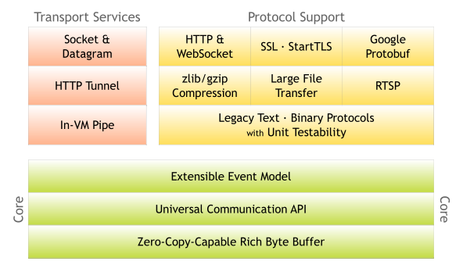
Netty

Slide 40
Birth of Vertx Project
Vertx was born to simulate Node.js Capability on JVM. initially it was named "Node.X"
A core project, called vertx-core, provides the APIs for asynchronous programming, non-blocking I/O, streaming, and convenient access to networked protocols such as TCP, UDP, DNS, HTTP or Web Sockets,
Vertx is industry ready , polyglot toolkit for building Nonblocking, evented io applications.
Vertx has been built on the top of Netty Core

Slide 41
Vertx binds Netty at Core , Netty communicates Epoll, Kqueue, IOCP Framework

Slide 42
Quarks apps
Vertx
Netty Core
NIO - JVM
Epoll
KQueue
IOCP

Slide 43
Vertx Concurrency Model

Slide 44
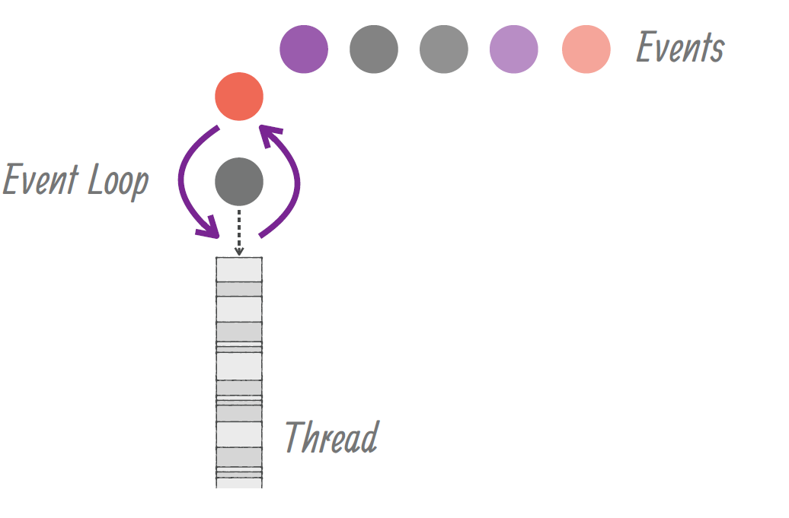
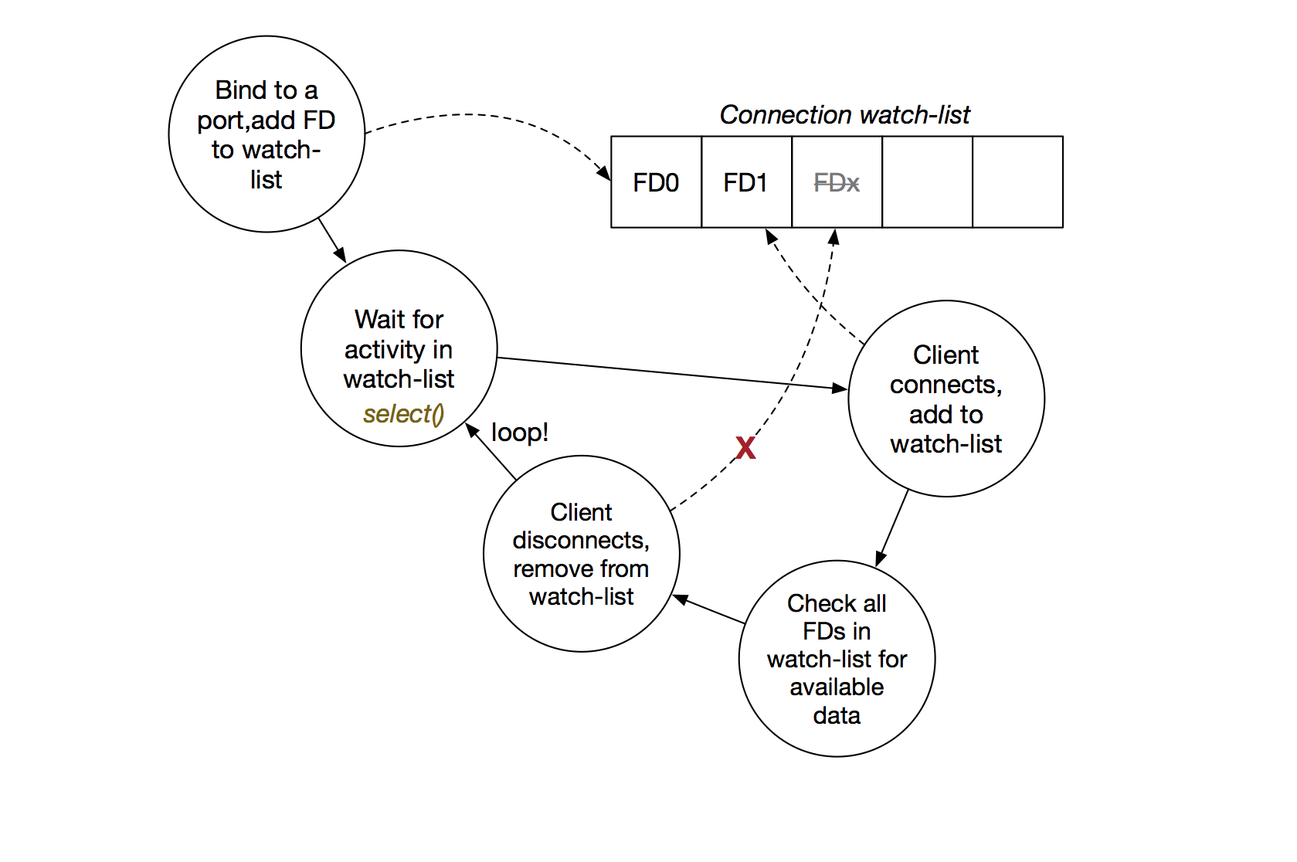
Vertx Runtime
Operating System

Slide 45
12*2=24

Slide 46
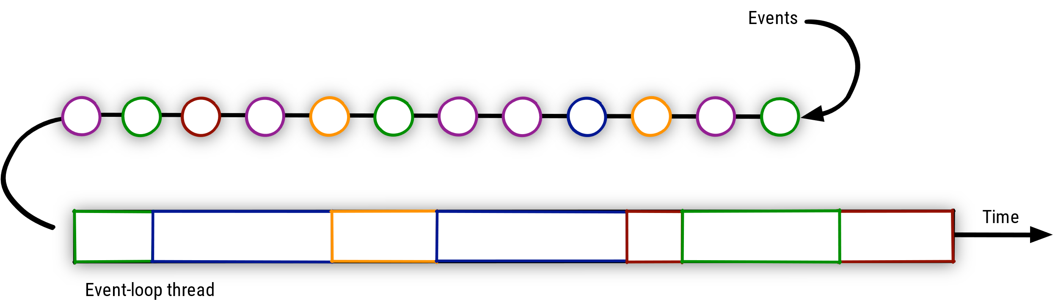

Slide 47
Events and Callbacks
Callbacks are functions/api registered to handle event notification.
Callbacks are registered in the task queues.
As soon as event arrived , Event loop thread assign handler to deliver results to caller.

Slide 48

Thank you
Subramanian Murugan

