Slide 1
MPP : Library Project
Prof. Micheal Yang
Team Member:
Chanproseth Kan (615168)
Kuylim Tith (615204)
Seavpheng Lao (615223)

Slide 2
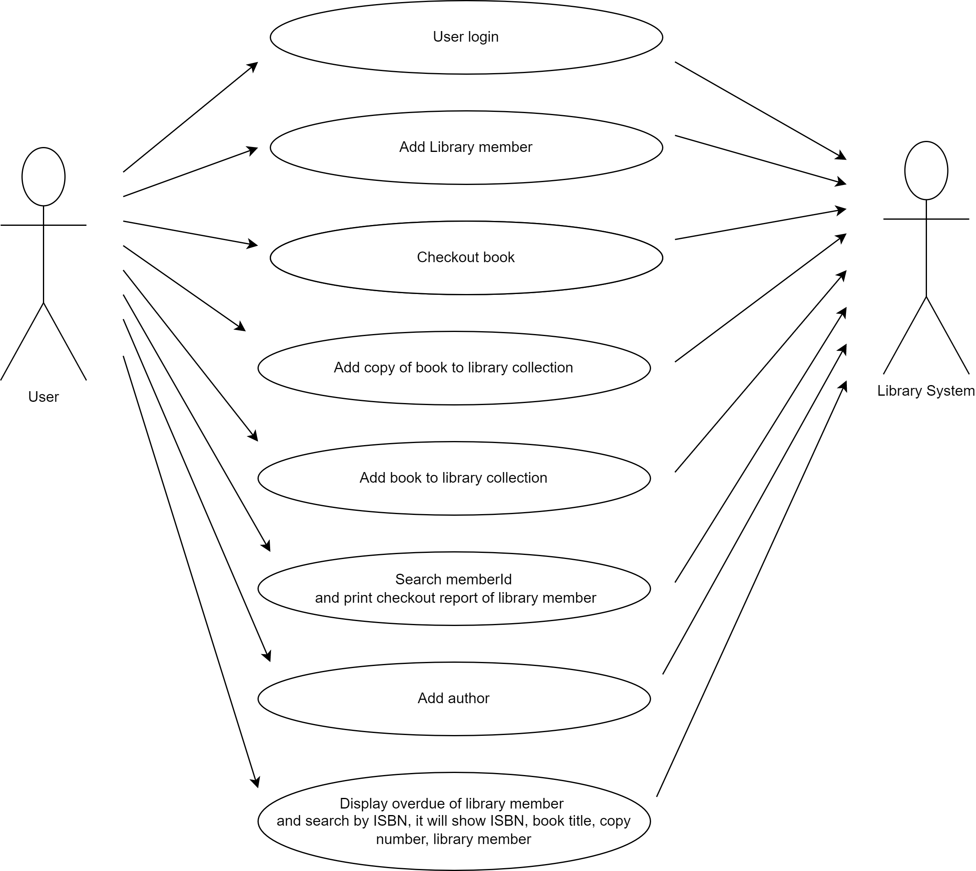
7 USE CASES
User Login
Add library member
Determine copy “overdue”
Checkout record of library member
Checkout book for library member
Add copy to library collection
Add book to library collection
Add author to book

Slide 3
Team Responsible
Member | Option | Option (Optional)
Chanproseth Kan | Add Copy to Collection | Add Book
Kuylim Tith | Add Library Member | Check Overdue Checkout
Seavpheng Lao | Checkout Book | View Checkout Record
Together | Login, Add Author

Slide 4
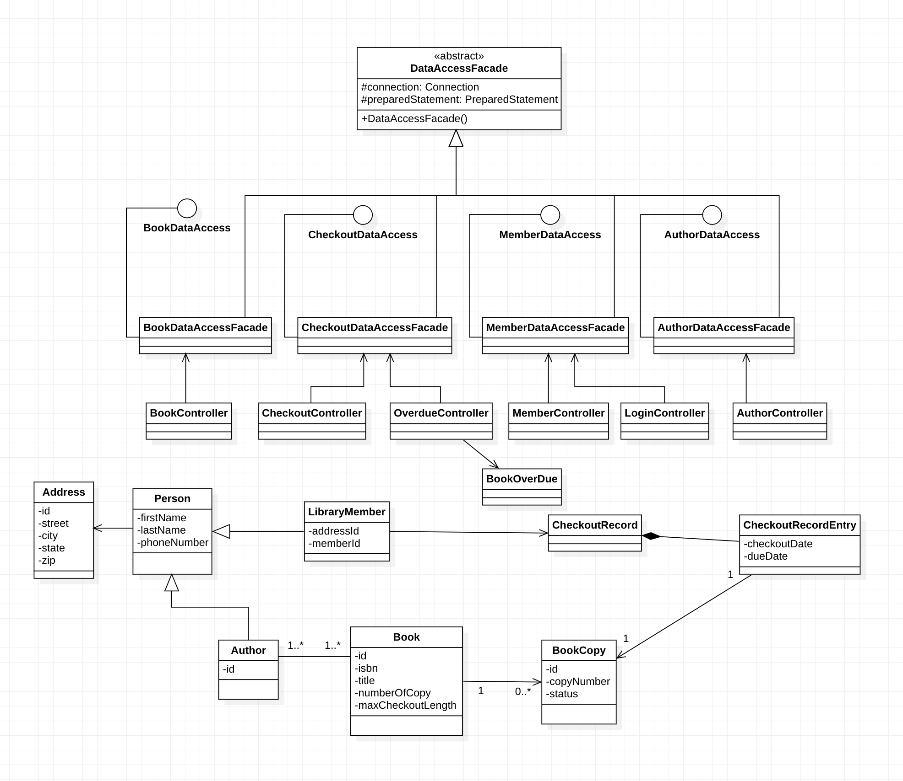
Class Diagram

Slide 5
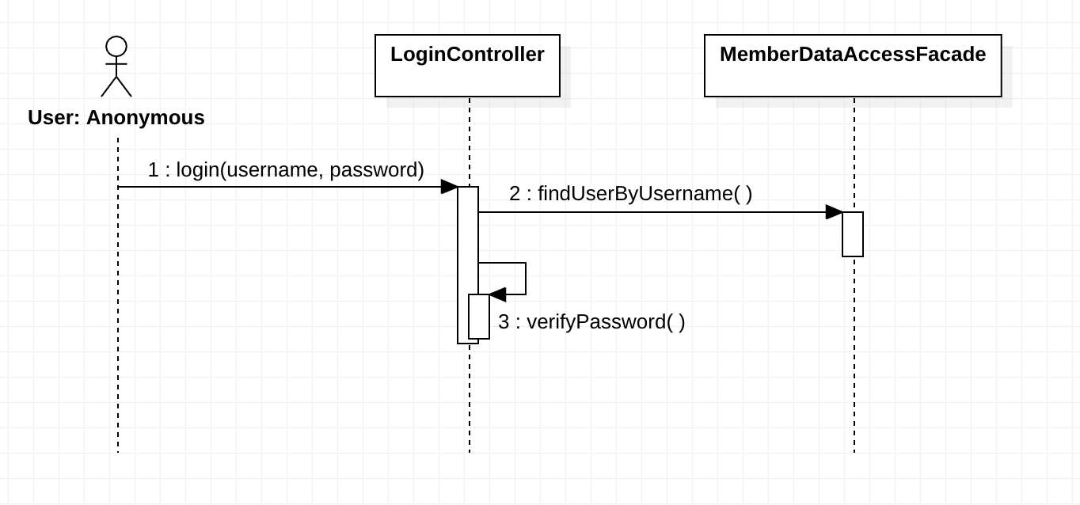
1. Squence Diagram: Login

Slide 6
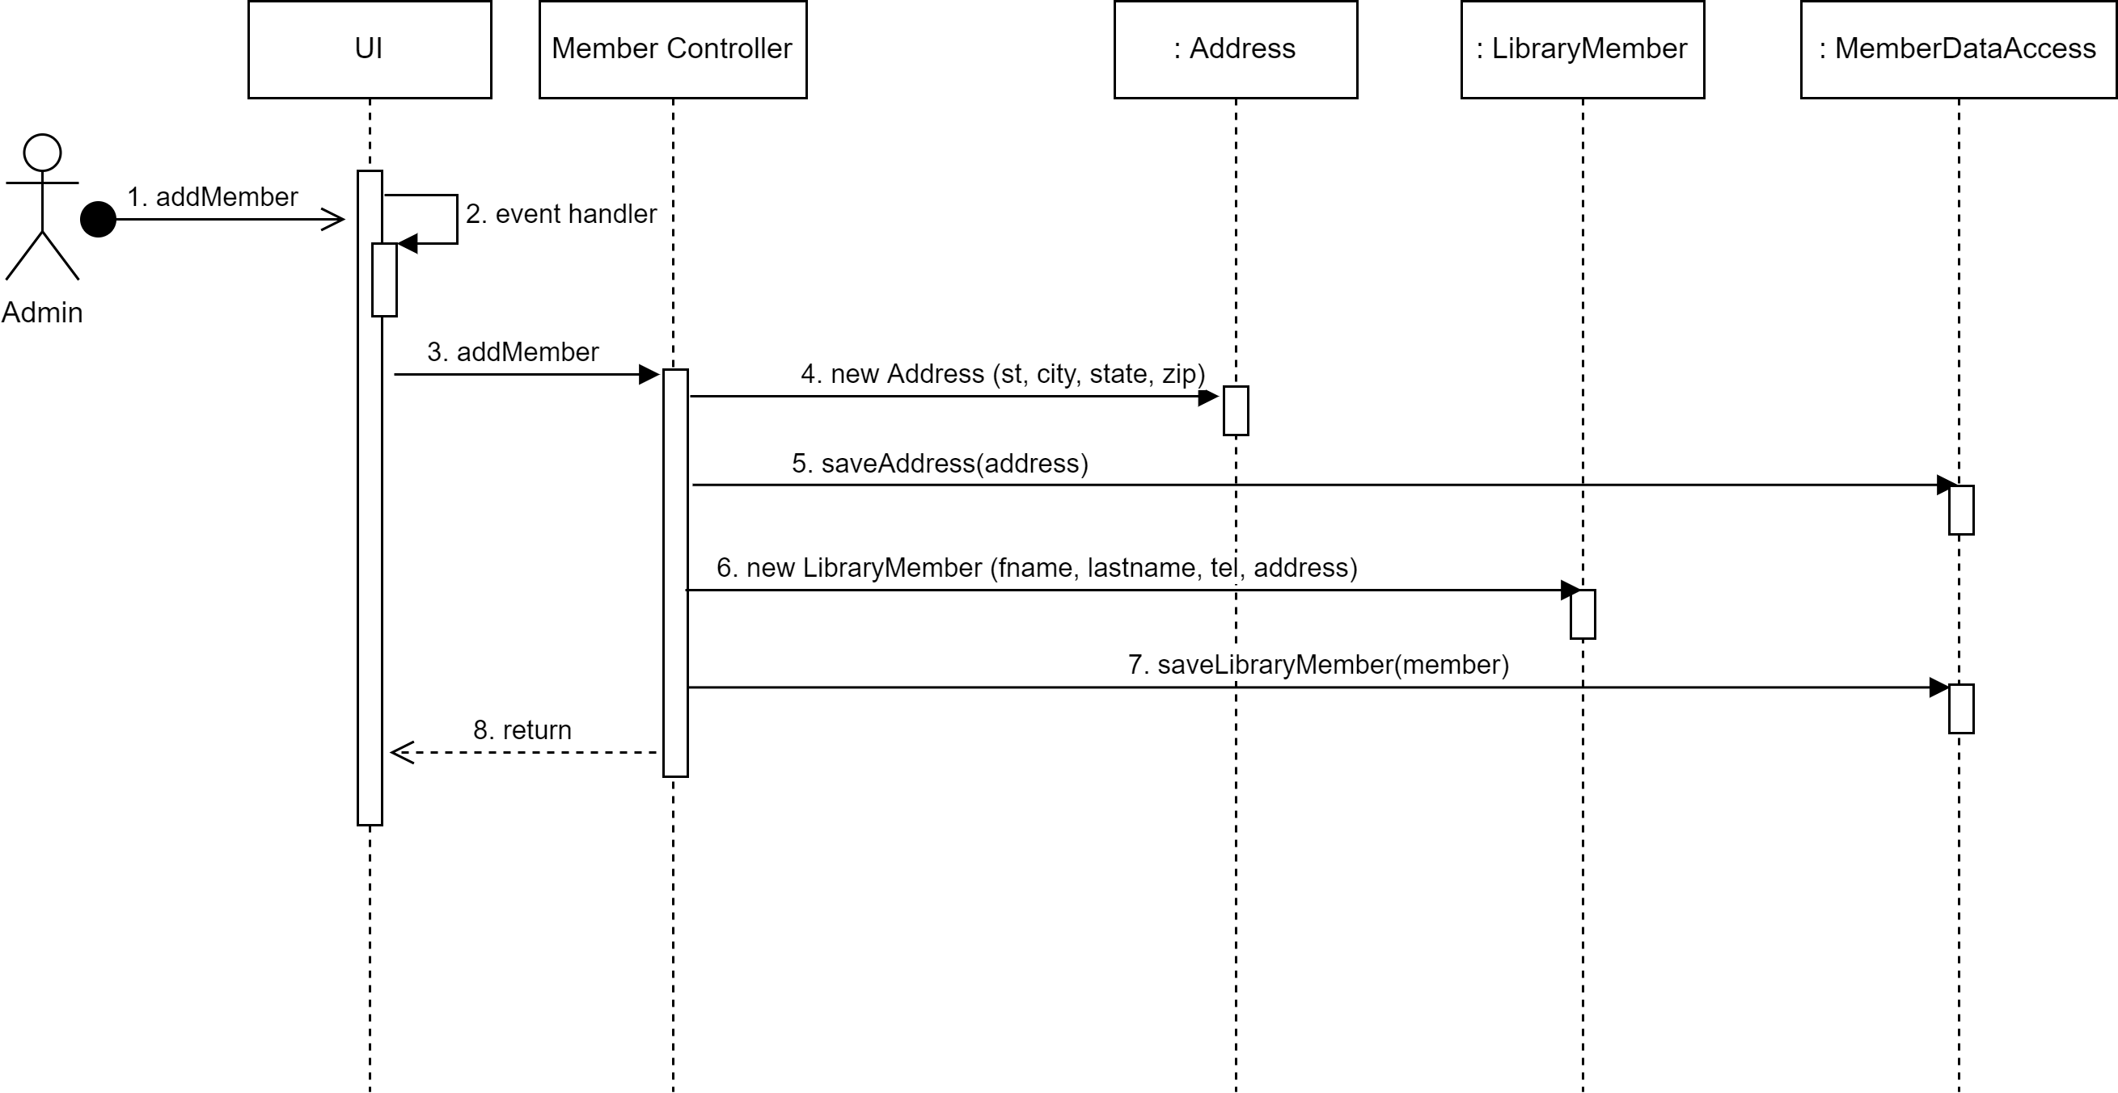
2. SD: Add Library member

Slide 7
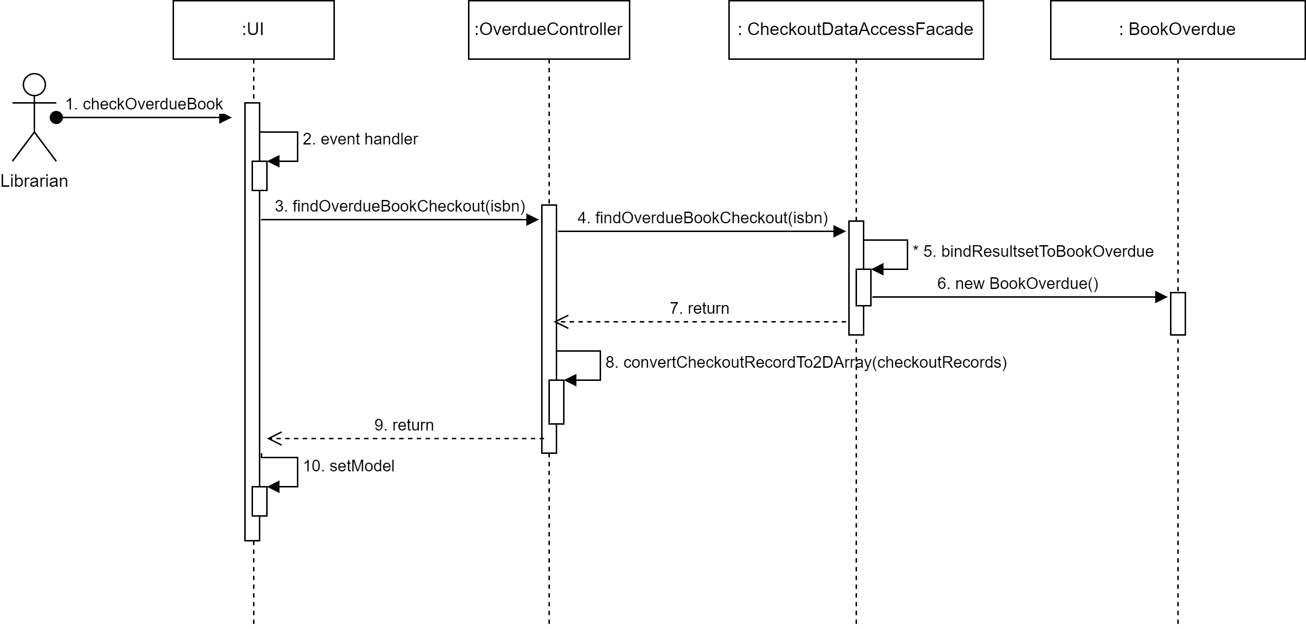
2.1 SD: Determine copy “overdue”

Slide 8
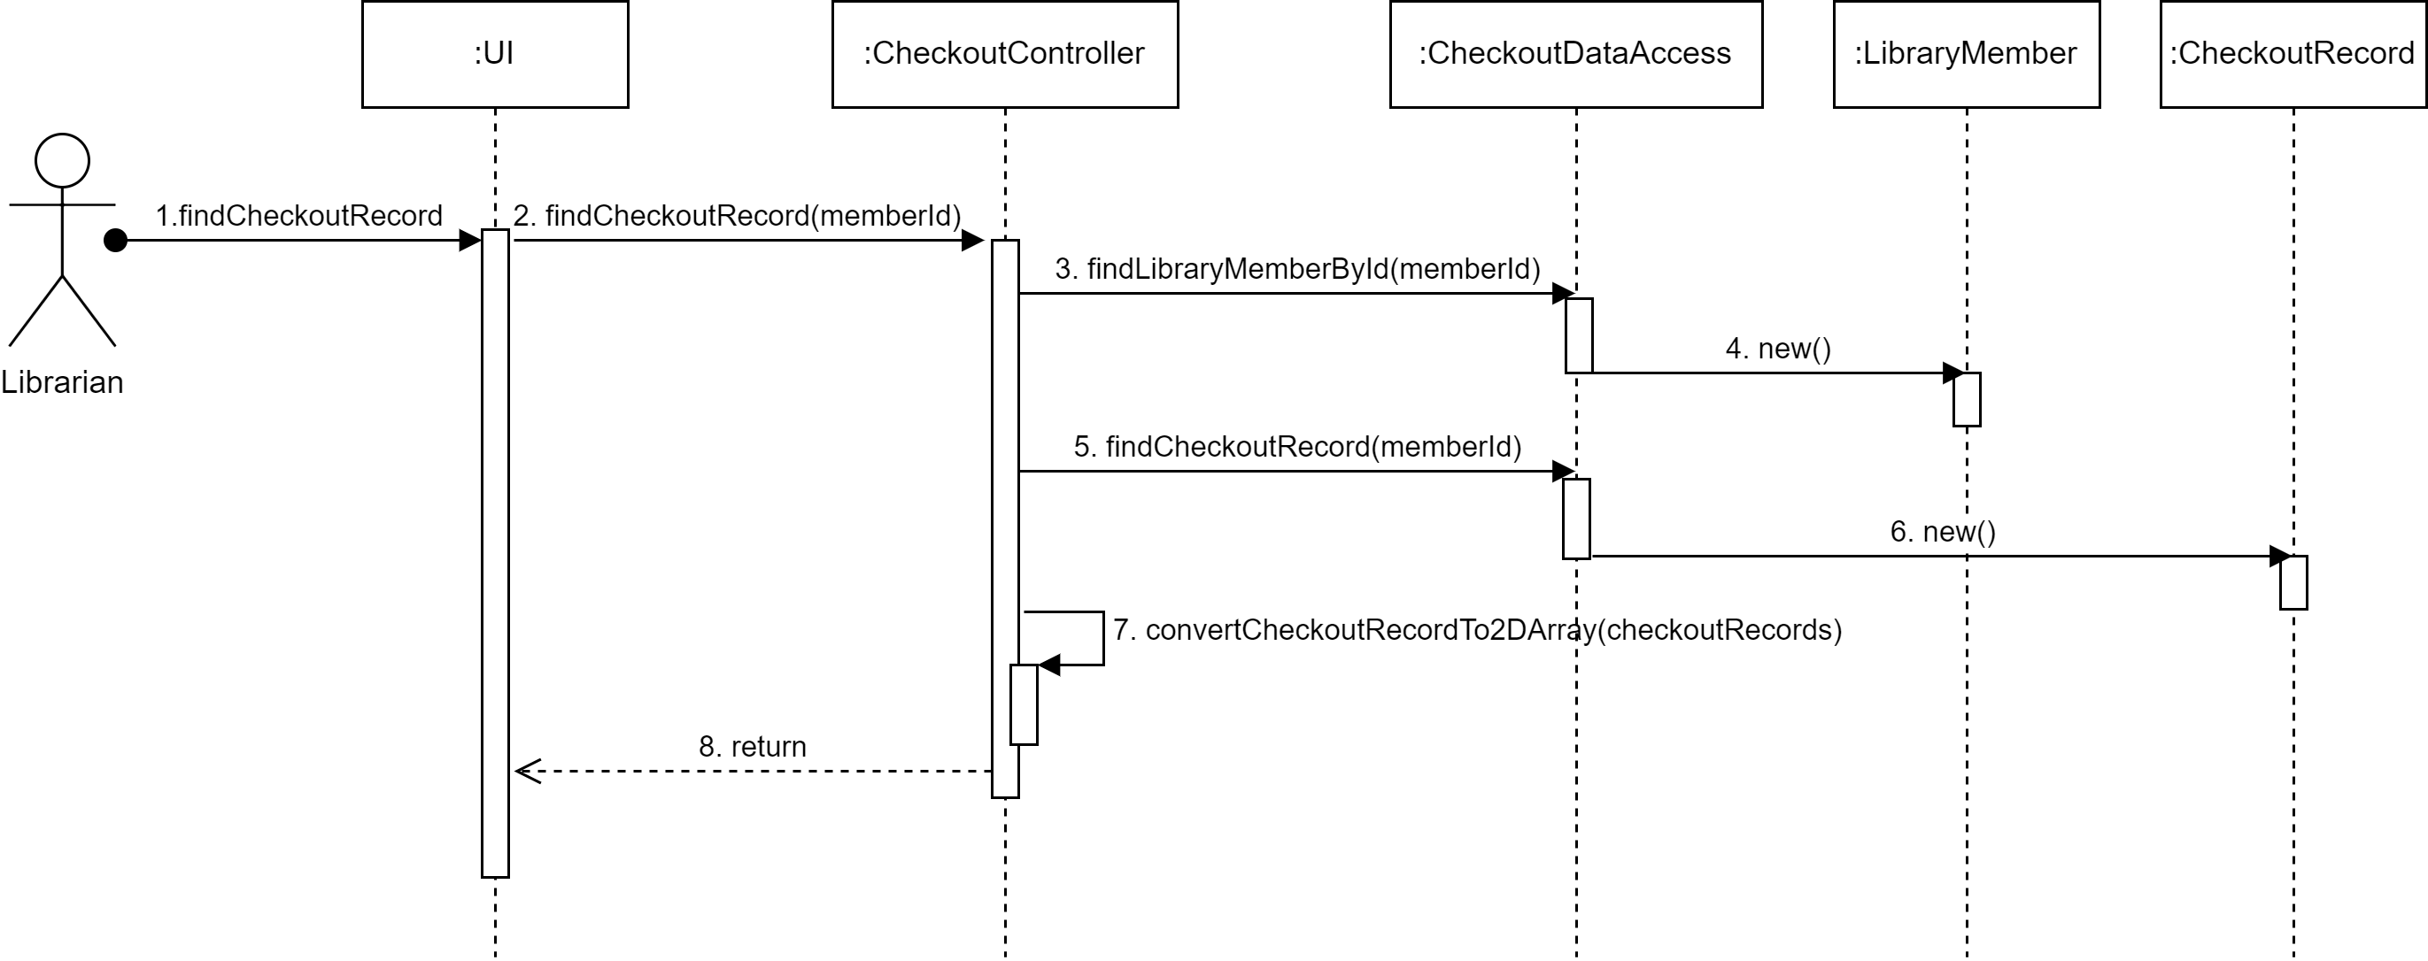
3 SD: Checkout Record of a Library Member

Slide 9
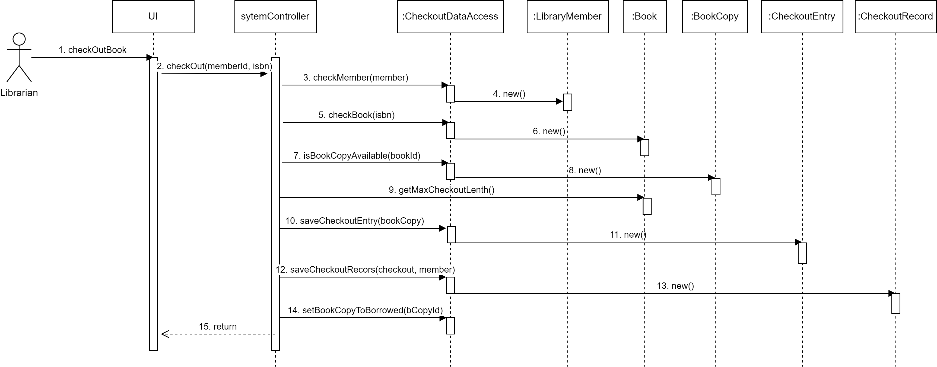
3.1 SD: Checkout book for Library Member

Slide 10
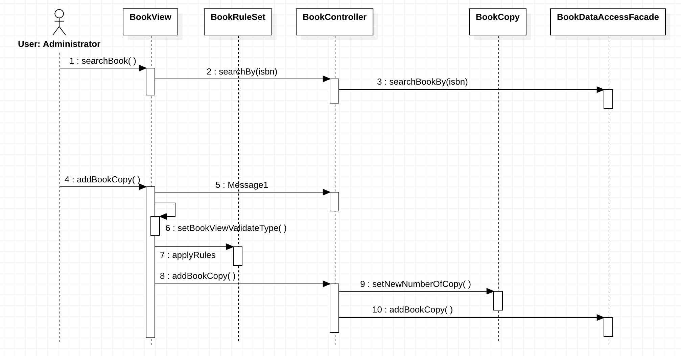
4 SD: Add copy to Library Collection

Slide 11
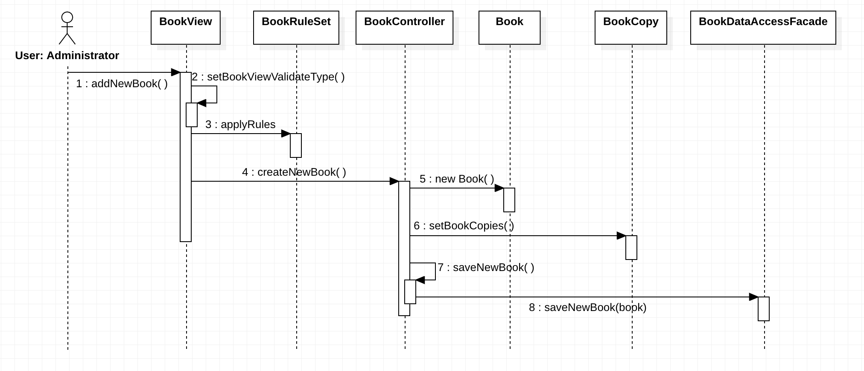
4.1 SD: Add book to Library Collection

Slide 12
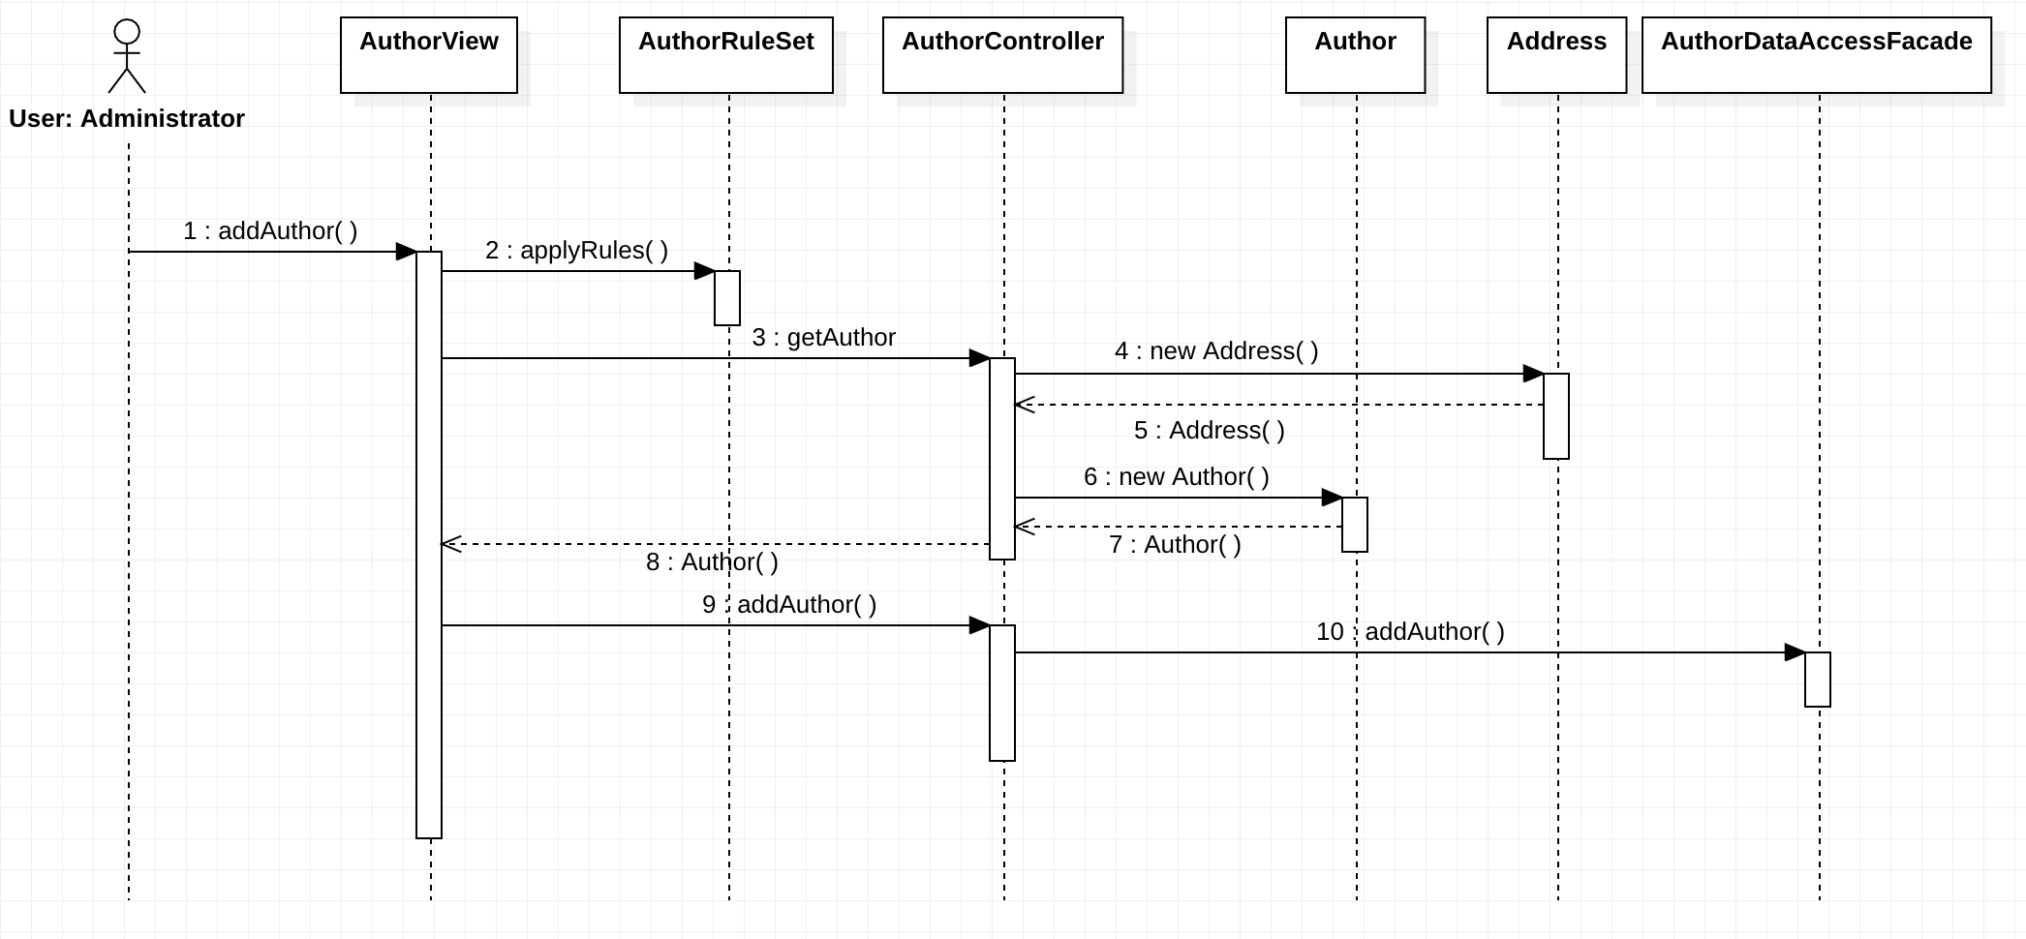
4.2 SD: Add Author to Book

Slide 13
Demo System

Slide 14
Thank You!!!

