Slide 1
DEMO

Slide 2
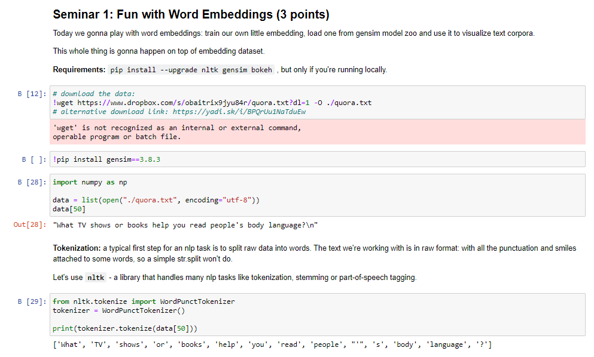


Slide 3
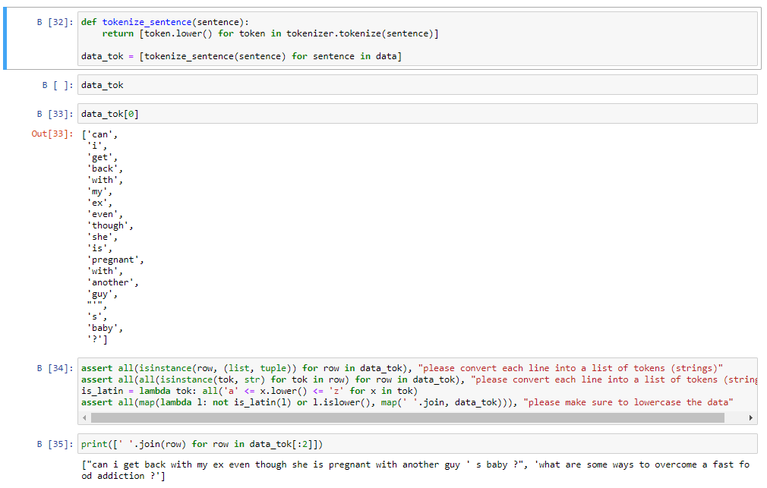
should be a list of lists of tokens for each line in data.

Slide 4
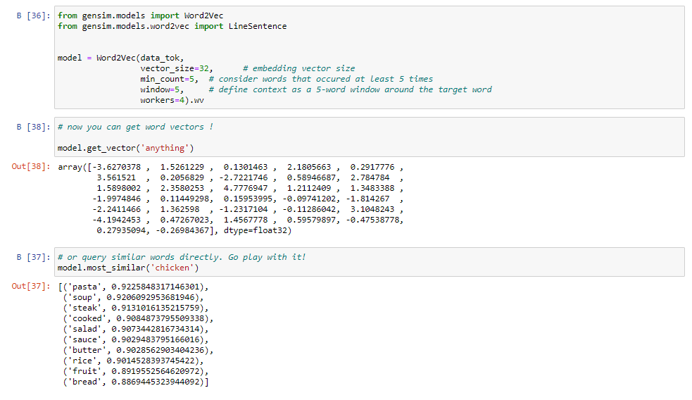

Slide 5
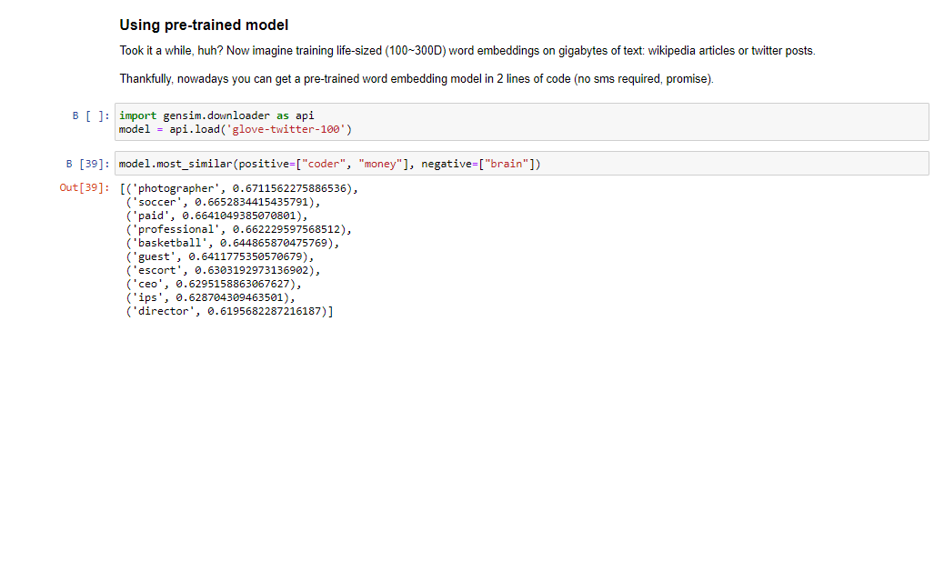
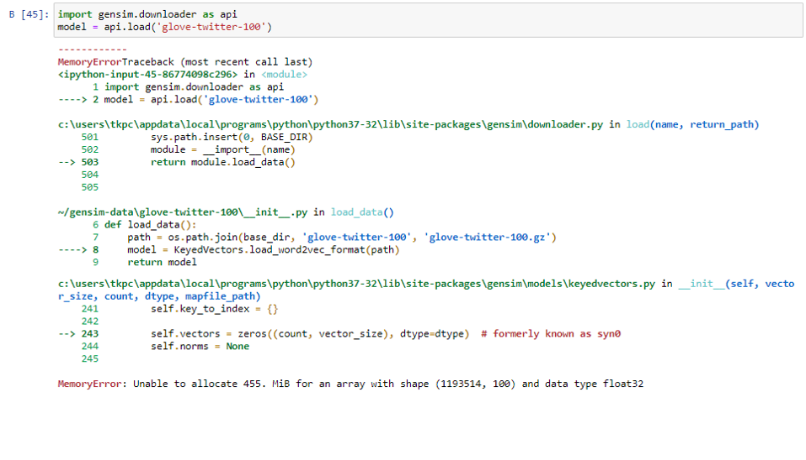

Slide 6
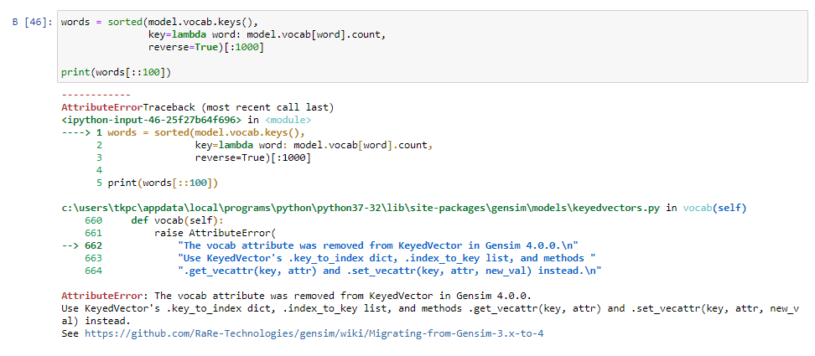



Slide 7

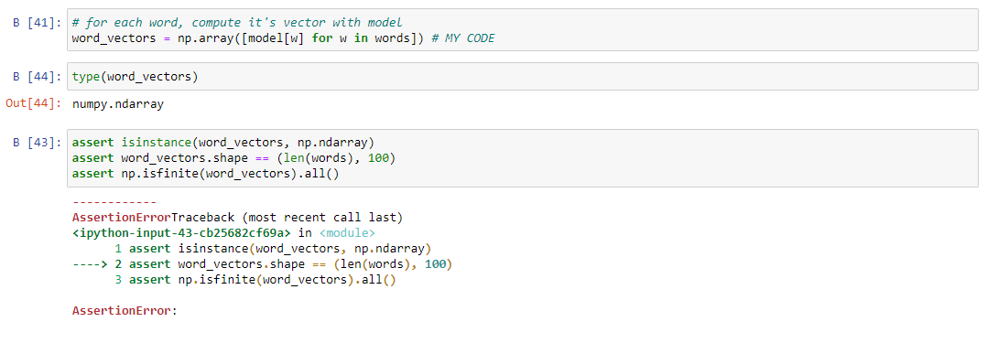

Slide 8
TryING WITH OWN DATA!

Slide 9
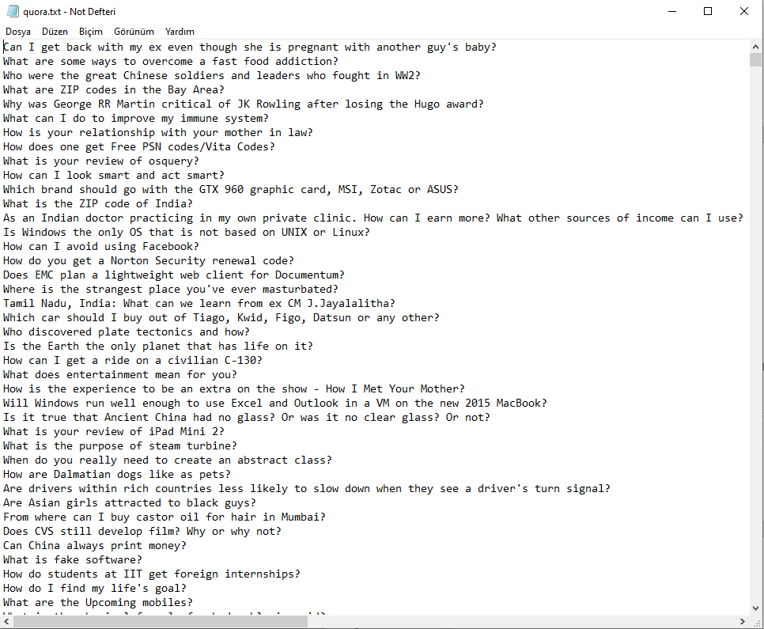
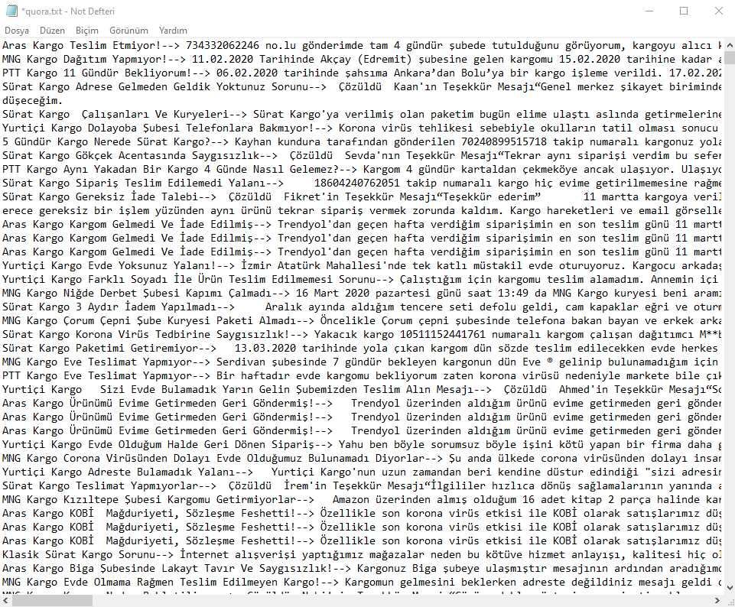
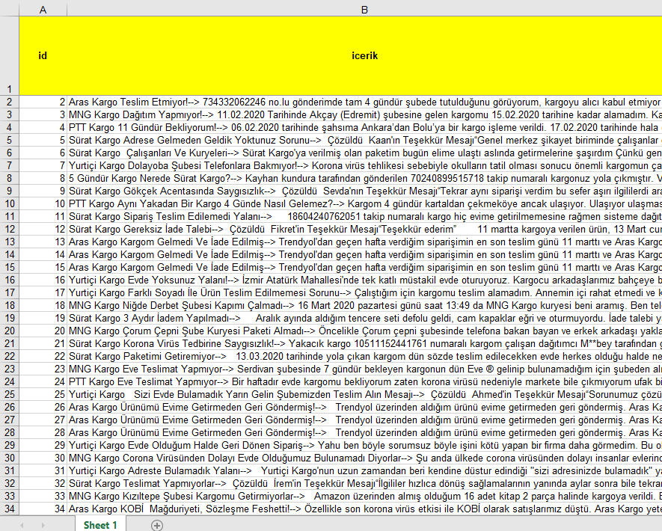

Slide 10
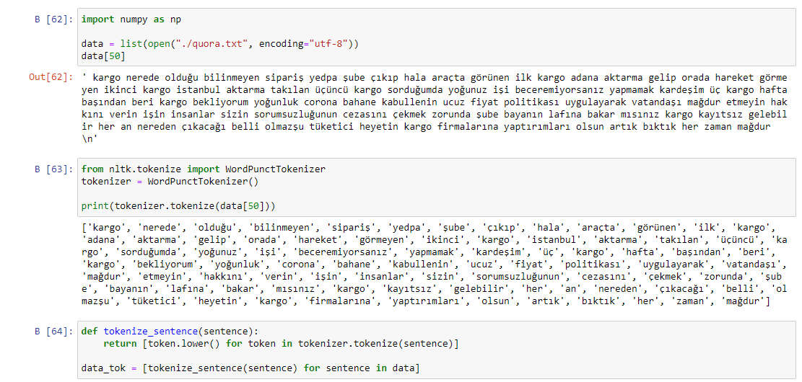

Slide 11
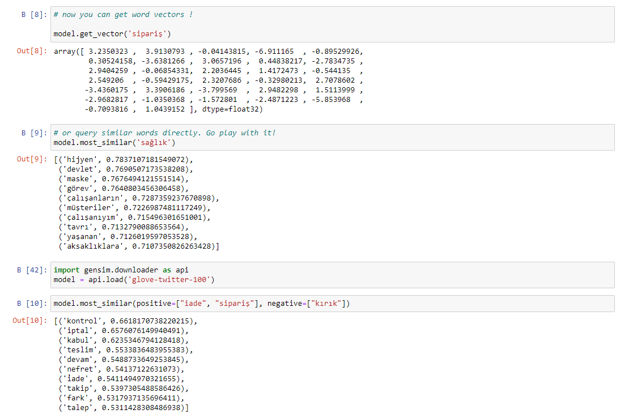
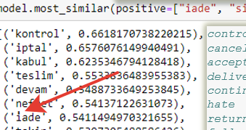
«sipariş» is meaning «order»
«sağlık» is meaning «health»
hygiene
state
mask
duty
employees
customers
attitude
experienced
glitch
positive "return", "order" negative "broken"
control
cancel
acceptance
delivery
continue
hate
return
follow-up
difference
request

Slide 12
Let’s do some NLP

Slide 14
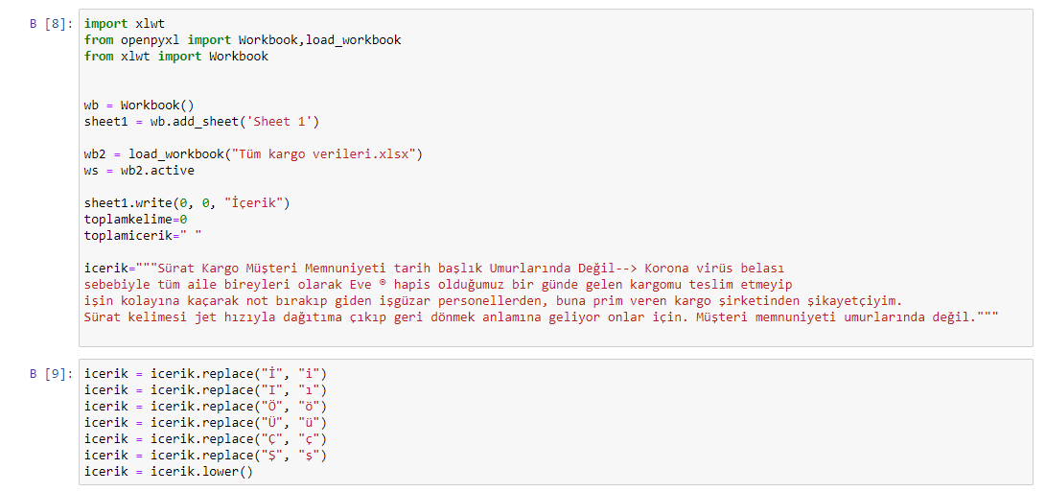

Slide 15
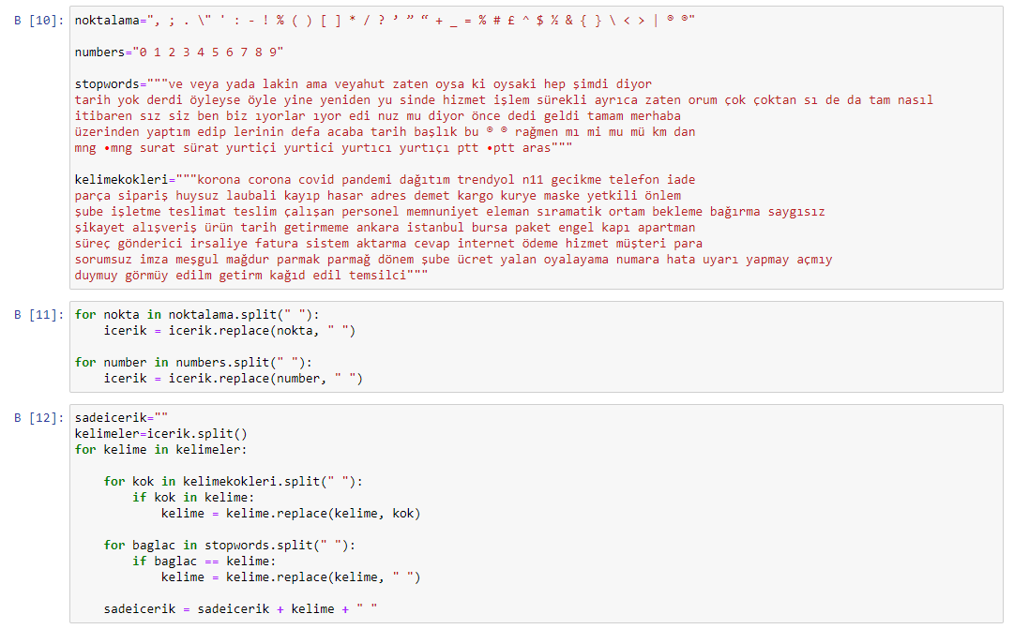

Slide 16
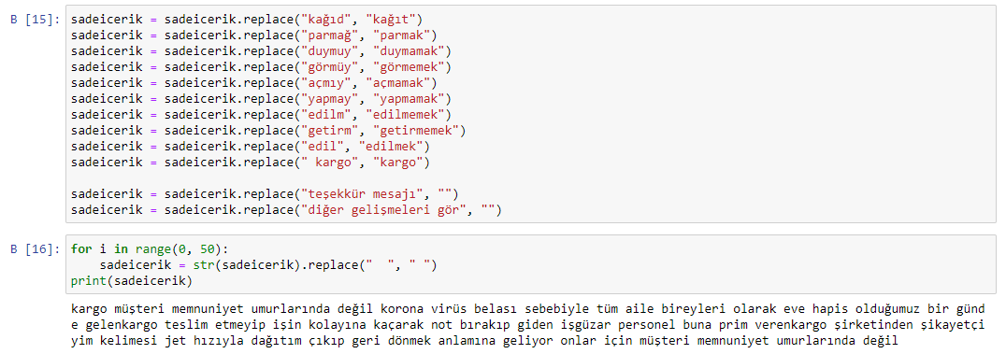

Slide 17
To BE SOON…
Tolga KUYUCUK

