Slide 1
Minimalist Pitch Deck
Here is where your presentation begins
DD/MM/YYYY
Feature Name/Product
Your Company Name

Slide 2
Table of contents
1.
4.
2.
5.
3.
6.
Overview and introduction
Demo to explain product value
Understanding the problem and solution
Our team and timeline overview
Identifying the market opportunity
Key financials and performance metrics
DD/MM/YYYY
Feature Name/Product
Your Company Name

Slide 3

What is a pitch deck?
A pitch deck is a short presentation that entrepreneurs use to describe their business and present it to potential investors. It usually consists of about 10 slides with:
An overview of the company's mission and the product or service offered
Market opportunity
Team, financials, etc.
The goal is to garner enough interest from investors so that they are motivated to invest in the business
DD/MM/YYYY
Feature Name/Product
Your Company Name

Slide 4
1
Overview and introduction
You can enter a subtitle here if you need it
DD/MM/YYYY
Feature Name/Product
Your Company Name

Slide 5
Let’s have a look
Mercury is the closest planet to the Sun and the smallest one in the entire Solar System. This planet’s name has nothing to do with the liquid metal, since Mercury was named after the Roman messenger god. Despite being closer to the Sun than Venus, its temperatures aren't as terribly hot as that planet’s. Its surface is quite similar to that of Earth’s Moon, which means there are a lot of craters and plains. Speaking of craters, many of them were named after artists or authors who made significant contributions to their respective fields. Mercury takes a little more than 58 days to complete its rotation, so try to imagine how long days must be there!
DD/MM/YYYY
Feature Name/Product
Your Company Name

Slide 6

Introduction
An overview of our company and its mission
The introduction of your company in the pitch deck should include a brief overview of who you are and what you do. It should also include a brief description of why your product or service is unique and the value it provides to customers
Understanding the core of our idea
The “our idea” part of a pitch deck should include an explanation of your product/service, how it works, and what the customer value is. You should also explain the market opportunity for your product/service
DD/MM/YYYY
Feature Name/Product
Your Company Name

Slide 7
Main ideas of a pitch deck
1.
2.
3.
Presentation outlining our vision
The value we bring to our investors
Understanding the value of our solution
A great presentation for a pitch deck should be concise, clear and easy to understand. Visual elements such as charts, graphs, images, and videos can help to make the presentation engaging
When it comes to picking investors for a pitch deck, it's important to research potential investors and understand their preferences, goals and interests
The value of a product is determined by how much customers are willing to pay for it. It's a combination of factors, including the quality of the product, its features, and how well it meets our customer needs
DD/MM/YYYY
Feature Name/Product
Your Company Name

Slide 8
Key ideas in market opportunity
How we approach research into new markets
How we bring innovative solutions to life
Analyze existing customer needs and identify gaps in the market to find new opportunities
Utilize technology and customer feedback to come up with novel solutions that meet your customer’s demands or needs
Anticipating and staying ahead of key trends
Adapting to seasonal spikes with smart solutions
Monitor changes in the marketplace, such as shifts in consumer behavior or emerging technologies, to stay competitive and capitalize on new opportunities and trends
Identify times of year when demand for certain products may spike, such as holidays or special occasions, and use these times to target customers or maximize sales
DD/MM/YYYY
Feature Name/Product
Your Company Name

Slide 9
4,498,300,000
9h 55m 23s
386,000 km
Number of users analyzed in our market research
Estimated delivery time per unit
Avg. distance travelled by logistics team
DD/MM/YYYY
Feature Name/Product
Your Company Name

Slide 10
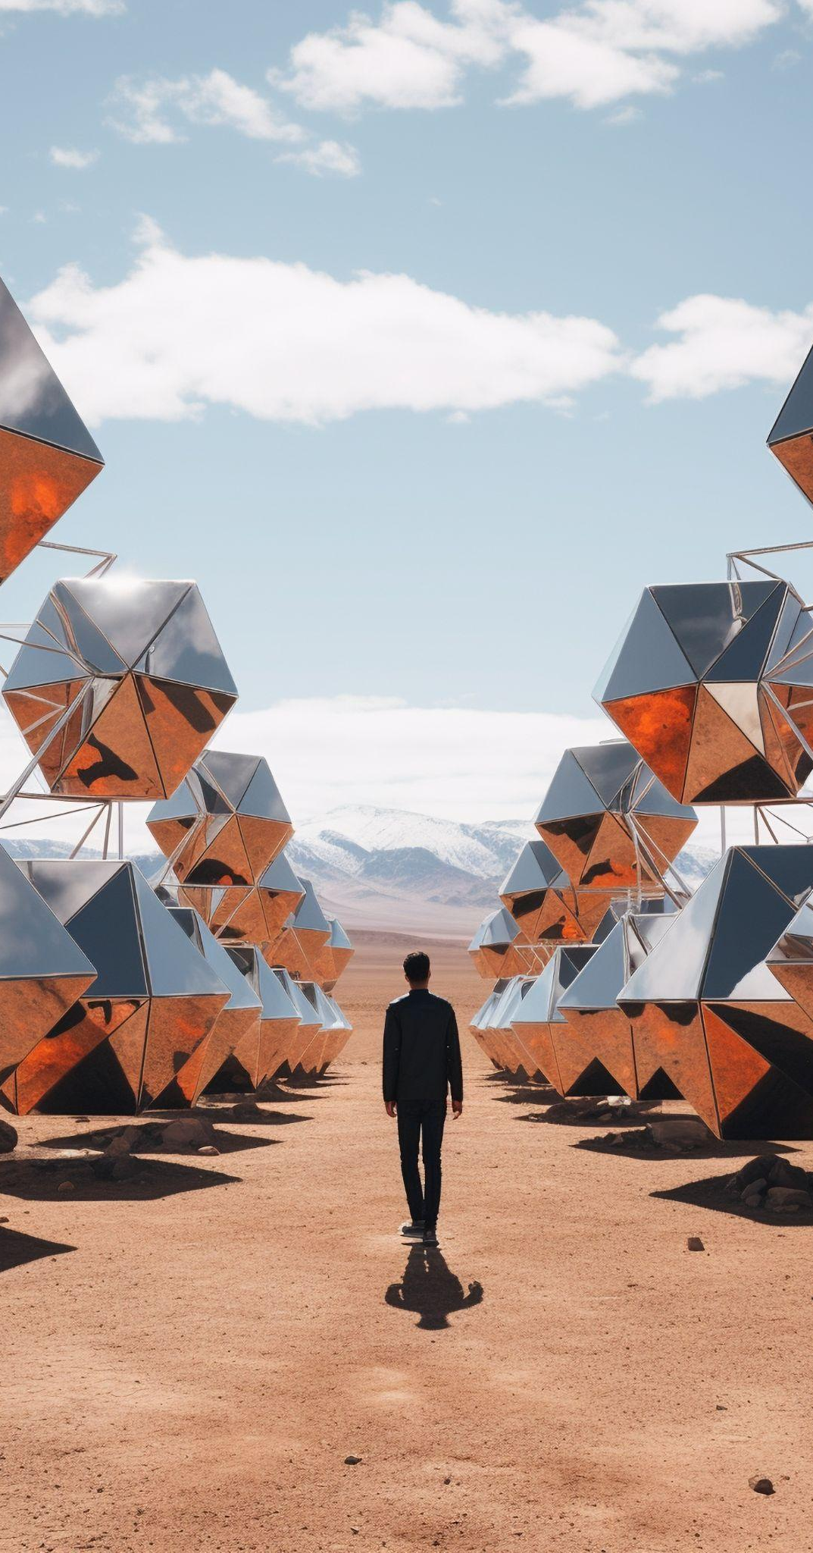
Product infographic
Effective visuals capture attention
Our product has unique features
Showcase the design of your product
What makes your product unique?
Our price is competitive
We prioritize the needs of our users
Share the cost and price with investors
Speak about the target audience
Our product is widely available
Regular updates keep things fresh
When is the product expected to be ready?
Do you plan on regularly updating your product?
DD/MM/YYYY
Feature Name/Product
Your Company Name

Slide 11
Organizational chart
Jane Doe
CEO
John Smith
Department Head
Maya Willson
Department Head
Emma Miller
Manager
Richard Taylor
Manager
Sarah Williams
Manager
Steven Ander
Manager
Brian Clark
Employee
Michelle García
Employee
James Scott
Employee
William Young
Employee
Alan Turner
Employee
DD/MM/YYYY
Feature Name/Product
Your Company Name

Slide 12
Roadmap infographic
Initiative | Objective | Jan | Feb | Mar | Apr | May | Jun | Jul | Aug | Sep | Oct | Nov | Dec
Understanding | Analyze and understand the needs of your target audience
Conduct research | Research existing products in the industry and analyze how successful they are
Brainstorm ideas | Generate ideas based on user feedback and research findings
Develop a prototype | Create a basic version of the product to show investors
Test for usability | Put the prototype through rigorous testing processes to ensure that it meets user requirements
Analyze feedback | Understand the opinion of the users who tried your product
DD/MM/YYYY
Feature Name/Product
Your Company Name

Slide 13
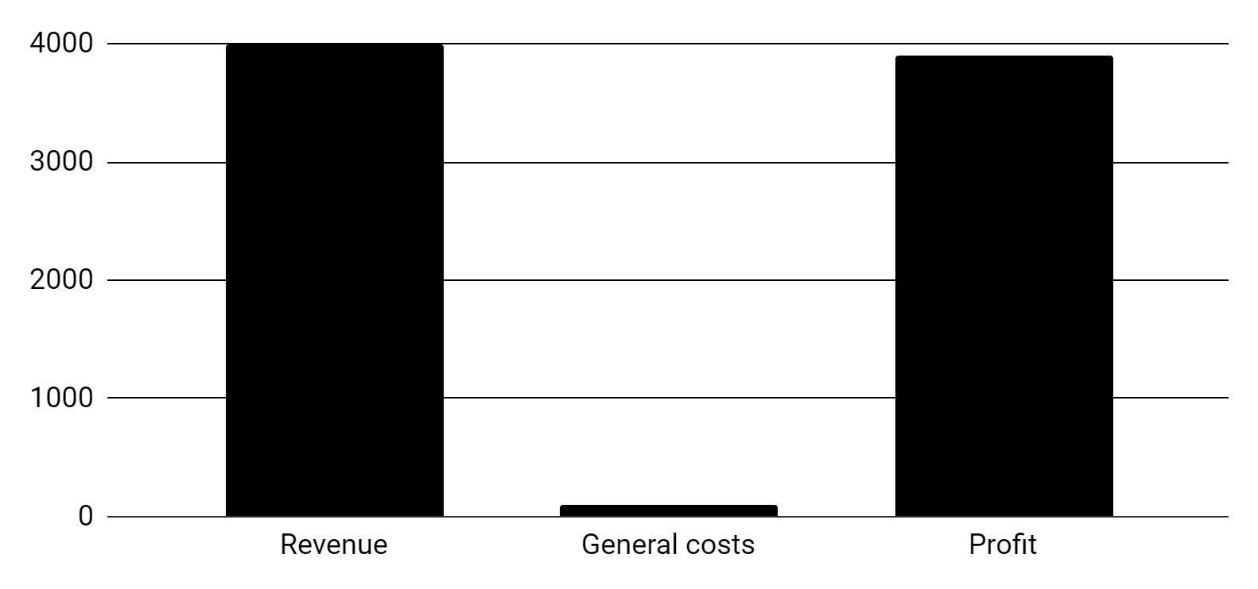
KPI dashboard
Product | Units | Revenue | Returns
Item 1 | 500 | 2,000,000 | 40
Item 2 | 1,000 | 50,750 | 10
Item 3 | 250 | 1,500,000 | 300
Item 4 | 500 | 2,000,000 | 40
Item 5 | 1,000 | 50,750 | 10
Item 6 | 250 | 1,500,000 | 300
$4,000,000
$100,000
$3,900,000
Revenue
General costs
Profit
Follow the link in the graph to modify its data and then paste the new one here. For more info, click here
DD/MM/YYYY
Feature Name/Product
Your Company Name

Slide 14
Thanks!
Any questions?

