Slide 1
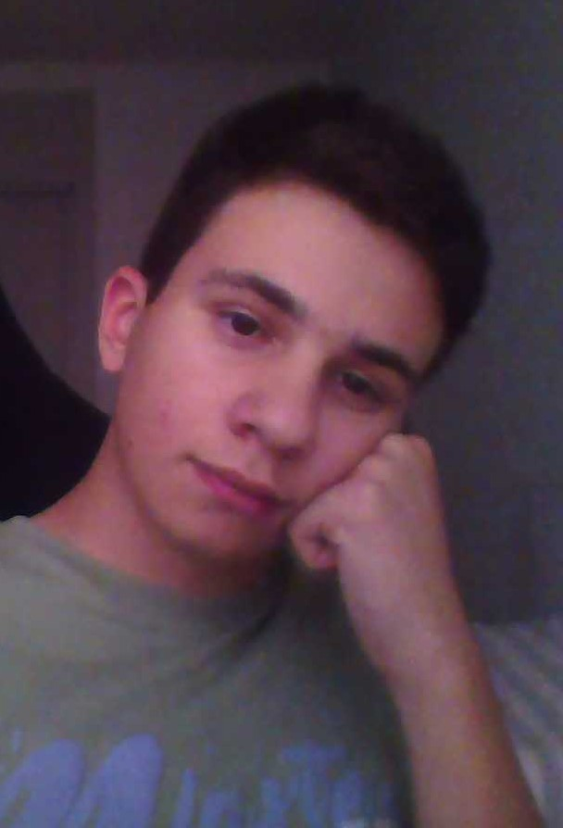
About Me
Kuzey Tuna Kale

Slide 2
Important dates in my life
Birth
Day
Primary
School
Middle
School
High
School
January 6, 2012
2018 - 2022
2023 - 2026
2026 - ?

Slide 3
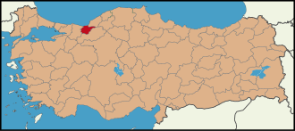
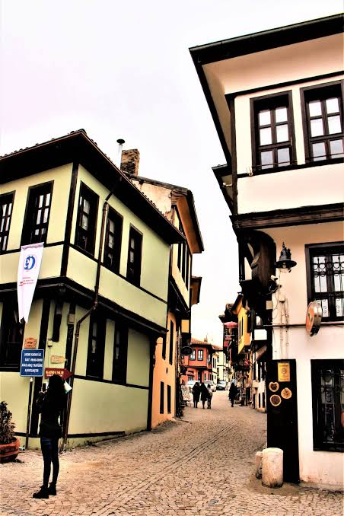
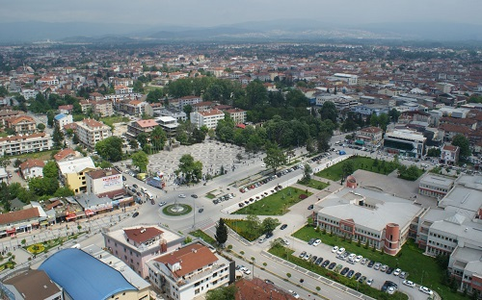
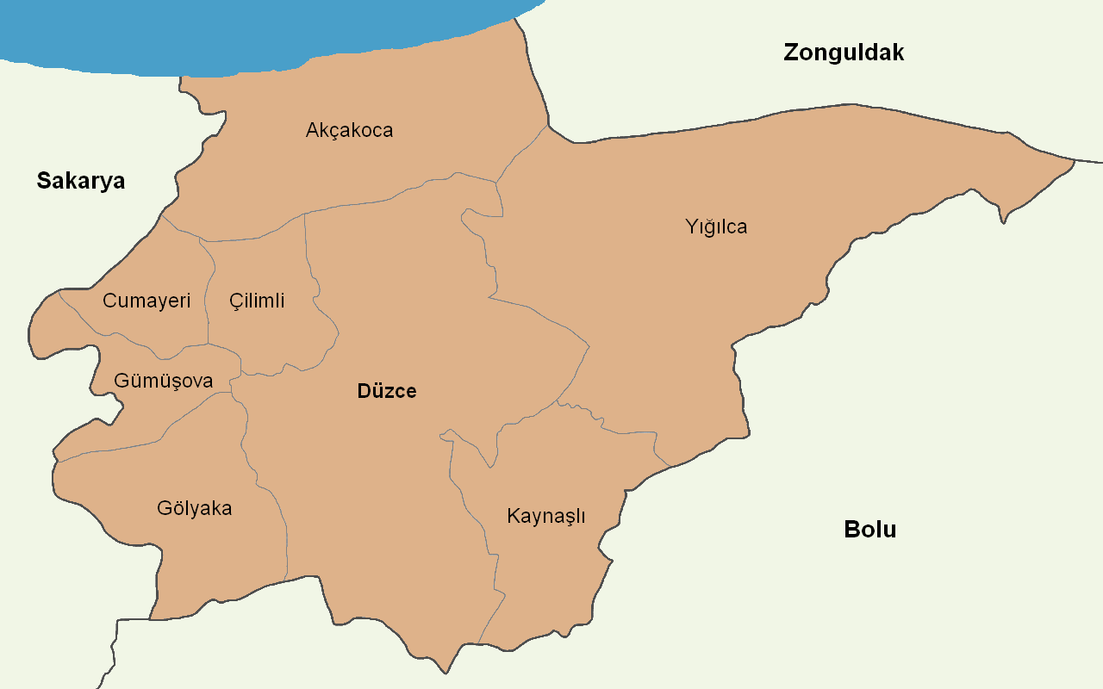
Cities
Eskişehir
Düzce

Slide 4
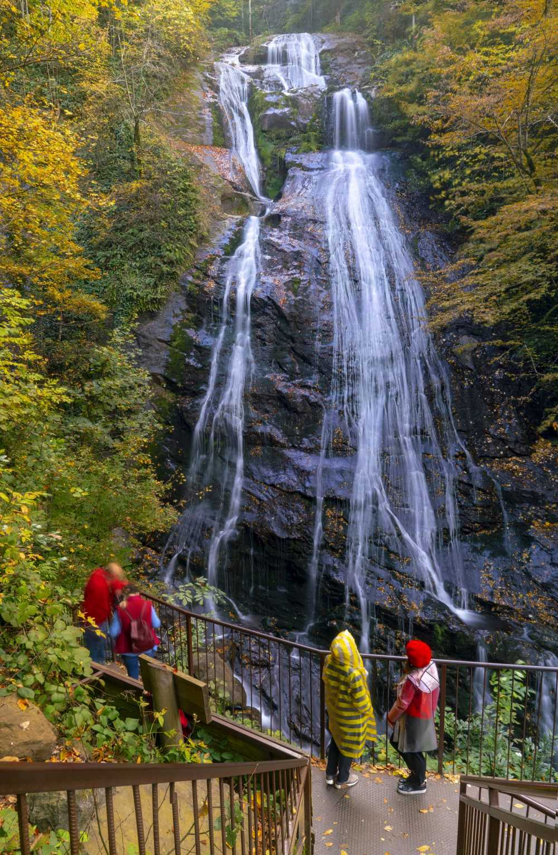
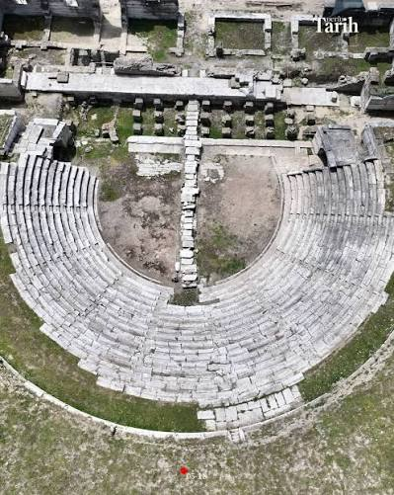
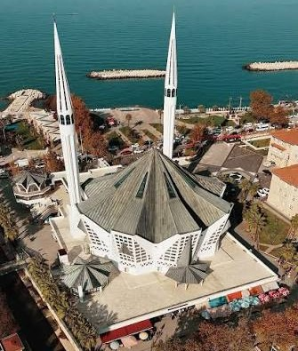
Düzce
Konuralp
Akçakoca
Güzeldere

Slide 5
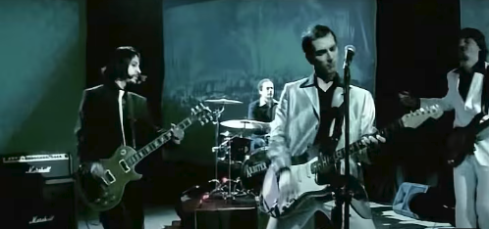
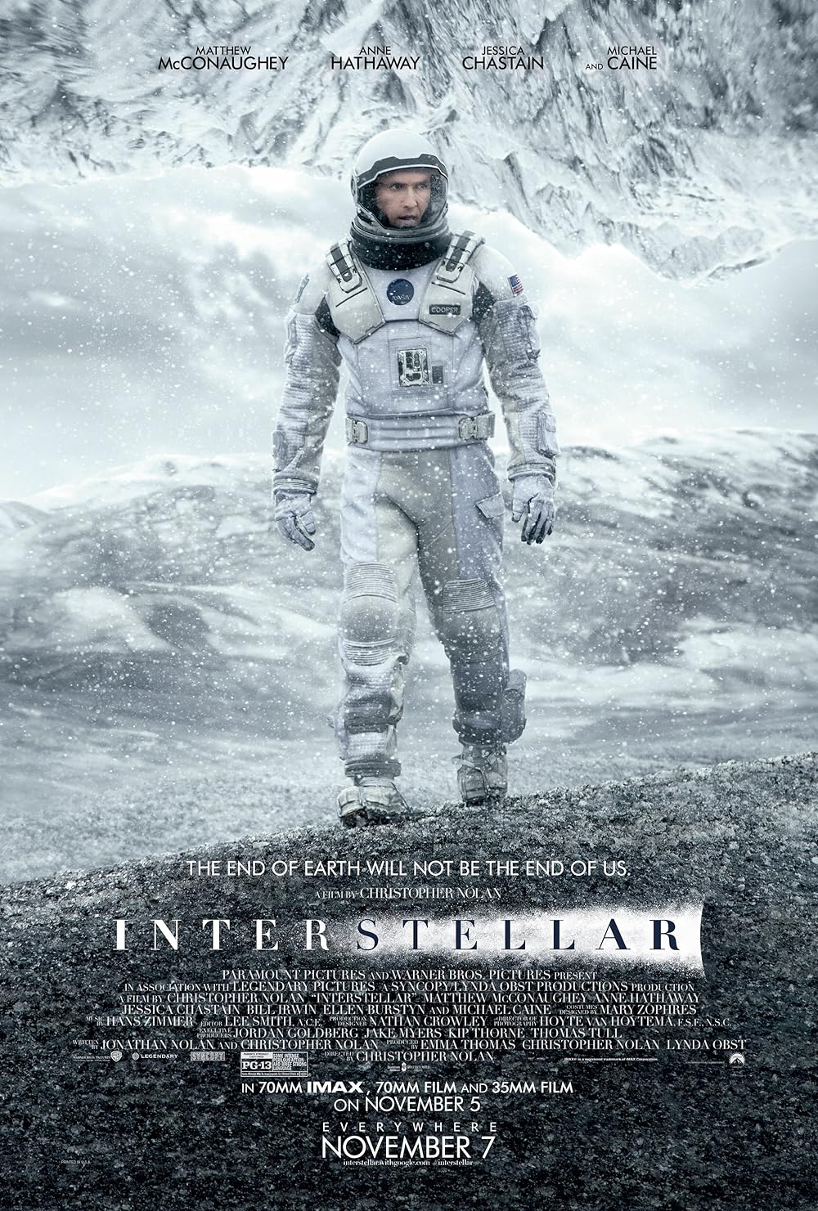
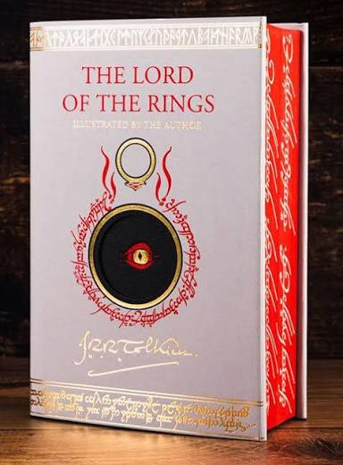

Things I like
Food
Mantı
Mantı
Song
Cambaz
Film
Interstaller
Book
Lord of the Rings
Series
Stranger Things

Slide 6
Hobbies
Reading
Nothing
Coding

Slide 7
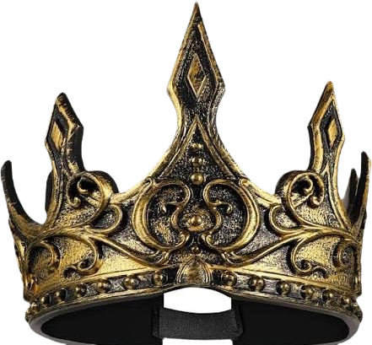
Coding
Reading
8%
90%
Nothing
2%

Slide 8
END

