Slide 1
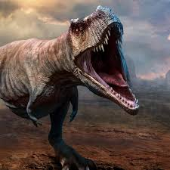
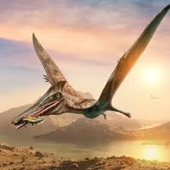

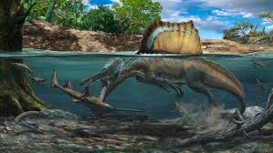
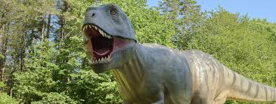
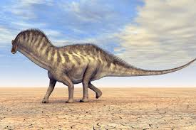
Jurassic Park
JURASSİC PARK

Slide 2
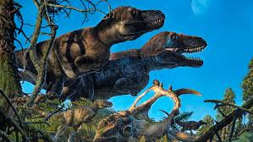
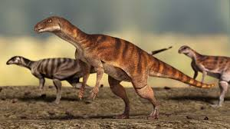
We think «Dinosaurs are interasting and enormous animals.» Then we create a park.
But there are dinosaurs in this park. I will introduce this park.

Slide 3
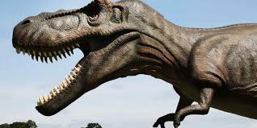
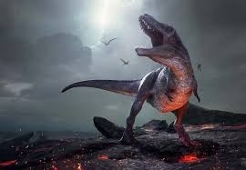
This is our Jurassic Park. You can visit there nine to seven. And you can come there monday to friday. It is free. If you come, you can see a big door.
You can come in this door. You see a road when you want to come. You see seven dinosaurs. These dinosaurs are Jurassic.

Slide 4
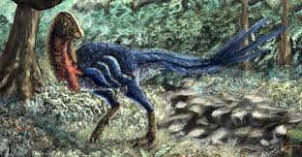
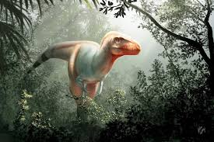
If you turn right, you see a restaurant. Its name is Jurassic Restaurant. You can walk to exit to the park. See you!
If you walk along the road, you see a big volcano. Then you can turn left there. If you do this and you walk along the road, you see a lake.

Slide 5
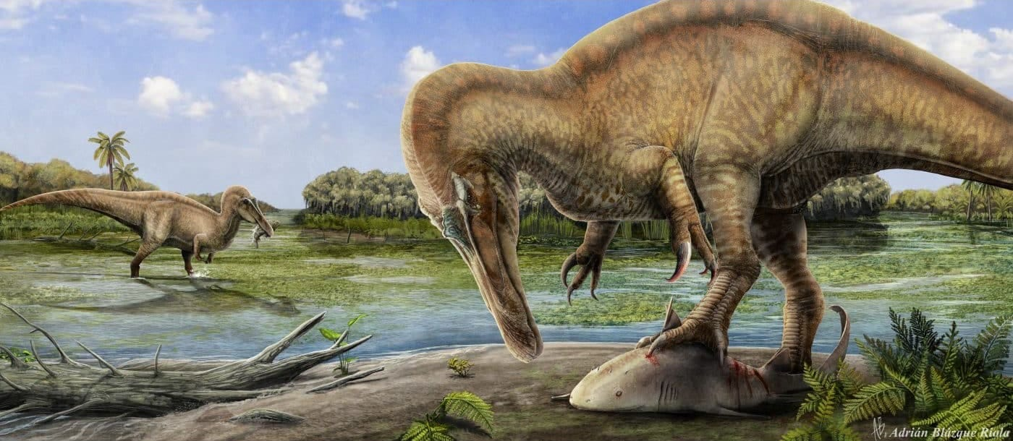
Kuzey Tuna Kale
Utku Kaan Erdoğan
M. Selçuk Sivrikaya
Mehmet Ali Dİlber
Caner Eymen Özşık

