Slide 1
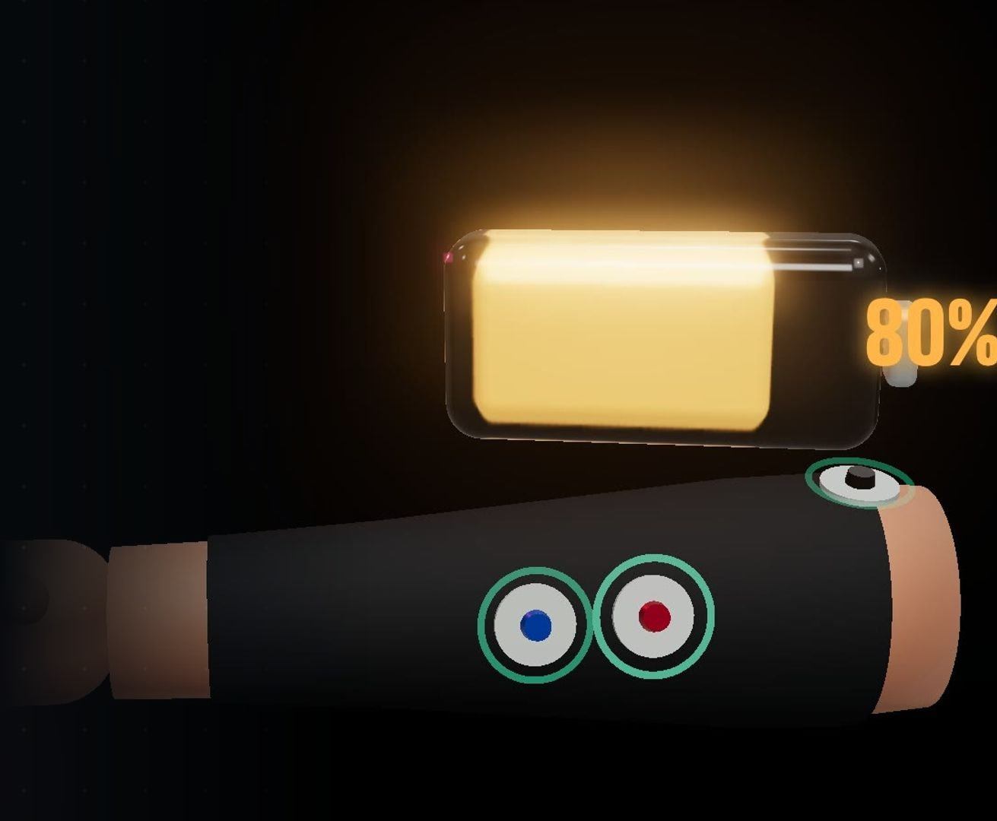
CLYF
BIGRED//HACKS 2026 · THEME: NAVIGATION
A forearm sleeve that tells climbers when to climb again.
TEAM
BUILT WITH
Jeremy Li
Arduino UNO Q · MyoWare 2.0 sEMG

Slide 2
CLIMBERS GUESS
HOW LONG TO REST.
THE PROBLEM
THE PUMP
On a hard route the forearms give out first. Grip fades, and the climb ends.
THE SHAKE-OUT
Hanging off a jug mid-route, you rest with no idea when you have actually recovered.
THE COST
Rest too little and you fall off the next move. Rest too long and you burn the session.
Maps give drivers an ETA. Climbers get guesswork.
CLYF

Slide 3
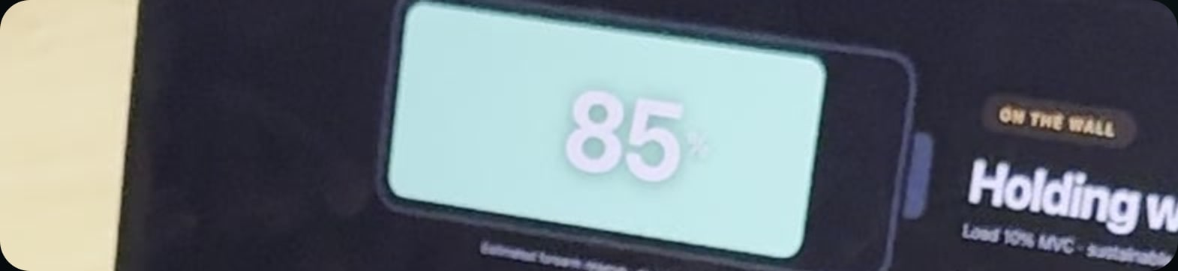
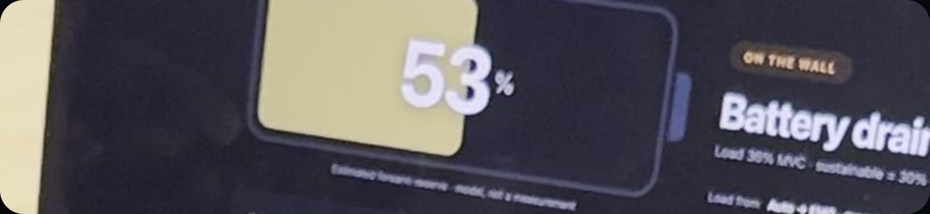
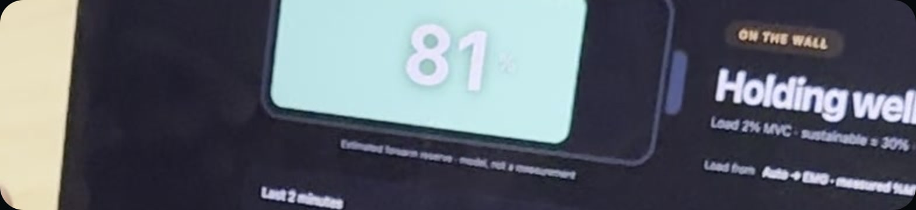
A FOREARM BATTERY
WITH AN ETA.
OUR SOLUTION
● GRIPPING
Effort above a sustainable level drains the battery.
FULL · 85
● RESTING
It recharges, with a countdown:
“Ready in 12 s”.
EMG sees a tense forearm and slows the recharge.
AFTER GRIPPING · 53
● RELAX FULLY
● READY
At 80% it glows and chimes: climb on.
AFTER RESTING · 81 · READY
CLYF · screenshots from the live dashboard during the demo

Slide 4
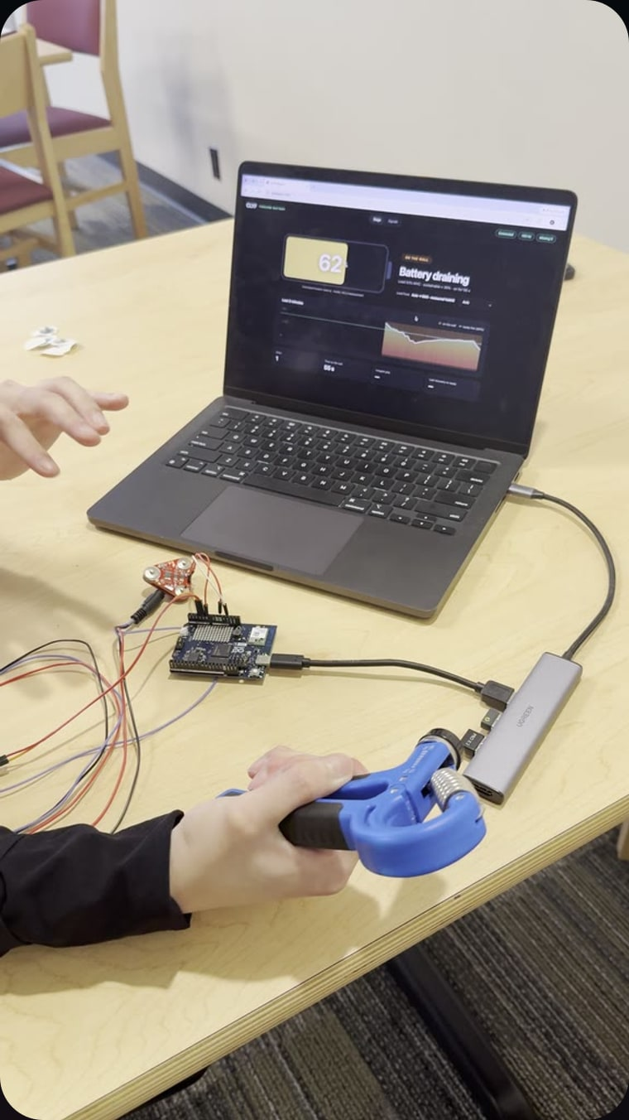
GRIP DRAINS IT. REST BRINGS IT BACK.
DEMO · ONE REAL SESSION
100%
Grip: 86 → 52 in 10 s
Rest: back to 80 in 18 s
READY
80%
60%
40%
20 s
30 s
40 s
50 s
gripping
resting
ready line, 80%
battery read off the dashboard, once per second
CLYF · full 60 s video on Devpost

Slide 5
FROM MUSCLE TO MINUTES.
HOW WE BUILT IT
01 · SENSE
THE SLEEVE
Surface EMG on the finger flexors, plus a force sensor on the hold.
MyoWare 2.0 + cable shield
FSR, 4 mm
02 · SAMPLE
ARDUINO UNO Q
The STM32 reads both channels on a fixed clock and streams every sample.
100 Hz · 12-bit ADC
0 dropped samples
03 · CLEAN
LINUX SIDE
Python on the board relays to the laptop over USB. No Wi-Fi needed.
Bridge RPC · Socket.IO
ADB port forward
04 · NAVIGATE
DASHBOARD
Auto-calibrated %MVC, bad-signal detection, and the battery model.
JavaScript · Canvas
ready at 80% · τ = 20 s
Arduino UNO Q
STM32 sketch
MyoWare 2.0
FSR 400
Python
Socket.IO
JavaScript
HTML5 Canvas
ADB
three.js (video)
CLYF

Slide 6
MEASURED, THEN MODELLED.
WHAT TO TRUST
MEASURED
Muscle effort, as % of your own max grip
Hand on the hold
How long each grip and rest lasted
How relaxed the forearm is while resting
ESTIMATED
Battery level and “ready in” countdown, from a W′-balance style model
Labelled as an estimate on screen
Demo constants, not yet fitted per climber
Spiky EMG
Calibrating from peaks made hard grips read 30–40%. Per-second averages fixed it.
Loose electrodes
A pinned or flat signal is flagged, not turned into a number.
Campus Wi-Fi
Device isolation blocked the link, so data runs over USB.
No resistor
The FSR floats without one, so it works as a contact switch for now.
CLYF

Slide 7
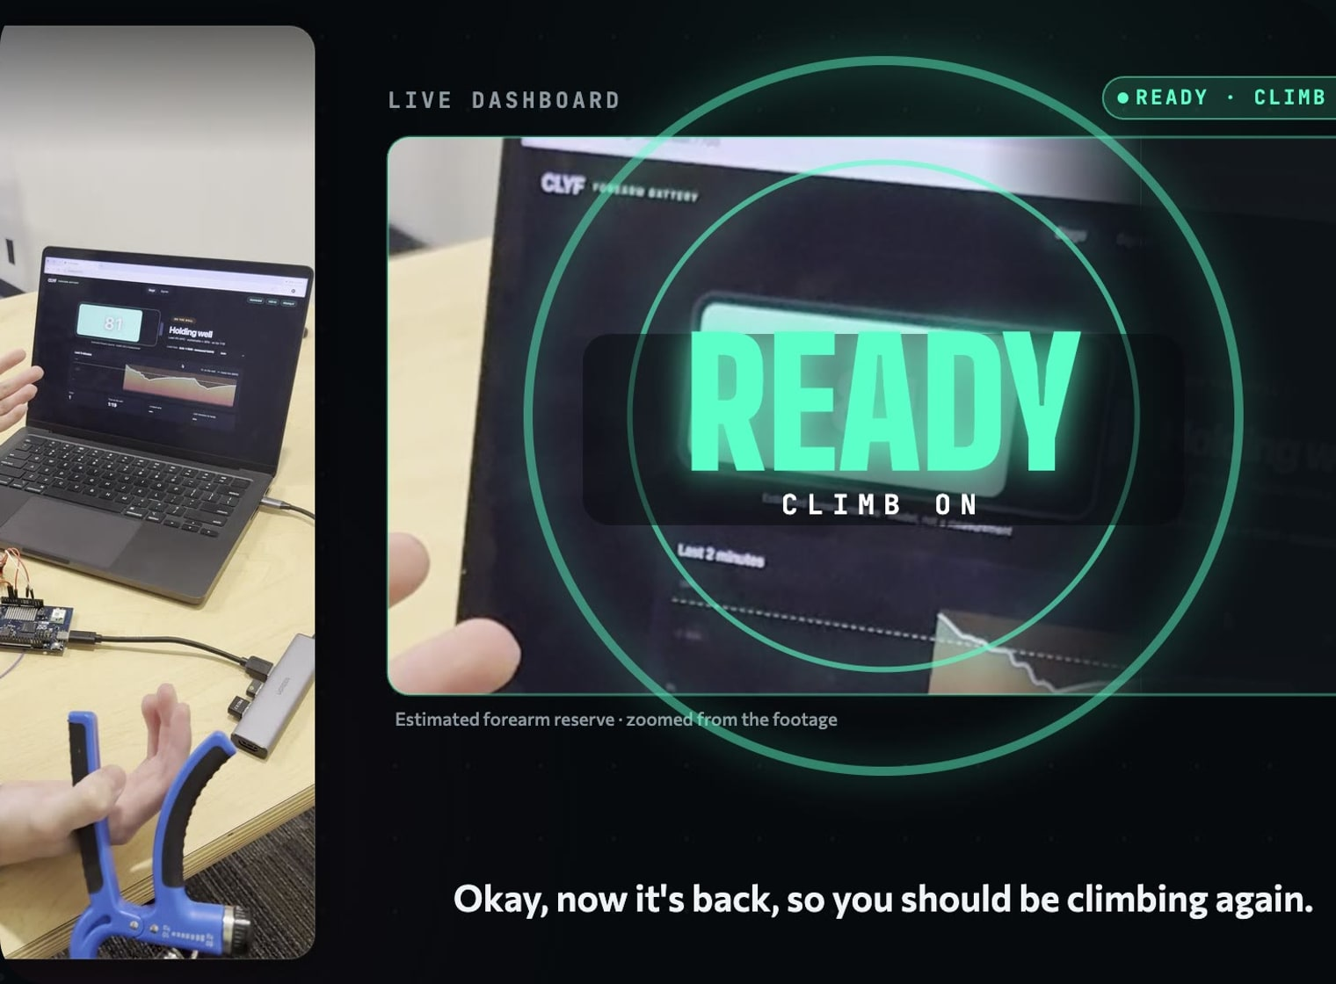
TURN A FEELING
INTO A NUMBER.
IMPACT
→
CLIMBERS
Rest exactly as long as you need on a project, and see effort across a session.
→
GYMS AND COACHES
Objective grip load per attempt instead of “how pumped were you?”
→
BEYOND CLIMBING
Any grip-heavy activity where recovery decides performance.
CLYF

Slide 8
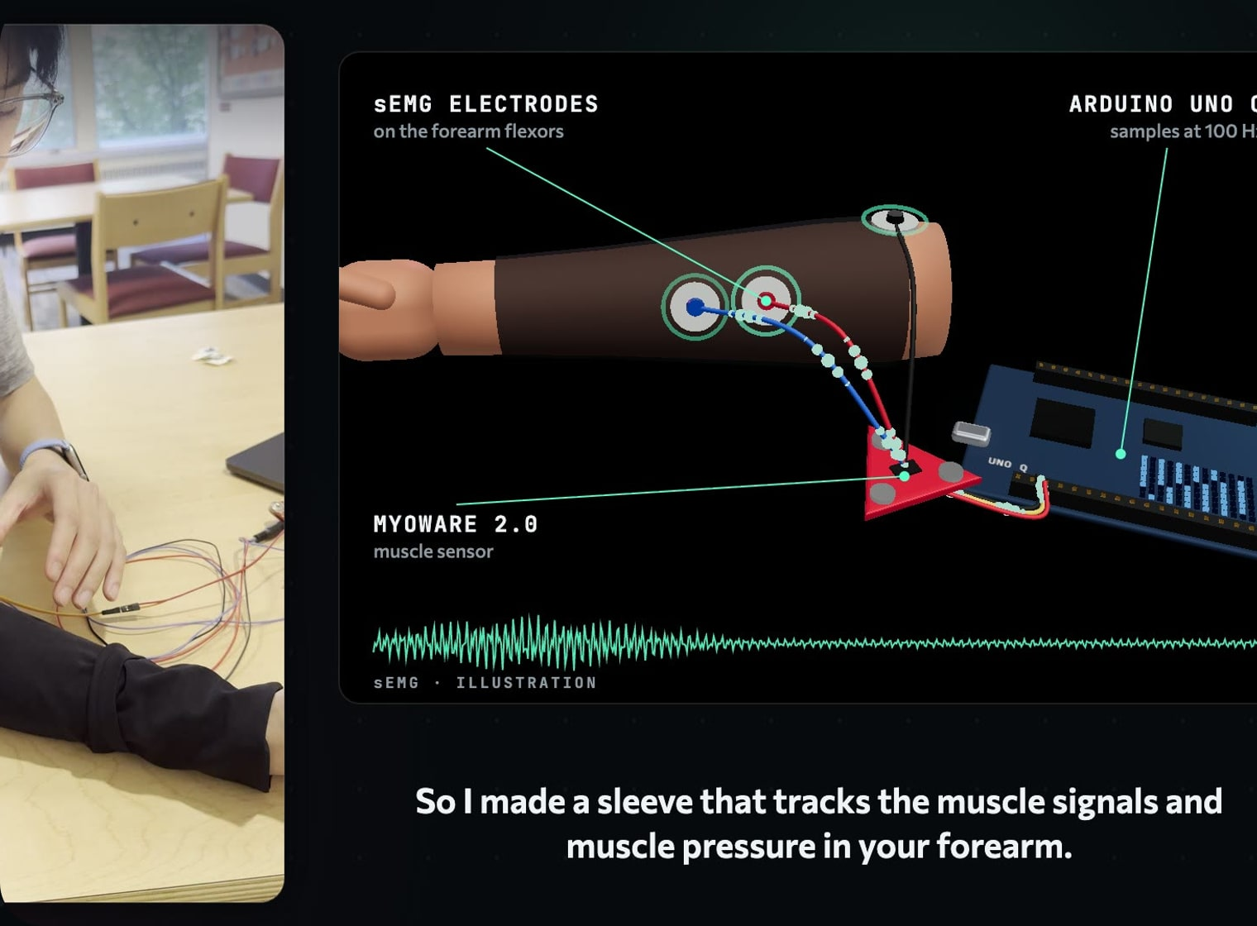
EYES ON THE WALL,
NOT ON A SCREEN.
WHAT’S NEXT
1
READY ON THE WRIST
A haptic tap from the watch when you’re recovered. The Bluetooth link is already built.
2
FATIGUE YOU CAN SEE
Track the raw EMG’s frequency shift, a known marker of muscle fatigue.
3
FITTED TO YOU
Learn each climber’s own drain and recovery rates from their sessions.
4
WIRELESS SLEEVE
Smaller board, battery power, and a cleaner fit.
CLYF

Slide 9
CLYF
THANK YOU
Know when to climb again.
Jeremy Li · BigRed//Hacks 2026

