Slide 1










Did you know that construction is as easy as pie?
Introducing kuzimba.com Fastest way to get your construction done right!

Slide 2
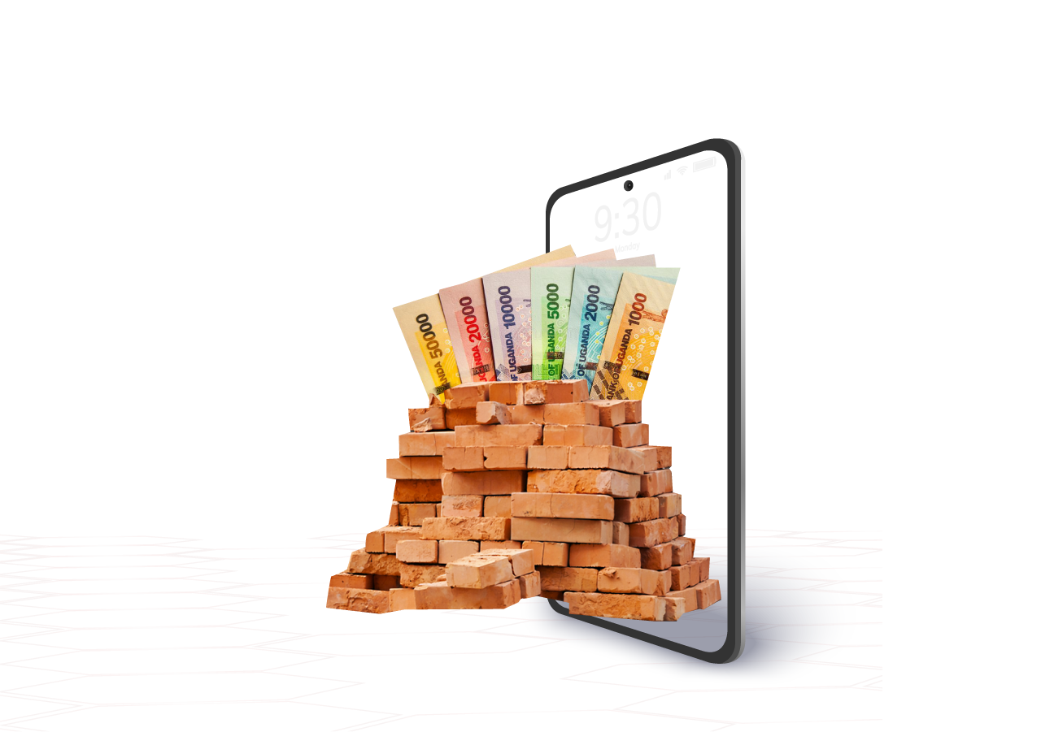

Also . . . Save for that dream home!
Save money on your
kuzimba wallet too!
For later use.

Slide 3


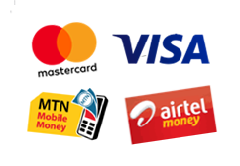
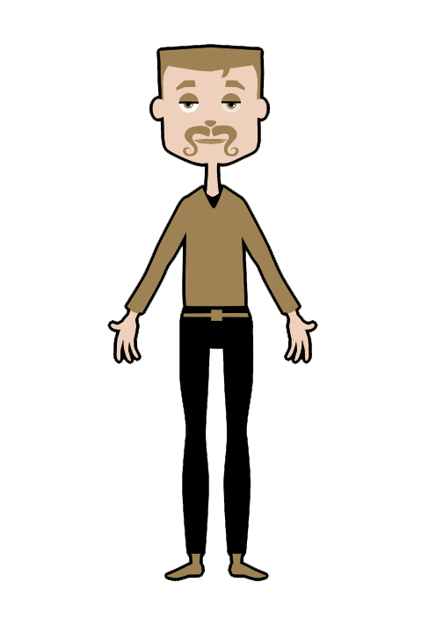




Include Everyone.
Professionals Team| Hardware Companies | Low Income Earners | Payment Platforms

Slide 4

Get Online . . . Save with Us
Buy from Us . . .
. . . and get the Services
to finish the job.
www.kuzimba.com

Slide 5

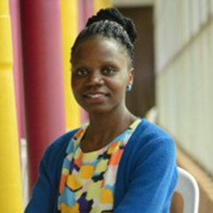
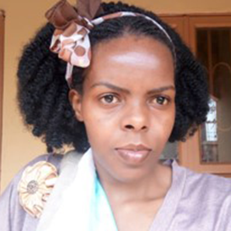
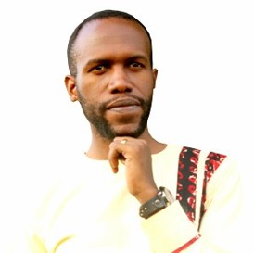
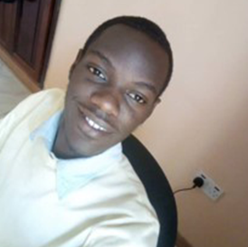





Thank You
Ephrance Namugenyi
Team Lead
Lillian Kusima
Product Designer
Alfred Ochola
Product Developer
Sidney Nkoba
Product Developer
#WomenInFinTech #LevelOneProject

