Slide 1
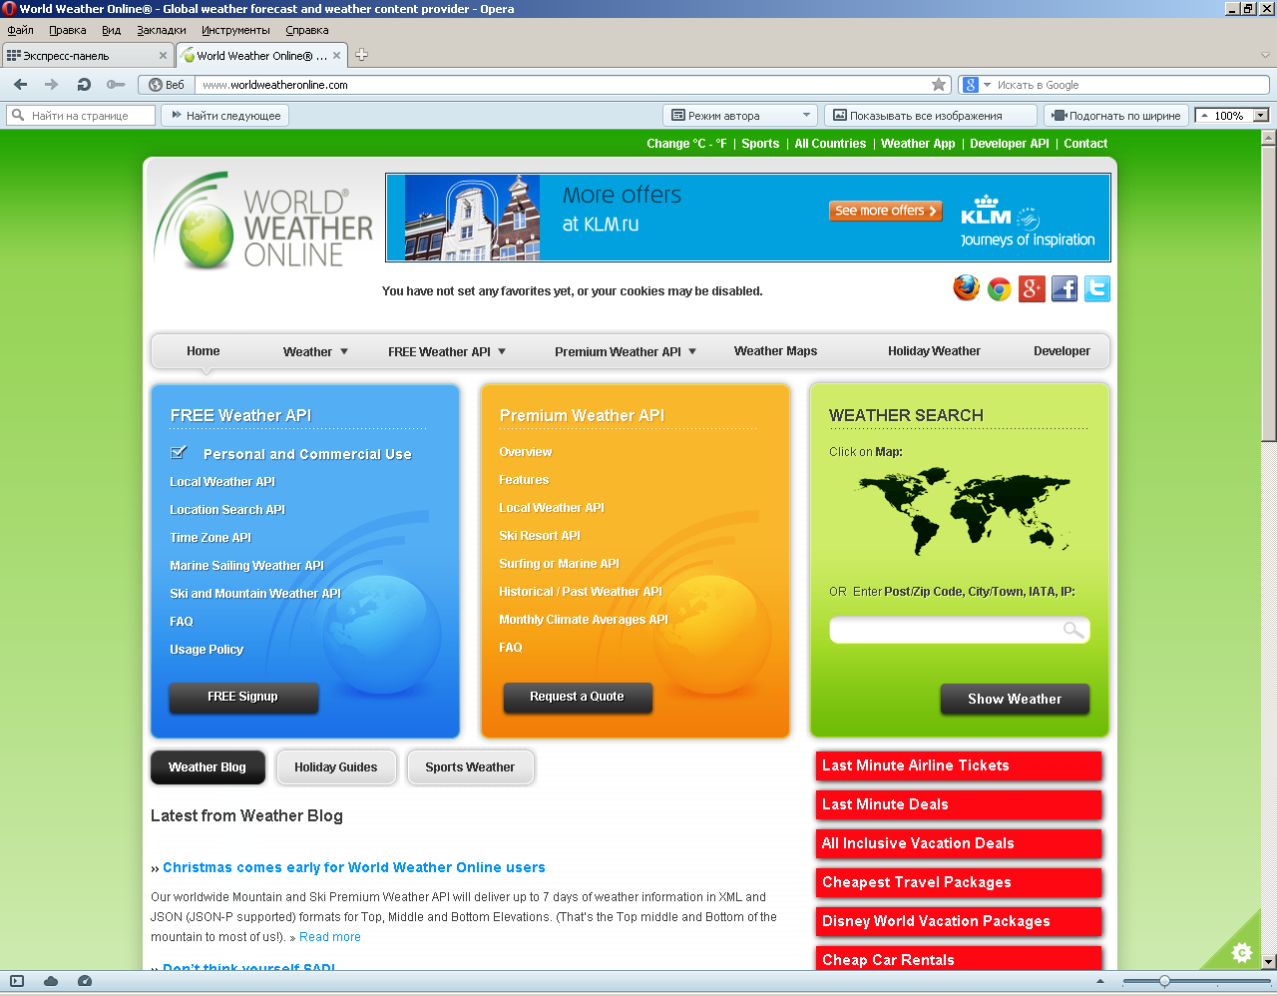

Slide 2
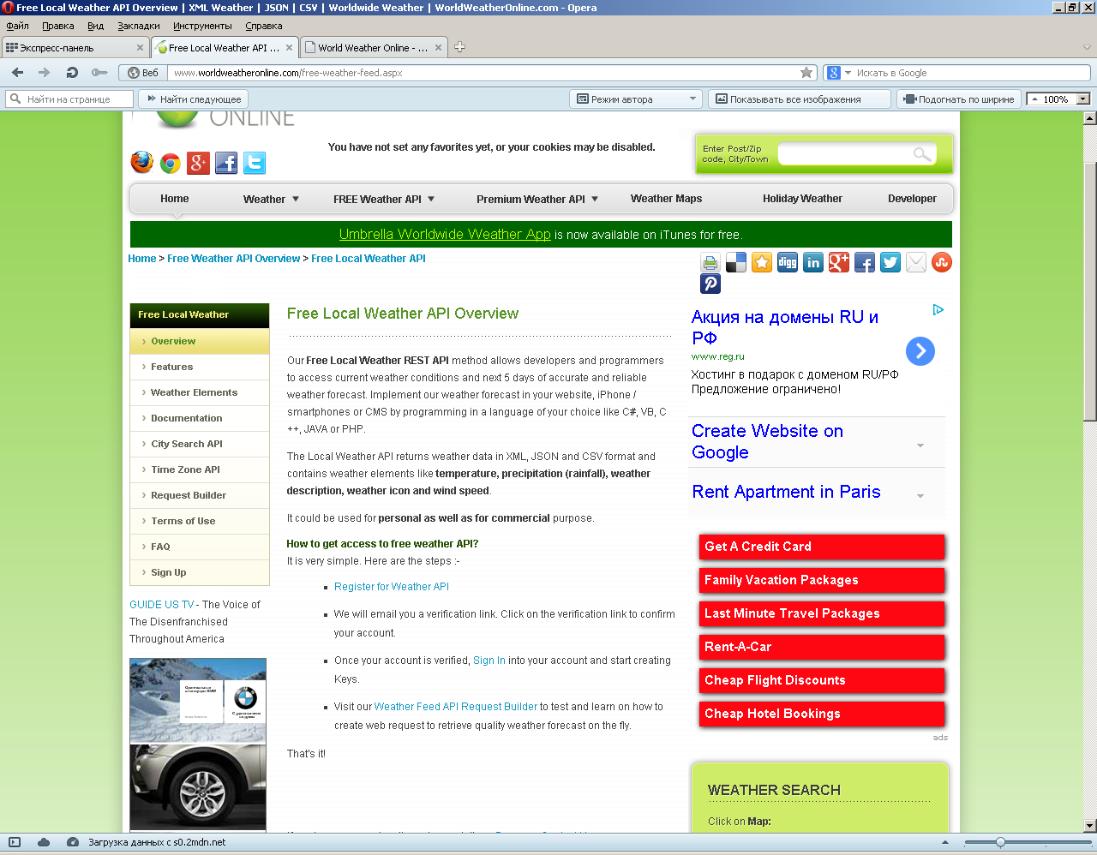

Slide 3
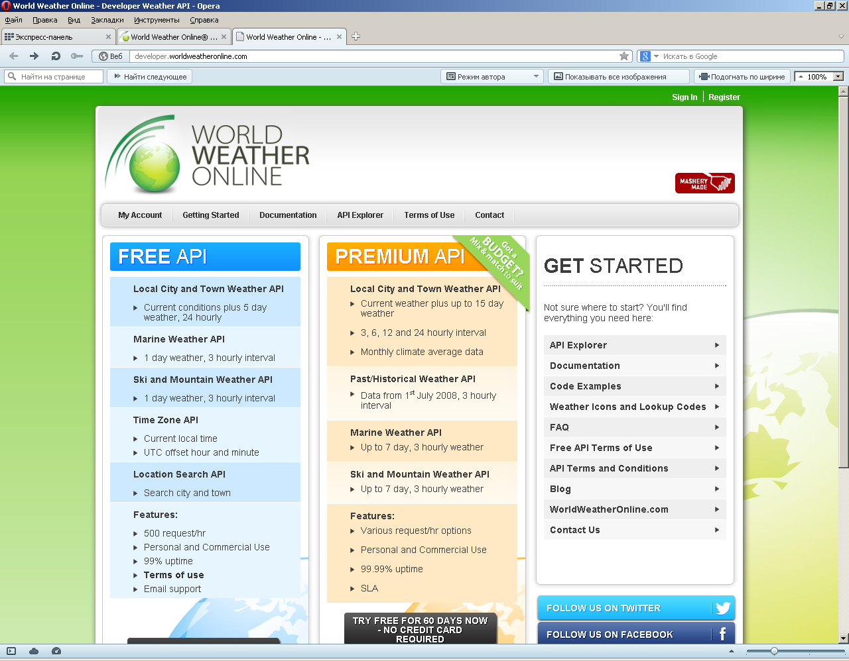

Slide 4
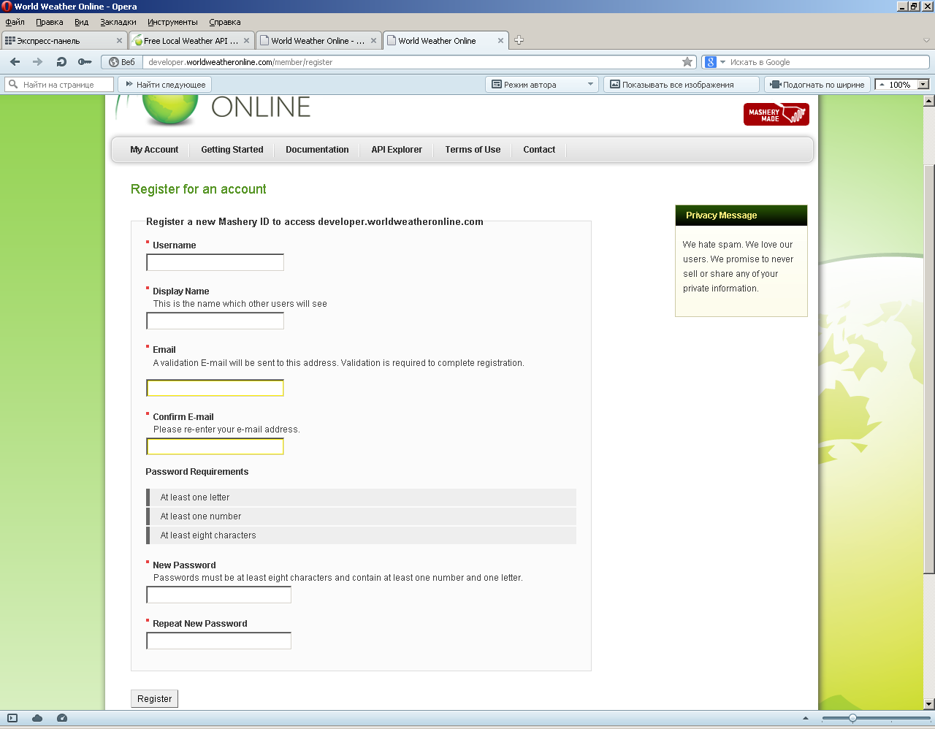

Slide 5
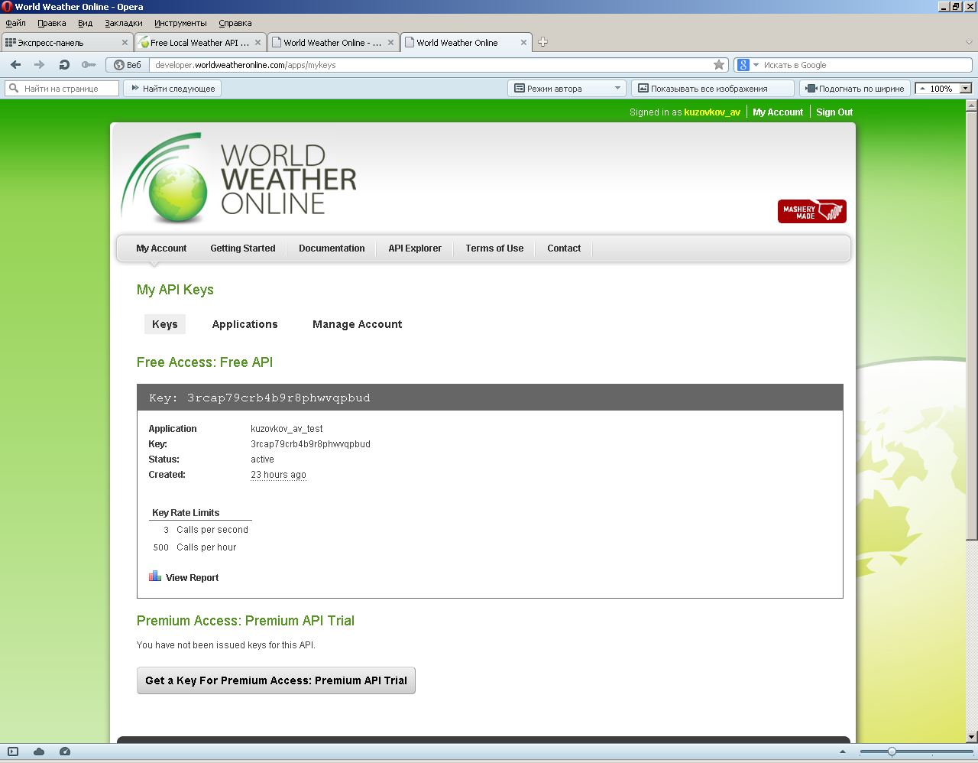

Slide 6
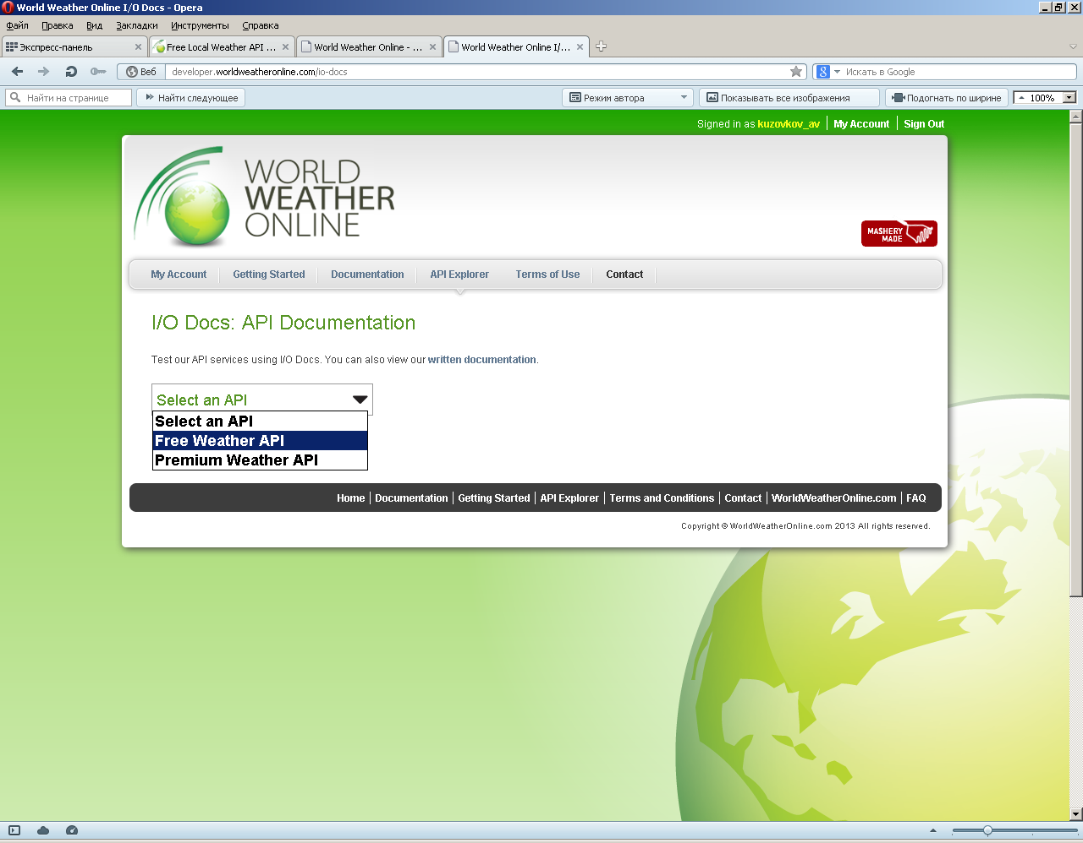

Slide 7
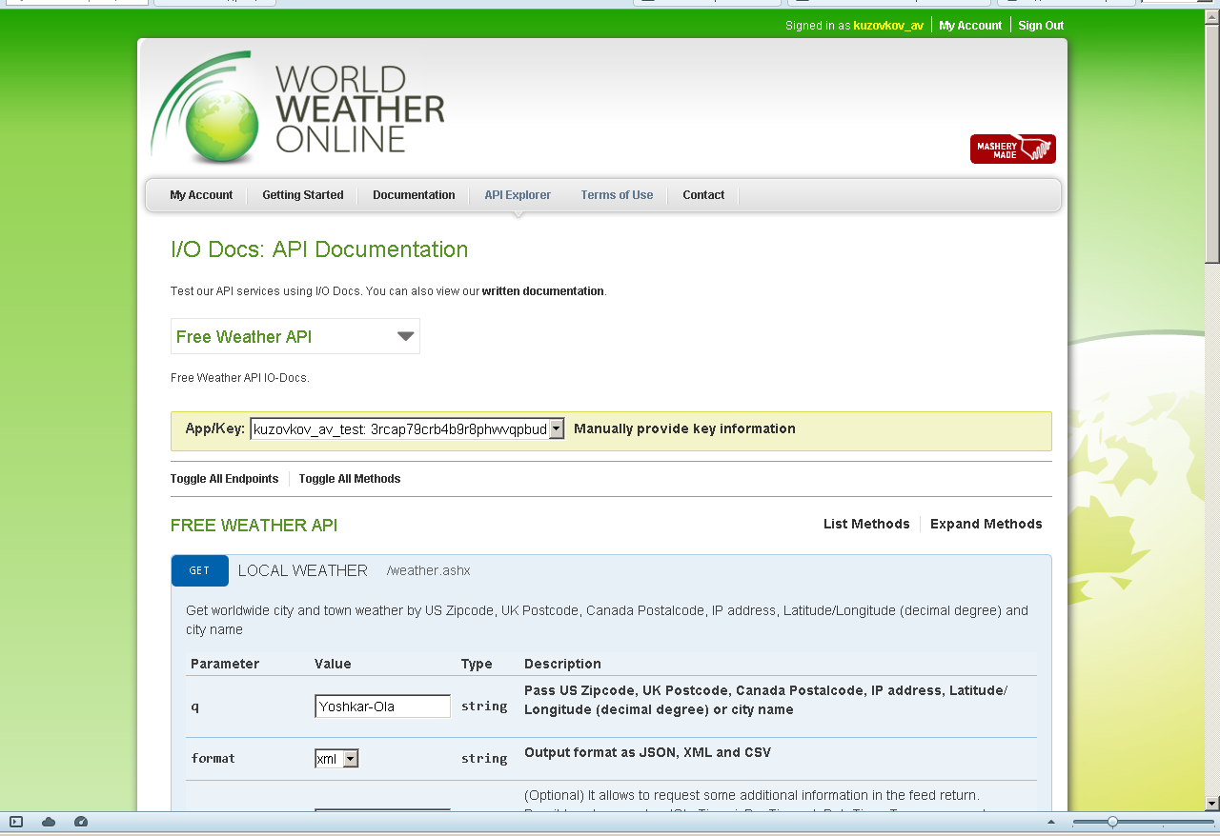

Slide 8
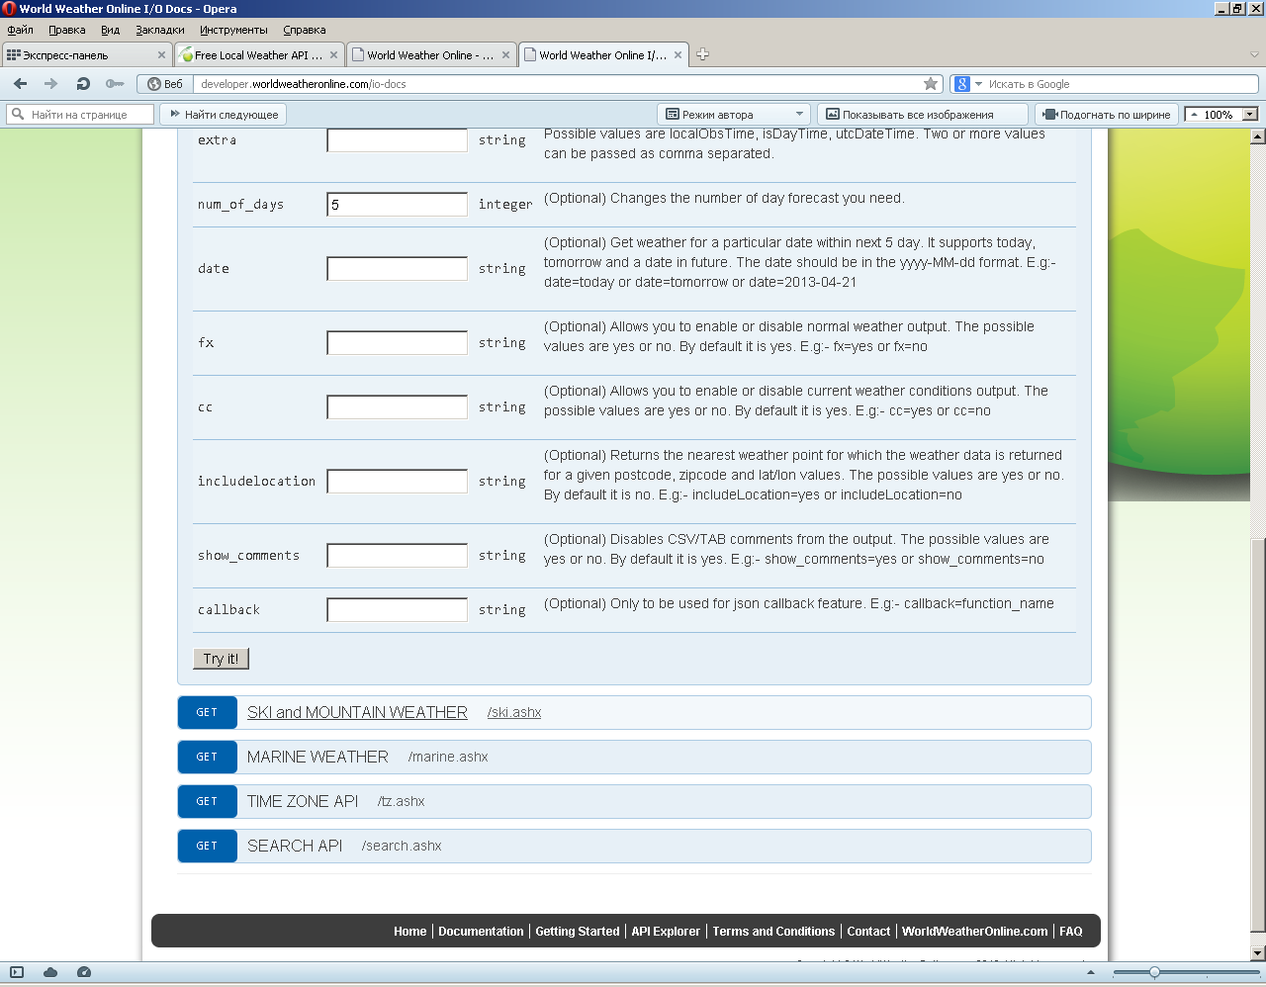

Slide 9
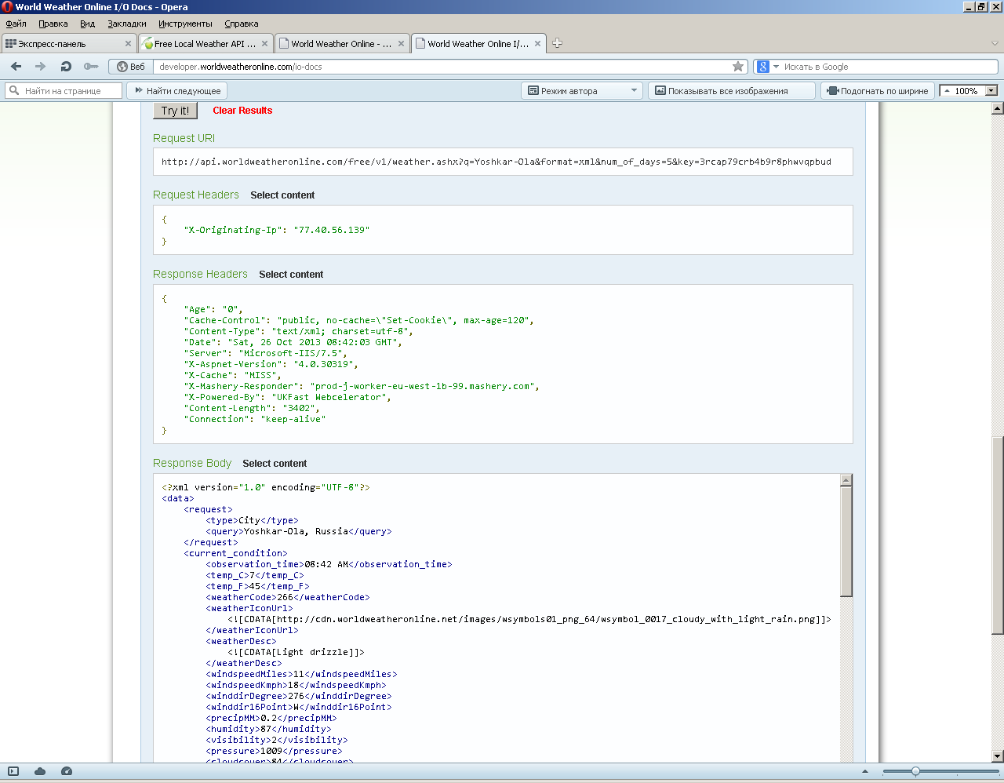

Slide 10
import urllib
city='Yoshkar-Ola'
date='tomorrow'
key='3rcap79crb4b9r8phwvqpbud'
rformat='xml'
url='http://api.worldweatheronline.com/free/v1/weather.ashx?q='+city+'&format='+rformat+'&num_of_days=5&date='+date+'&key='+key
web=urllib.urlopen(url)
txt=web.read()
print txt

Slide 11
<?xml version="1.0" encoding="UTF-8"?><data><request><type>City</type><query>Yoshkar-Ola, Russia</query></request><current_condition><observation_time>09:00 AM</observation_time><temp_C>7</temp_C><temp_F>45</temp_F><weatherCode>266</weatherCode><weatherIconUrl><![CDATA[http://cdn.worldweatheronline.net/images/wsymbols01_png_64/wsymbol_0017_cloudy_with_light_rain.png]]></weatherIconUrl><weatherDesc><![CDATA[Light drizzle]]></weatherDesc><windspeedMiles>11</windspeedMiles><windspeedKmph>18</windspeedKmph><winddirDegree>276</winddirDegree><winddir16Point>W</winddir16Point><precipMM>0.2</precipMM><humidity>87</humidity><visibility>2</visibility><pressure>1009</pressure><cloudcover>84</cloudcover></current_condition><weather><date>2013-10-27</date><tempMaxC>6</tempMaxC><tempMaxF>43</tempMaxF><tempMinC>2</tempMinC><tempMinF>36</tempMinF><windspeedMiles>8</windspeedMiles><windspeedKmph>13</windspeedKmph><winddirection>S</winddirection><winddir16Point>S</winddir16Point><winddirDegree>176</winddirDegree><weatherCode>143</weatherCode><weatherIconUrl><![CDATA[http://cdn.worldweatheronline.net/images/wsymbols01_png_64/wsymbol_0006_mist.png]]></weatherIconUrl><weatherDesc><![CDATA[Mist]]></weatherDesc><precipMM>5.4</precipMM></weather></data>

Slide 12
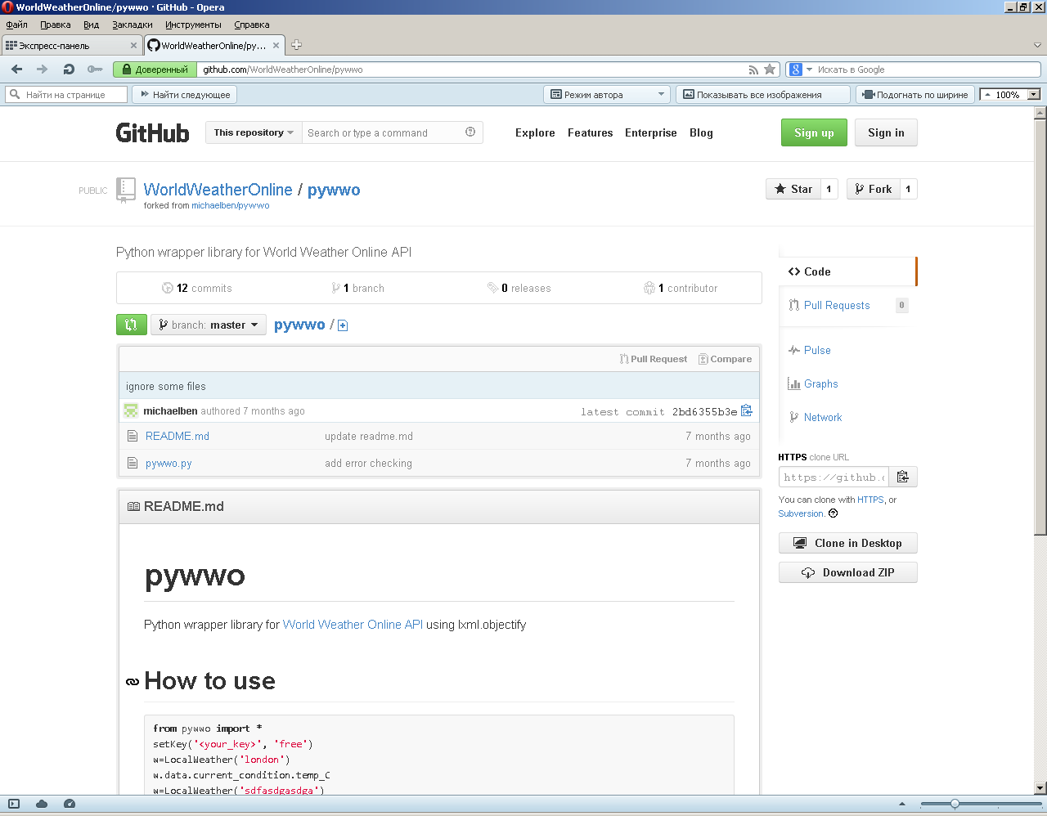

Slide 13
from urllib import urlencode
import urllib2
from lxml import etree
from lxml import objectify

Slide 14
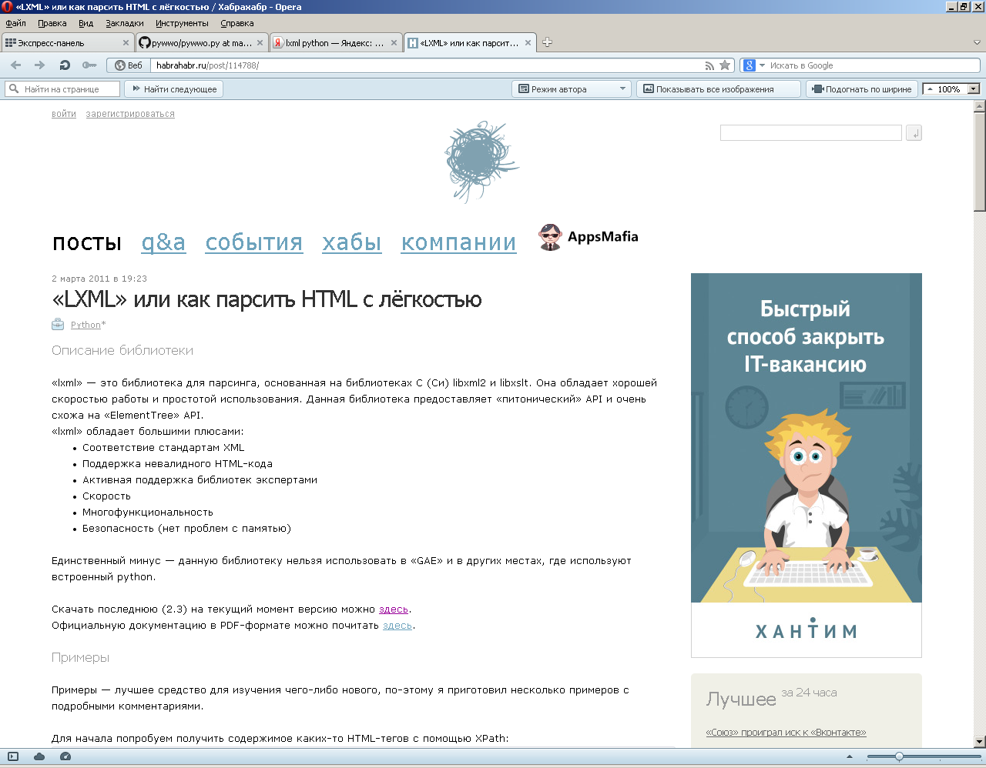

Slide 15
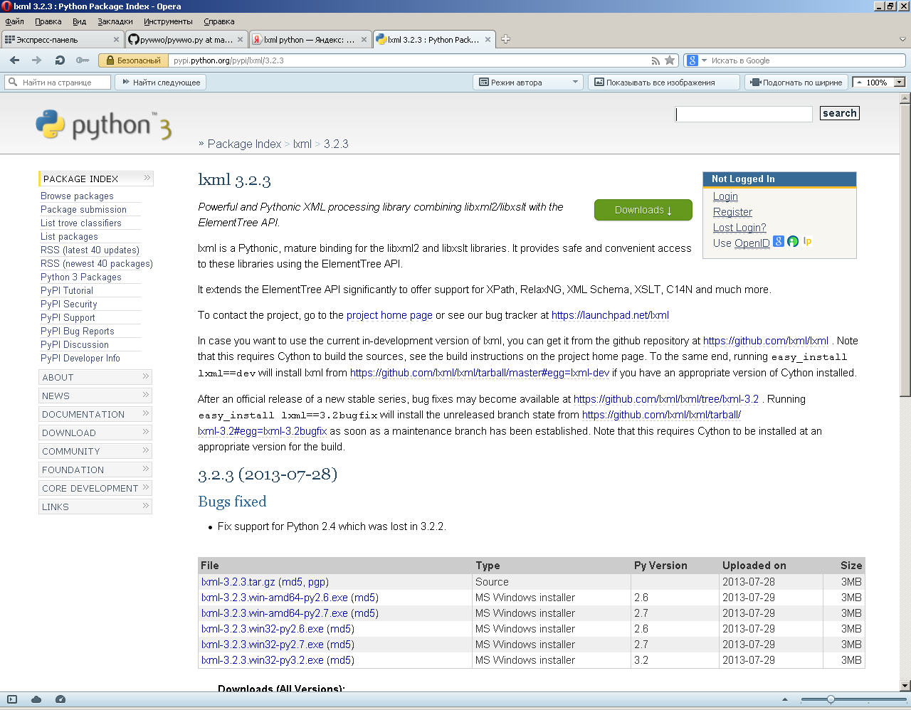

Slide 16
from pywwo import *
key='3rcap79crb4b9r8phwvqpbud'
place='Yoshkar-Ola'
date='tomorrow'
setKey(key, 'free')
w=LocalWeather(place,num_of_days=5,date=date)
print 'место '+str(w.data.request.query)
print 'прогноз на '+str(w.data.weather.date)
print 'температура '+str(w.data.weather.tempMinC)+' - '+str(w.data.weather.tempMaxC)+' C'
print 'скорость ветра '+str(int(w.data.weather.windspeedKmph)/3.6)+'м/с'
print 'дополнительно '+str(w.data.weather.weatherDesc)

Slide 17
Python 2.7.5 (default, May 15 2013, 22:43:36) [MSC v.1500 32 bit (Intel)] on win32
Type "copyright", "credits" or "license()" for more information.
>>> ================================ RESTART ================================
>>>
место Yoshkar-Ola, Russia
прогноз на 2013-10-27
температура 2 - 6 C
скорость ветра 3.61111111111м/с
дополнительно Mist
>>>

Slide 18
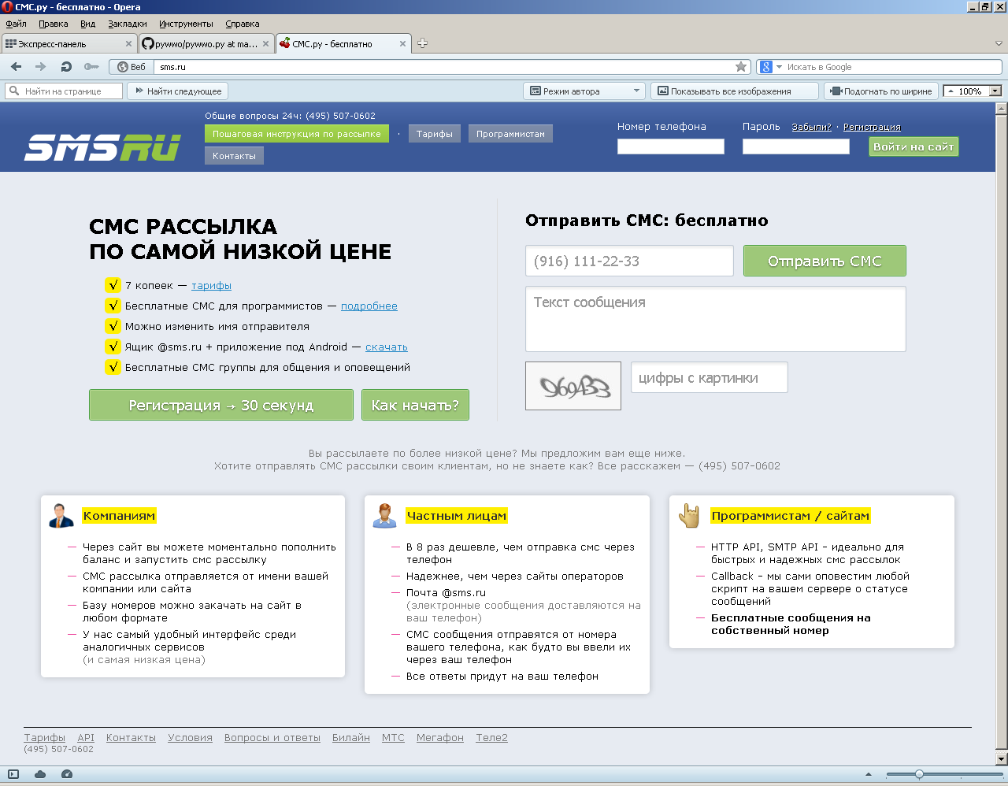

Slide 19
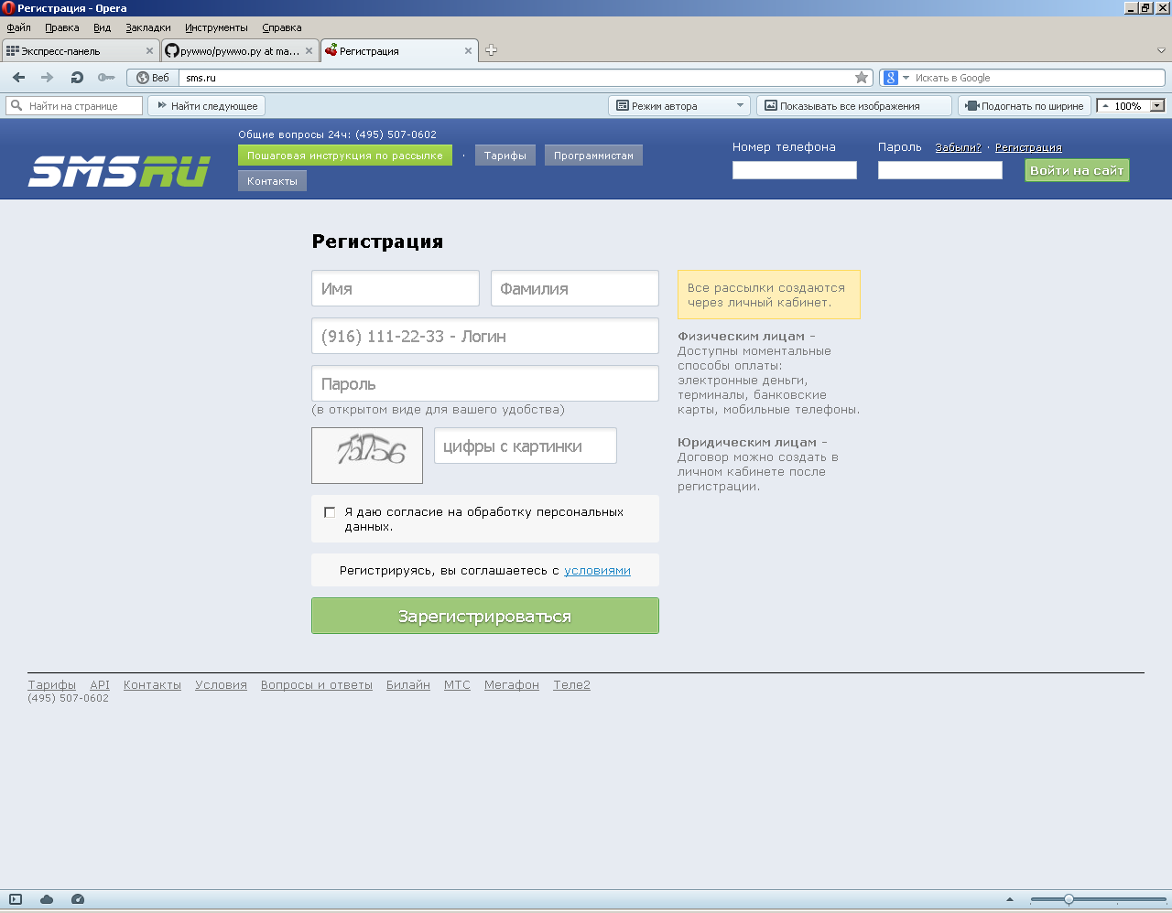

Slide 20
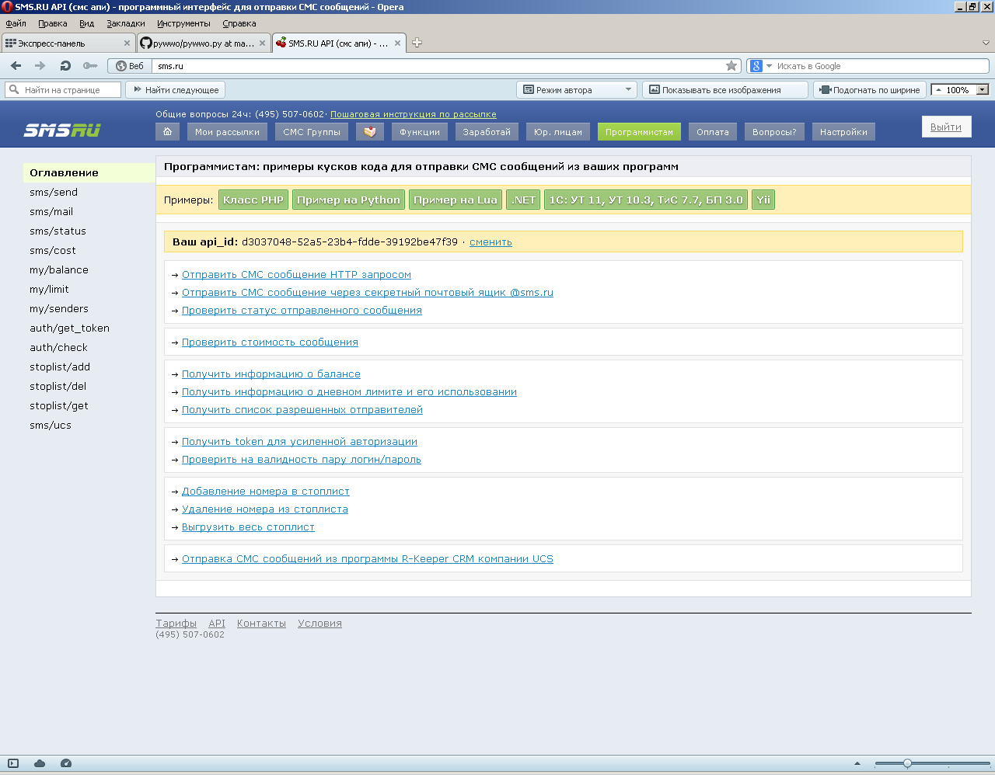

Slide 21
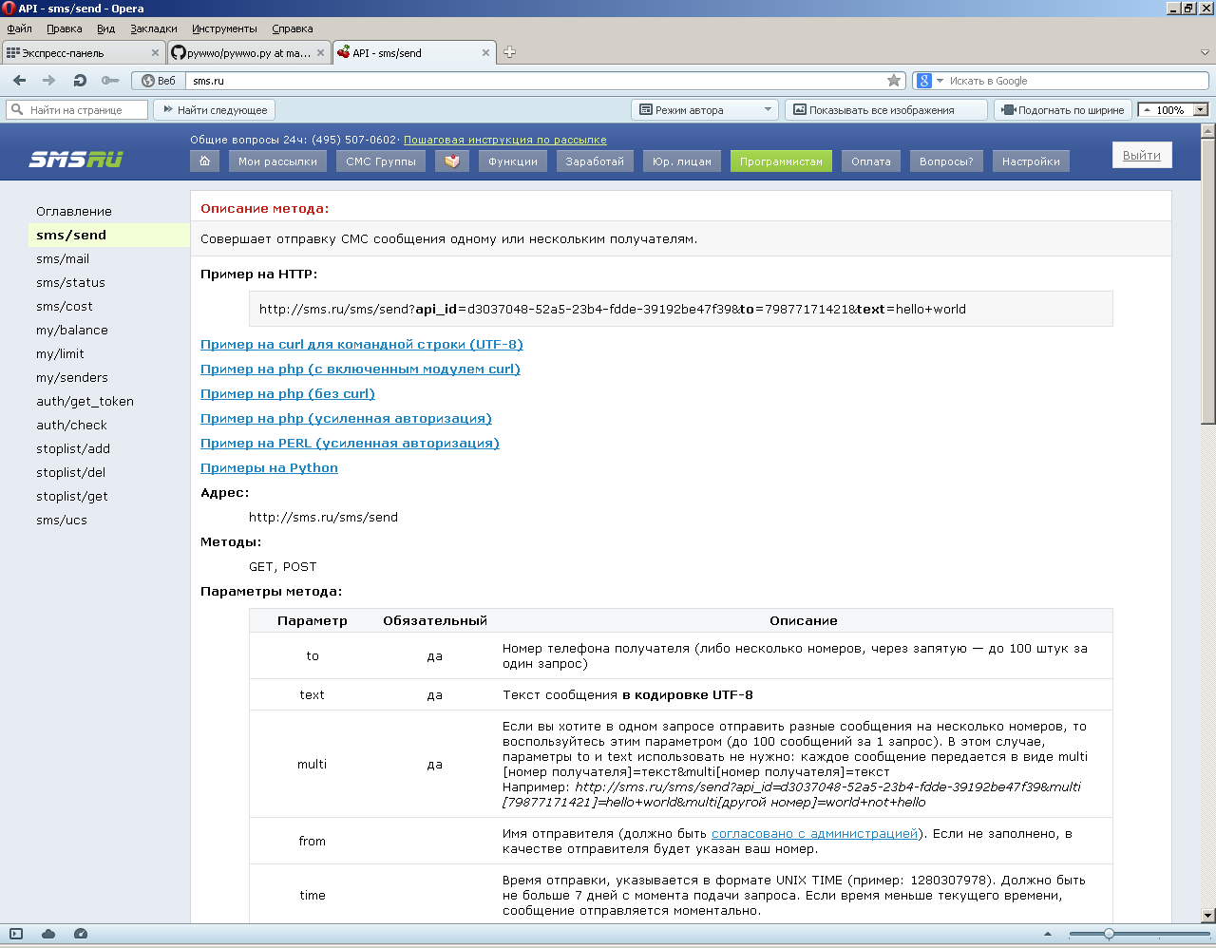

Slide 22
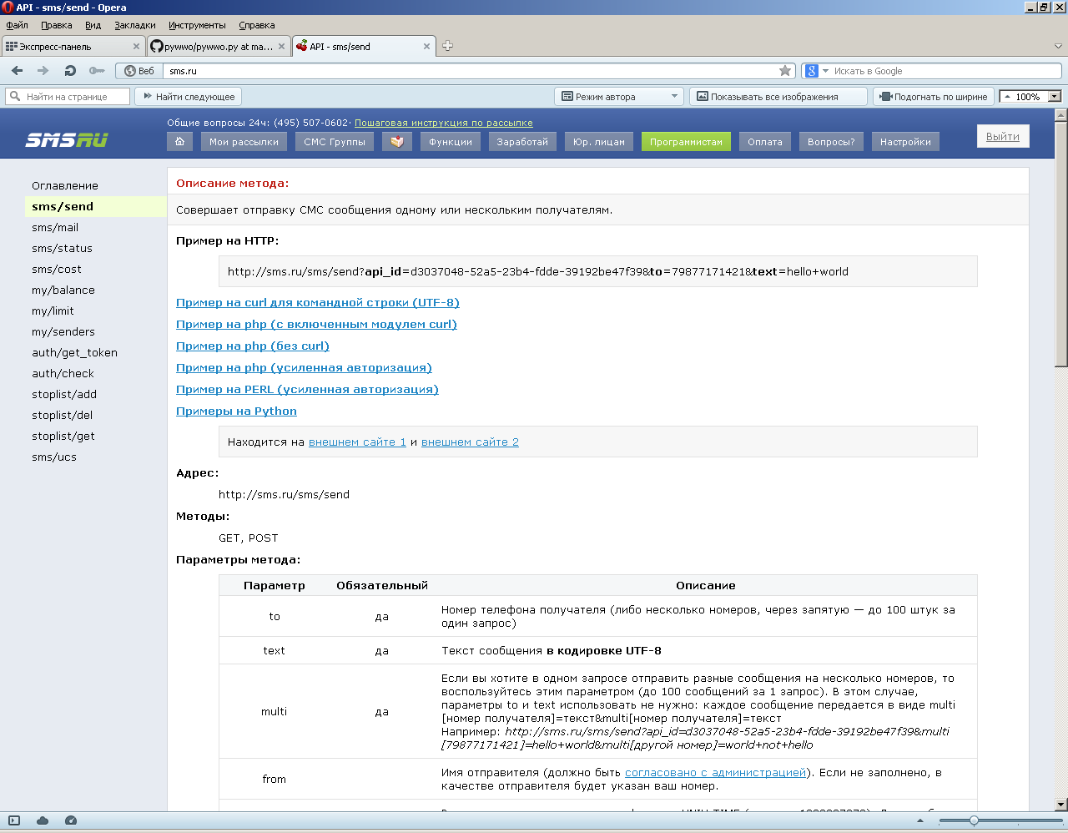

Slide 23
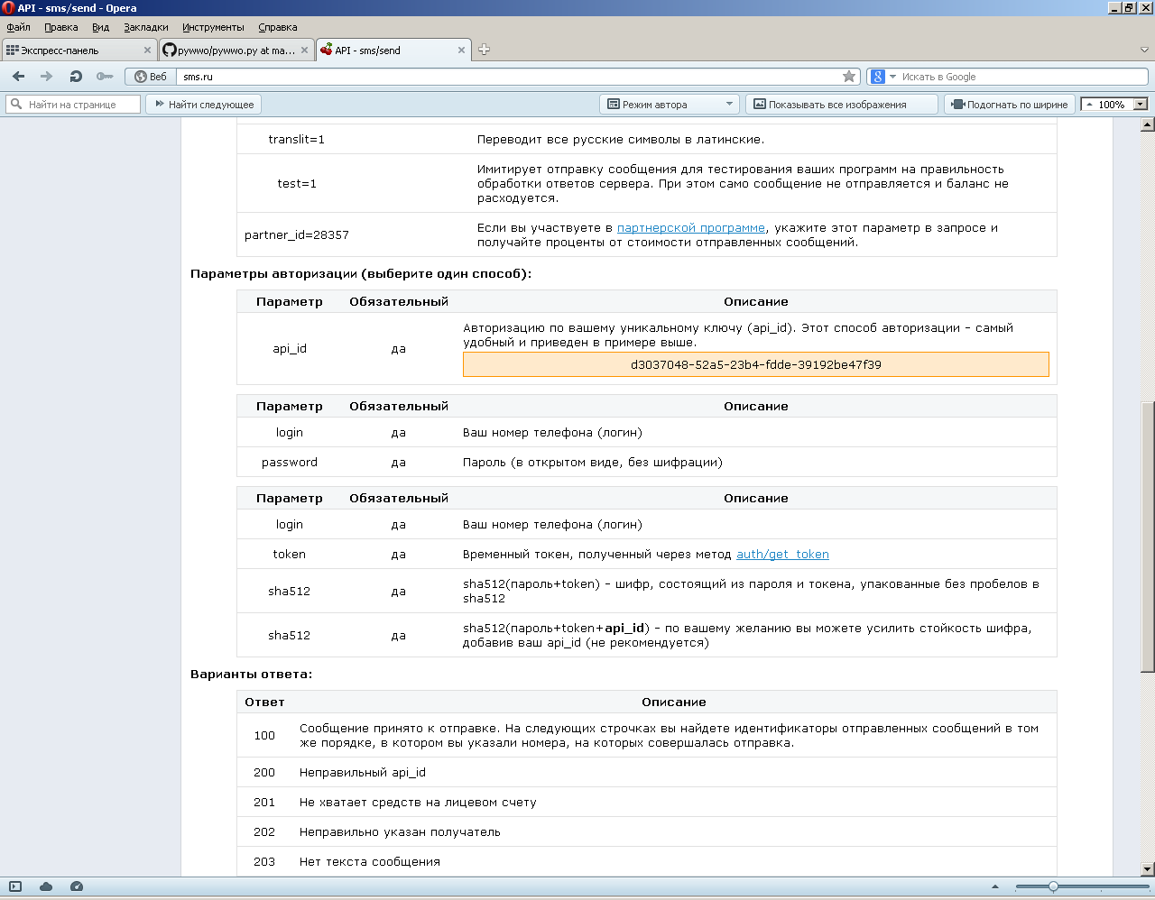

Slide 24
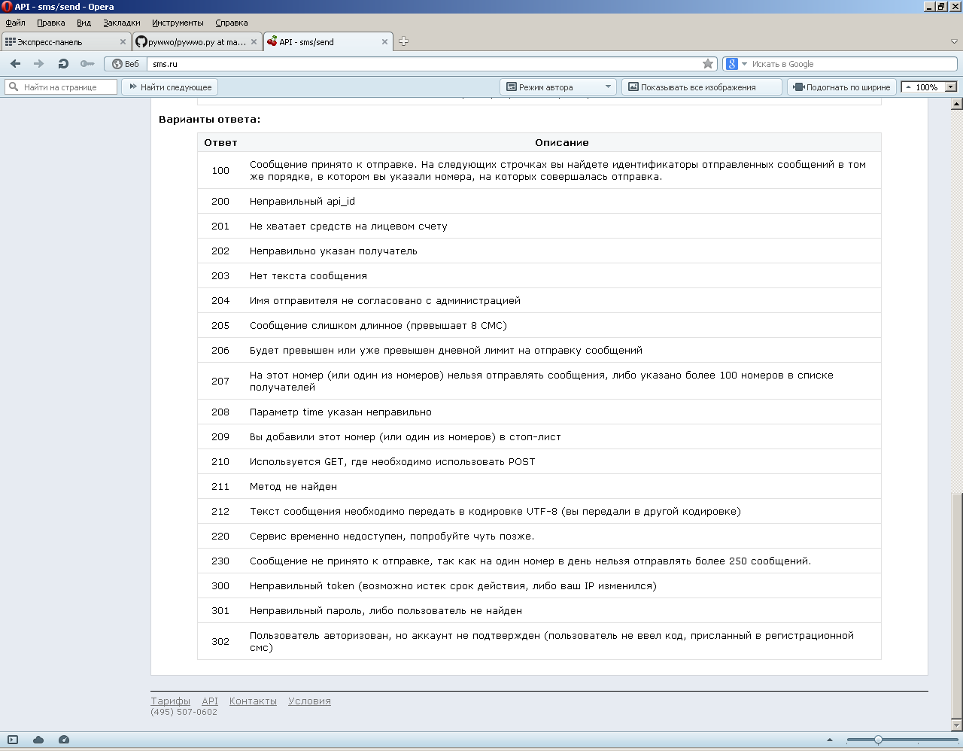

Slide 25
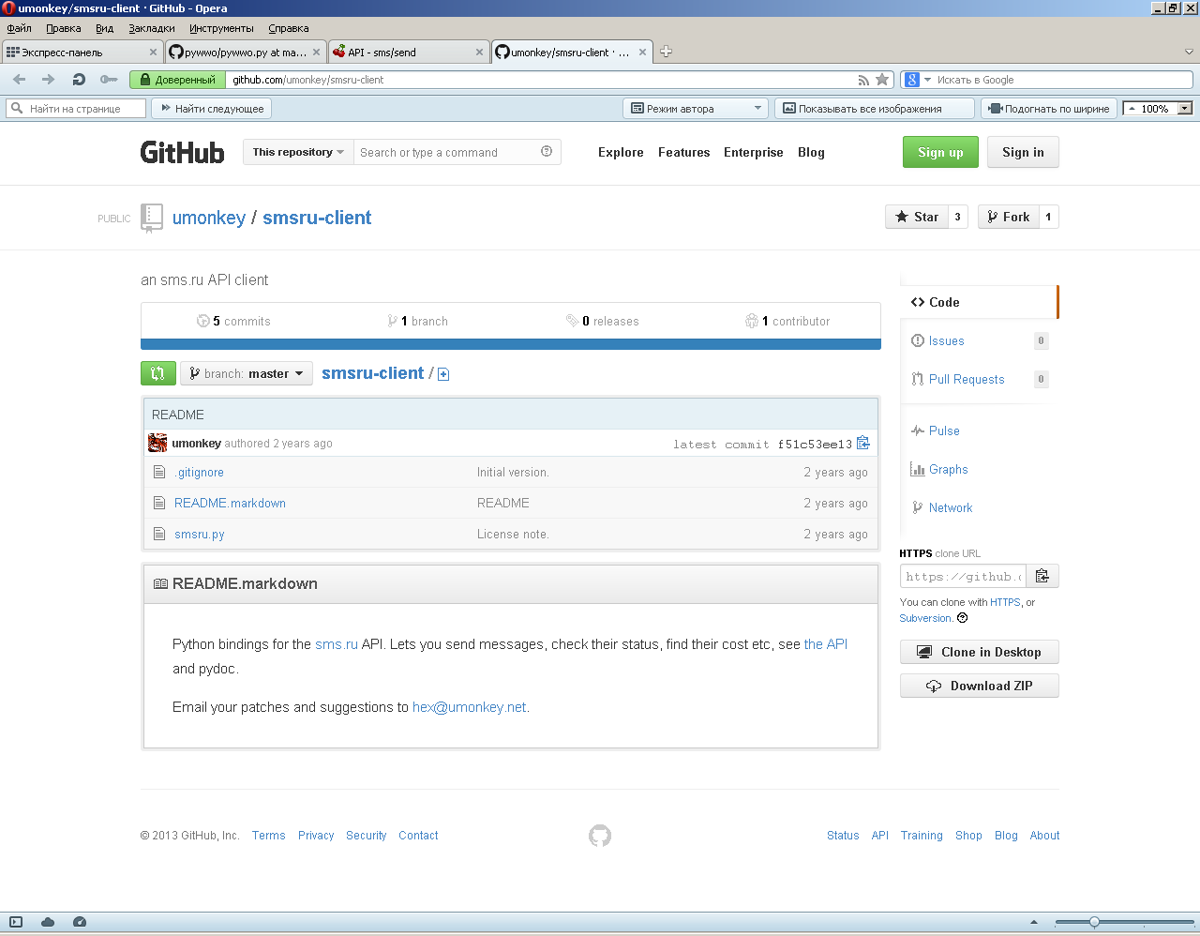

Slide 26
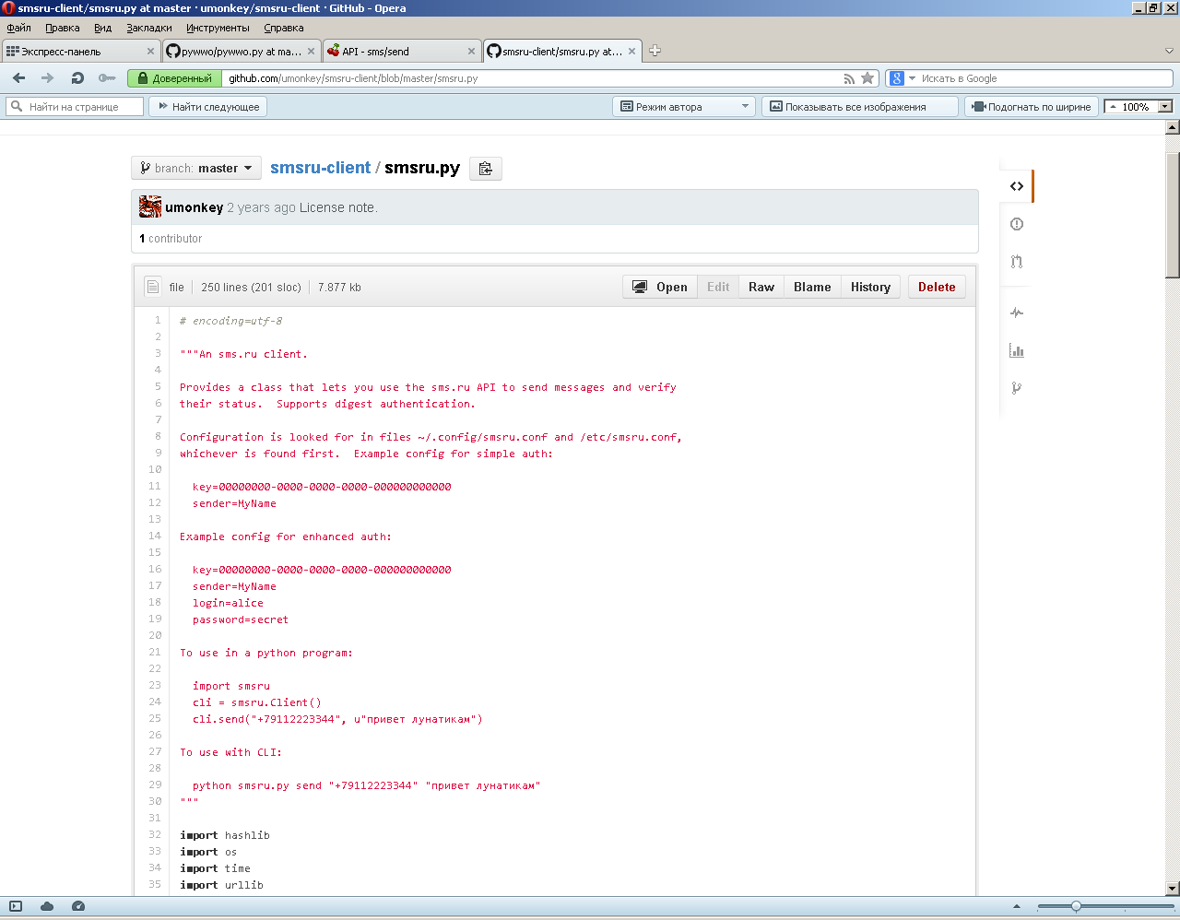

Slide 27
Configuration is looked for in files ~/.config/smsru.conf and /etc/smsru.conf,
whichever is found first. Example config for simple auth:
key=00000000-0000-0000-0000-000000000000
sender=MyName
Example config for enhanced auth:
key=00000000-0000-0000-0000-000000000000
sender=MyName
login=alice
password=secret
To use in a python program:
import smsru
cli = smsru.Client()
cli.send("+79112223344", u"привет лунатикам")
To use with CLI:
python smsru.py send "+79112223344" "привет лунатикам"
"""
import hashlib
import os
import time
import urllib
import urllib2
CONFIG_FILES = ("~/.config/smsru.conf", "/etc/smsru.conf","smsru.conf")

Slide 28
key=d3037048-52a5-23b4-fdde-39192be47f39

Slide 29
#coding=utf-8
import smsru
cli = smsru.Client()
print cli.send("+79877171421", u"привет лунатикам")
Python 2.7.5 (default, May 15 2013, 22:43:36) [MSC v.1500 32 bit (Intel)] on win32
Type "copyright", "credits" or "license()" for more information.
>>> ================================ RESTART ================================
>>>
(100, 'Message accepted', '201343-570117')
>>>

