Slide 1
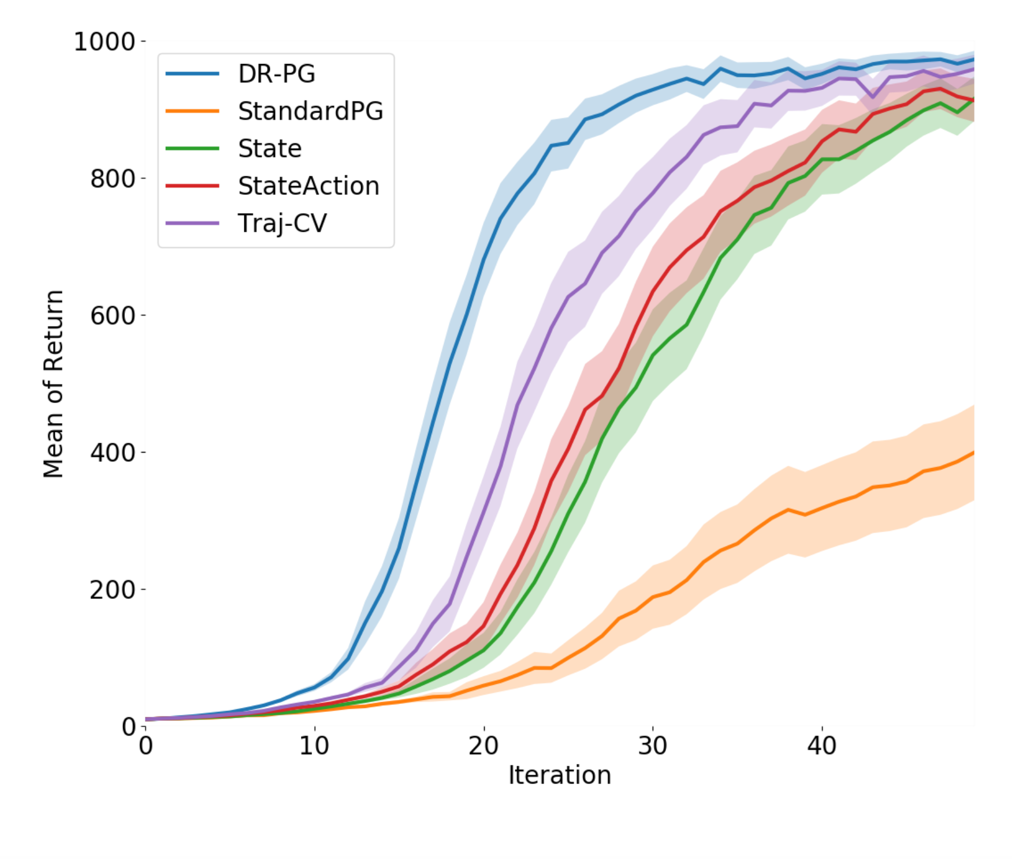
Off-Policy Doubly Robust Policy Gradient
Ömer Doruk Süder¹, Konstantinos Vergopoulos², Anastasios Vlachos²
¹D-MATH, ETH Zurich; ²D-ITET, ETH Zurich
1 Introduction
4 Variance Analysis
Policy Gradient (PG) estimators often suffer from high variance.
In [1] a general estimator for the on-policy policy gradient was proposed, which can achieve minimum variance.
Our goal in this project is to derive the off-policy version of DR-PG.
The covariance matrix of our estimator is given by:
Contrary to the on-policy case, the existence of in front of the control variate terms and prevents us from achieving zero variance in the case when we have perfect side information, i.e. when and
Exponents indicate the inducing distribution
2 Method Overview
The DR estimator, proposed in [2], uses an approximate value function to reduce the variance of IS via control variates. We use its recursive form:
Now the off-policy policy gradient can be derived as
and find a recursive expression for .
Importance sampling (IS) gives an unbiased estimate of
The Importance Sampling Ratio is defined as
5 Simulation Results
6 Results and Discussion
Setting:
Observe that if the importance sampling ratio , then we recover the results for the on-policy case.
Special case (more on report)
3 The DR-PG Estimator (off-policy)
Off policy DR-PG estimator:
This estimator is unbiased (shown) by term-by-term analysis.
References
Fig: Comparison of different PG estimators in on-policy optimization. Y-axes show the mean of the expected returns of the policies over 150 trials learned by different PG methods. Error bars show double the standard errors, which correspond to 95% confidence intervals.
Jiawei Huang and Nan Jiang. From Importance Sampling to Doubly Robust Policy Gradient, June 2020. URL http://arxiv.org/abs/1910.09066. arXiv:1910.09066
Nan Jiang and Lihong Li. Doubly Robust Off-policy Value Evaluation for Reinforcement Learning, May 2016. URL http://arxiv.org/abs/1511.03722. arXiv:1511.03722

