Slide 1
Accurate Prediction of Worst Case Eye Diagrams for Non-Linear Signaling Systems
Aadithya V. Karthik*, Sayak Ray, Robert Brayton, and Jaijeet Roychowdhury
EECS Dept., The University of California, Berkeley
Mar 2014, TAU, Santa Cruz
Notes:
-

Slide 2
Overview of this talk
The Worst Case (WC) eye diagram problem
  Starting from the basics, i.e., what is an eye diagram?
Existing algorithms for WC eye estimation
  PDA, illustrated with an example
Where PDA fails
  Cannot handle general formulations of problem
A new algorithm for WC eye computation
  Illustrated with an example
Results
  8b/10b encoder (PCI Express, USB, etc.)
  Our technique is much less pessimistic than PDA

Slide 3
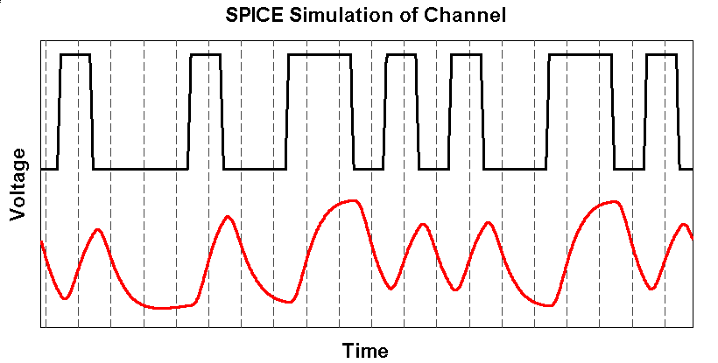
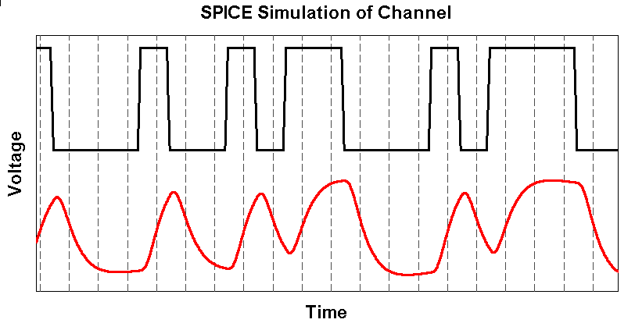
What is an Eye Diagram (1/2)?
Bits
Analog Channel
Analogish “Bits”
(delay, ISI, crosstalk, etc.)

Slide 4
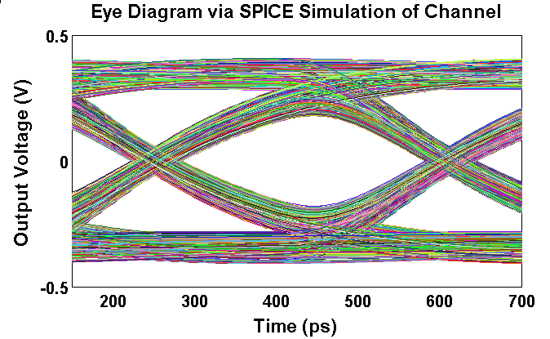

What is an Eye Diagram (2/2)?
Eye
Overlay sections between dashed vertical lines
WC Eye
Eye

Slide 5
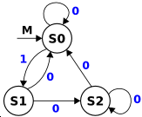
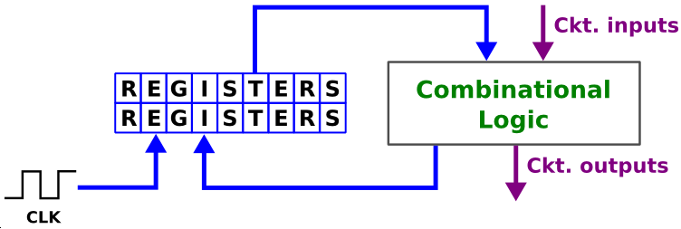
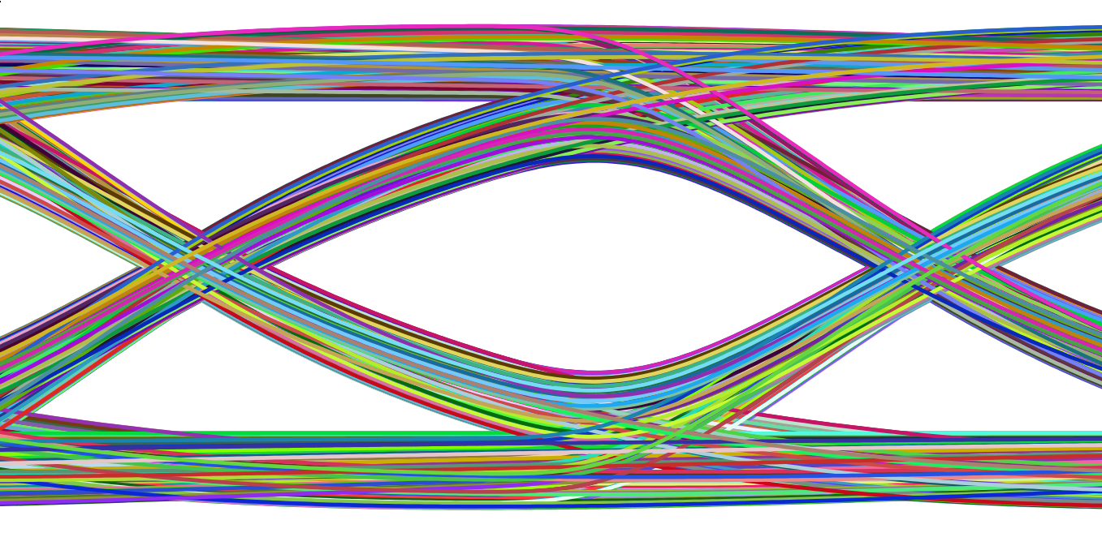

The Worst Case Eye Problem
Arbitrary
Correlated
Bit sequence
Analog (LTI) Channel
Digital System
PDA
Output eye
Pure analog → PDA
Analog + Digital
  Non-Linear System
  Correlated bits
  PDA too pessimistic
  Our new algorithm!
Problem: Compute worst-case eye

Slide 6

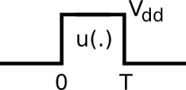
Peak Distortion Analysis (PDA)
Assume channel is LTI
Key idea: WC Eye = 2 Optimization Problems
LTI Channel
WC1
WC0
Linear combination of the bits!
Need mutually independent bits
[0, 1, 0, 1, 1]
Correlated bits: PDA fails!

Slide 7
Questions

