Slide 1

Create Views Using a Graphical Designer
LESSON 2.3b
98-364 Database Administration Fundamentals

Slide 2
Lesson Overview
In this lesson, you will learn:
What is a graphical designer?
How is T-SQL different from graphical designers?
What is a view?
What is a query?
How is a view created?
How do you create queries in Design View?
Notes:
Lesson 2.3b overview
2

Slide 3
What is a graphical designer?
A graphical designer is a largely object-oriented method of database management using drag-and-drop functions, drop-down menus, or both.
A graphic designer, such as Jet SQL, is used in the Microsoft® Access® application to extract, manipulate, and structure data that resides in a relational database management system (RDBMS).
Jet SQL is based largely on the ANSI SQL-92 standard, with additional extensions.

Slide 4
How is T-SQL different from graphical designers?
T-SQL is a procedural programming language that uses command lines to help the user work with the database.
Graphical designers, such as Microsoft Access, are object-oriented and use drag-and-drop functions instead of command lines.

Slide 5
What is a view?
A view is a virtual table that displays the data from a selected table or tables.
In RDMSs, a logical table (or view) is created through the specification of one or more relational operations on one or more tables.

Slide 6
What is a query?
Query (1)—a specific set of instructions for extracting particular data.
Query(2) —to extract data from a database and present it for use.
A query is a question to a table or tables within a database. The syntax of the question depends on the database language. In this lesson, we focus on graphical database queries.

Slide 7
How is a view created?
A view is a SELECT query that selects data from a table, allowing you to view the data in a chosen order.
In Access, you can use queries to select data from a table or tables or other queries. The data is limited by the definition of the query.
Queries are SQL commands, as follows:
SELECT
UPDATE
DELETE
Queries include clauses such as
WHERE
FROM
ORDER BY
Notes:
Use the guiding question as a class starter, allowing the students time to answer the question in their journals. Discuss student answers to the question.

Slide 8
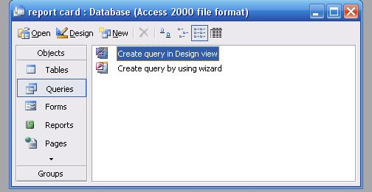
How do you create queries in Design View?
Double-click Create Query in Design View to open
Notes:
This is a screenshot from Access.

Slide 9
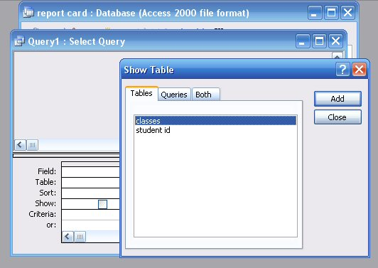
Select one or more tables from the Show Table dialog box.

Slide 10
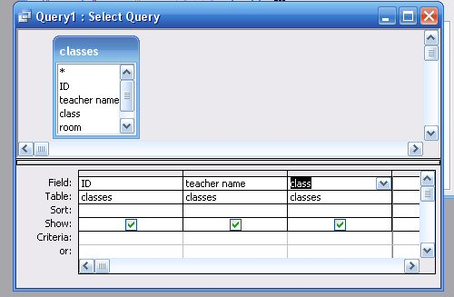
Once the table is selected, you can select fields from the field lists.
field list

Slide 11
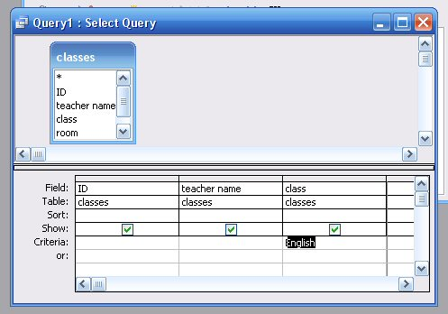
You can specify conditions in the criteria area of the design grid.
criteria area

Slide 12
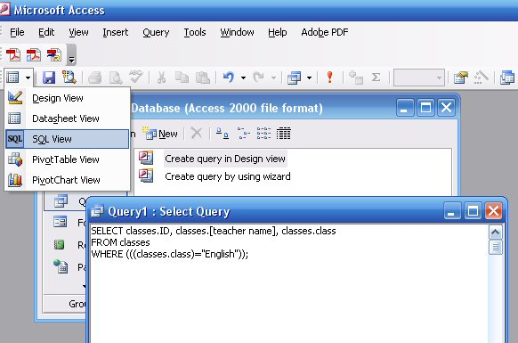
When you create a query in Design View, Access builds the necessary SQL statements behind the scenes.
The SQL view displays the generated SQL statement, which also can be edited.

Slide 13
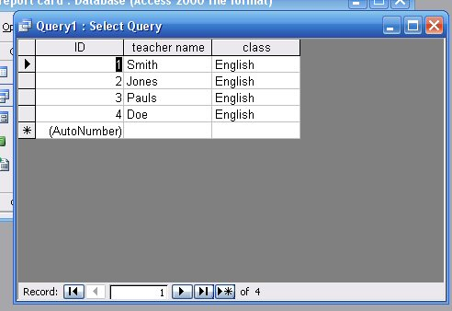
Run the query, and the result is displayed as shown here.

Slide 14
Lesson Review—Discussion Questions
What is the relationship between tables, queries, and views?
How is T-SQL different from graphical designers?
Notes:
A database manager applies queries on tables, and results are shown in a view. Queries can be run on stored views.
T-SQL is a procedural programming language that uses command-line functions to help the user work with the database. Graphical designers, such as Access, are object-oriented and use drag-and-drop methods rather than command lines.

