Slide 1
FORMFLOW AI · PROJECT DEMO
THE CORE IDEA
From request to ready-to-use form.
FORM → FLOW
PROMPT
VALIDATE
SHARE
Presented by: Vaishnavi Sankhala
AI-POWERED FORM GENERATION AND VALIDATION ASSISTANT
To simplify form creation by generating customised forms using simple text prompts.
Notes:
Introduce FormFlow AI as a lightweight assistant that turns a plain-language request into a usable form. Emphasize the three-part promise: generate, validate, and share.

Slide 2




01 · GENERATION PIPELINE
From prompt to dynamic form
The browser turns a short request into working form logic without a backend inference service.
Prompt
Infer
Render
Validate
Enter the request.
Local JavaScript infers fields and validation rules.
HTML renders structure; CSS styles it; JavaScript adds behavior.
JavaScript checks the entries.
PROMPT INPUT
GENERATED FORM
“Create a registration form for a campus event.”
Fields, required states, and validation appear here.
02
Notes:
Walk from left to right. The important implementation choice is local JavaScript field inference: the browser interprets the prompt, then HTML, CSS, and JavaScript create the dynamic form and its behavior.

Slide 3
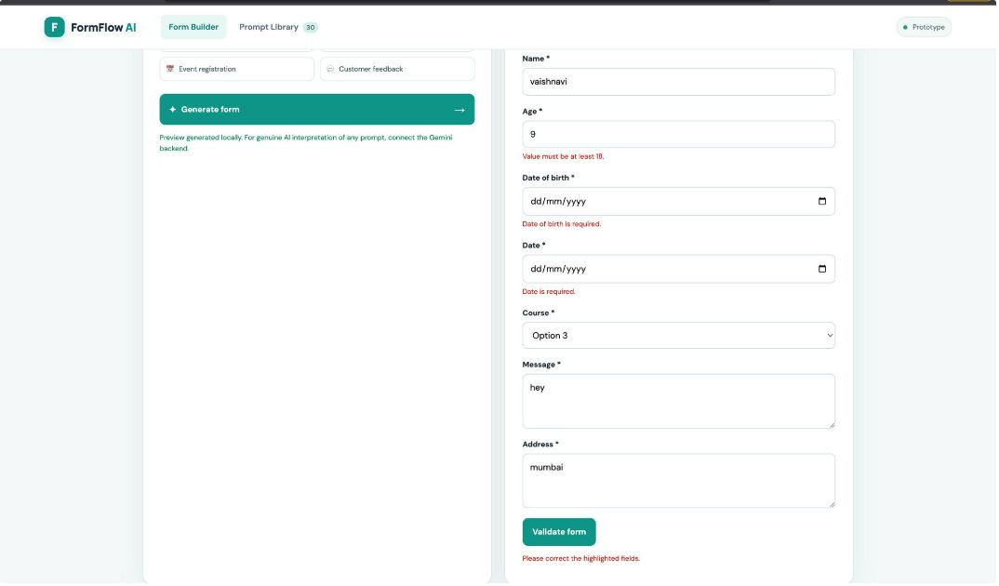


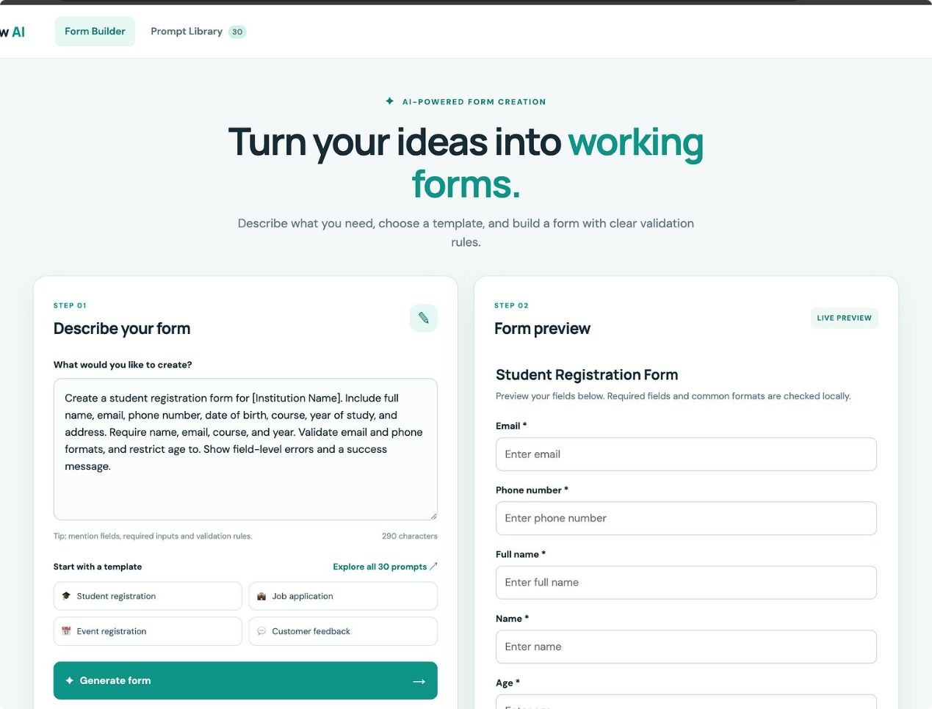


SCREENSHOT PLACEHOLDER
02 · AUTOMATION CHAIN
Automation removes repetitive form work
Generate fields
Validate early
Infer likely fields and input types from the prompt.
Check required and invalid inputs before submission.
VALIDATION STATE
Clear error message before submit.
Print to PDF
Share structure
Use the browser's print dialog for completed forms.
Encode the form structure into a shareable link.
03
Notes:
Focus on the work FormFlow removes: deciding field types, checking incomplete input, preparing a printable result, and rebuilding the same structure for a recipient. Keep the PDF step accurate: it uses browser print-to-PDF, not server-side generation.

Slide 4
03 · DEPLOYMENT ARCHITECTURE
Shareable structure, lightweight deployment
The frontend stays simple: code is deployed once, while each link carries the form structure it needs.
GitHub
Vercel
Shareable URL
Blank client form
Print to PDF
Stores the HTML, CSS, and JavaScript project code.
Deploys the live frontend.
Validated details become a browser-generated PDF.
Contains the encoded form structure.
Recipients open the link and start fresh.
DATA PATH
STORAGE MODEL
FORM SCHEMA → ENCODED URL → BLANK FORM
Validated submissions are not stored in a database.
04
Notes:
Explain the architecture as a deliberate lightweight choice. GitHub holds the code, Vercel deploys the frontend, and the URL carries the encoded form schema. Recipients receive a blank client form. Completed details are validated locally and printed through the browser, with no database response storage.

Slide 5
04 · LIVE WALKTHROUGH
PROJECT CAPTURE PLACEHOLDERS
Live demo: prompt, validate, share
01 · PROMPT
02 · FORM
Prompt entry screen
Generated fields
Enter a form prompt.
Generate the form and inspect inferred fields and input types.
Trigger validation with an incomplete or invalid input.
Complete the form and download a PDF through print-to-PDF.
Open the shared link and fill the blank client form.
03 · VALIDATE
04 · PDF
Incomplete input state
Browser print dialog
05 · SHARE
Blank client form
CURRENT LIMITS
FUTURE SCOPE
Replace each marked panel with the project's real screenshot.
Local inference · no database response storage
Richer field inference · backend persistence · analytics · stronger sharing controls
05
Notes:
Run the demo in this order so each action proves one part of the system. Close by naming the current boundaries honestly, then separate them from future scope: richer field inference, backend persistence, analytics, and stronger sharing controls.

