Slide 1
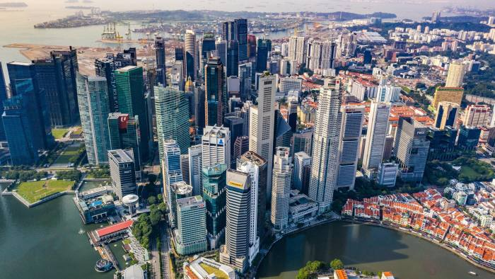
Singapore – Smart City
Island city-state in Maritime Southeast Asia
Metropolis: 5,896,686 people
Singapore smart city vision:
In 2015, the government announced the ‘Smart Nation Initiative’ with an aim to see Singapore become the world’s first smart nation by 2025, and also further enhance networked computerization capabilities in order to remain globally competitive.

Slide 2
Singapore - Smart Mobility
Singapore Smart City
Citizen Interaction
Energy
Mobility
Security
Environment
City Service Applications
Express Monitoring and Advisory System
Bike Sharing
Smart Parking
Smart Traffic Lights

Slide 3
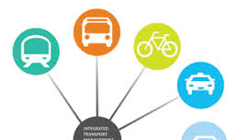
Singapore - Smart Mobility
Goal:
Enhance traffic flow and maintain safe road traffic. Coordinate with public transportation, a vehicle quota system and congestion charge to enhance the cities transport system.

Slide 4
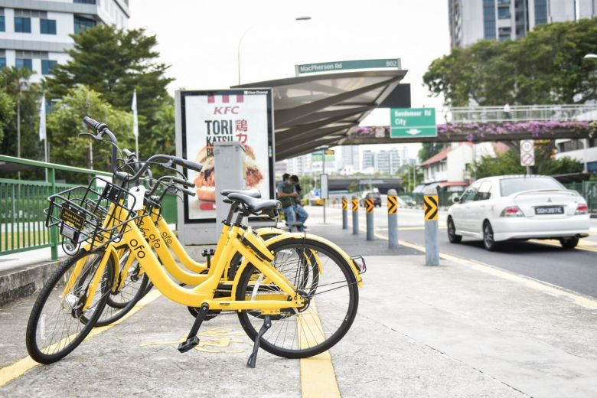
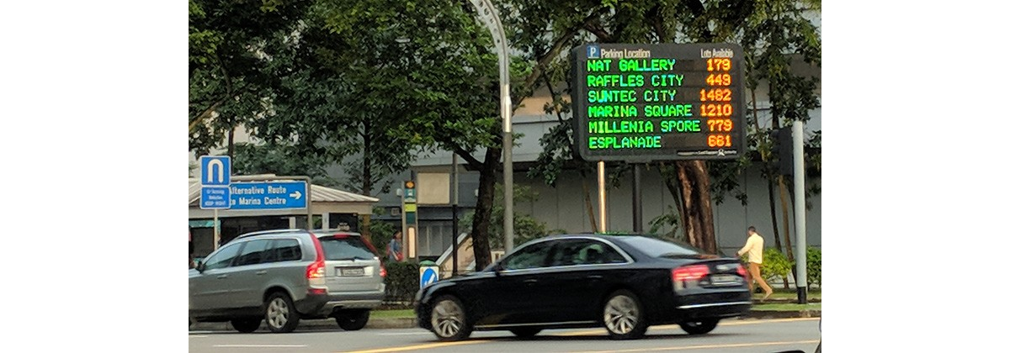
Singapore - Smart Mobility
Bike sharing
App based bike renting service
Flat fee for first thirty minutes and subsequent charge per minute
Smart Parking
Parking information displayed on electronic sign boards or online via One Motoring and other applications
Pay for parking via app
Promotes more efficient use of existing parking facilities

Slide 5
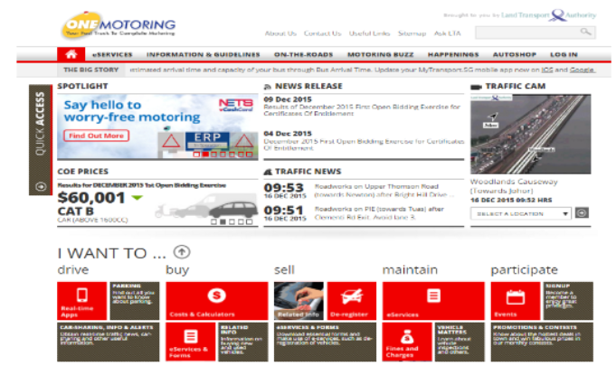



Singapore – Smart Mobility
Singapore – Smart Mobility
City Service Applications
One Motoring
A comprehensive portal provides traffic information from surveillance cameras and taxis with GPS.
Snapshots of roadways taken every 5 minutes
Provides ERP rates, traffic news, road work information, traffic images, travel time calculator, road maps and directions, and parking information
MyTransportSG
Provides bus loading information for more than 4700 public buses
Color coded bus space availability
Track traffic in real time
PARKING.SG
Pay for parking through mobile app
SG Bike
Largest bike sharing service in Singapore

Slide 6
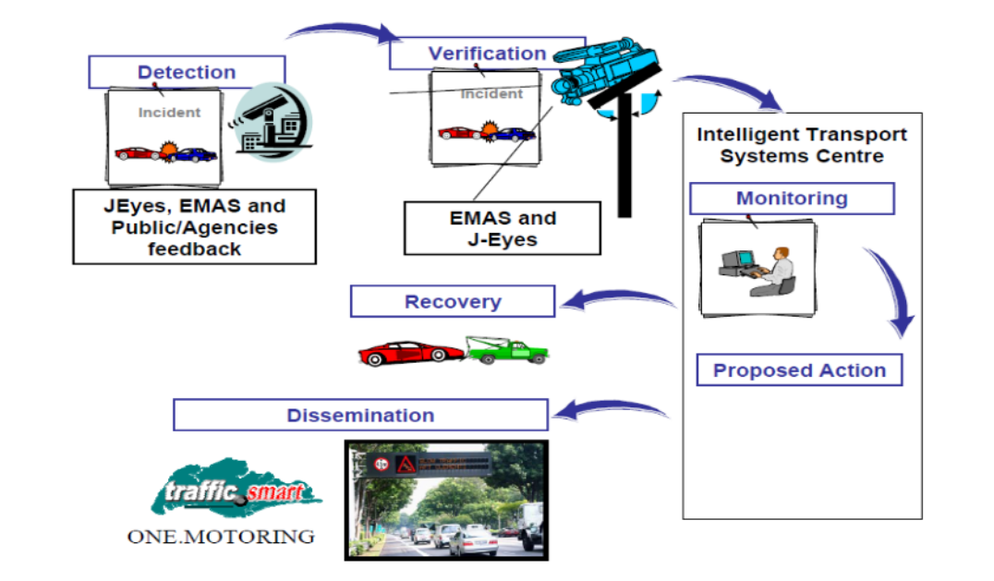
Singapore – Smart Mobility
Express Monitoring Advisory System (EMAS)
Surveillance cameras look out for road accidents
When accident is detected, a vehicle recovery crew arrives withing 15 minutes to the nearest car park
Travel time information provided on signboards
Graphics and color coded information provided on traffic situation ahead

Slide 7
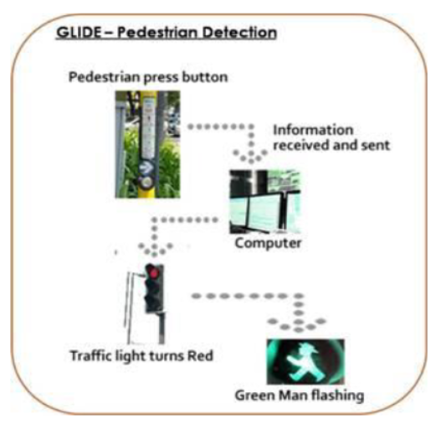
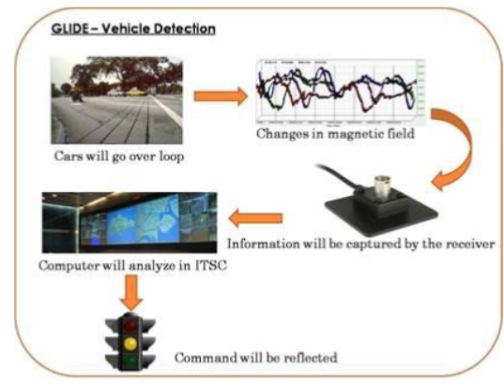
Singapore – Smart Mobility
Singapore – Smart Mobility
Smart Traffic Lights - Green Link Determining System (GLIDE)
All traffic signals controlled by this system
Green light allocated based on real time traffic demands
Minimize driver stops
Automatically detect traffic flow, traffic light faults, and pedestrians through the use of thin metal wire detector loops below road surface and before signal junctions
Links traffic signals at adjacent junctions and coordinates their green start times

Slide 8
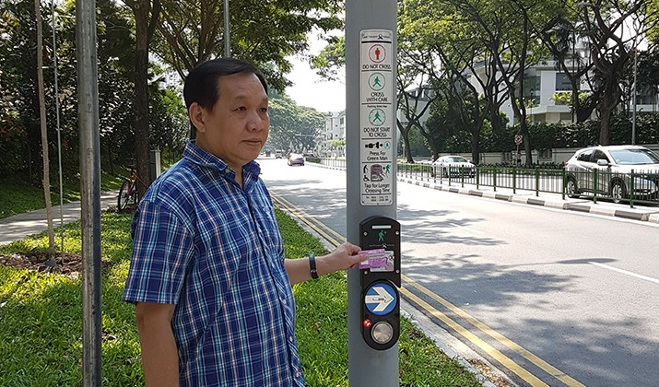
Singapore – Smart Mobility
Smart Traffic Lights - Green Man+
Allocates longer green man time for elderly and people with disabilities
Provides 3-13 seconds more green time
Simply tap senior citizen or person with disabilities concession card on card reader above push button

Slide 9
Singapore – Smart Mobility
Driving characteristics of smart mobility
Use of city applications to inform motorists of driving conditions and public transport availability
System to provide real time information on parking availability
Enhanced green light systems to ease flow of traffic and create safe pedestrian mobility
Smooth, safe, and swift accident response to restore flow of traffic
Use of taxi gps system to collect travel information

Slide 10






Singapore – Smart Mobility
Leading stakeholders
Singapore residents
Singapore Government
Project Partners

Slide 11
Singapore – Smart Mobility
Relationship among stakeholders
Taxi gps systems used to collect travel information and predict future congestion (TrafficScan)
TrafficScan information provided to EMAS, GLIDE, and OneMotoring
Buses cooperate with Land Transport Authority to provide bus availability information
Surveillance cameras provide visual information on traffic conditions
ITS center decimates accident information provided by cameras via OneMotoring
Residents use data provided to navigate efficiently

Slide 12
Singapore – Smart Mobility
Apparent technology level
Partnership with private companies
Bike sharing
Smartphone app to unlock bikes
Smart parking
Electronic sign boards
Smartphone app for parking payment
GLIDE
Metal wire detector loops below road surface
EMAS
Cameras installed on poles and street lamps
Green Man+
Card readers on street crossing poles

Slide 13
Singapore - Smart Mobility
Hard Constraints
Growing populations and lack of space make traffic management difficult in Singapore
2/3rds of young in Singapore aspire for car ownership
Lack of bicycle parking spaces and showering facilities to facilitate increased bike riding

Slide 14
Singapore – Smart Mobility
System considerations
Economical – Increased transportation efficiency to reduce cost to departments and residents
Ecological – Singapore aims for 9 in 10 peak period journeys to be made via Walk-Cycle-Ride modes and have greener bus and taxis by 2040
Scientific and Technological – Investment in electric and autonomous public transportation to be made
Social – Facilitate car-lite culture
Political – Completely government funded with no outside funding

Slide 15
Singapore – Smart Mobility
What is the System-of-Interest For?
Seeks to manage traffic flow, provide reliable public transport, and support mobility options for a car-lite city.
Convenient, well connected, and fast transport system
Integrate a greener more inclusive public transport system that promotes healthier lives

Slide 16
Singapore – Smart Mobility
Why does the sponsor want the system?
Provide motorists with real time information to increase traffic flow
Enhance reliability of public transport to support car-lite nation
Create efficient, well connected, and fast transportation network to meet demands of growing population

Slide 17
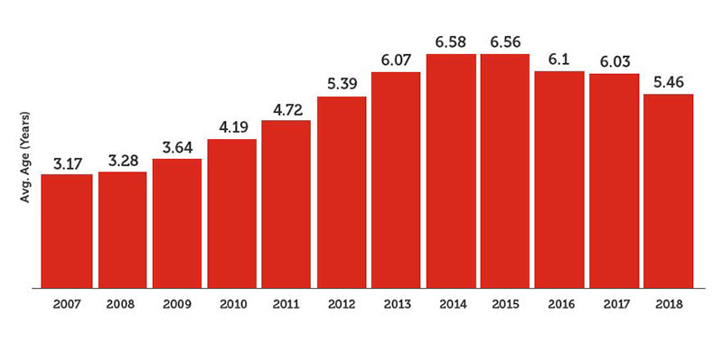
Singapore – Smart Mobility
Tangible benefits of Smart Mobility – Private car ownership decrease
Decrease

Slide 18
Singapore – Smart Mobility
Value of system – Intangible Annual benefits for smart mobility
Increase used of public transport facilitate car-lite nation
Increase health benefits from physical mobility
Faster travel time
Increased access to transportation city services
Reduction in air pollution

Slide 19
Singapore – Smart Mobility Use Cases and Descriptions– Bicycle Share (Bicing) for Smart Mobility:
Domain Case | Use Case | Brief Use Case Description
Bike Sharing | Setting up | Customer installs bike sharing application, creates an account, and links a payment method
 | Unlocking | Customer scans QR code using application or enters bike number to unlock bike
 | Ending trip | Customer returns bike to designated parking areas (marked as P’s on application), and pushes red lever to lock bike and raise bike stand

Slide 20
Singapore – Smart Mobility Use Cases and Descriptions– Smart Parking for Smart Mobility:
Domain Case | Use Case | Brief Use Case Description
Smart Parking | Determine Available Parking | Sensors under parking spots detect absence and presence of cars. Information is transmitted to roadside electronic panels and mobile application via wifi.
 | Download and register Parking.SG app | User downloads Parking.SG app on Android or iPhone.
 | Use Parking.SG app | User selects car park location and vehicle details to view costs and parking end time. User then adds their card information, enters parking duration, and pays for parking
 | End parking session | User ends parking manually or session is ended automatically based on chosen duration

Slide 21
Singapore – Smart Mobility Use Cases and Descriptions– Smart Traffic Lights for Smart Mobility:
Domain Case | Use Case | Brief Use Case Description
Smart Traffic Lights | Detect traffic flow | Thin metal wire detector loops below road surface detect vehicles and activation of pedestrian buttons detect pedestrians
 | Provide efficient green light time | Computer provides optimal green light time based on real time traffic demands and links traffic signals at adjacent junctions to coordinate their start times.
 | Use GreenMan+ | Pedestrians use senior citizen or person with disabilities concession card on card reader to increase green man time.

Slide 22
Singapore – Smart Mobility Use Cases and Descriptions– Express Monitoring and Advisory System for Smart Mobility:
Domain Case | Use Case | Brief Use Case Description
Express Monitoring and Advisory System | Detect incident | Cameras and public feedback are used for detection of incidents
 | Respond to incident | Intelligent Transport Systems Centre staff propose action based on incident such as vehicle recovery
 | Disseminate information | Incident information displayed on electronic road signs or via the ONE.MOTORING website

Slide 23
Singapore – Smart Mobility Use Cases and Descriptions– City Service Applications for Smart Mobility:
Domain Case | Use Case | Brief Use Case Description
Citi Service Applications | Use ONE.MOTORING wesbite | Users can access ONE.MOTORING with a pc. The website provides semi-live traffic feeds and incident information. Users can also perform a variety of other transport related tasks such transfer vehicle ownership or purchase licenses
 | Provide access to Singapore mobile apps | Links to the various smart apps are included in Useful Apps section of the Smart Nation Singapore Website

