Slide 1
Trajectory
Pushing you off into the unknown.

Slide 2
Idea
A chatbot to help you in planning for the weekend trip.
Give your budget, time period you’re free and we’ll personalize a trip just for you!
Theme
Code Cruise + Autodata

Slide 3
So, what’s different?
“arey bhyi, I read that post last week on that blog about best party getaways under 3000, it’s the same rey”
Takes your budget into consideration and locates the best fit places for you considering length of stay, travel cost, hotel costs, season of booking etc.
Analyzes your FaceBook and Twitter profiles to get a hint of your personality (it wouldn’t be nice of us to send you off to museums if you’re a party animal)
A much cooler interface (Telegram or Messenger!) which won’t get bored no matter how many times you query it, and with as many parameters as you want!

Slide 4
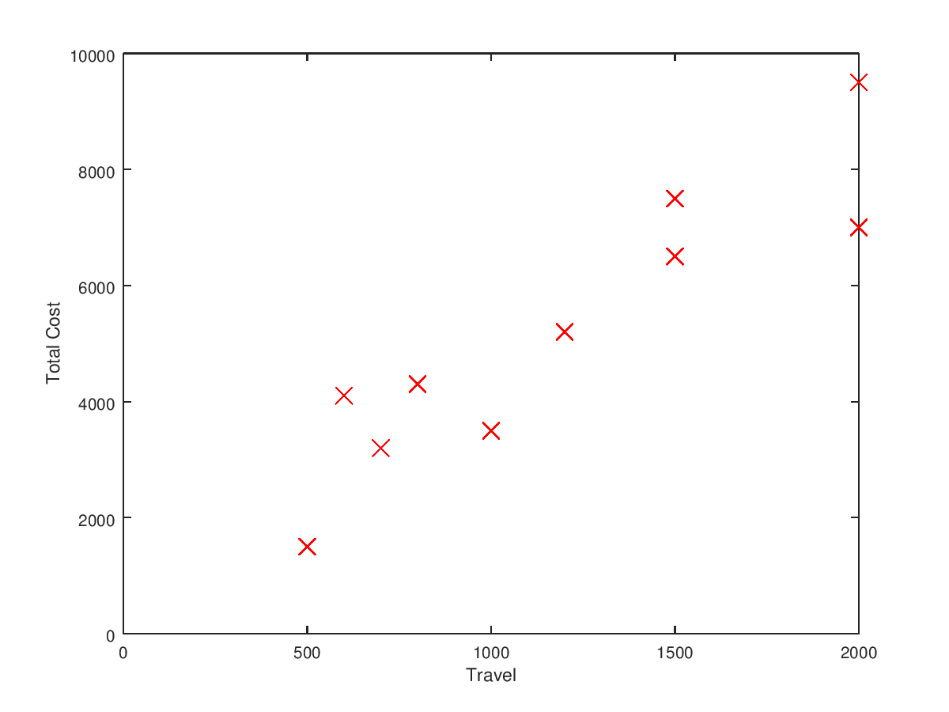
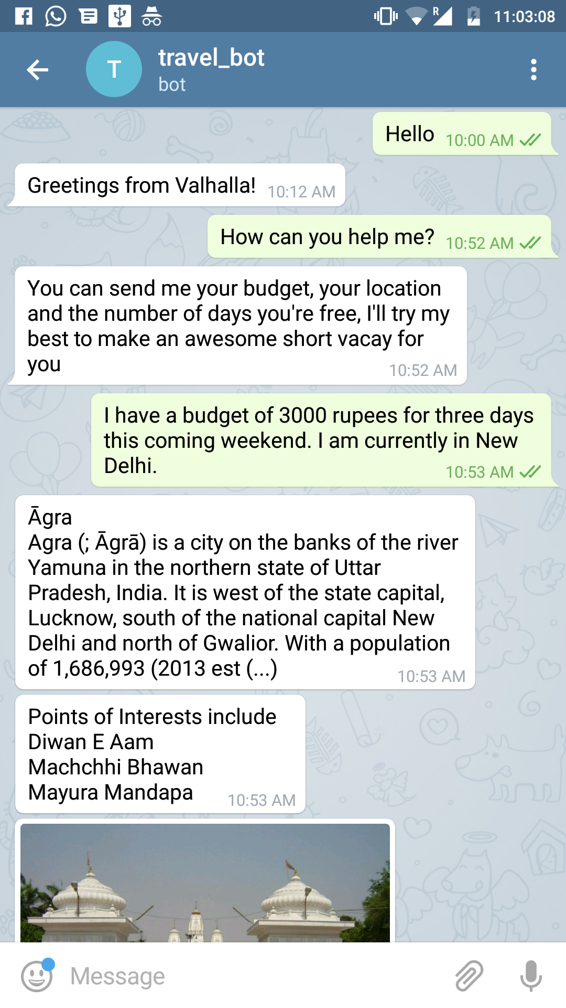
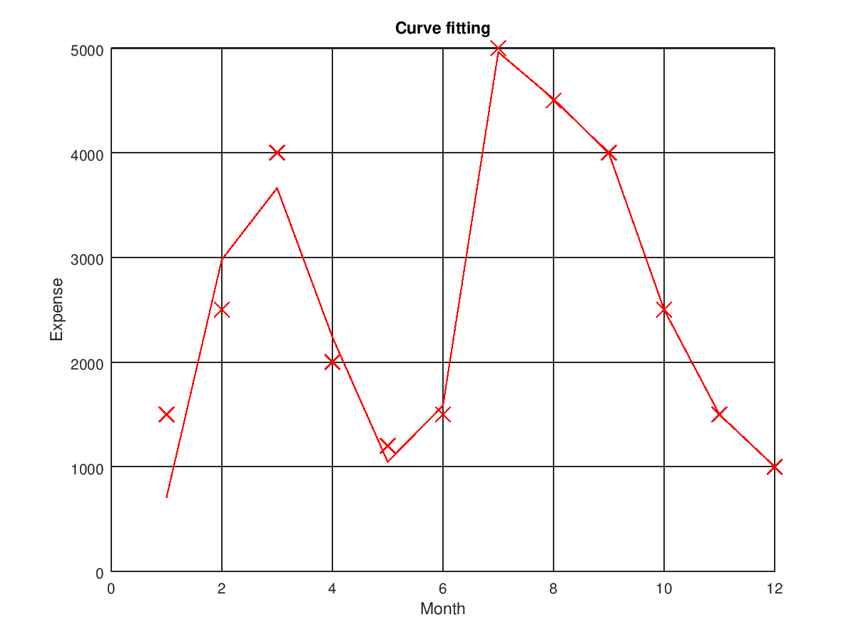
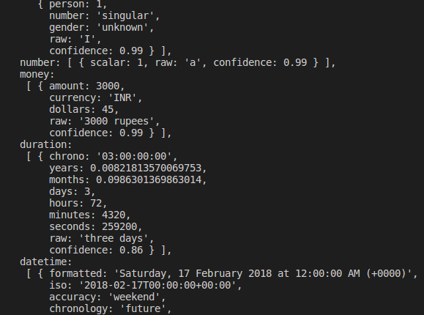
Working
=
@trajectory_bot on Telegram

Slide 5
Datasets Used
Open Data Government to calculate the average expenditure by every traveller (in India). This includes all costs incurred like housing, adventure sports etc
MMDS Project for personality insights.
Open Source Projects/ APIs Used
MapMyIndia to get points of interest
Geodist to get geographical information
Telegram-Bot-Api to connect with Telegram

Slide 6
The code can be found at github.com/kvaluruk/3AM
Thanks!
Vibhor Vimal and Yash Sharma

