Slide 1
DROWSINESS DETECTION WHILE DRIVING
REVA HACKOTHAN 2021-22

Slide 2
PROJECT DESCRIPTION
In National highway authority of India contemplated that during mid-night 90% mishaps are expected the driver's sluggishness and exhaustion. With this view, making of clever vehicles has been dramatically expanded. Self-driven vehicles can end up being an extraordinary method to manage sleepy driving.
But if the vehicle consists of drowsiness detection model with it then an alert will be given to the driver if the driver found to be drowsy. The advantage of this model is it will generate an alert and there will be no chances or minimal chances of meeting with an accident due to driver’s drowsiness.

Slide 3
Scipy -
It is an open-source Python library used for legitimate enrolling and specialized registering. It contains modules for advancing, straight variable based math, incorporating, addition, uncommon capacities, and designing reason.
Imutils -
Imutils are a large number of comfort capacities to make essential picture handling capacity as an illustration interpretation, revolution, resizing, skeletonization, and showing Matplotlib pictures simpler with OpenCV and both Python 2.7 and Python 3.
Numpy-
It is a library is from Python which adds support for enormous, multi-dimensional clusters and grids, alongside a huge assortment of undeniable level numerical capacities to work.
Pygame-
Pygame is a bunch of Python modules intended for composing video games and it works in cross platform mode also. It is included with PC illustrations and sound libraries intended to be utilized with the Python programming language.
TOOLS AND TECHNOLOGIES

Slide 4
FUNCTIONAL REQUIREMENT
The project includes three modules. The modules are Capturing image and preprocessing, Implementation of algorithm to generate eye aspect ratio, Detection of drowsiness.
Module 1:
Capturing image and preprocessing. Purpose: Capturing Image, Video and converting the same to text format Input: Video Function: It will accept the image in video format and the system will convert it to text format for preprocessing. In preprocessing the system will convert the received image which is of video format and the libraries of python will convert the same to text format.
Output: Image with preprocessed data will be obtained.
Module 2:
Implementation of algorithm to generate eye aspect ratio. Purpose: To generate Eye aspect ratio Input: Text format data from first module Function: Determining Eye Aspect Ratio and plotting of graph.
Output: It will generate a graph.
Module 3:
Detection of Drowsiness Purpose: To detect the drowsiness and give an alert if application finds the same Input: Graph from second module Function: It will detect drowsiness from the data and will give alert to the driver.
Output: It will give alert to the driver if the driver is drowsy.

Slide 5
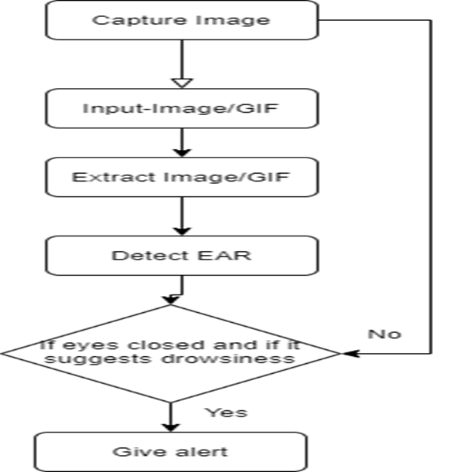
System design

Slide 6
SOFTWARE TESTING
Testing
Testing is a process, to evaluate the functionality of a software application with an intent to find whether the developed software met the specified requirements or not and to identify the defects to ensure that the product is defect-free to produce the quality product.
Unit Testing and Integration Testing
The unit testing and system testing are the interdependent activities of software testing. Unit testing is the method of testing various isolated software components separately. Integration testing is the process of testing the interface between two software units or modules. Its focus is on determining the correctness of the interface. These testing strategies has been used to check that the system behaves as expected. The testing strategy was based on the functionality and the requirements of the system

Slide 7
CONCLUSION
In this project first an live image will be captured from the camera and it will be converted to text format and it will be sent to check Eye aspect ratio,followed by this then a graph will be generated based on the image and Eye aspect ratio will be calculated and it will be compared with the threshold value, frames of the image and count of the same.In the last step drowsiness will be detected based on the comparison of Eye aspect ratio value with the threshold value and if it exceeds the limit then system will predict the condition as drowsiness and then an alarm will ring till the driver open both the eyes.As per the accuracy concern the algorithm is tested for 100 images and found to be 90% accurate.

Slide 8
FUTURE ENHANCEMENT
The main aim of this project is to detect vehicle driver’s drowsiness and giving alert on the same if found. The system is designed in such a way that it takes video from the normal camera whereas in future advance cameras can be deployed with some exorbitant features like infra-red, night vision, AI features etc.
In future a mobile app can be developed where the camera will be integrated with wire/wireless medium with the app and it will predict whether the driver is drowsy or not and even it will detect driver’s drunken status either

Slide 9
THANK YOU

