Slide 1
WELCOME
TO OUR
PRESENTATION

Slide 2



Ancient tools
Industrial evolution
Modern technology

Slide 3
TECHNOLOGY
AND
LIFE
Group’s member:
Nguyen Minh Tri – 17552568
Tran Nhu Anh Vu – 1752632
Lam Gia Hung – 1752254
Nguyen Phuc Minh – 1752348

Slide 4
Content
Smart home
Transportation
Communication
Education

Slide 5

Education
write the knowledge
in some bamboo tape or pieces of paper

Slide 6

Education
Internet arrived; data is shared around the world.

Slide 7





Education
Multimedia
Virtual Tour
Keep Class
Schedules Online
Social Groups
Feedback, Quiz
and Surveys

Slide 8

Smart home
Smart cities
Wearables
IoT devices
Smart Retail
Autonomous Vehicles

Slide 9
Smart home
Make life easier and more convenient.
Giving command by voice, remote control, tablet or smartphone, the home reacts.
Most applications relate to lighting, home security, home theater and entertainment, and thermostat regulation

Slide 10
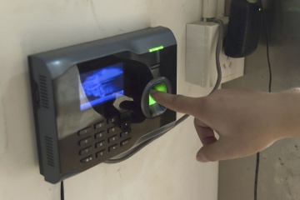
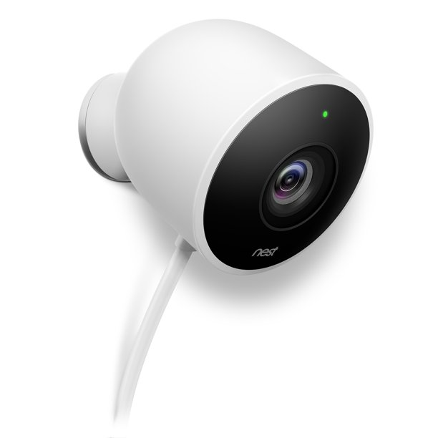

Smart home
LED lights
Smart locker
Motion sensors
Some other devices…

Slide 11
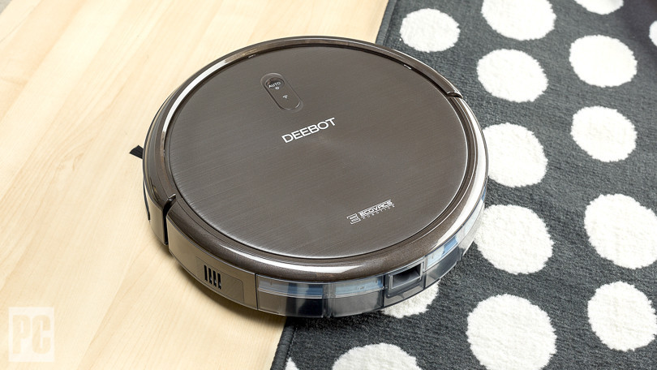
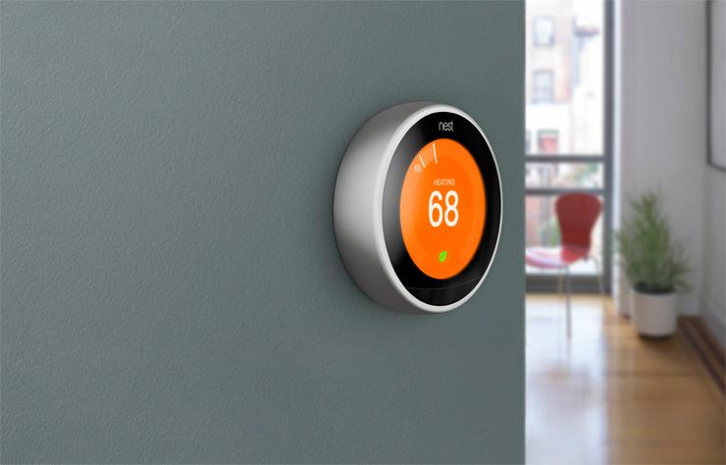
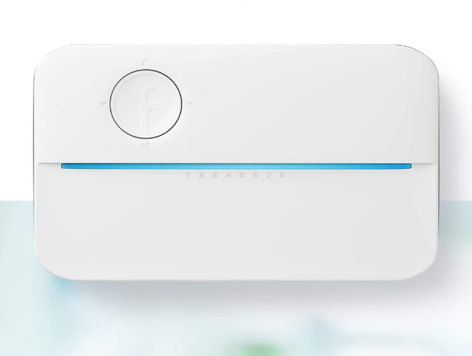
Smart home
Smart Vacuums
Nest Learning Thermostat
Smart speaker
but there are many challenges to overcome.
When planning the system, it's important to consider a few factors…

Slide 12


Smart home
?
How many people will be required to use the system
Who will know how to operate the system
Who will know how to maintain the system and address failures

Slide 13
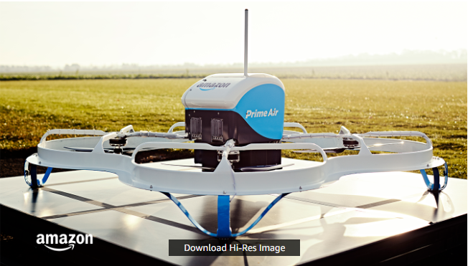
Transportation
Drone Delivery
30 minutes or less
Amazon Prime Air
Up to 5 pounds
Expensive

Slide 14



Driverless Cars
Less traffic
More free time
Better health
Increased Demand for
New Jobs
Tesla
Google

Slide 15



Space tourism
Seven people go to the space in first space tourist in 2001
$20 million
No space tourist
has flown since 2009

Slide 16
Space tourism
Virgin Galactic
More than 700 people
$200.000 and $250.000
Each flight will be six passengers
Experience weightlessness and be afforded incredible views of Earth

Slide 17




Communication
long distance
time consuming
and
outdated
information
Use letters

Slide 18




Communication
Chat app
is one of the best evolution in human’s technology

Slide 19



Communication
Some companies have created platforms where people can send and receive money from any location having Internet.

Slide 20
References:
www.hippovideo.io/blog/10-ways-can-use-technology-in-education/
www.questsolution.com/blog/item/57-how-technology-is-changing-the-transportation-and-logistics-industry
www.amazon.com/Amazon-Prime-Air/b?ie=UTF8&node=8037720011
www.wired.co.uk/article/spacex-blue-origin-space-tourism

Slide 21

THANK YOU
FOR YOUR ATTENTION

