Slide 1

DEPARTMENT OF COMPUTER SCIENCE AND ENGINEERING
DUPLICATE PROJECT CHECKER
Under the Guidance of
Mrs.G.SWAPNA
CHEPPALI KALYANI
R190388

Slide 2
ABSTRACT
Project Management System aims to streamline student project management and prevent duplication across the university.
Using Python and Flask, it allows users to search and compare project titles in the student database.
The system detects duplicates by comparing project titles with student data, including name, ID number, section, and faculty guide.
The user-friendly interface enables quick searches, displaying potential duplicates and detailed student and guide information.
Emphasizing user experience, the platform is easy to navigate for both students and faculty.

Slide 3
Current progress includes a project title search function, user interface design, and database integration for accurate duplicate checks.
Future enhancements will add features for viewing guides and managing projects efficiently.
The system helps prevent project duplication and streamline the project management process for the university.
Users can quickly search for project titles and view results of potential duplicate projects.
The platform provides detailed information regarding students and their respective guides.
The system integrates seamlessly with the student database for accurate and efficient duplicate checks.
It supports both students and faculty in managing and monitoring projects effectively.

Slide 4
INTRODUCTION
Project management is essential for organizing, executing, and tracking various projects, especially in academic settings.
The "Project Duplicate Checker" is an innovative system designed to help university staff and students identify duplicate project titles.
It ensures that no two students work on the same project.
This system streamlines and enhances the management of student projects.
It prevents redundant work and promotes originality.
Traditionally, identifying project duplication was a manual task performed by faculty members.
This manual process was time-consuming and prone to human error.

Slide 5
With the increasing number of students and projects in academic institutions, an automated and efficient solution is essential.
The "Project Duplicate Checker" addresses this need by utilizing web technologies and backend systems.
It enables faculty to manage projects and track potential duplications easily.
In educational institutions, project duplication occurs when multiple students choose the same project.
This leads to redundant work and confusion among students and faculty.
Traditional methods of checking for duplicate projects rely on manual inspection.
Manual inspection is not scalable and can lead to delays in project approvals.
The "Project Duplicate Checker" solves this problem with an automated system.
It allows faculty and students to efficiently check for duplicate projects based on project titles and other relevant details.

Slide 6
Students can quickly identify any potential duplicates.
This approach minimizes the administrative burden on faculty.
It allows faculty to focus on more critical aspects of project guidance and assessment.
The system improves efficiency by automating the process of checking for duplicate projects.
It saves time fBy implementing a web-based platform, the system enables students to search for their project titles.
or both faculty and students.
The tool ensures that students select original projects, fostering creativity and innovation.
By providing an easy-to-use platform, the system reduces unnecessary work and promotes academic integrity.

Slide 7
LITERATURE
Efficient management of project duplication detection is crucial for maintaining academic integrity and encouraging originality among students.
Traditionally, supervisors have relied on manual methods and personal knowledge to identify duplicate projects.
These methods are often slow, prone to errors, and limited by the expertise available.
This can lead to delayed interventions and unintentional approvals of plagiarized projects.
As the educational sector faces increasing challenges, there has been a gradual shift towards digital solutions to enhance project management.
Basic online systems have emerged as initial improvements over manual processes.
These systems provide platforms for supervisors to check project titles and abstracts against existing databases.

Slide 8
However, these applications often lack advanced features such as real-time updates and comprehensive project databases.
They also lack tailored recommendations, leading to potential oversight and suboptimal project management practices.
Despite these limitations, basic online systems have helped reduce some of the burden associated with manual duplication checks.
They provide supervisors with quicker access to information.
Basic online systems often fall short in providing comprehensive project information and tailored recommendations.
They may lack real-time updates on project submissions and advanced comparison capabilities.
This can result in missed duplicates and ineffective management practices.
Despite these shortcomings, basic online systems have played a crucial role in alleviating some of the burden associated with manual project duplication checks.

Slide 9
Year | Authors | Method | Outcome | Drawback
2011 | M. Abubakar et al. | Web-based supervision management system prototype | Web-based supervision management system prototype | Dependency on large datasets, performance variability across datasets
2013 | A. Abdulkareem et al. | University portal for managing undergraduate projects using ASP.NET and Microsoft SQL Server | Automates supervisor allocation, manages project processes | Complex implementation, limited duplication detection
2017 | Jumoke Soyemi, Folasade O. Isinkaye | Web-based student project duplication detection using HTML, JavaScript, CSS, and PHP | Prevents project duplication, encourages originality, provides a centralized database for supervisors | Requires manual input, lacks real-time updates.

Slide 10
MOTIVATION
The motivation behind the development of the "Project Duplicate Checker" is to maintain order and clarity in managing academic projects.
With a growing number of students, the likelihood of project duplication increases, making manual handling impractical.
This system aims to improve efficiency by automating the process of checking for duplicate projects.
It saves time for both faculty and students.
The tool ensures that students select original projects, fostering creativity and innovation.
By providing a platform for easy search and check of project titles, the system reduces unnecessary work.
It promotes academic integrity and ensures that project titles are unique.

Slide 11
CONTRIBUTION
The "Project Duplicate Checker" contributes to academic project management by offering several key benefits.
The system integrates a search function that allows students to check if their project has already been taken before submitting their final proposal.
This ensures originality and helps reduce redundancy, promoting a more efficient workflow within the academic environment.
The functionality significantly reduces the workload for faculty, allowing them to approve or reject projects with minimal effort.
The backend of the system, powered by Python and integrated with a database, ensures accurate and real-time updates of project statuses.
The platform prioritizes user experience by featuring a simple and intuitive interface.

Slide 12
MODULE-1
The Project Search and Duplicate Checking module ensures no two students submit identical or highly similar project titles.
This functionality promotes originality and prevents plagiarism in student projects.
Users can search for existing projects by entering the title or related keywords.
The system uses an algorithm to compare the input with existing project titles and identify duplicates.
Search results include details like student names, ID numbers, sections, email IDs, project titles, and guide names.
The system notifies the user if no matching projects are found or if duplicates exist.

Slide 13
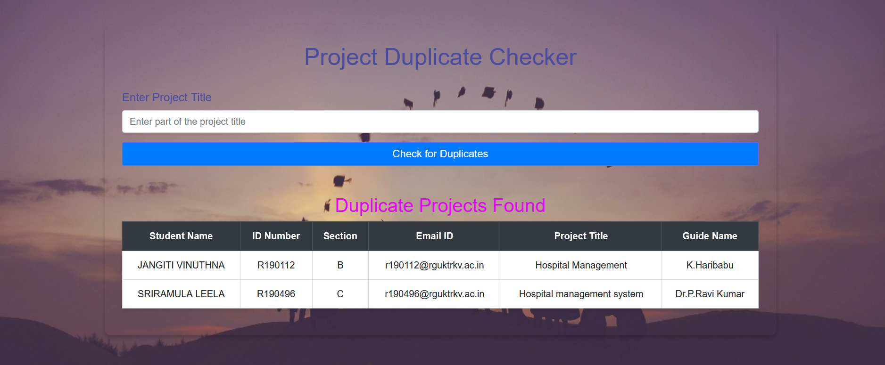
The interface is user-friendly, with a search bar, button, and results section.
The duplicate checking mechanism processes the input, queries the database, and uses similarity assessment algorithms.
Results are displayed in a table format, making comparison easy.
The system ensures fast, responsive search processes with optimized database querying and data integrity checks.

Slide 14
MODULE-2
The Database Management module ensures efficient, reliable, and secure management of data in the Project Management System.
It uses SQLAlchemy for seamless communication between the Flask application and MySQL database.
The primary objective is to manage and manipulate data efficiently, ensuring integrity and security.
Database configuration involves setting up the database URI, username, password, host, and secret key.
Data models are defined using SQLAlchemy classes, representing tables and columns in the database.
Key data models include "Students_data" for student information and "guide" for guide details.
The module executes SQL queries using SQLAlchemy, providing flexibility for complex operations.

Slide 15
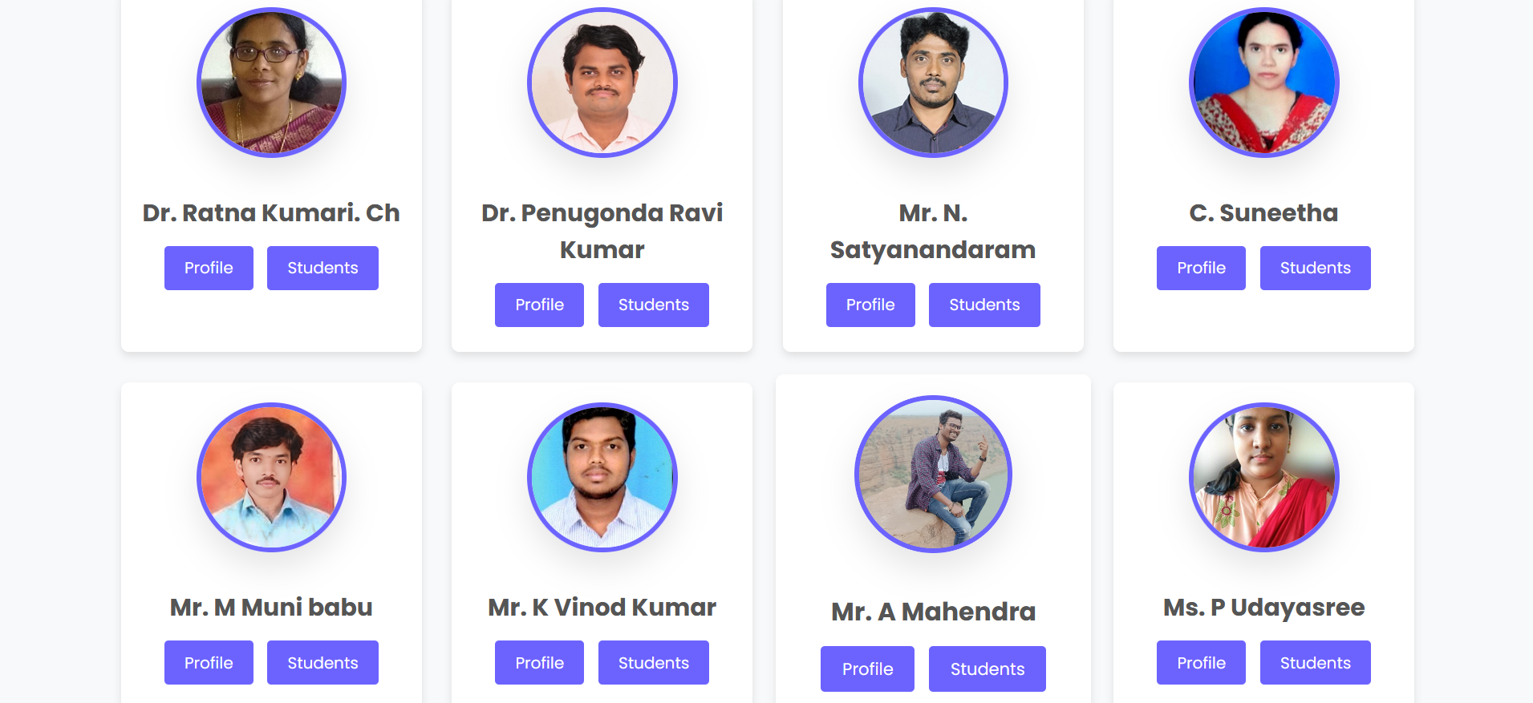
Key functionalities include student login, guide information retrieval, project checking, and student profile viewing.
The student login validates ID and SSC details to allow access to the system.
The project checker feature helps ensure project uniqueness by identifying similar projects and displaying relevant
The guide information feature displays details about faculty members, including names, images, and students working under each guide.

Slide 16
MODULE-3
The User-Friendly Interface module ensures an intuitive and seamless experience for users.
The home page serves as the central hub, providing easy access to different sections of the application.
The navigation bar offers links to the home page, guide, and project checker for easy navigation.
The introduction section provides a brief overview of the system's purpose and features.
Quick links offer direct access to frequently used sections like student login and project checker.
The student login page allows students to securely log in using their ID number and SSC details.
The guide information page lists all available guides, along with their names and images.
The students under guide page displays students working under a selected guide, with their details and project titles.

Slide 17
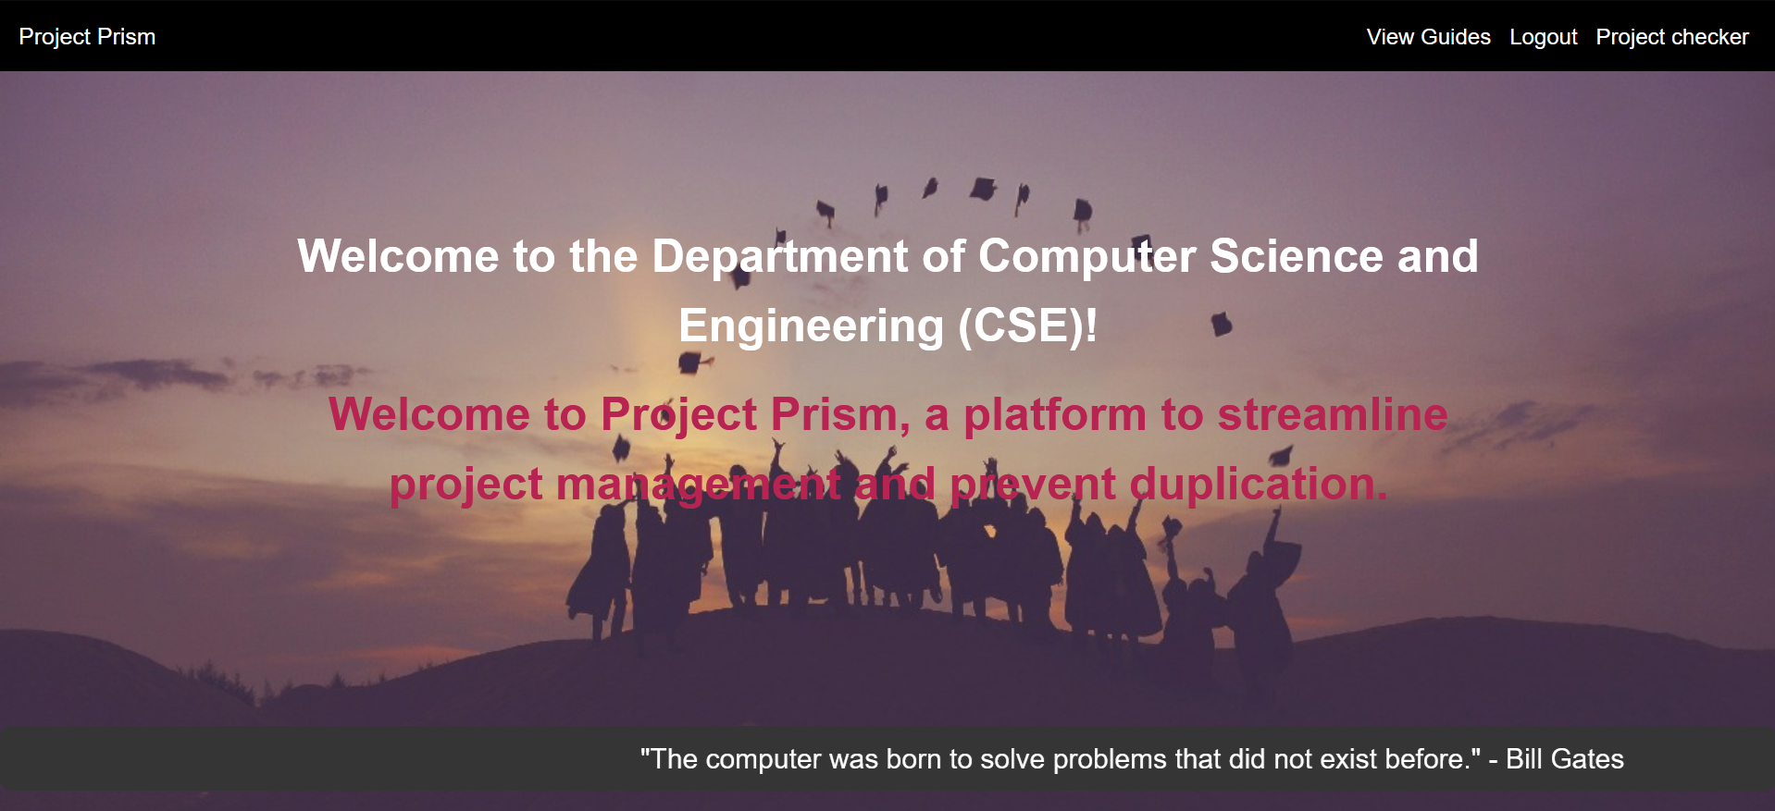
The project checker page allows users to search for existing projects and verify project title uniqueness.
The student profile page shows detailed student information, including project titles and associated guides.
The faculty profile page provides detailed information about faculty members and their students.
The faculty login page allows faculty members to securely log in to access their functionalities.

Slide 18
CONCLUSION AND FUTURE ENHANCEMENT
The Project Management System effectively manages student and project data while ensuring secure authentication.
It prevents duplicate project submissions, promoting originality and academic integrity.
MySQL and SQLAlchemy ensure secure and efficient data storage and retrieval.
Implementing automated notifications for project deadlines, updates, and announcements.
Adding features to track project progress and generate detailed reports.
Improving the search functionality with advanced filters and sorting options
Developing a mobile-friendly version or dedicated mobile app for increased accessibility.

Slide 19
REFERENCES
https://www.researchgate.net/publication/312523925_A_web-based_final_year_Students_Project_Duplication_Detection_System
https://www.rguktrkv.ac.in/index.php

