Slide 1
Agentic Self-Correction in LLaMA3
Enhancing E-Commerce Sentiment Analysis through Multi-Agent Reflection
Phase 1: Baseline
Phase 2: Multi-Agent Agentic
Amazon Reviews 2023 · 2,000 Samples
LLaMA-3-8B + LoRA · BLIP Visual Verifier · LanceDB RAG · Dissonance-Triggered Self-Correction
PES MTech Project · March 2026

Slide 2
01 · PROBLEM STATEMENT
The Problem: Why Single-Pass LLMs Fail
LLaMA-3 excels at language — but a single inference step has no factual verification
⚠
Sentiment Hallucinations
🔍
Context Blindness
💬
Linguistic Errors
AI mistakes user error for product defect
e.g. 'watch isn't waterproof' labelled as defect
— no access to spec sheets to verify claims
Ignores product images and metadata
Text-only: blind to shattered screen photos
Missing visual evidence = incomplete sentiment
Misreads sarcasm: 'Amazing, it broke in 2 days'
No critic to trigger re-evaluation
Mixed sentiment scored incorrectly
THE GAP
A critical need for a system that doesn't just read sentiment — but verifies it against product facts and multimodal evidence. The transition: passive single-pass classifier → agentic verifier-in-the-loop.

Slide 3
02 · RESEARCH GAP
From Passive Classifier to Agentic System
What the baseline does well — and the three gaps that motivate Phase 2
BASELINE (Wang et al., 2025)
Gullibility Gap
Factual Grounding
✓ LLaMA-3-8B + LoRA fine-tuning
Baseline assumes user text is always correct. No access to specs to challenge claims.
✓ DQC: TextBlob quality filtering
✓ VGST: diversity-maximising sampling
✓ One-Shot + Zero-Shot CoT prompting
Critic Gap
Autonomous Auditing
✓ Paper accuracy: 92.6% F1: 93.3%
→
No self-correction loop. Sarcasm and irony pass unchallenged through the single-pass model.
✗ Single-pass — no reflection
✗ Text only — no images/metadata
Visual Gap
Modality Isolation
✗ No factual verification
Text-only. Product images and metadata are ignored — a shattered screen photo is invisible.

Slide 4
03 · DATASETS
Datasets: Baseline vs Proposed
Two different datasets — one for training, one for the Phase 2 multimodal evaluation
Phase 1 — Kaggle Amazon Reviews
Phase 2 — Amazon Reviews 2023 (UCSD McAuley Lab)
Source: arhamrumi/amazon-product-reviews
Source: McAuley-Lab/Amazon-Reviews-2023
Size: ~500,000 product reviews
Scale: 570M reviews · 48M products · 33 categories
Labels: 1–5 star ratings
Eval: All Beauty · 2,000 samples
Fields: review text, rating, category
Review data: text, rating, user ID, timestamp
Challenge: heavy positive bias, noisy labels
Metadata: title, specs, category, price
Fix: TextBlob DQC + stratified sampling
Product images: multiple views per product
+ VGST diversity + neutral oversample
Final training pool: 4,000 samples
Enables: text + image + metadata reasoning

Slide 5
04 · DATA PIPELINE
Phase 1 Data Preprocessing Pipeline
Five ordered steps to produce a clean, balanced, diverse 4,000-sample training set
01
TextBlob DQC
02
Stratified Sampling
03
VGST
04
Oversample Neutral
05
Cap max_samples
Drop reviews where TextBlob polarity contradicts the numeric rating. Removes noisy, mislabelled examples.
Balance to equal counts per class (1–5 stars) up to 10,000 samples. Prevents majority-class bias.
Greedy diversity sampling: select reviews that maximise new token coverage. Lexical richness.
Duplicate rating-3 examples ×2. Neutral sentiment is the hardest class — more examples help.
Shuffle and take first 4,000. Final training pool is balanced, diverse, and neutral-boosted.
→
→
→
→
OUTPUT:
Clean · Balanced (equal per class) · Lexically Diverse · Neutral-boosted · Capped at 4,000 samples → fed into LLaMA-3-8B + LoRA (r=16, α=128, 5 epochs, best checkpoint)

Slide 6
05 · PHASE 1 TRAINING
Phase 1: LLaMA-3-8B + LoRA Fine-Tuning
Supervised fine-tuning with parameter-efficient LoRA — text-only, single-pass classification
LoRA: Parameter-Efficient Fine-Tuning
Hyperparameters
h = Wx + ΔWx = Wx + BAx
Learning Rate
5e-5
cosine scheduler
B ∈ ℝᵈˣʳ and A ∈ ℝʳˣᵈ with r ≪ d
Epochs
5
best checkpoint saved
Only A and B are updated — base weights frozen
Batch Size
3
grad accumulation = 4
Reduces trainable params from d² to 2·r·d
LoRA Rank r
16
paper uses r=4
Init: A ~ Gaussian, B = 0 → ΔW = 0 at start
LoRA Alpha α
128
paper uses α=64
Max Samples
4,000
paper uses 2,000
Target modules: q_proj, k_proj, v_proj, o_proj
Max Seq Length
1,024
truncation left
Layers: last 8 transformer layers
Quantisation
4-bit NF4
bitsandbytes
Quantisation: 4-bit NF4 (fits Colab T4 16GB)

Slide 7
06 · PHASE 2 ARCHITECTURE
Phase 2: Multi-Agent Agentic Pipeline
Four specialised agents with dissonance-triggered self-correction — LangGraph stateful workflow
AGENT 01
AGENT 02
AGENT 03
AGENT 04
Analyst
Visual Verifier
RAG Prover
Critic
LLaMA-3-8B + LoRA
BLIP + LLM
LanceDB k-NN (k=3)
Dissonance Engine
• Reads review text with one-shot + CoT
→
• Downloads product image via URL
→
• Queries vector index of review corpus
→
• Collects votes [H, Ev, Gf]
• Produces draft rating H (Hypothesis)
• BLIP generates text caption (Ev)
• Retrieves 3 similar past reviews (Gf)
• D = std(votes) / 2 (normalised)
• Same adapter as Phase 1 baseline
• LLM re-prompts with visual evidence
• all-MiniLM-L6-v2 384-d embeddings
• D ≥ 0.4 → self-correction loop
SELF-CORRECTION LOOP
When D ≥ 0.4: Critic generates targeted feedback → Analyst re-runs with critique injected into prompt → up to 2 iterations. On 922 of 2,000 samples (46.1%), agents disagreed enough to trigger the loop.

Slide 8
07 · CRITIC & SELF-CORRECTION
The Critic Node & Dissonance Mechanism
Mathematical definition of disagreement and the reflection loop that resolves it
Dissonance Formula
Decision Flow
D = √( Σ(vᵢ − v̄)² / 3 ) ÷ 2
D = 0.000
All agents agree → release immediately
D < 0.400
Low disagreement → majority vote wins
vᵢ = vote from agent i (1–5 stars)
v̄ = mean of three votes
D ≥ 0.400
High disagreement → Critic feedback loop
÷ 2 = normalise to [0, 1] range
Threshold: D ≥ 0.4 → trigger correction
Loop ×2
Max 2 correction iterations then release
Run 1 Statistics (2,000 samples)
Self-corrections triggered
Samples with D ≥ 0.4
Mean dissonance
Max dissonance
922
669
0.211
0.471
46.1% of all samples
33.5% of all samples
across all 2,000 samples
hardest disagreement seen

Slide 9
08 · PHASE 1 RESULTS
Phase 1 Baseline Results
Performance on Kaggle Amazon Reviews (4,000 eval samples) vs paper reference
Classification Metrics
Why the gap exists
Metric
Our Run (Colab T4)
Paper (RTX 4090)
Gap
Paper: RTX 4090, exact data splits,
Accuracy
66.6%
92.6%
−26 pp
full experimental setup.
Weighted F1
68.4%
93.3%
−24.9 pp
Our run: Colab T4 (free tier),
Macro F1
49.9%
—
—
single-sample inference,
4-bit quantisation.
Precision
74.1%
95.3%
−21.2 pp
BLEU-4
60.7
30.2
+30.5
Goal is methodological alignment
— not bit-for-bit reproduction.
ROUGE-1
64.5
85.5
−21 pp
Despite the gap, Phase 1 is our
controlled baseline for Phase 2
* Gap in BLEU-4 is positive because our model outputs full CoT reasoning text (longer sequences)
comparison.

Slide 10
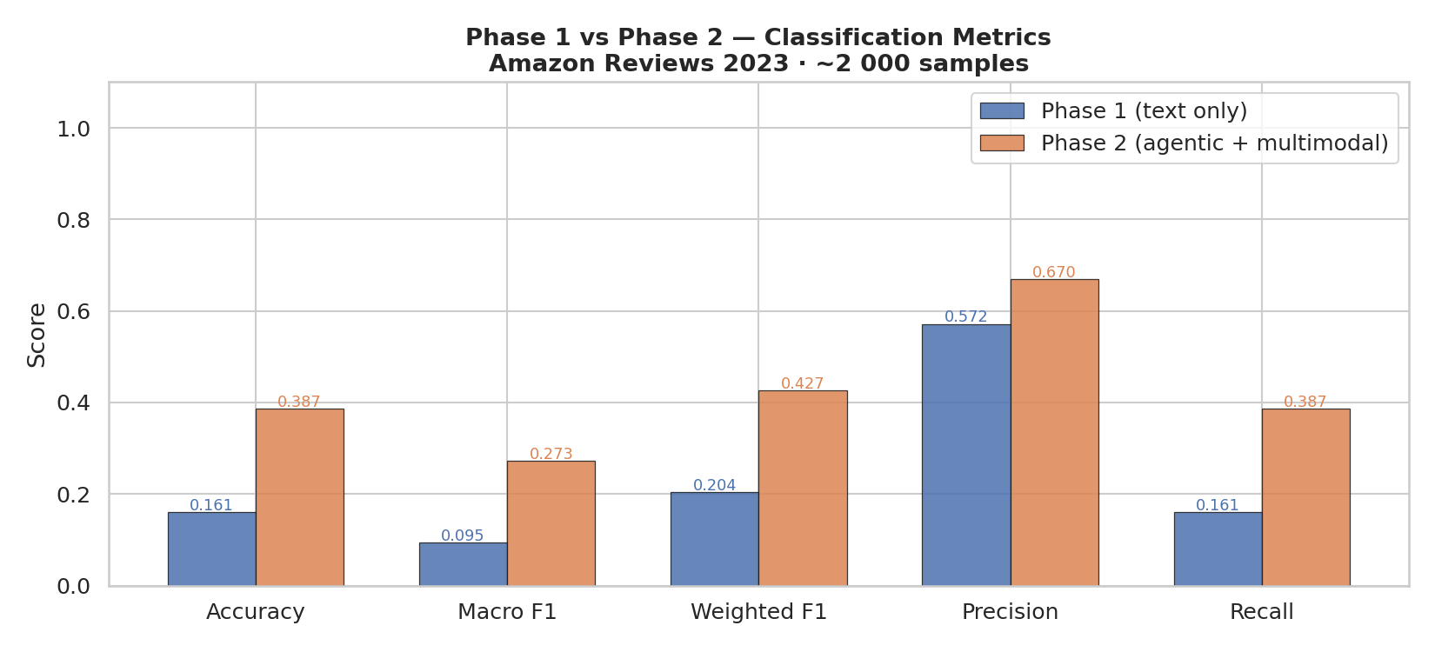
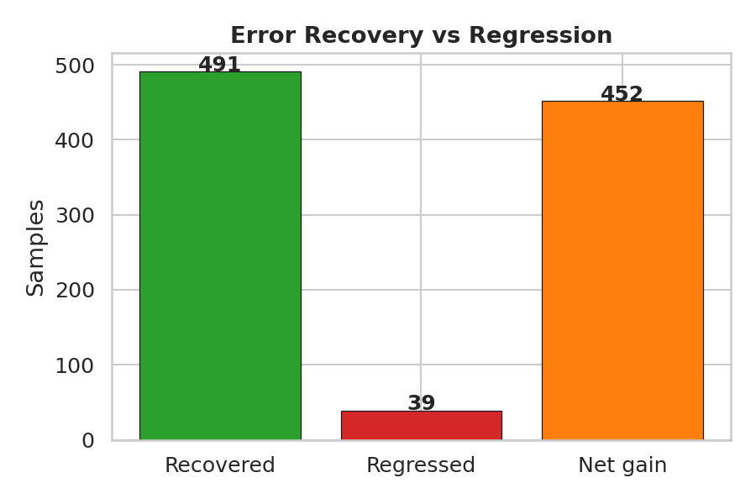
09 · PHASE 2 RESULTS
Phase 1 vs Phase 2: Headline Results
Amazon Reviews 2023 · All Beauty · 2,000 samples · Run 1
Accuracy
Macro F1
MAE
Latency
16.1%
38.7%
0.095
0.273
1.520
0.964
0.77s
2.83s
+22.6 pp
+17.8 pp
−0.557
3.7× overhead
Phase 1
Phase 2
Phase 1
Phase 2
Phase 1
Phase 2
Phase 1
Phase 2

Slide 11
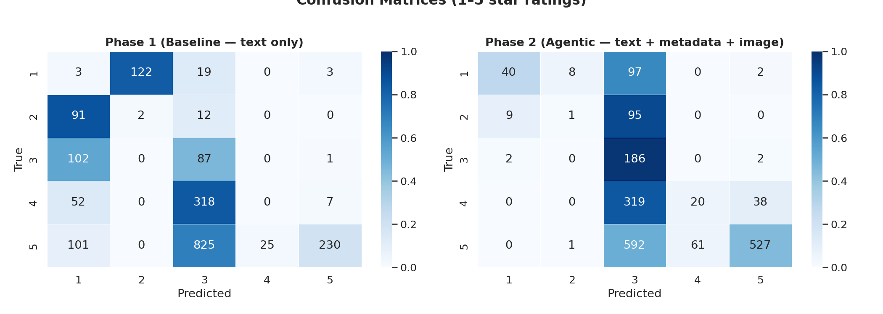
10 · CONFUSION MATRICES
Prediction Quality: Confusion Matrices
Phase 2 concentrates predictions along the diagonal — Phase 1 collapses to narrow classes
Phase 1: 90% of errors are under-predictions. Model collapses to 1★ and 3★. Only 25 of 377 true 4★ samples are predicted correctly (6.6% recall).
Phase 2: 5★ predictions jump from 241 to 569 — tracking the true distribution. 3★ accuracy reaches 97.9%. Diagonal is substantially denser.

Slide 12
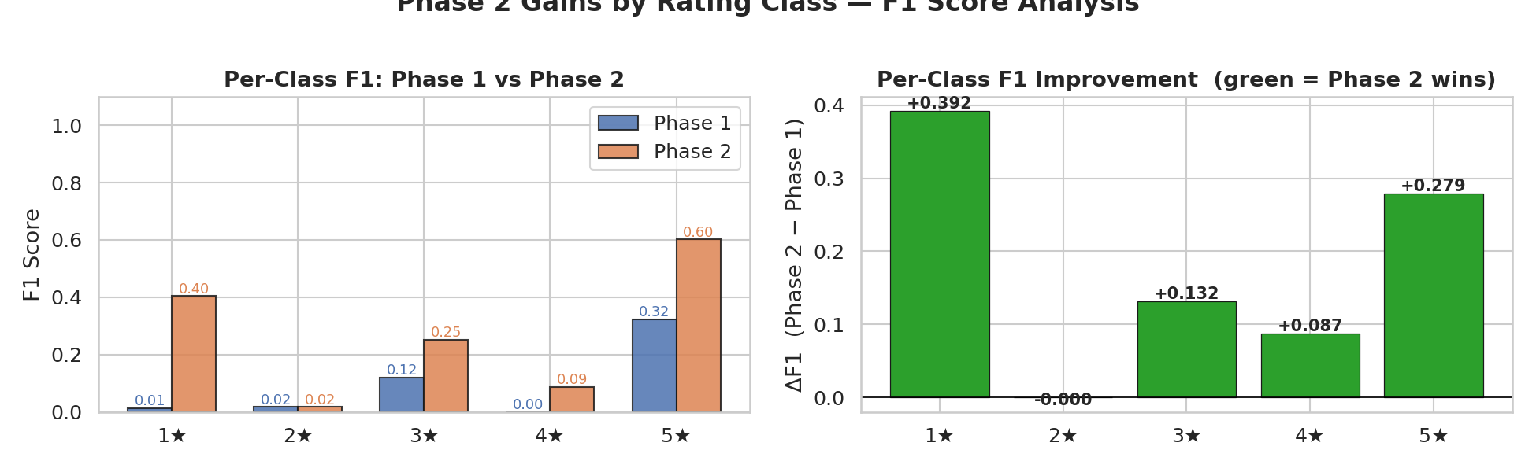
11 · PER-CLASS ANALYSIS
Per-Class F1 & Rating Distribution
3★ neutral class gains the most — metadata and image context resolve ambiguity
Per-Rating Accuracy
Class n P1 P2 Δ
1★ 147 2.0% 27.2%
+25.2 pp
2★ 105 1.9% 1.0%
−1.0 pp
3★ 190 45.8% 97.9%
+52.1 pp
4★ 377 0.0% 5.3%
+5.3 pp
5★ 1181 19.5% 44.6%
+25.1 pp
3★ is the biggest winner: metadata resolves neutral ambiguity

Slide 13
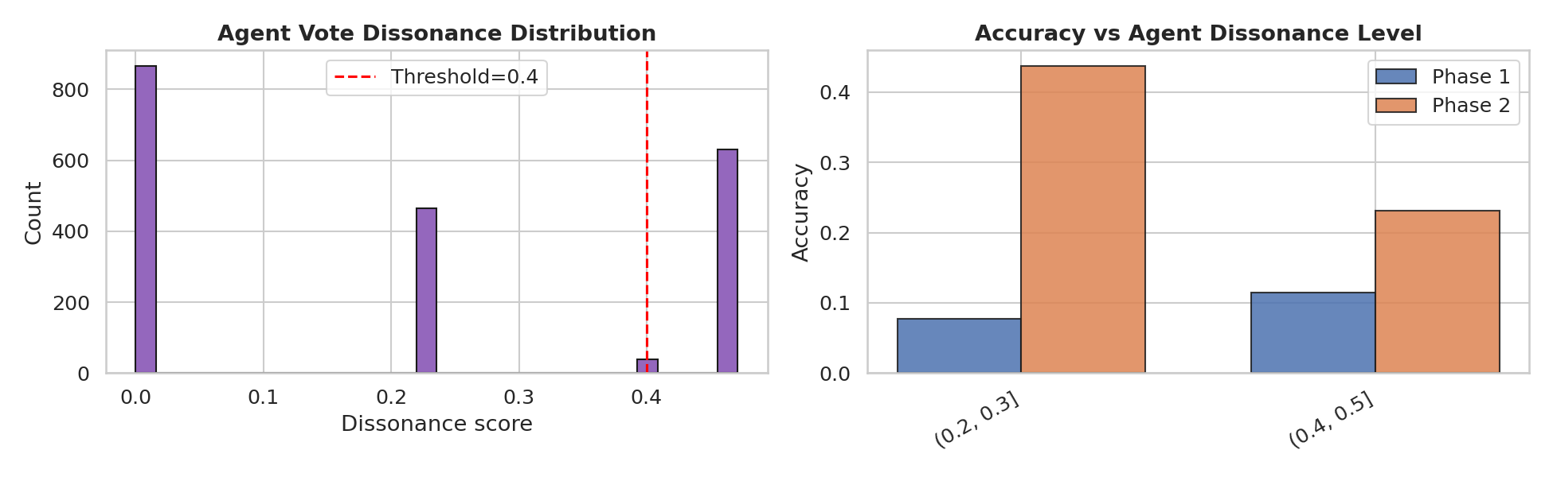
12 · DISSONANCE ANALYSIS
Agent Dissonance: When Agents Disagree
Dissonance is a proxy for sample difficulty — Phase 2 improves at every level
Key Findings
D < 0.1 (fully agree):
+23.9 pp gain — context alone helps, not self-correction
D ∈ [0.2, 0.3) (moderate):
+36.0 pp — biggest gain; agents converge despite ambiguity
D ≥ 0.4 (SC triggered):
+11.7 pp — hardest samples; loop helps but gains are lower
Primary insight: The +22.6 pp gain is NOT driven primarily by self-correction — context enrichment (metadata + BLIP) is the dominant mechanism.

Slide 14
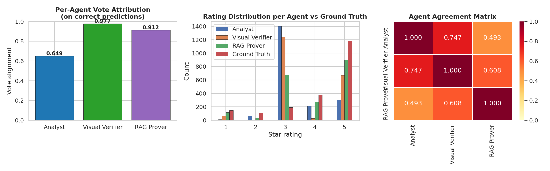
13 · EXPLAINABILITY
Agent Contribution & Explainability
Phase 2 provides a complete audit trail — which agent voted what and why
Agent Alignment (on correct P2 samples)
Analyst
64.9%
Text-only — conservative bias
RAG Prover
91.2%
Retrieved context corrects it
Visual Verifier
97.7%
Highest — image grounding
The Analyst alone replicates Phase 1's bias. Two agents with independent evidence overrule it 35% of the time.

Slide 15
14 · ANALYSIS
Why Phase 2 Works: 3 Mechanisms
A data-driven decomposition of the +22.6 pp gain from Run 1
Primary driver
Secondary driver
Tertiary driver
① Context Breaks Rating Collapse
② Multi-Agent Majority Overrules Analyst
③ Self-Correction Handles Ambiguity
• Phase 1 under-predicts 90.2% of errors — defaults to 1★/3★
• Analyst alone = 64.9% correct on winning samples
• Triggered on 922 samples (46.1%) when D ≥ 0.4
• 288 of 491 recoveries: P1 guesses 3★ → P2 corrects to 5★ (58.7%)
• Visual Verifier = 97.7% RAG Prover = 91.2%
• +16.6 pp on corrected samples vs +27.7 pp on uncorrected
• Product metadata + BLIP caption give agents signal to commit
• Two independent evidence sources outvote conservative Analyst
• Useful for genuinely hard cases — not the primary gain source
• to higher ratings that text alone cannot support
• on 35% of ultimately correct predictions
• Recovery ratio: 491 recovered / 39 regressed = 12.6×

Slide 16
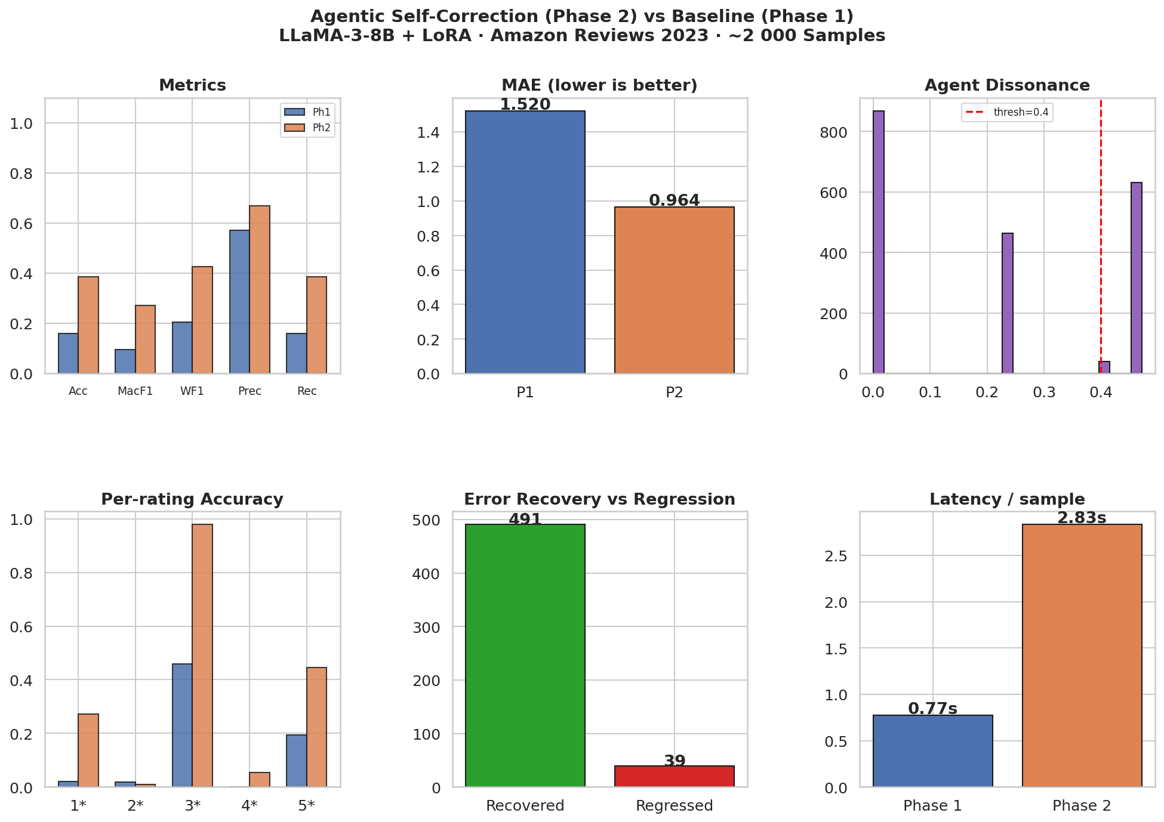
15 · SUMMARY DASHBOARD
Full Results Dashboard
All key metrics in one view — Amazon Reviews 2023, 2,000 samples, Run 1

Slide 17
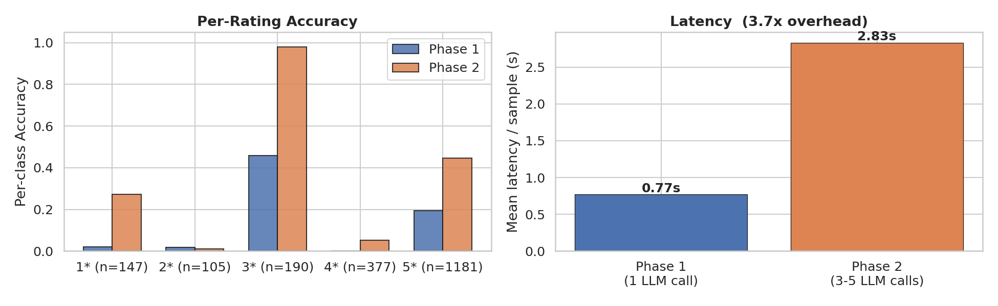
16 · EVALUATION FRAMEWORK
Evaluation Framework & Latency Trade-off
Phase 2 adds grounding and verification metrics — and pays a 3.7× latency cost
Metric Framework
▌
Accuracy / F1 / MAE
Both phases — classification quality
▌
Dissonance score D
Phase 2 only — agent disagreement
▌
Per-agent vote
Phase 2 only — explainability
▌
Error recovery
Phase 2 only — net errors fixed
▌
Latency (s/sample)
Both — efficiency cost
Latency trade-off:
Phase 1: 0.77s/sample (1 LLM call) → Phase 2: 2.83s/sample (3–5 LLM calls). 3.7× overhead is justified by +22.6 pp accuracy and full audit trail.

Slide 18
17 · CONCLUSION
Conclusion & Future Work
A passive classifier becomes an explainable, self-correcting agentic system
Phase 1 vs Phase 2 — Final Comparison
Dimension
Phase 1 (Baseline)
Phase 2 (Proposed)
Result
Context
Text only
Text + metadata + BLIP
+22.6 pp acc
Architecture
1 LLM call
4-agent pipeline
12.6× recovery
Correction
None
D-triggered (≤2 iters)
46.1% triggered
Explainability
Opaque single
Per-agent audit trail
97.7% V.Verif.
FUTURE WORK
▶ LLaVA instead of BLIP — direct pixel-level image grounding for the Visual Verifier
▶ LanceDB with CLIP-indexed full product spec sheets — stronger factual grounding for RAG Prover
▶ Scale to 10,000+ samples across multiple product categories — broader evaluation
▶ Optimise latency: batch agent calls, cache RAG lookups — reduce 3.7× overhead

