Slide 1

Clustering and Classification of UVM Test Failures Using Machine Learning Techniques
Andy Troung, Daniel Hellström, Harry Duque, Lars Viklund
Axis Communications AB, Lund, Sweden

Slide 2
Problem Statement
Applying coverage-driven constrained random verification
Test suites often consists of a large number of test invocation
Same base tests run many times
Different seeds
Adjusted random distributions
One problem often results in many test invocations failing
Analysis of test failures
Which failures have a common cause?
What is the type of root cause for each failure?
Can this analysis be automated using machine learning?

Slide 3
Input Data
Simulation log files from UVM test benches
Semi-structured text
Consists mostly of UVM report messages
Dataset used for evaluation:
12500 samples labeled with failure root cause
Originated from 29 UVM test benches

Slide 4
Features
Convert input into numerical feature vectors
Examples of information extracted:
UVM test name and UVM configuration settings from command line
UVM report messages
Simulator warnings and error messages
Some information is abstracted
Mostly the frequency of occurrence is used as the feature
Original set consists of 616 features

Slide 5
Dimensionality Reduction
Feature selection
Remove less relevant features
Manual or automatic
Feature extraction
Merge existing features
Applied manual feature selection
Based on domain knowledge
Reduced set down to 287 features
Baseline used for evaluation
Evaluated algorithms for automatic selection and extraction

Slide 6
Classification
Supervised learning problem
Training using a dataset associating input with output
Input is simulation log file
Output is failure root cause
Algorithm creates a model that predicts output for new input data

Slide 7
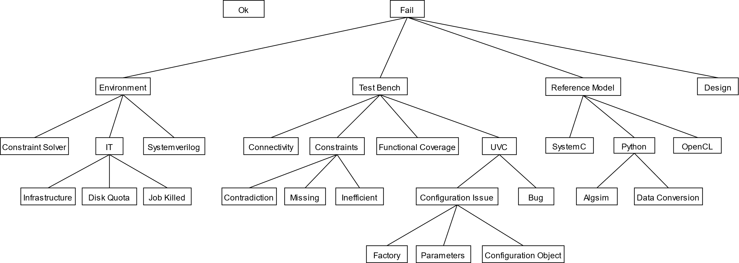
Taxonomy of Test Failure Root Causes

Slide 8
Classification Algorithms
Nine classification algorithms evaluated
Selected because they use different strategies
Three dimensionality reduction algorithms evaluated
Two feature selection algorithms
One feature extraction algorithm
Implementations from scikit-learn
Initial evaluation using default hyperparameter settings

Slide 9
Classification Algorithm Evaluation
Dataset divided into a training set and a test set
10000 samples for the training set
2500 samples for the test set
Evaluation steps:
Initial evaluation using training set and k-fold cross validation
Optimization of the most promising algorithms
Final evaluation using test set

Slide 10
Confusion Matrix
 |  | Predicted
 |  | YES | NO
Actual | YES | True Positive | False Negative
 | NO | False Positive | True Negative

Slide 11
Classification Metrics
Accuracy
How often is the classifier correct?
(TP + TN) / Total
Precision
When it predicts yes, how often is it correct?
TP / (TP + FP)
Recall
When it is actually yes, how often does it predict yes?
TP / (TP + FN)
F₁-score
Harmonic mean of precision and recall

Slide 12
Initial Classification Results
Classifier | Accuracy | Precision | Recall | F₁-score | Train (s) | Predict (s)
Baseline feature set
Random forest | 0.899 | 0.907 | 0.904 | 0.905 | 0.277 | 0.132
SVC poly | 0.556 | 0.864 | 0.560 | 0.609 | 52.655 | 56.315
SVC rbf | 0.806 | 0.845 | 0.800 | 0.813 | 17.311 | 36.422
LinearSVC | 0.851 | 0.856 | 0.852 | 0.852 | 72.463 | 0.184
Decision tree | 0.892 | 0.901 | 0.899 | 0.899 | 0.342 | 0.067
Logistic regression | 0.841 | 0.851 | 0.840 | 0.842 | 62.498 | 0.191
K-neighbors | 0.883 | 0.890 | 0.887 | 0.888 | 0.522 | 56.618
Naïve Bayes | 0.643 | 0.763 | 0.652 | 0.607 | 0.180 | 0.933

Slide 13
Summary of Initial Classification Evaluation
Three algorithms performed better than the others
Random forest
Decision tree
k-nearest neighbors
Impact of dimensionality reduction
Slightly lower scores
Significantly reduced computation time

Slide 14
Optimization of Classification Algorithms
Tune hyperparameters
Small hyperparameter space
Decision tree and k-nearest neighbor
Exhaustive search
Large hyperparameter space
Random forest
Random search

Slide 15
Classification Results After Optimization
Classifier | Accuracy | Precision | Recall | F₁-score | Train (s) | Predict (s)
Random forest | 0.907 +0.9% | 0.915 +0.9% | 0.913 +1.0% | 0.913 +0.9% | 8.410 +2936.1% | 2.074 +1471.2%
Decision tree | 0.896 +0.4% | 0.904 +0.3% | 0.902 +0.3% | 0.902 +0.3% | 0.385 +12.6% | 0.113 +68.7%
K-neighbors | 0.885 +0.3% | 0.891 +0.1% | 0.891 +0.7% | 0.891 +0.5% | 0.101 -9.0% | 0.994 -41.0%

Slide 16
Final Classification Results
Classifier | Accuracy | Precision | Recall | F₁-score | Train (s) | Predict (s)
Random forest | 0.907 | 0.916 | 0.912 | 0.913 | 5.344 | 0.182
Decision tree | 0.895 | 0.902 | 0.900 | 0.900 | 0.111 | 0.002
K-neighbors | 0.880 | 0.888 | 0.886 | 0.886 | 0.059 | 0.113

Slide 17
Summary of Classification Evaluation
Random forest performs best
Algorithms generalizes well to new data
Learning and classification run-times are reasonable
Most common misclassification is design bug vs. reference model bug

Slide 18
Significance of Data

Slide 19
Prediction Confidence

Slide 20
Clustering
Unsupervised learning problem
Divide the dataset into clusters (groups)
Clusters will contain samples that are similar
In this case same failure root cause
Different types of algorithms:
Prototype-based
Density-based
Graph-based

Slide 21
Clustering Algorithms
Three different clustering algorithms evaluated
One of each of the three main types
One dimensionality reduction algorithms evaluated
Two different visualization algorithms evaluated
Implementations from scikit-learn
Hyperparameter settings were optimized

Slide 22
Clustering Algorithm Evaluation
Metrics used for classification are not applicable
No risk of overfitting since there is no training
No need for a separate test set
No need for cross-validation
Measure similarities between clusters while ignoring permutations
Adjusted Rand Index (ARI)
Based on pair-counting
Range [-1, 1]
Adjusted Mutual Information (AMI)
Based on information theory
Range [0, 1]

Slide 23
Clustering Results
Algorithm | AMI | ARI | Computation time (s)
Baseline feature set
K-means | 0.505 | 0.480 | 0.079
DBSCAN | 0.568 | 0.530 | 0.086
Agglomerative Clustering | 0.540 | 0.515 | 0.036
Dimensionality reduction using PCA
K-means | 0.543 | 0.513 | 0.041
DBSCAN | 0.593 | 0.545 | 0.007
Agglomerative Clustering | 0.543 | 0.519 | 0.006

Slide 24
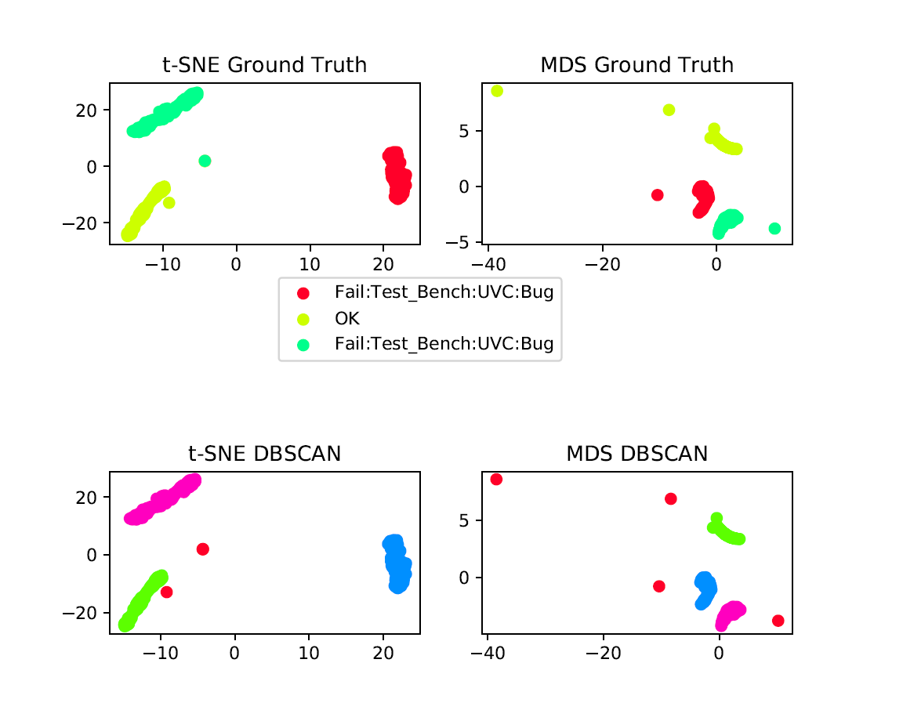
Visualization of Clustering

Slide 25
Tool Implementation
Prototype tool based on the most suitable algorithms
Implemented in Python using scikit-learn
Pre-processing of log file using regular expressions
Interactive visualization of clustering results

Slide 26
Future Work
Investigate dependency on test bench coding style
Investigate dependency on report verbosity level
Use other data in addition to log files
Improve performance of clustering algorithms
More careful feature engineering
Tuning of hyperparameters

Slide 27
Conclusions
Machine learning can effectively be applied to classify UVM test failures
Random forest yielded an accuracy of 0.907 and an F₁-score of 0.913
Machine learning for clustering UVM test failures was less convincing
DBSCAN yielded an AMI score of 0.593 and an ARI score of 0.545
Clustering algorithms can provide a good overview when used in combination with visualization algorithms
The investigated algorithms show promise as tools to reduce the time invested in analyzing failures in large test suites

Slide 28
Questions

