Slide 1
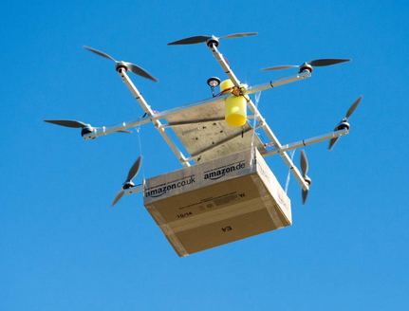
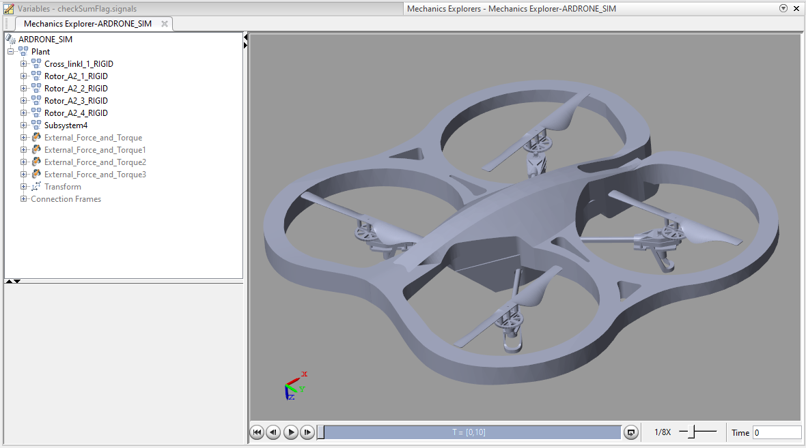
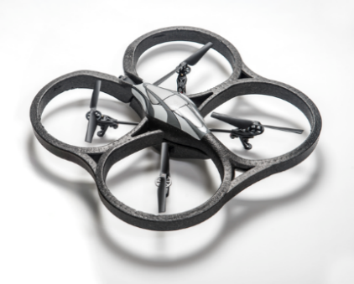
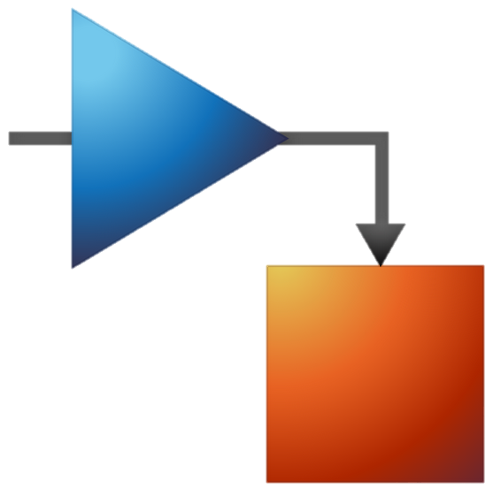

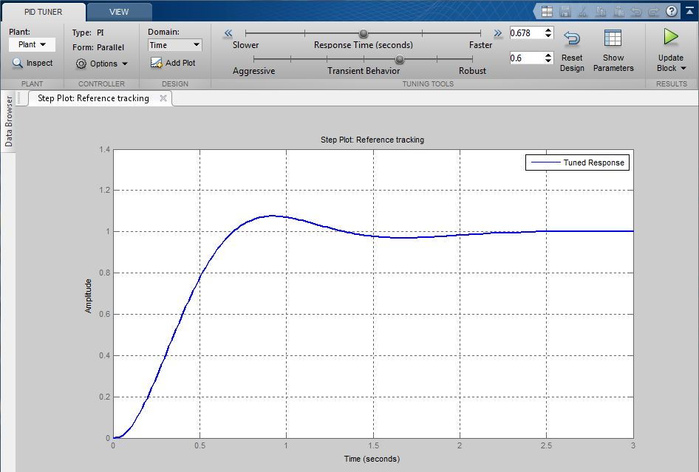
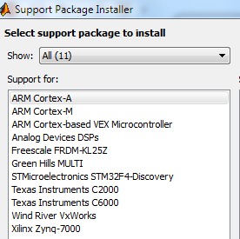
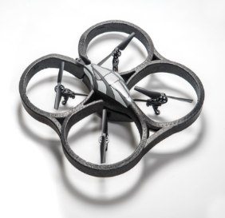
Optimize Design and Implementation using Simulink for Flying Drone application
Objective
Autonomous systems are becoming more important in the industry and society.
These systems heavily rely on advanced control and information systems.
Use one multi-domain simulation environment to design and implement controls applications on an AR Drone.
Workflow
Algorithm Development
Architectural Development
Implementation
Laptop
Simulink Controls
Simulink Model compiled into Optimized C
AR Drone
Simulink Models
Start / Stop
Values for plots
Benefits
Optimize and easily validate through simulation before production
Efficient target optimized automatically generated code
Short iteration cycles to optimize algorithm performance on hardware
Notes:
Suggestion for MATLAB EXPO 2016 Benelux.

