Slide 1
Microbiome Experiment Aug 2022
Questions: Does probiotic exposure impact the immune system and resident microbiome, and is this consistent across probiotic strains? Do probiotics persist after exposure ceases?

Slide 2
Probiotic list
Probiotic #1 Proteobacteria Pseudomonas RBS5.4 at 6 x 10^7 cells/ml stock
= ASV16 ASV18 in combined run
Probiotic #2 Proteobacteria Stenotrophomonas THA2.2 at 6 x 10^7 cells/ml stock
=ASV9 ASV9 in combined run
Probiotic #3 Proteobacteria Pseudomonas RBS5.11 at 6 x 10^7 cells/ml stock
=ASV11 ASV10 in combined run
Probiotic #4 Cocktail, 6 x 10^7 cells/ml each probiotic
=combo of ASV16,9,11
Control frogs

Slide 3
Experimental Design

Slide 4
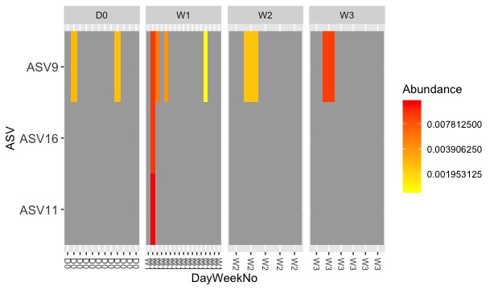
Controls, each frog is a band = greater sample size Day 0, week1 and few individuals week2 and week3 (to ask probiotic persistence question). Sampling over time (Day0, week1, week2, week3)
ASV9 matches THA2.2 (P2)
Stenotrophomonas just present on some individuals

Slide 5
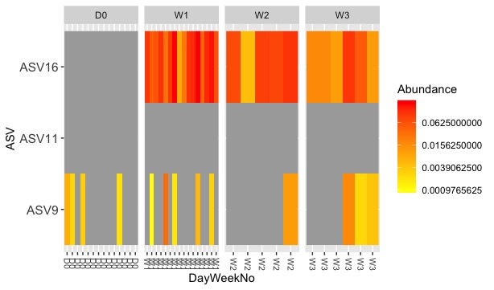
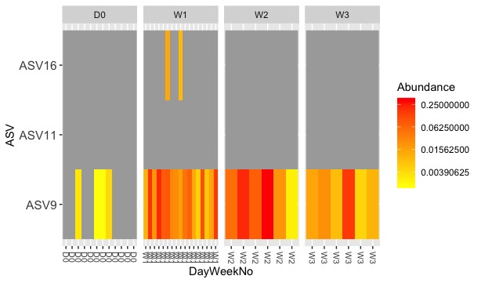
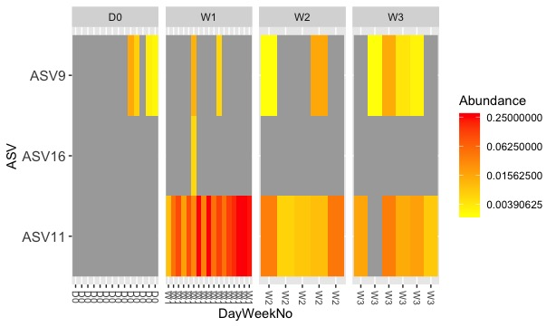
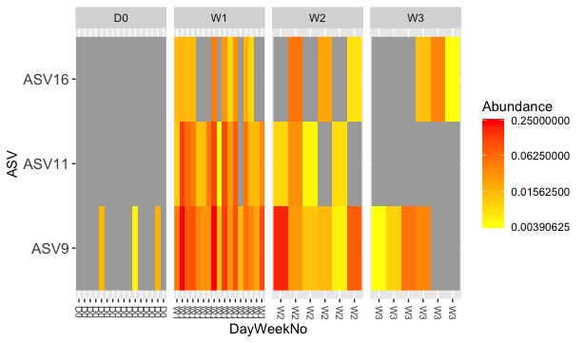
Experiment worked! ASV9 (Stenotrophomonas) is already present on Xenopus, but we can increase it’s abundance (P2 treatment). Single probiotics persist for 21 days for single probiotics (P1, P2, P3), but not for the probiotic cocktail (P4)
P1 = Pseudomonas RBS5.4 = ASV16
THIS IS FROM RUN 1 data analysis and needs to be updated for combined run. ASV numbers change in combined run
P2 = Stenotrophomonas THA2.2 = ASV9
P3 = Pseudomonas RBS5.11 = ASV11
P4 = cocktail

