Slide 1
Mini-Project 1 – Part 2 ECE 471 Fall 2024
Karthik Vasu (kvasu2), Wilmer Smilde (wsmilde2), Xinran Yu (xinran4)

Slide 2
Task 3
Q1: Based on the above assumptions, answer the following questions on basic probability.
The assumption of at most one disengagement per mile allows us to treat the occurrence of a disengagement in a mile as a random variable with a ___Bernoulli_____ distribution
Based on the above assumptions, calculate the probability of disengagement per mile on a cloudy day.
Based on the above assumptions, calculate the probability of disengagement per mile on a clear day.

Slide 3
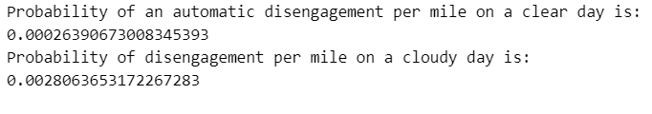
Task 3
Q1: Based on the above assumptions, answer the following questions on basic probability
Similarly, calculate the probability of an automatic disengagement per mile on a cloudy day, and the probability of an automatic disengagement per mile on a clear day.
How likely is it that there are 100 or more disengagements in 10,000 miles under cloudy conditions? (hint: use Central Limit Theorem)

Slide 4
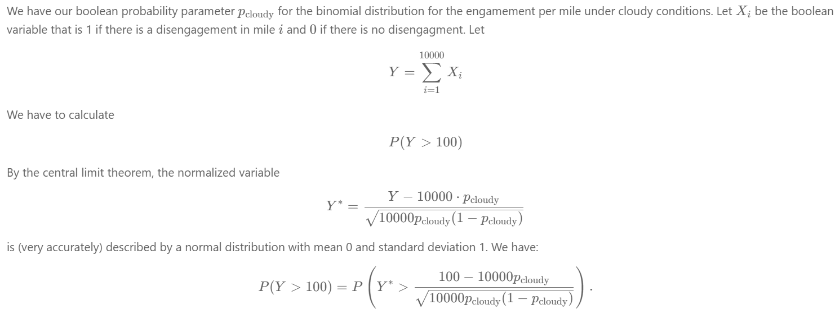


Slide 5
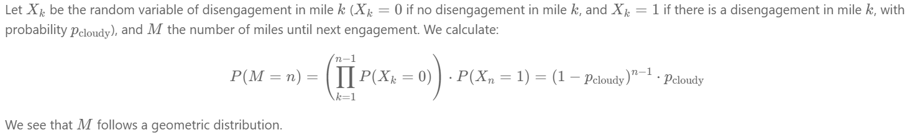
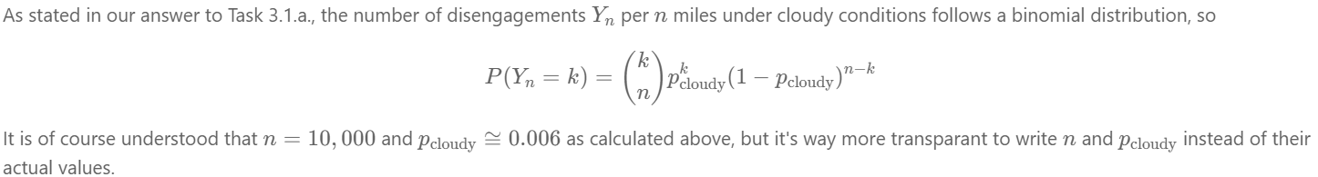
Task 3
Q2: Assuming that the disengagement per mile is a random variable with the distribution you answered in Task 3.1.a, and the weather condition is cloudy .
What is the distribution of “the number of miles until the next disengagement”? Explain your reasoning. Calculate and state the values of the parameters of the distribution
What is the distribution of “the number of disengagements in 10,000 miles”? (hint: this is equivalent to drawing n=10,000 independent trials from the distribution of disengagement per mile you calculated from Task 3.1.a). Calculate and state the values of the parameters of the distribution.

Slide 6

c) Notice that the number of disengagements “$n"$ in Task 3.2.b is large while the probability of disengagement per mile $"p"$ is very small, what distribution does your answer in Task 3.2.b approximate? Calculate and state the values of the parameters of the distribution.

Slide 7
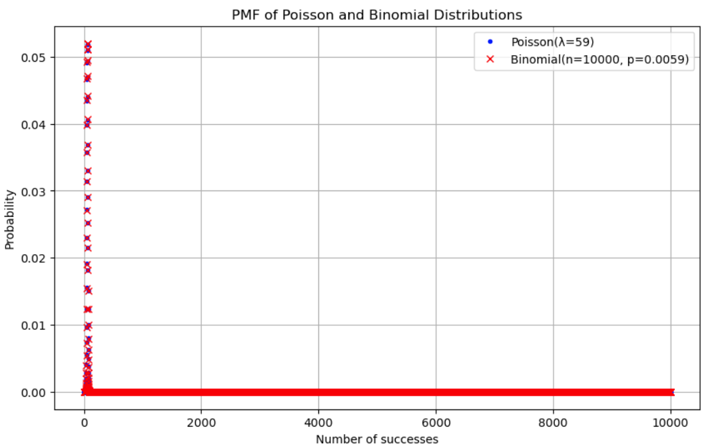
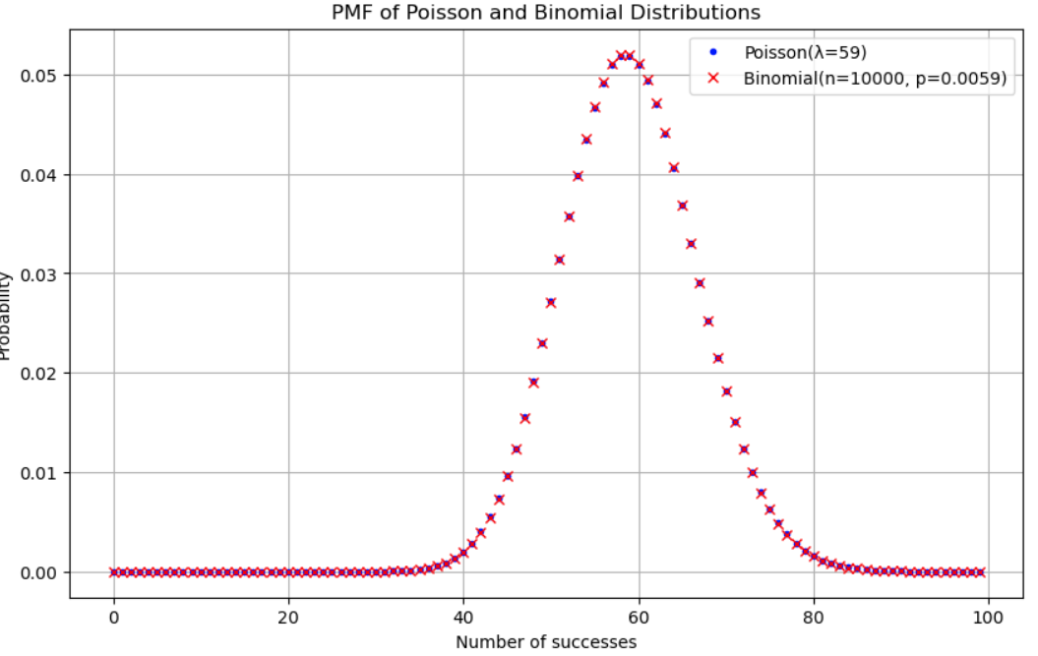
Task 3
Q2: Assuming that the disengagement per mile is a random variable with the distribution you answered in Task 3.1.a, and the weather condition is cloudy .
Plot the probability mass function (PMF) of the distribution in Task 3.2.b and Task 3.2.c for:
x-axis ranging between 0 and 10000. 2. The x-axis ranging between 0 and 100

Slide 8
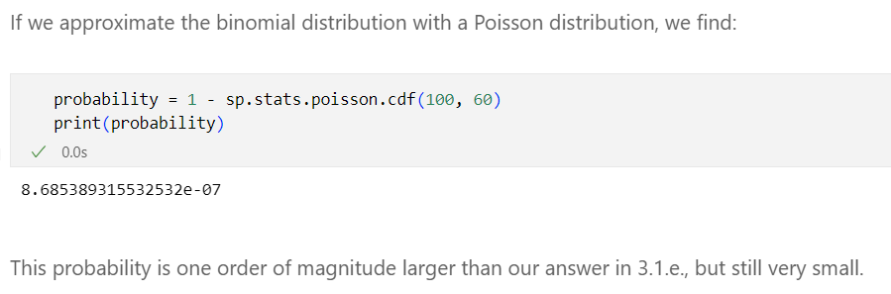
e) Solve Task 3.1.e by using the cumulative distribution function (CDF) of the distribution you computed in Task 3.2.c and compare the results. Discuss your findings

Slide 9
Task 3
Q3: What’s the conditional probability that the reaction time is:
Greater than 0.4s given that the weather was cloudy? Reaction time is measured only in cases where there was an automatic disengagement.
Greater than 0.7s given that the weather was clear? Reaction time is measured only in cases where there was an automatic disengagement.

Slide 10
Task 3
Q4: A study found that an automatic AV disengagement will result in an accident if the human driver is slow in reacting. Following reactions are considered slow: (i) a reaction time greater than 0.4s under cloudy conditions and, (ii) a reaction time greater than 0.7s under clear conditions. Find the probability of an accident per mile due to automatic AV disengagement and slow reaction.

Slide 11
Task 3
Q5: You will investigate how to diagnose the cause of an AV disengagement based on new observations:
An AV had a disengagement with a reaction time greater than 0.4s on a cloudy day. What is the posterior probability that the root cause of the disengagement was “Software Froze”?
What is the posterior probability that the root cause of the disengagement was “Software Froze if the disengagement happened on a clear day with reaction time greater than 0.7s. Based on the probabilities calculated in Tasks 3.5.a and 3.5.b, discuss your findings.

Slide 12
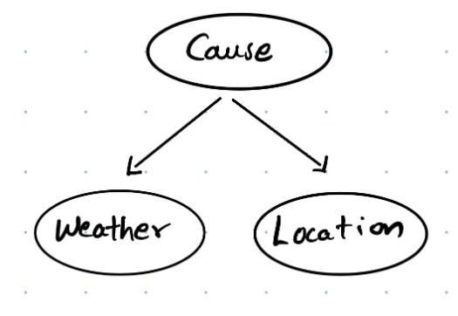
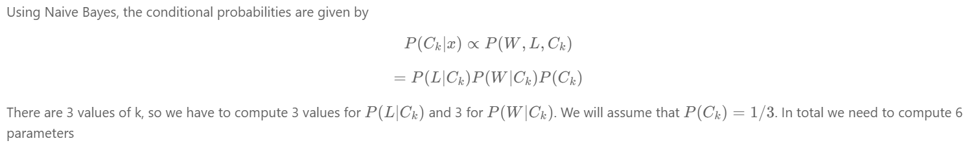
Task 3
Q6: In this question, you will construct a Naive Bayes model to infer the root cause of disengagement scenarios of AVs. Naive Bayes assumes that the factors are class conditionally independent. We assume that both Location (urban-street or highway) and Weather (cloudy or clear) are factors related to the Cause (consider the Cause has 3 different values, “Software Froze”, “Hardware Fault” or “Other”), and Location and Weather are independent given the Cause. Answer the following questions
Draw a graph for the Naive Bayes model described in the question.
b) Count the number of parameters needed to define the Naive Bayes model (including the prior and the conditional probability distributions

Slide 13
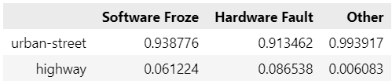
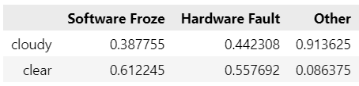

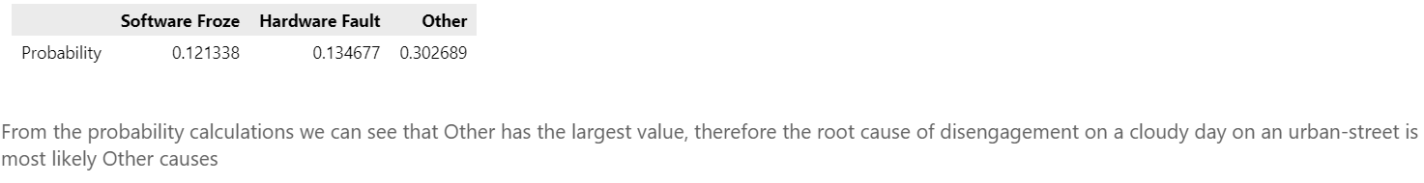
Task 3
Q6 (continued):
Based on the number of parameters needed, derive, and show the conditional probability tables and prior probability from the given dataset to infer the Cause .
b) According to the conditional probability tables you derived, what is the most probable root cause of disengagement given the Weather was cloudy and the Location was urban-street

