Slide 1
MP-0 : Platform Introduction
Archit Joshi, Vignesh Krishnan, Amith Kopparapu Venkata Boja

Slide 2
Hardware Configuration
Challenges:
Clocking requirements
High Performance slave port
Understanding VDMA-DDR and VDMA-Vidout relationships
Slave/master relationships
VTC vs. Vid-out slave/master timing mode
Debugging Methods:
Putty: status registers, error registers, custom print statements
Timing signals: tReady, tValid, Locked

Slide 3
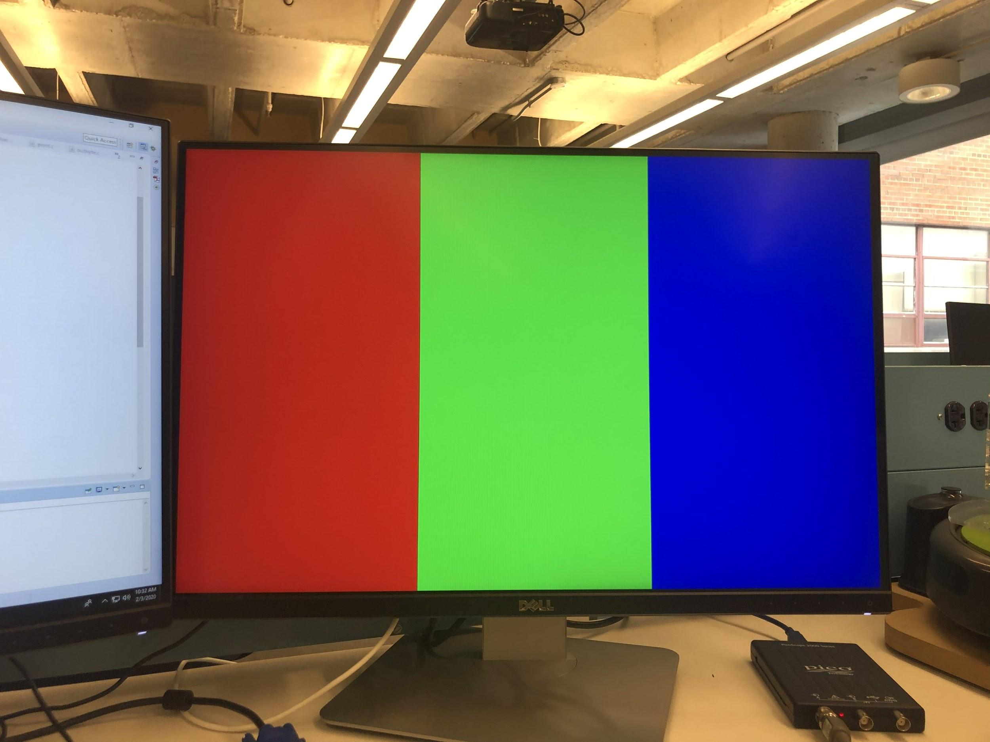
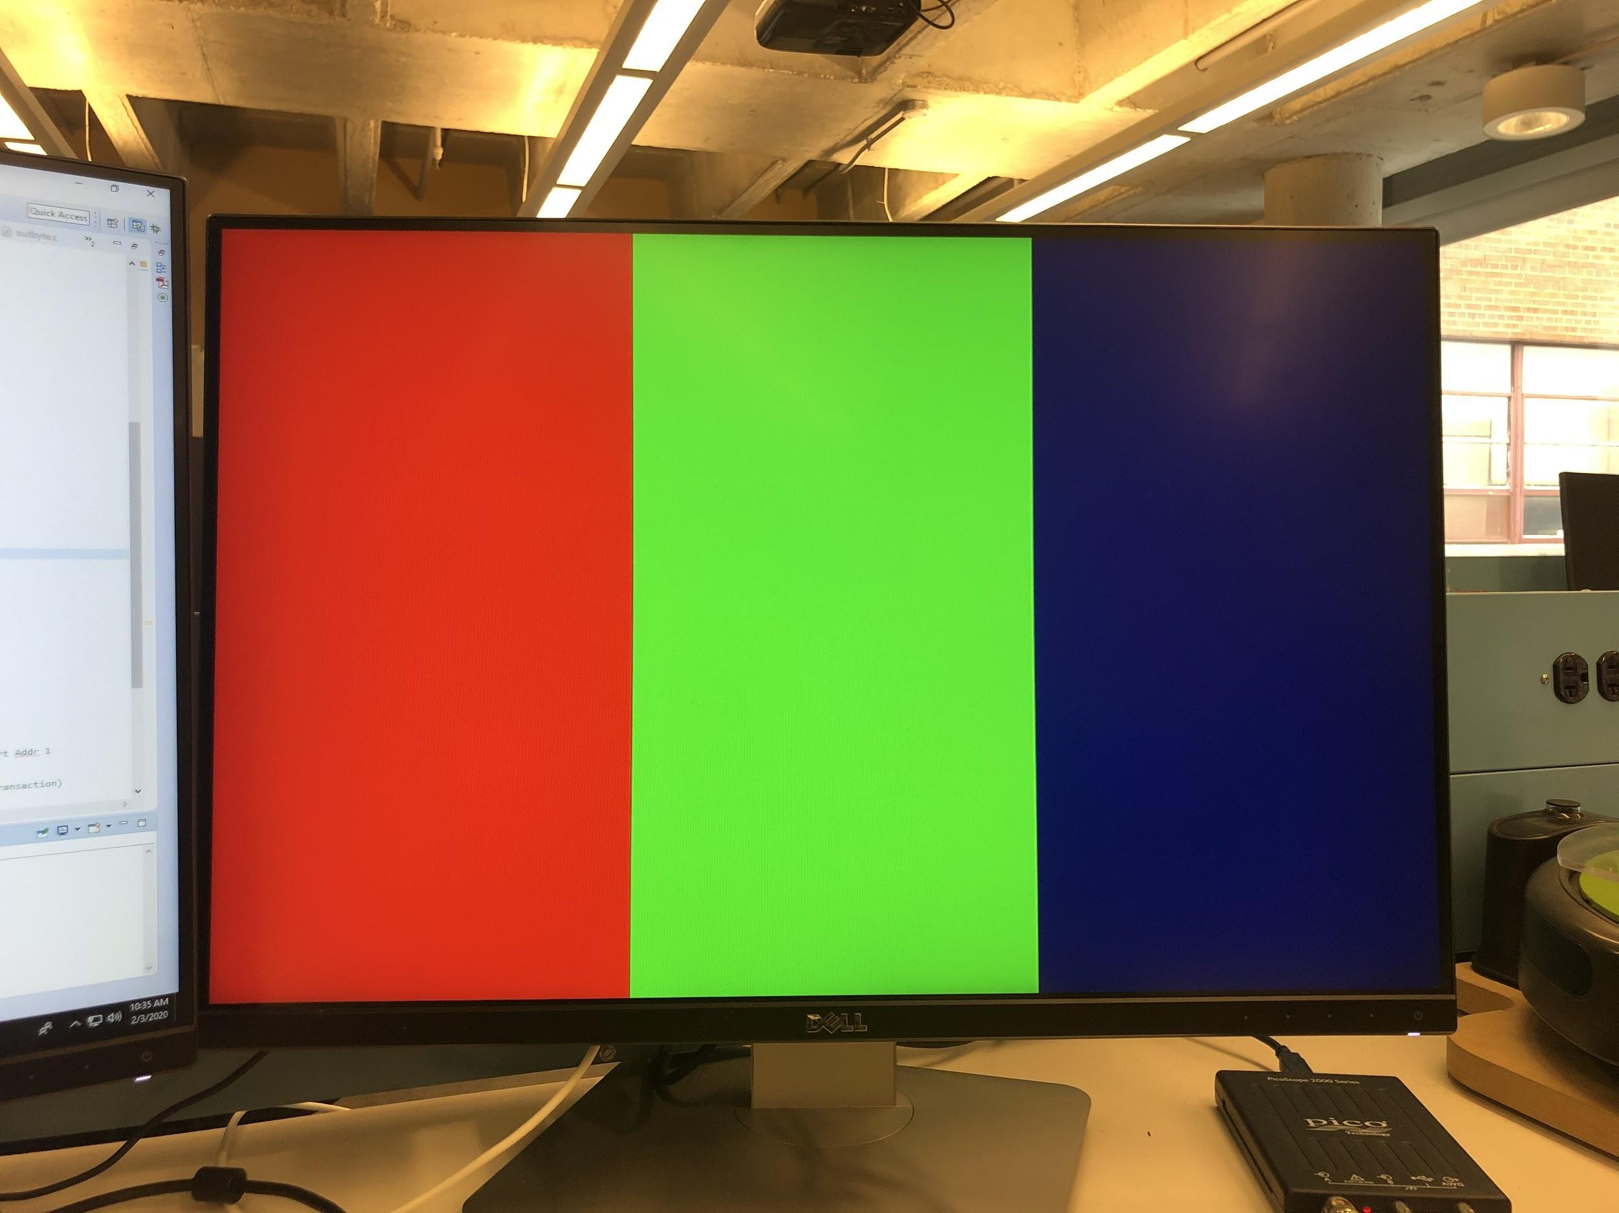
VGA Test
Challenges:
Dark color issue

Slide 4
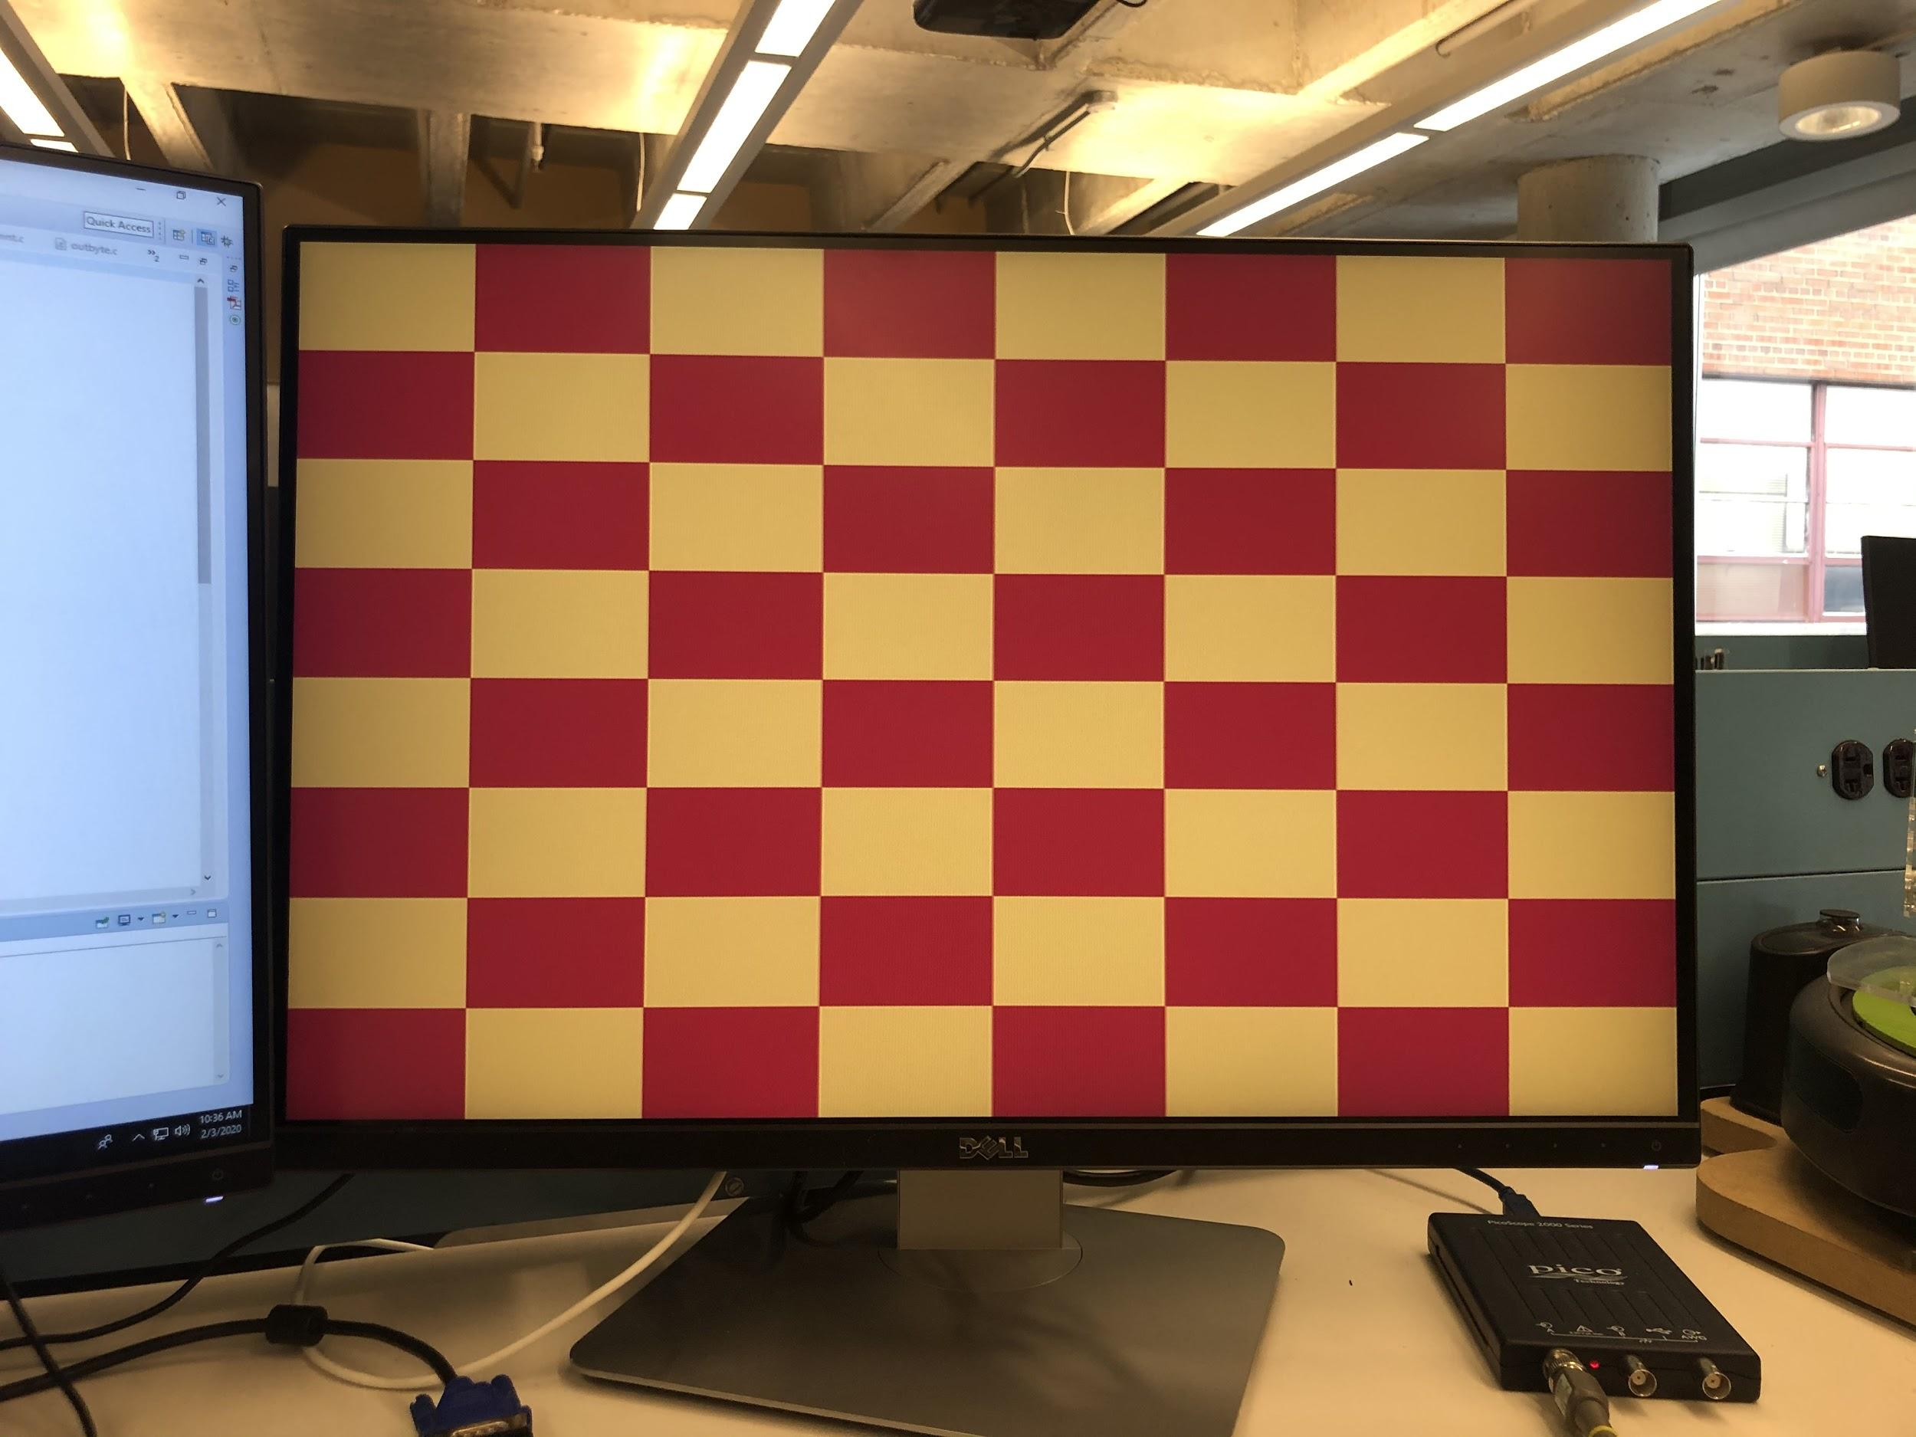
Cyclone Checker
Challenges:
Color conversion

Slide 5
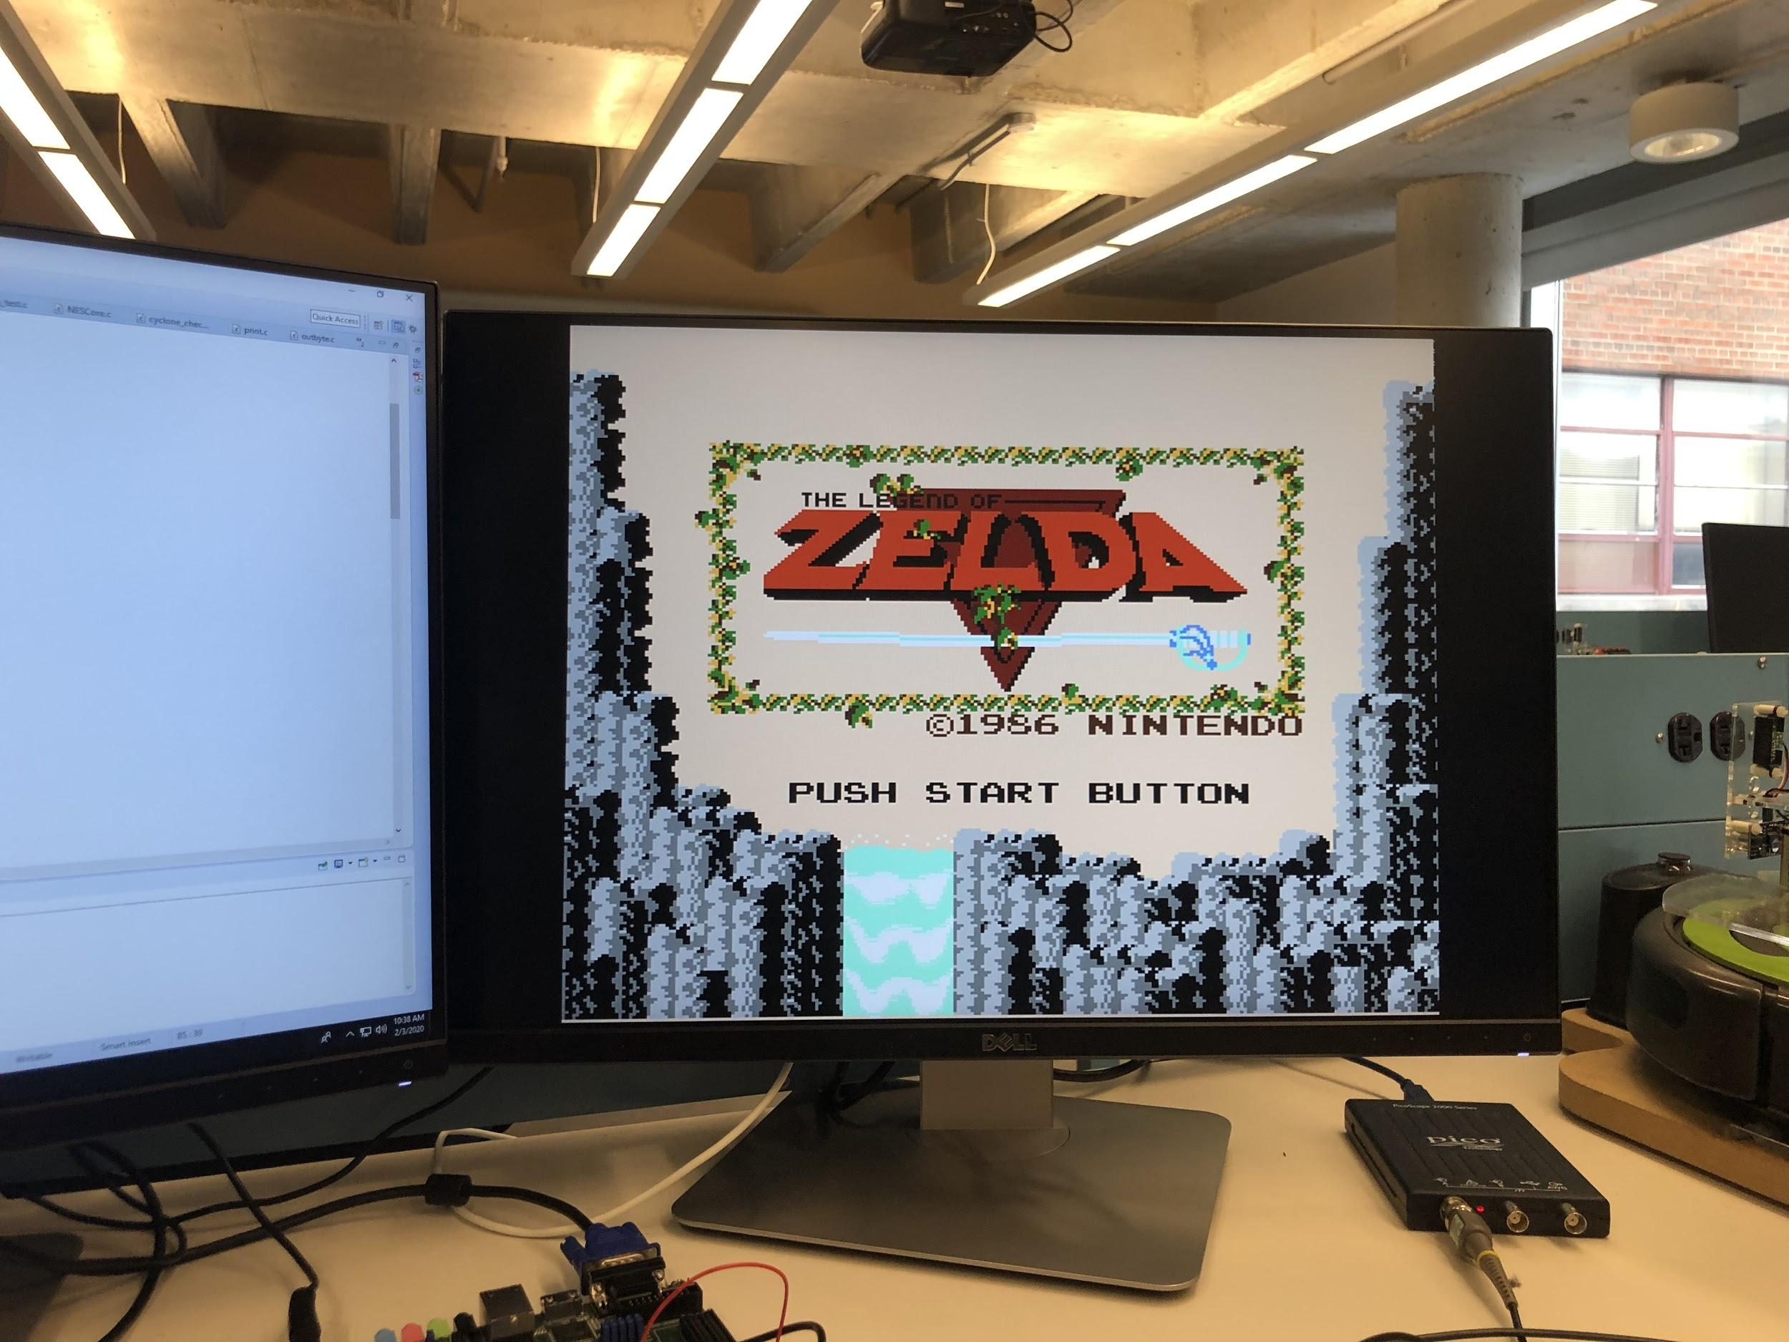
NES Emulator
Challenges:
Understanding bootloader interactions with NESCore and memory
256x240 to 640x480 algorithm
No bonus points, minimum requirements were plenty

