Slide 1
Animal Shelter
Project by Christina Bolashikova, Celine Feyzova, Reneta Toplaska and Afra Yusrefova

Slide 2




Team participants
Christina Bolashikova
Celine Feyzova
Reneta Topalska
Afra Yusrefova

Slide 3
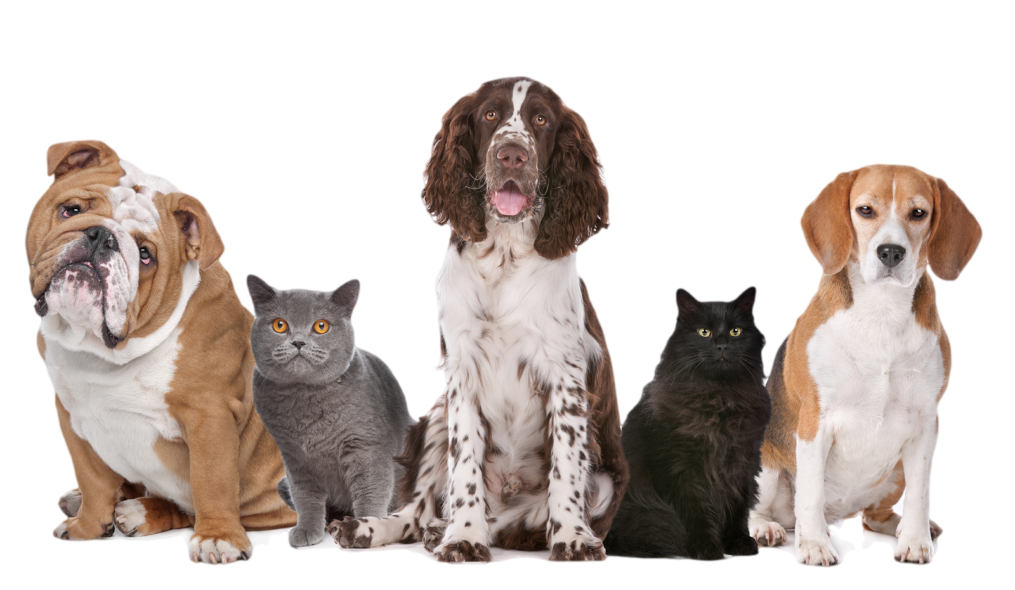
What's the idea
The main idea – to make the administrative work of the staff at an animals shelter easier and more precise
Performs different operations and displaying animals, etc.
User-friendly and easy to navigate

Slide 4




What did we use?
Microsoft Teams
C++
GitHub
Visual Studio 2019

Slide 5
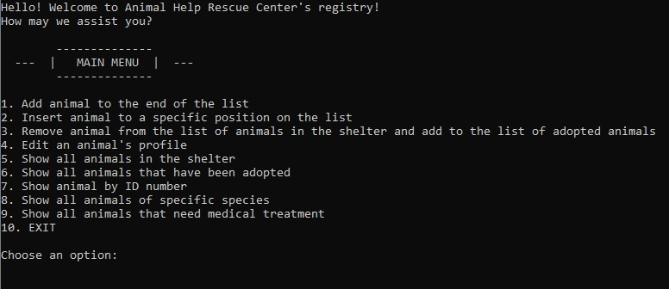
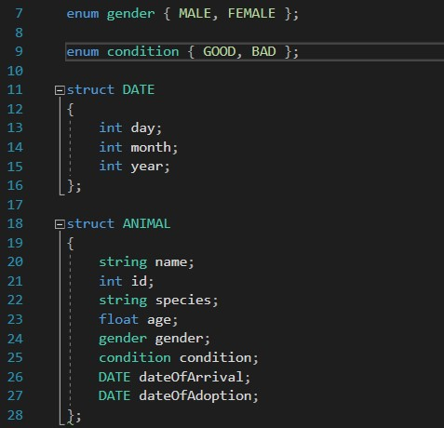
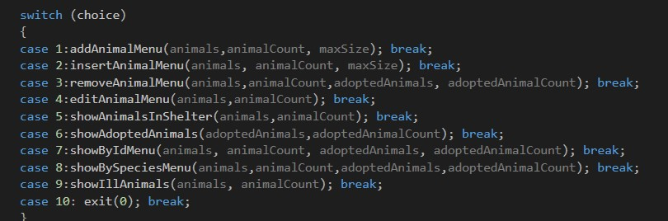

Slide 6
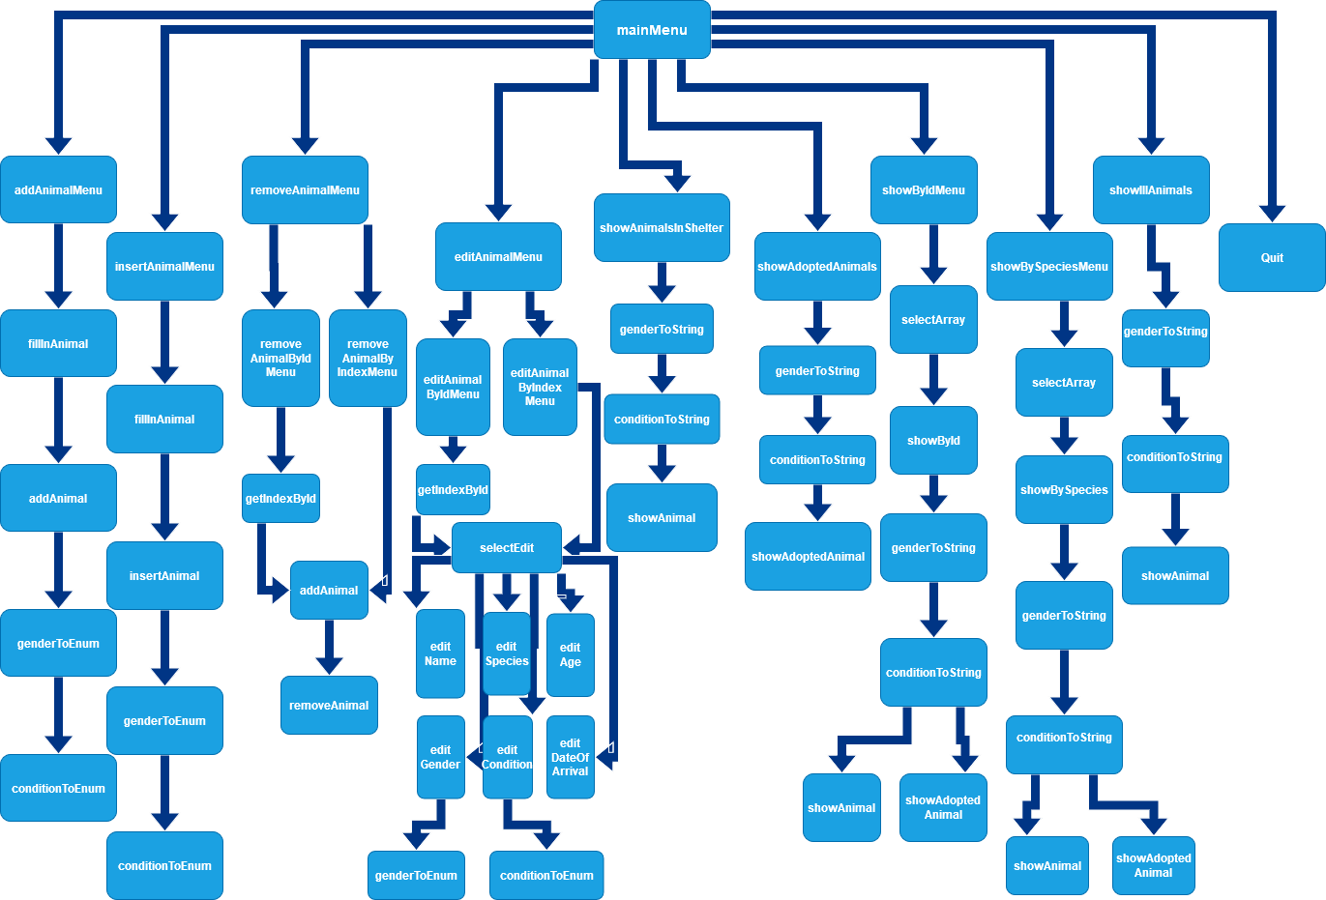

Slide 7
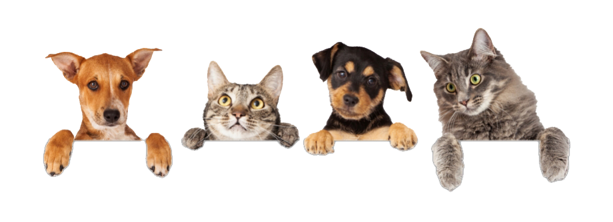
Thank you for your attention!
Any questions?

