Slide 1
Python Programming
By- Ginni Aggarwal
CDAC Noida

Slide 2
Introduction to Python Programming
Python is a popular programming language.
It was created by Guido van Rossum, and released in 1991.
Python is a widely used general-purpose, high-level programming language.
Its design philosophy emphasizes code readability, and its syntax allows programmers to express concepts in fewer lines of code than would be possible in languages such as C.
Python supports multiple programming paradigms, including object-oriented and functional programming or procedural styles.

Slide 3
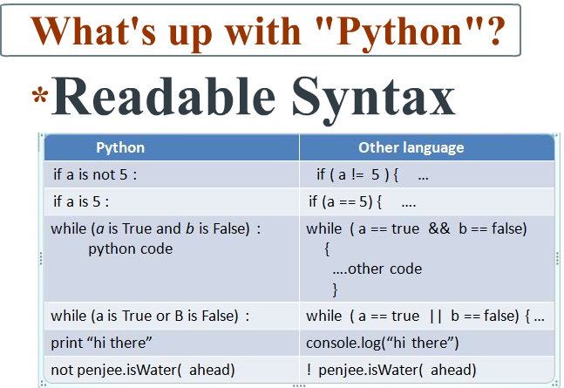
Code Readability

Slide 4
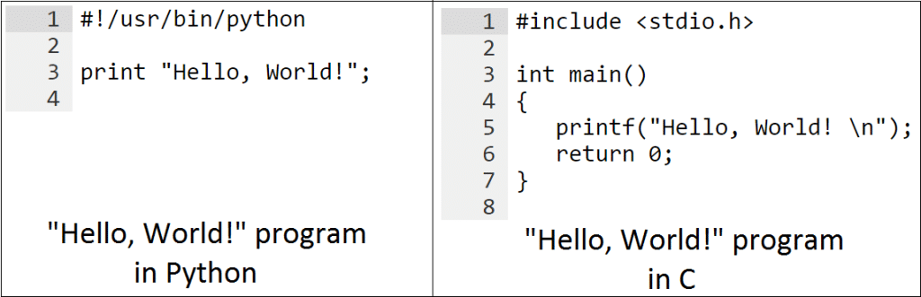
Fewer lines of code

Slide 5
Introduction to Python Programming
Python is Interpreted
Python is Interactive
Python is Object-Oriented
Python is Beginner's Language

Slide 6
Python Feature
Easy to learn
Easy to read
Easy to maintain
A broad standard library
Case-sensitive

Slide 7
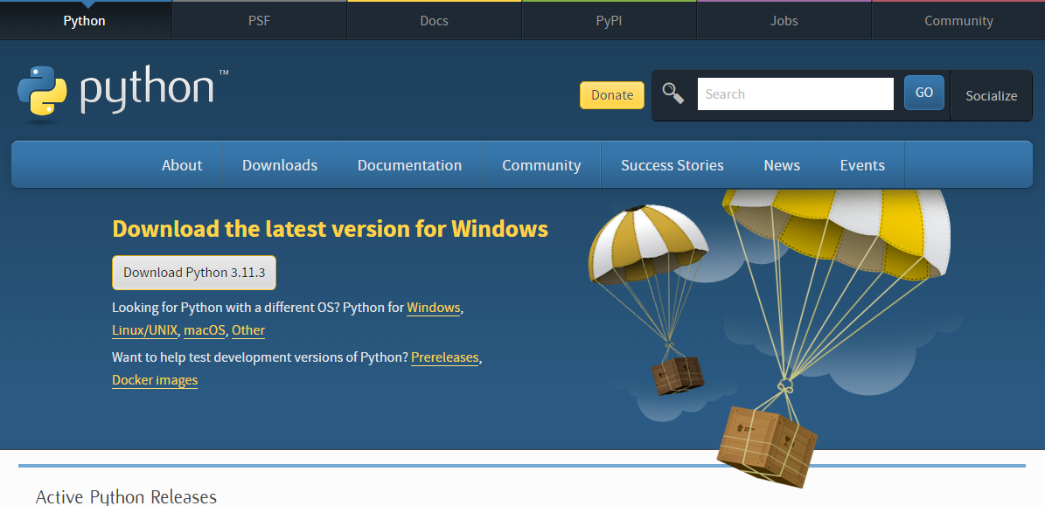
To install Python on a Windows machine, follow these steps:
Download Python for Windows.
Run the Python installer.
Here you will see the Python wizard, which is very easy to use. Just accept the default recommended settings and click on the Next button, wait until the install is complete and you are done.

Slide 8
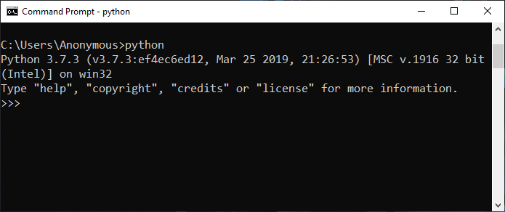
How to Run a Python Script
(1) Interactive Interpreter: You can enter python and start coding right away in the interactive interpreter by starting it from the command line.
C:>python

Slide 9
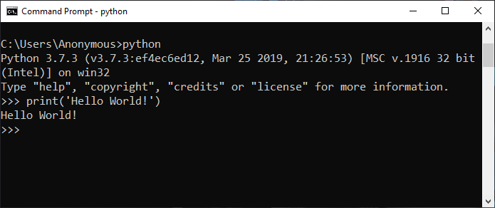
How to Run a Python Script

Slide 10
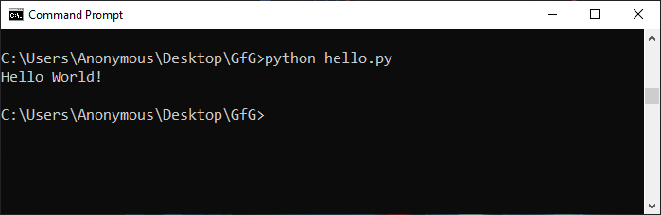
How to Run a Python Script
(2) Script from the Command-line: A Python script can be executed at command line by invoking the interpreter on your application, as in the following:
C:>python script.py

Slide 11
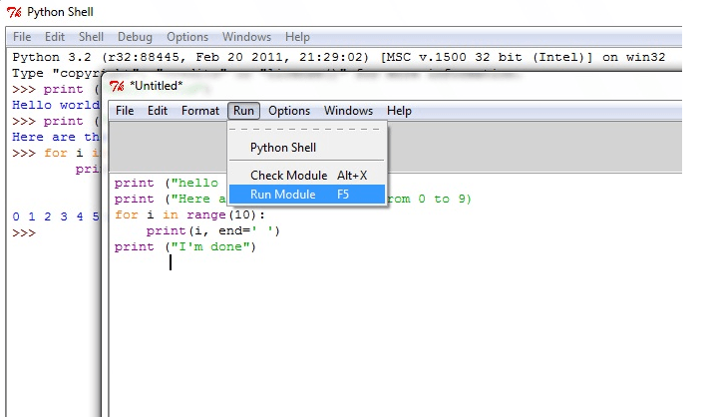
How to Run a Python Script
3) Integrated Development and Learning Environment- IDLE is an integrated development environment (IDE) for Python. The Python installer for Windows contains the IDLE module by default.

Slide 12
Python Identifiers:
A Python identifier is a name used to identify a variable, function, class, module or other object.
An identifier starts with a letter A to Z or a to z or an underscore (_) followed by zero or more letters, underscores and digits (0 to 9).
Python does not allow punctuation characters such as @, $ and % within identifiers.
Python is a case sensitive programming language. Thus, Manpower and manpower are two different identifiers in Python.
Python is loosely typed language.

Slide 13
Reserved Words:
Reserved words may not be used as constant or variable or any other identifier names.
All the Python keywords contain lowercase letters only.

Slide 14
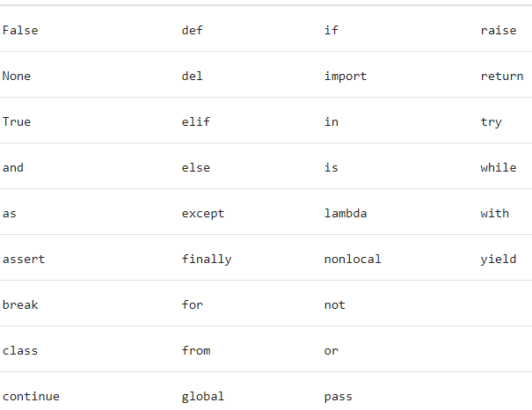
Reserved Words:

Slide 15

Lines and Indentation:
One of the first caveats programmers encounter when learning Python is the fact that there are no braces to indicate blocks of code for class and function definitions or flow control.
Blocks of code are denoted by line indentation, which is rigidly enforced.
The number of spaces in the indentation is variable, but all statements within the block must be indented the same amount.

Slide 16
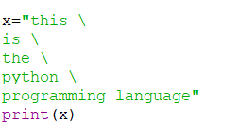

Multi-Line Statements
Statements in Python typically end with a new line.
Python does, however, allow the use of the line continuation character (\) to denote that the line should continue.

Slide 17



Multi-Line Statements
Statements contained within the [], {} or () brackets do not need to use the line continuation character

Slide 18

Quotation in Python:
Python accepts single ('), double (") and triple (''' or """') quotes to denote string literals, as long as the same type of quote starts and ends the string.
The triple quotes can be used to span the string across multiple lines.

Slide 19
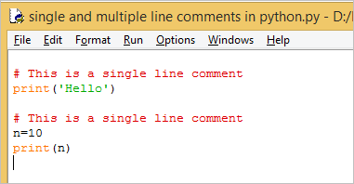
Comments in Python:
Comments can be used to explain Python code.
Comments can be used to make the code more readable.
Comments starts with a #, and Python will ignore them:

Slide 20
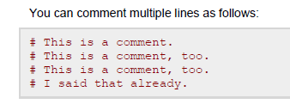
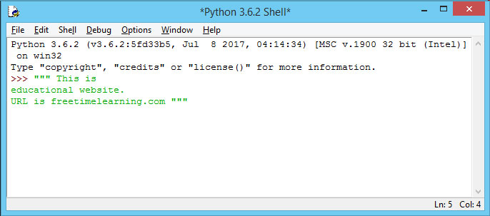
Multi Line Comments

Slide 21
Python variable
Variables are nothing but reserved memory locations to store values.
when you create a variable you reserve some space in memory.
Based on the data type of a variable, the interpreter allocates memory and decides what can be stored in the reserved memory.
Therefore, by assigning different data types to variables, you can store integers, decimals or characters in these variables.
Python variables do not have to be explicitly declared to reserve memory space.
The declaration happens automatically when you assign a value to a variable.
The equal sign (=) is used to assign values to variables.

Slide 22
Assigning Values to Variables:
Python variables do not have to be explicitly declared to reserve memory space.
The declaration happens automatically when you assign a value to a variable.
The equal sign (=) is used to assign values to variables.

Slide 23
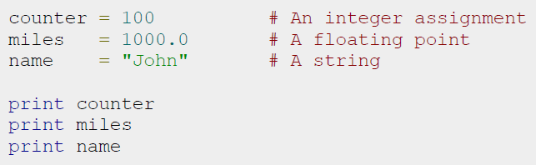
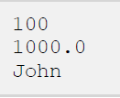
Assigning Values to Variables:
Output:

Slide 24


Multiple Assignment:
Python allows you to assign a single value to several variables simultaneously
Here, an integer object is created with the value 1, and all three variables are assigned to the same memory location.
You can also assign multiple objects to multiple variables.

