Slide 1

FLEXIBLE STATISTICS DATA ANALYSIS
http://rosa.unipr.it

Slide 2
From .m to .html using .xml
.m FILE
mreadFS.m
out
(struct)
removeextraspacesLF.m
mwriteFS.m
xmlwriteFS.m
.m FILE
out (struct)
.xml file
xmlreadFS.m
htmlwriteFS.m
.html FILE
helpGUI
HelpGUI.mlapp

Slide 3
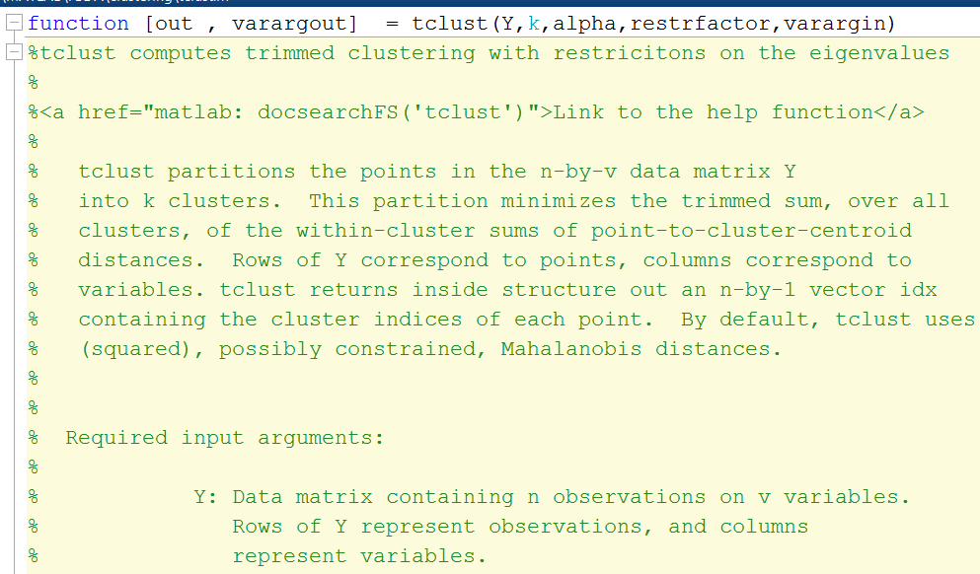
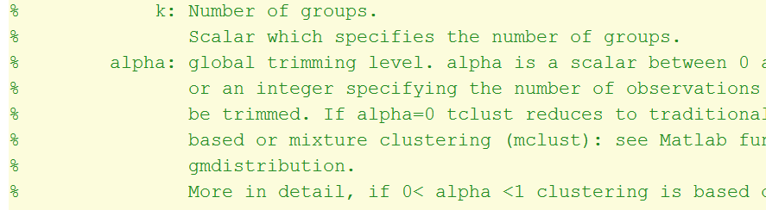
Example of (structured) .m file
Second line is «purpose»
Description
Required input arguments section

Slide 4
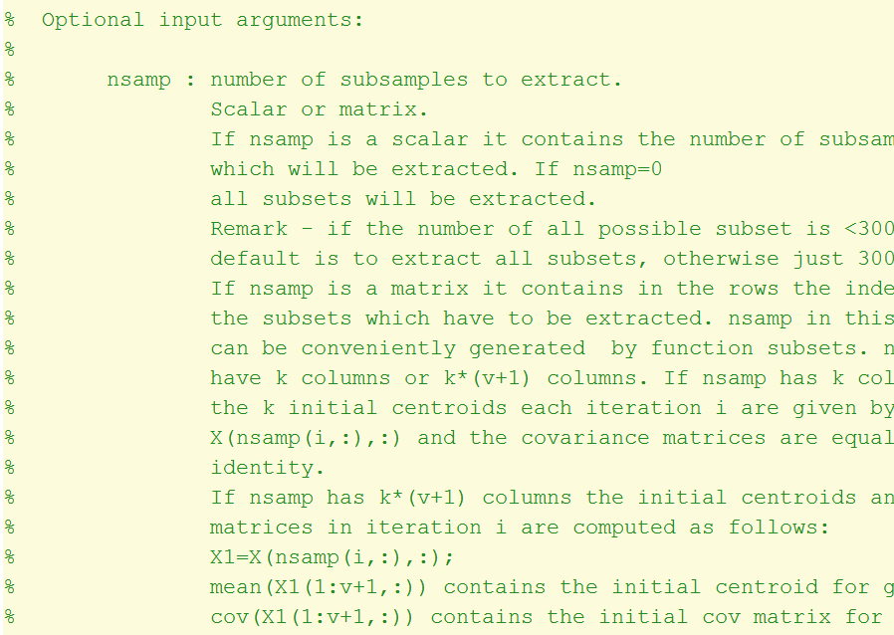
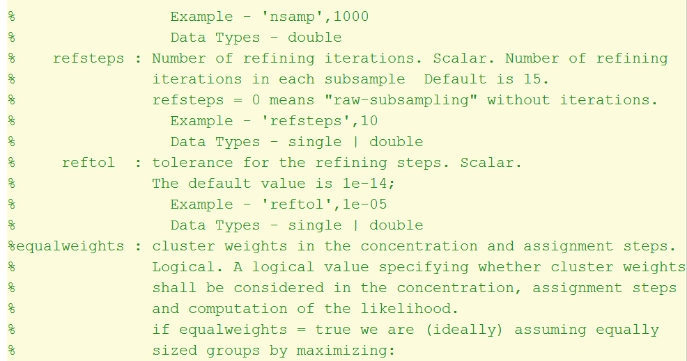
Example of (structured) .m file
Required input arguments section
Each argument has: «short description», «type indication», «long description», «Example «and 2Data type»
Type indication
Long description
Short description
Example and Data Types

Slide 5
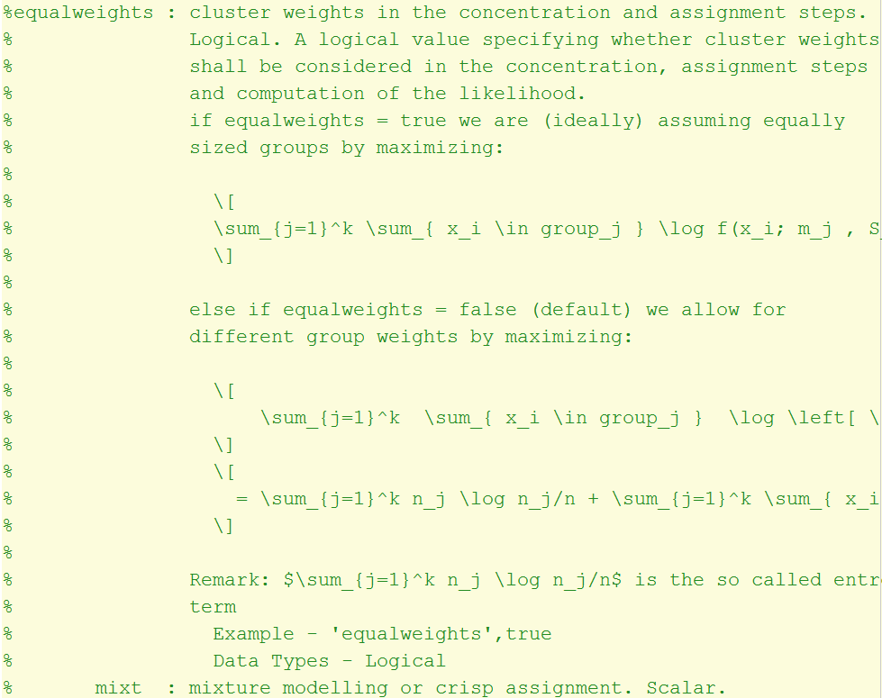
Example of (structured) .m file
Some arguments contain LATEX equations

Slide 6
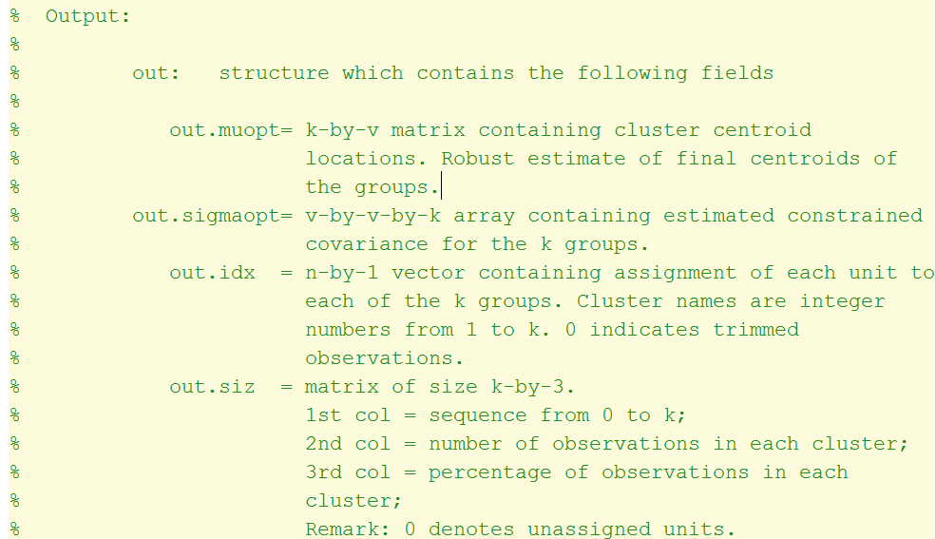
Example of (structured) .m file
Ouptut arguments section
In the description of each argument (input or output) there may be line feeds which need to be preserved

Slide 7
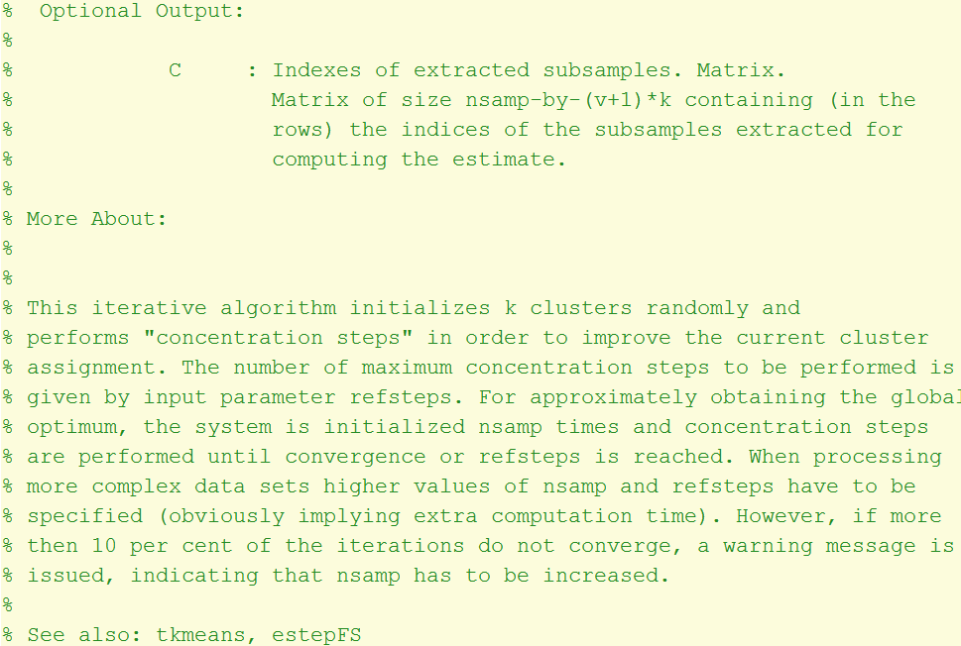
Example of (structured) .m file
Optional output is presente if the function contains varargout arguments section
In the «More About» section additional details are given about the function
In the «See Also» section there are links to conntected functions

Slide 8
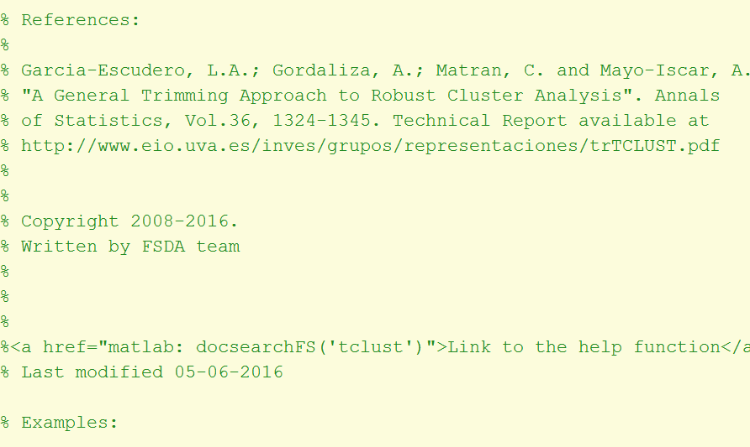
Example of (structured) .m file
References section
Copyright section
Link to corresponding HTML function using docsearchFS
Examples section

Slide 9
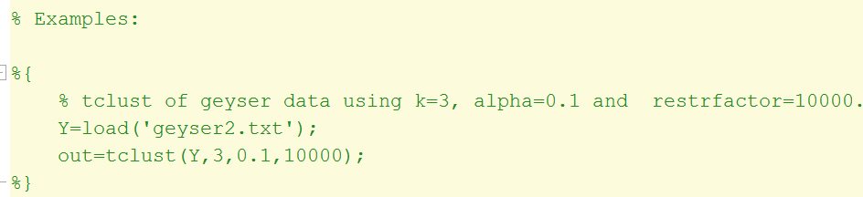
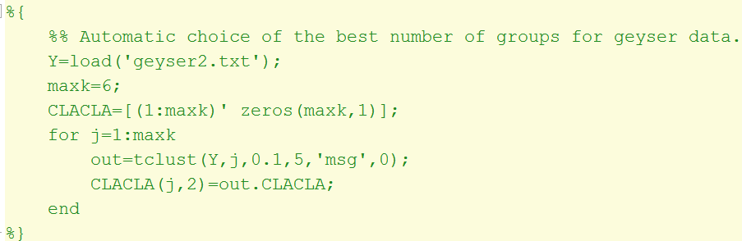
Example of (structured) .m file
Examples section
Each example is delimited by signs %{ %}
The double % sign at the beginning of the example denotes an example which isìas to be automatically executed in the corresponding HTML function
Sometimes the examples contain code indentation which must be preserved

Slide 10
File «mreadFS.m»
Transforms a MATLAB .m file into a MATLAB structure (say out) with the following fields.
out.titl: string with the tille
out.purpose: string with file purpose
out.description: string with file description
out.InpArgs: cell of size b×8 with «Required Input Arguments»
out.OptArgs: cell of size c×8 with «Optional Input Arguments»
out.OutArgs: cell of size d×8 with «Output Arguments»
out.MoreAbout: string with additional theoretical details
out.Acknowledgements: string with acknowledgements
out.References: cell of size f×1 with the references
out.SeeAlso: cell of size gx1 with connected MATLAB files
out.Ex: cell of size hx1 with Examples
out.ExtraEx: cell of size lx1 with Extra Examples
out. InpArgsMisMatch: eventual mismatch in InpArgs
out.OutArgsStructMisMatch: eventual mismatch in OutArgs
out.linkHTMLMisMatch: eventual mismatch in links

Slide 11
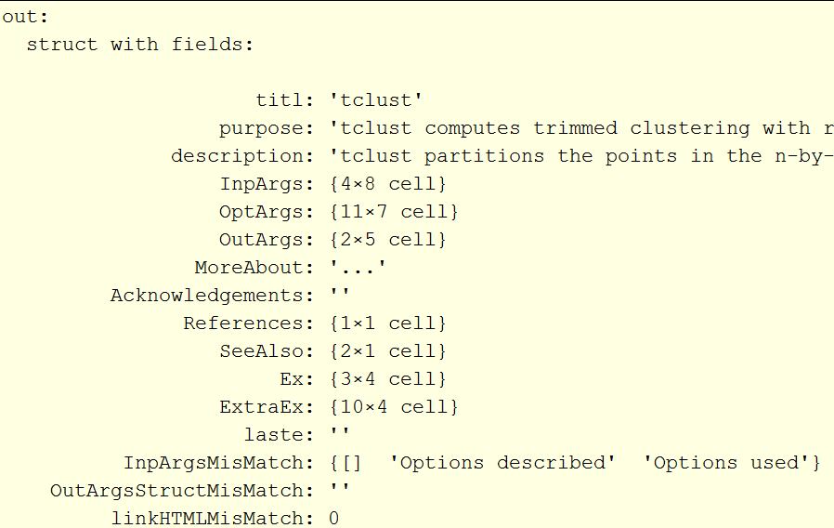
Example of the out strucure created by function mreadFS.m starting from file tclust.m

Slide 12
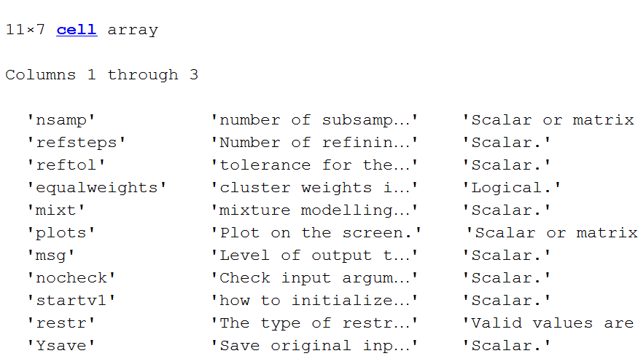
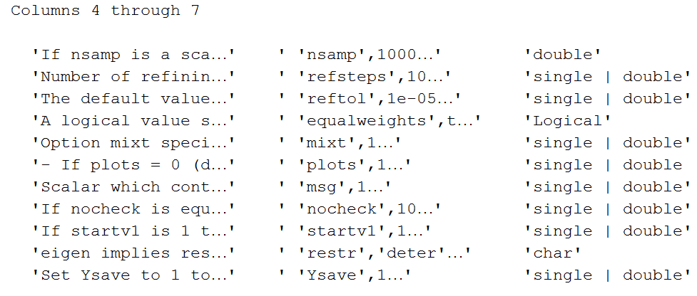
Dissection of the field out.OptArgs (Optional arguments section)

Slide 13
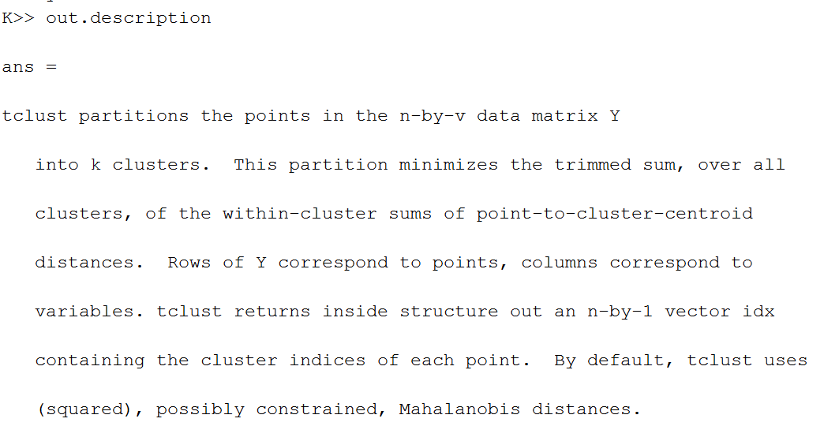
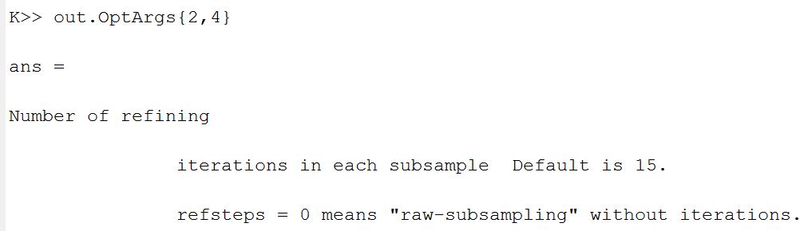
Dissection of the field out.description and a particular element inside out.OptArgs

Slide 14
File «removeextraspacesLF.m»
Removes extra spaces and extra line feeds(CR) from a string except those when
symbol ';' is followed by one or more spaces and a CR;
symbol ':' is followed by one or more spaces and a CR;
symbol '.' is followed by one or more spaces and a CR;
symbol '\[' is followed by one or more spaces and a CR;
symbol '\]' is preceded by one or more spaces and a CR.
symbol '\\' is preceded by one or more spaces and a CR.
Remark: this routine is passed to all fields of structure out created by «mreadFS.m»

Slide 15
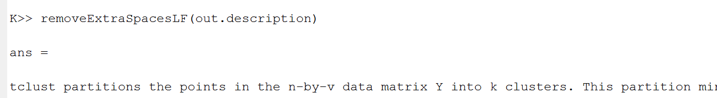
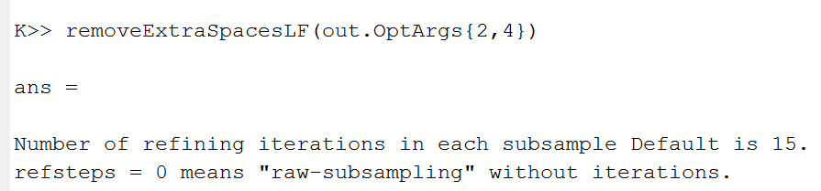
Dissection of the field out.description and a particular element inside out.OptArgs after applying function removeextraspacesLF.m
All the text contained inside out.description is put on a single line.
Note that wanted line feeds (those for which symbol «.» is followed by a line feed) are preserved.

Slide 16
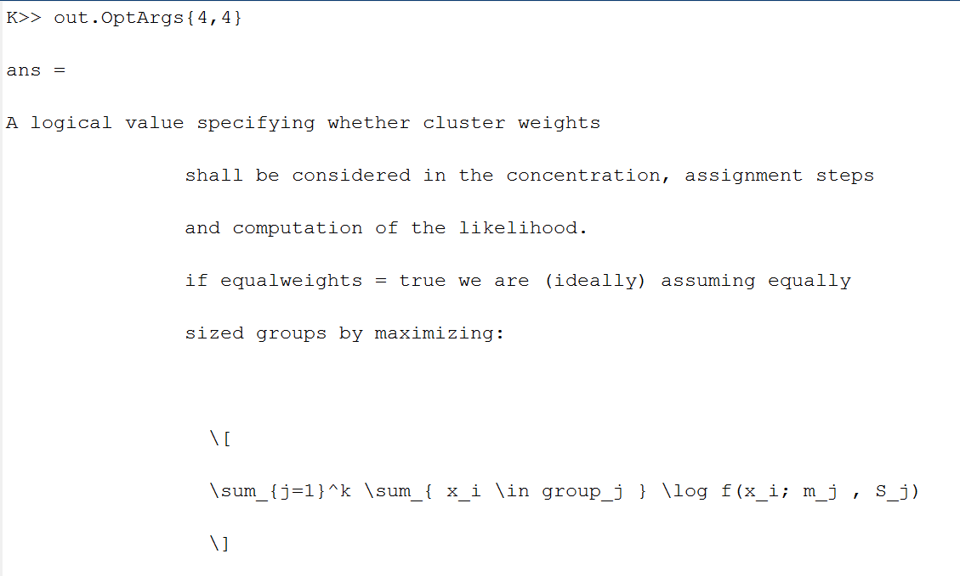
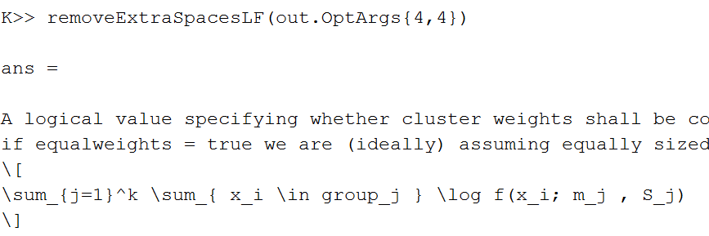
Dissection of a particular element inside out.OptArgs before and after applying function «removeextraspacesLF.m»
Before
After

Slide 17
File «xmlwriteFS.m»
Transforms MATLAB structure ‘out’ into an .XML file named «out.titl».xml
REMARK: file «xmlcreateFS.m» calls routines «mreadFS.m» and «removeextraspacesLF.m» to create using only one call the corresponding .XML file.
«xmlcreateFSallFiles.m» applies routine «xmlcreateFS.m» to all .m files indexed by routine «makecontentsfileFS.m» to create using only one call all .XML files
All .XML files are created in (FSDAroot)/helpfiles/XML
File «xmlreadFS.m»
Transforms a .XML file into a structure out containing the fields described previously

Slide 18
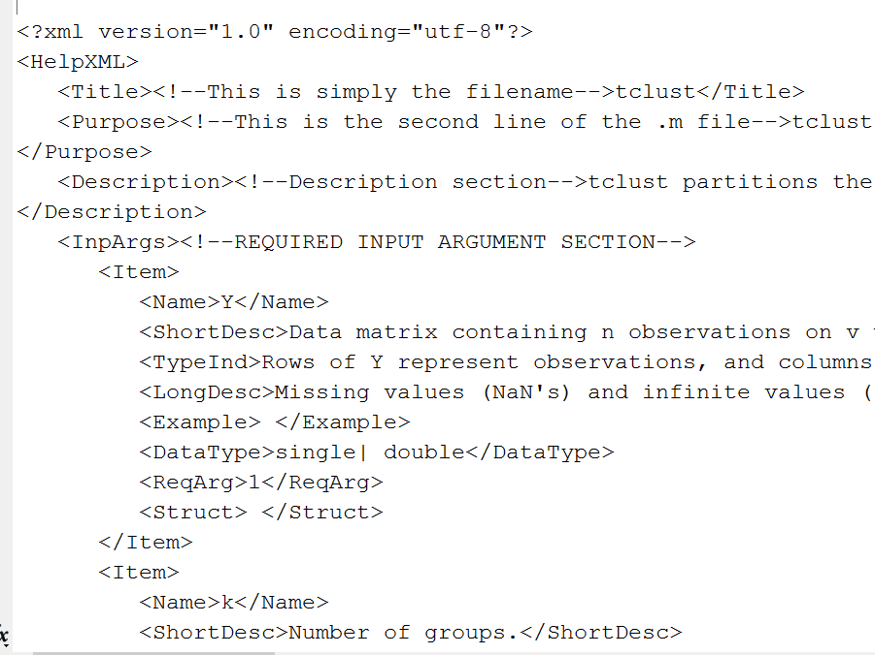
Example of the output produced by «xmlwriteFS.m»

Slide 19
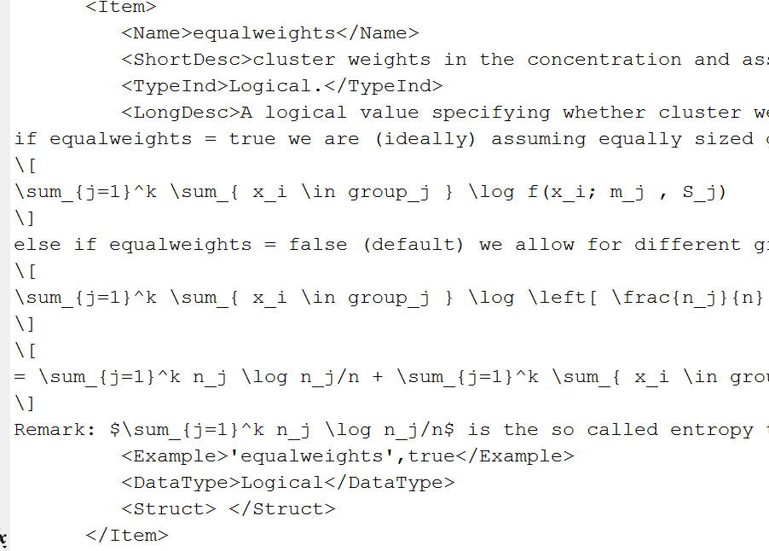
Example of the output produced by «xmlwriteFS.m»
Wanted line feeds are preserved inside the xml file

Slide 20
helpGUI (a .mlapp file)
Graphical user interface to edit all fields inside structure out.
This is organized in 7 Tab groups.
This GUI calls routine «xmlreadFS.m» to obtain structure out and with its fields populations the different controls of the GUI.
All modification made throught the GUI have the effect of changing structure out.
Buttom «save changes to .m and XML file»
calls routine «xmlwriteFS.m» to write the modifications in the corresponding .XML file
calls routine «mwriteFS.m» to write the modifications in the preamble of the corresponding .m file
writes modified out structure in a .MAT file which can be used by routine «htmlwriteFS.m»

Slide 21
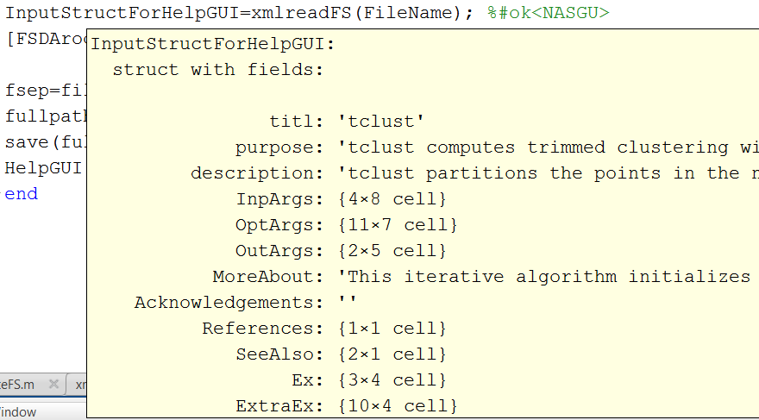
Example of the output produced by «xmlreadFS.m»
Starting from .XML file, structure out is completely reconstructed
The fields of the structure populate the GUI

Slide 22
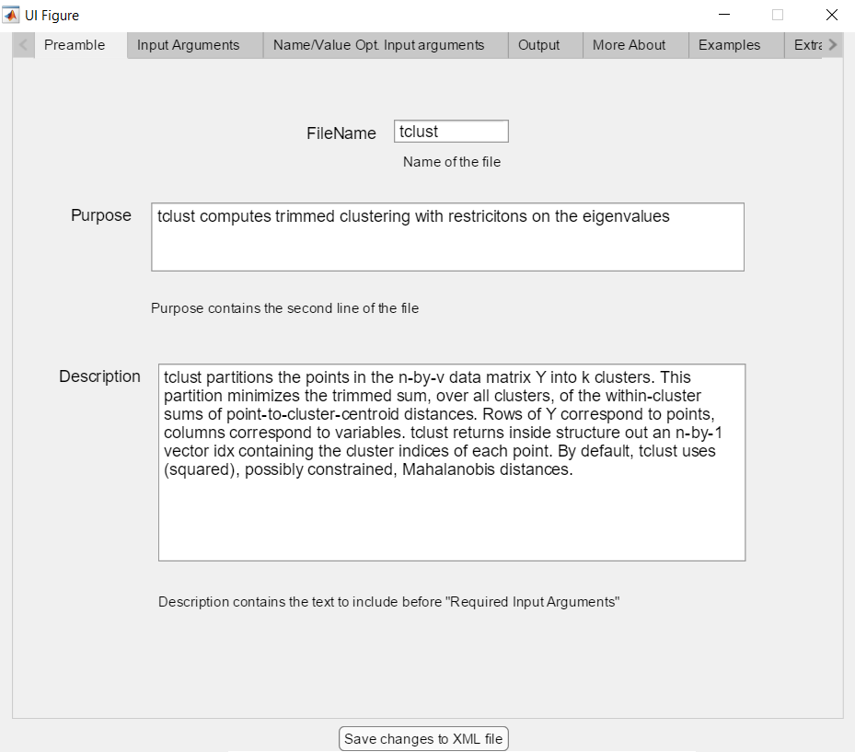
Some screenshots from the GUI: the «Preamble» tab

Slide 23
Some screenshots from the GUI: the «Optional Arguments» tab

Slide 24
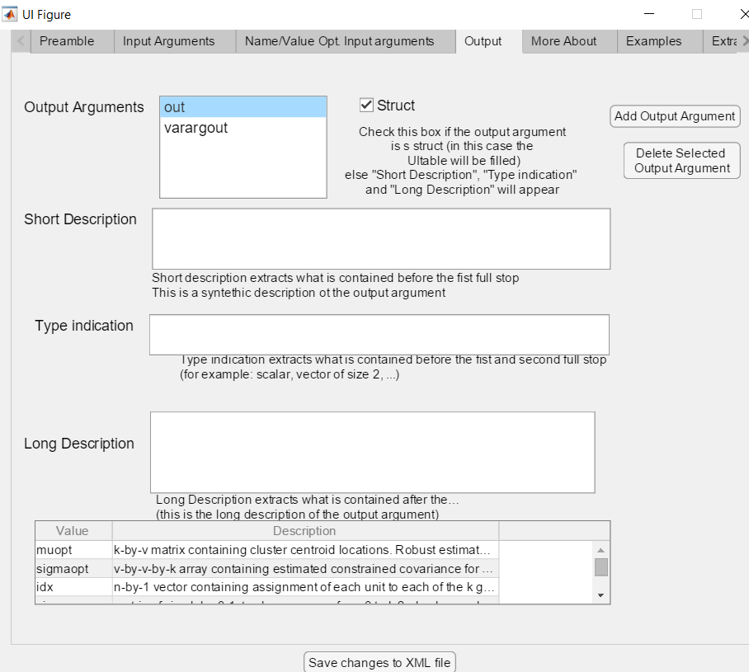
Some screenshots from the GUI: the «Output Arguments» tab

Slide 25
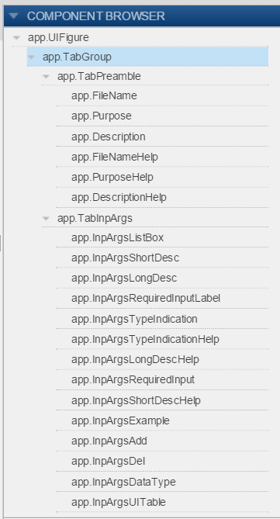
Each buttom of the GUI has the corresponding callback function

Slide 26
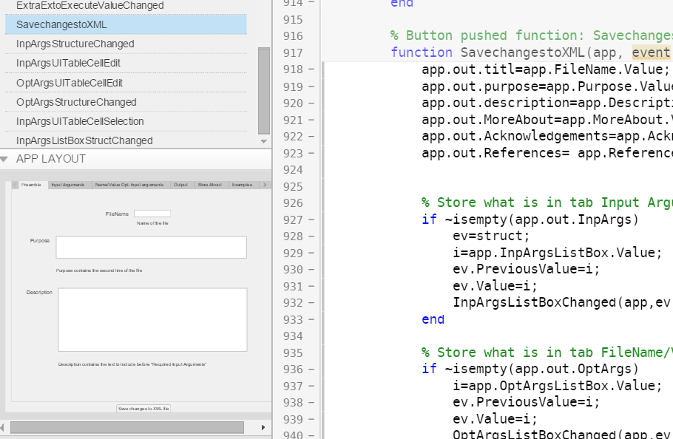
Dissection of the first part of the callback assocaited to «Save changes to XML» button)
Routine «SavechangestoXML» call routines mwriteFS.m and xmlwriteFS.m

Slide 27
File «mwriteFS.m»
This file takes as input structure out and writes the preamble of the corresponding .m file
The core of this routine is function «wraptextFS.m». This function not only does text wrapping, but also enables us:
to control left margin of the text;
to control the maximum width of the text or the right margin;
to add a (comment) sign at the beginning of each row of the wrapped text;
to indent the first line of the text.
to personalize comments, and left margin for comments

Slide 28
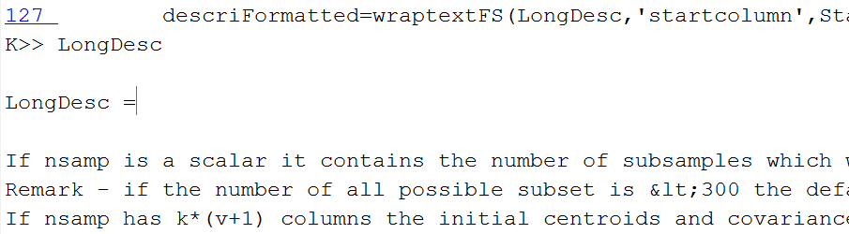
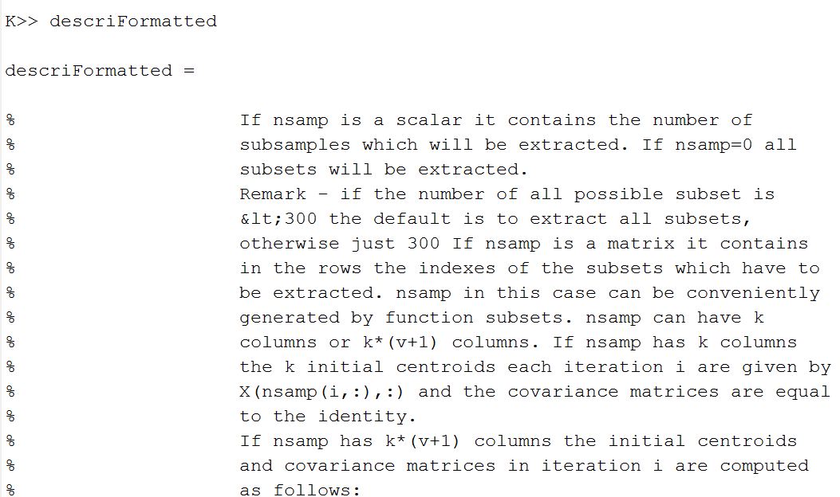
Example of the application of function «wraptextFS.m» to a particular item
LongDesc is the unformatted string before applygin routine «wraptextFS.m»
descriFormatted is the formatted string after applying routine «wraptextFS.m»

Slide 29
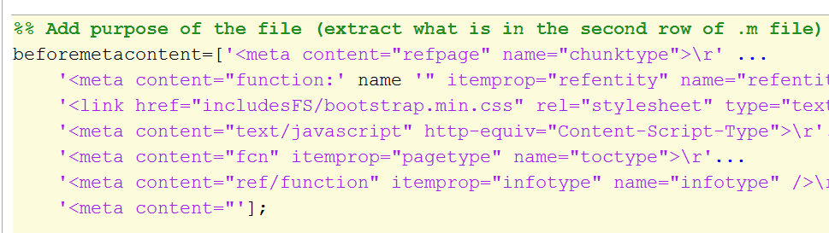
File «htmlwriteFS.m»
This routine takes as input the out structure described previously and creates the corresponding HTML file using the styles of the MATLAB help system
In this routine all elements of structure out are embedded inside the HTML MATLAB framework

Slide 30
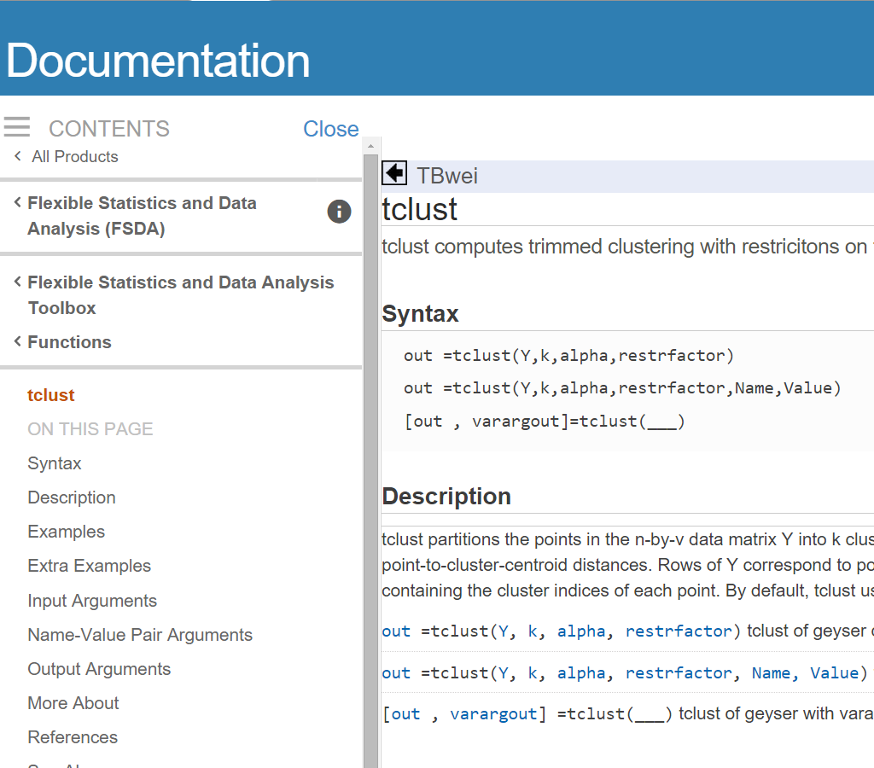
File «htmlwriteFS.m»

Slide 31
Conclusions
We have developed a fully automatic system which enables us to have a one to one correspondence between the .m and the .html file
There is no need to learn the rules which the input .m file has to obey because all the information can be added using the GUI.
The portability of .XML files guarantees that the documentation produced can be used in any platform

