Slide 1
COMMUNICATION VIA SUPERDENSE CODING
By
VENKATA DURGA KUMAR NARENDRA KOPPURAVURI,
PRATHINA VASIREDDY,
POOJITHA CHINNELUKA.

Slide 2



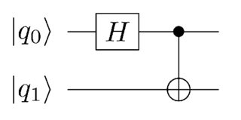
ENTANGLEMENT
Entanglement is the state where two qubits are so strongly correlated using Hadamard and C-not gates.
Once the qubits are entangled, they can neither be separated nor the relation between them can be reversed.

Slide 3
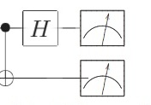
BELL MEASUREMENT
Bell measurement is opposite to Entanglement, in this first C-not gate is applied and then Hadamard is applied.

Slide 4
Encoding and Decoding message bits
Here as part of encoding the message we convert the message to binary form using ascii values.
And the binary form message is divided into a list of two bits and send a pair of message bits from the list each time.
The reverse process is done at the decoding time as well.
As as example, if the message is “Quantum” and the binary form of that will be “01010001011101010110000101101110011101000111010101101101”
We divide this into the form of list pf pair of bits
['01', '01', '00', '01', '01', '11', '01', '01', '01', '10', '00', '01', '01', '10', '11', '10', '01', '11', '01', '00', '01', '11', '01', '01', '01', '10', '11', '01']

Slide 5
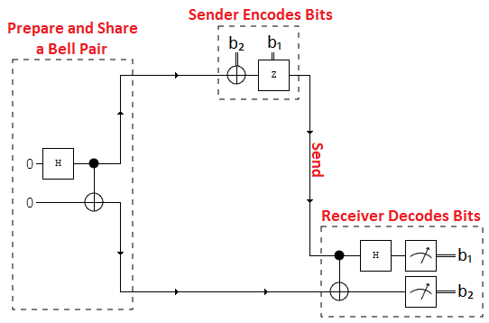
SUPERDENSE CODING
Superdense coding is a quantum communication protocol that allows a user to send 2 classical bits by sending only 1 qubit.
First a bell pair consisting of 2 qubits is prepared. Where q0 is the sender’s qubit and q1 is the receiver’s qubit. To do this q0 is put in-to a superposition of states using a Hadamard gate.
Then a CNOT operation is performed with q0 being the control and q1 being the target.

Slide 6
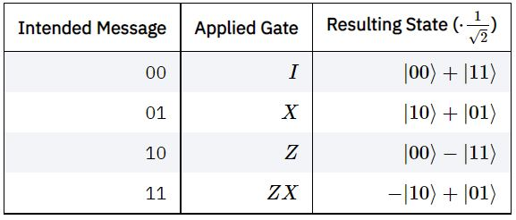
z
Encode the information on to q0
If the message is 00 then perform no operation.
If the message is 01 then perform a Pauli-Z operation where q1s state is flipped.
If the message is 10 then apply a Pauli-X gate.
If the message is 11 then apply a Pauli-Z gate followed by a Pauli-X gate

Slide 7
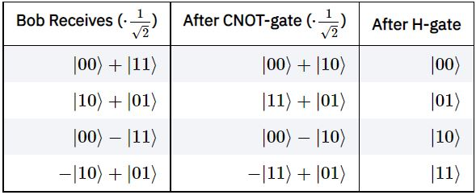
BELL MEASUREMENT - Receiver decodes the information
Next q0 is sent and the receiver has to decode the qubit. This is done by applying a CNOT where the received q0 is the control and q1 is the target. Then a hadamard gate is applied to q0

