Slide 1
Results and Discussions

Slide 2
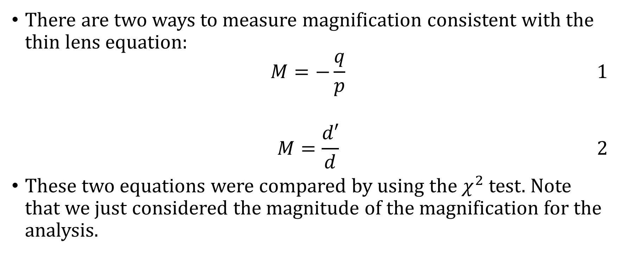
Magnification
There are two ways to measure magnification consistent with the thin lens equation:
$$\begin{aligned}M=−\frac{q}{p}\#1\end{aligned}$$
$$\begin{aligned}M=\frac{d′}{d}\#2\end{aligned}$$
These two equations were compared by using the $χ^{2}$ test. Note that we just considered the magnitude of the magnification for the analysis.

Slide 3

Focal Length
$$\begin{aligned}\frac{1}{f}=\frac{1}{d}+\frac{1}{d′}\#3\end{aligned}$$
$f$: focal length
$d$: object distance
$d′$: image distance

Slide 4
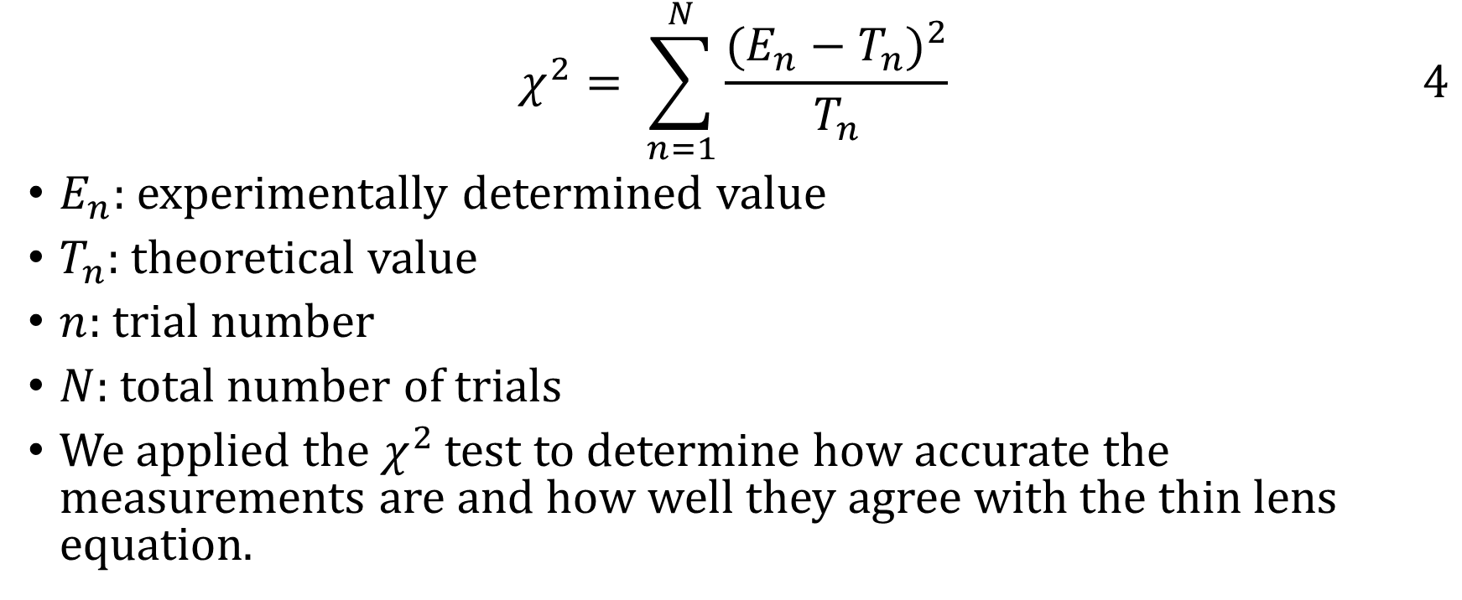
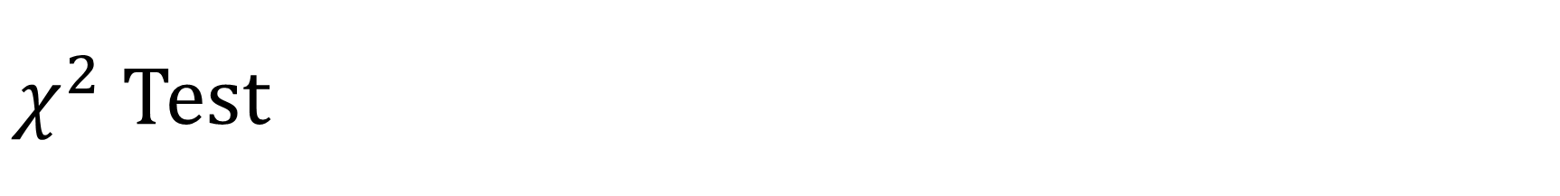
$χ^{2}$ Test
$$\begin{aligned}χ^{2}= \sum_{n=1}^{N}{\frac{{(E_{n}−T_{n})}^{2}}{T_{n}}}\#4\end{aligned}$$
$E_{n}$: experimentally determined value
$T_{n}$: theoretical value
$n$: trial number
$N$: total number of trials
We applied the $χ^{2}$ test to determine how accurate the measurements are and how well they agree with the thin lens equation.

Slide 5
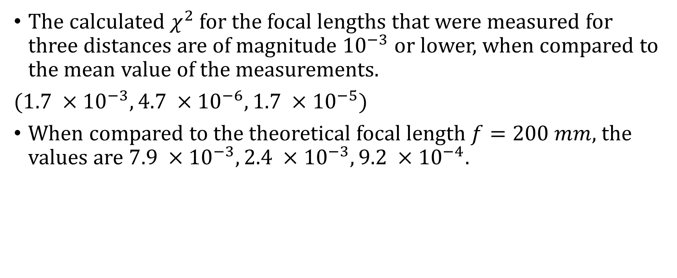
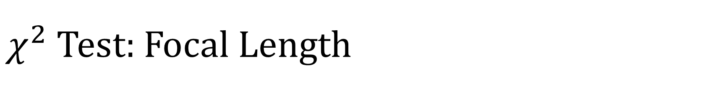
$χ^{2}$ Test: Focal Length
The calculated $χ^{2}$ for the focal lengths that were measured for three distances are of magnitude ${10}^{−3}$ or lower, when compared to the mean value of the measurements.
($1.7 ×{10}^{−3}, 4.7 ×{10}^{−6},1.7 ×{10}^{−5}$)
When compared to the theoretical focal length $f=200 mm$, the values are $7.9 ×{10}^{−3}, 2.4 ×{10}^{−3},9.2 ×{10}^{−4}.$

Slide 6
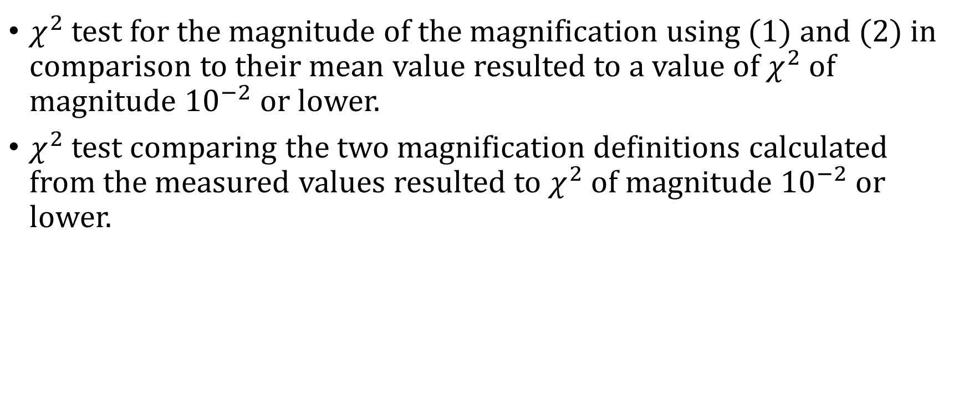
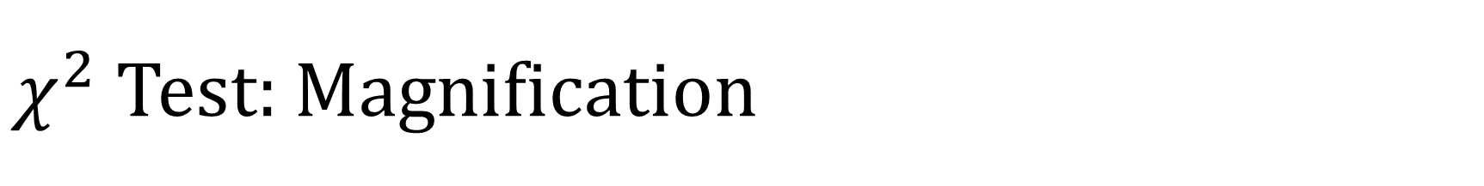
$χ^{2}$ Test: Magnification
$χ^{2}$ test for the magnitude of the magnification using (1) and (2) in comparison to their mean value resulted to a value of $χ^{2}$ of magnitude ${10}^{−2}$ or lower.
$χ^{2}$ test comparing the two magnification definitions calculated from the measured values resulted to $χ^{2}$ of magnitude ${10}^{−2}$ or lower.

Slide 7
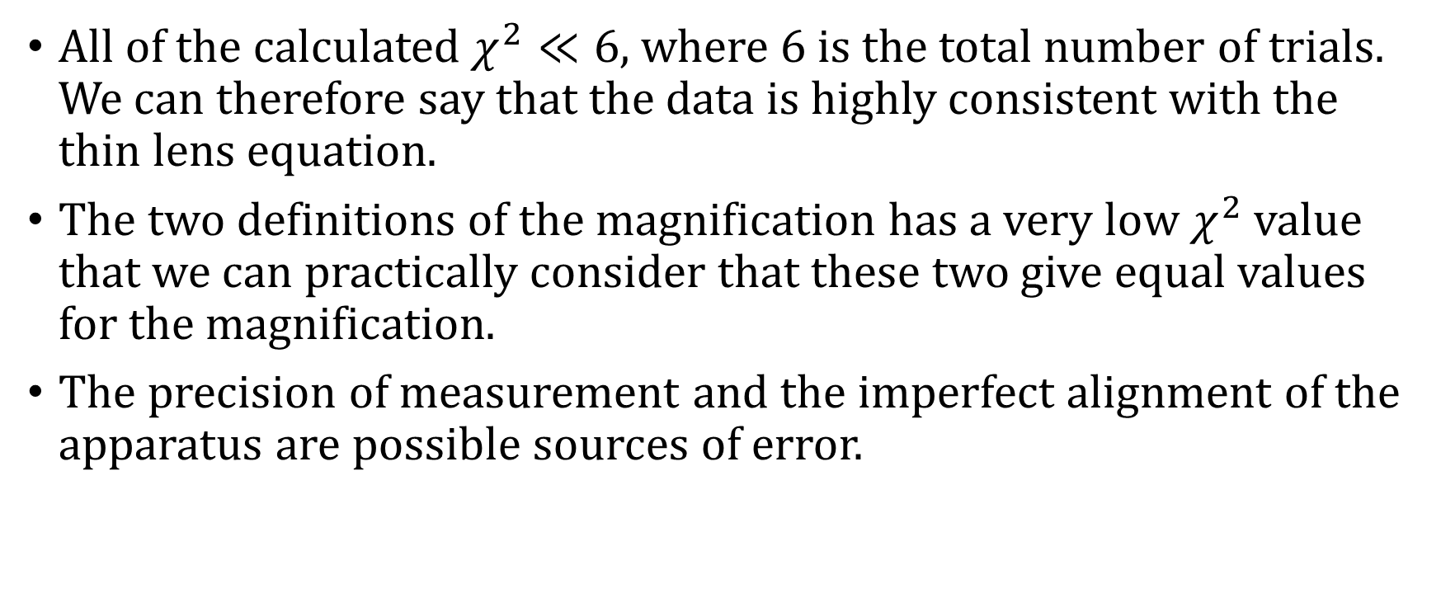
$χ^{2}$ Test
All of the calculated $χ^{2}≪6$, where 6 is the total number of trials. We can therefore say that the data is highly consistent with the thin lens equation.
The two definitions of the magnification has a very low $χ^{2}$ value that we can practically consider that these two give equal values for the magnification.
The precision of measurement and the imperfect alignment of the apparatus are possible sources of error.

