Slide 1
ANALYZING THE AGREEMENT OF THE THIN LENS EQUATION WITH CONVEX LENSES USING THE CHI-SQUARED TEST

Slide 2
ABSTRACT
Thin lens equation neglects the thickness of a spherical lens. In line with this, this experiment wants to test this equation statistically. A setup consisting of an incandescent bulb, transparent grid, diaphragm, lens, and a viewing screen was prepared. Then sets of values of image and object distances were obtained by varying the position of the lens. Results showed a close agreement between the theoretical and experimental focal lengths as well as between the magnification obtained by getting the ratio of the object and image distances and the magnification computed from the ratio of the object and image heights.

Slide 3
INTRODUCTION
Lenses, Thin lens equation, Chi-squared test

Slide 4
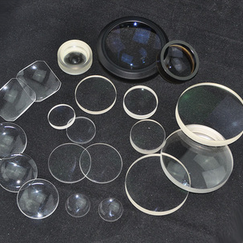
LENSES
refracting optical devices that focuses or disperses light
usually made with glass and normally has a spherical surface

Slide 5
Thin lenses
thickness of the lens appears to be negligible in comparison to the radius of curvature of the lens

Slide 6
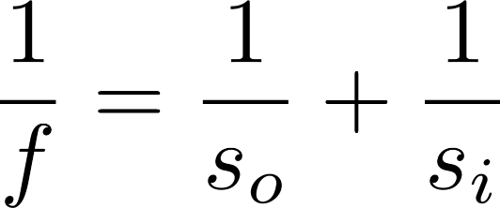

THIN LENS EQUATION
$f$ - the focal length of the lens used
$so$ - distance of the object from the lens
$si$ - distance of the image formed from the lens

Slide 7
CHI-SQUARED TEST
To determine whether there is a significant association between the two variables

Slide 8
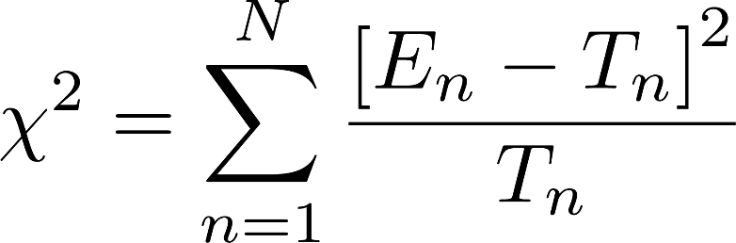
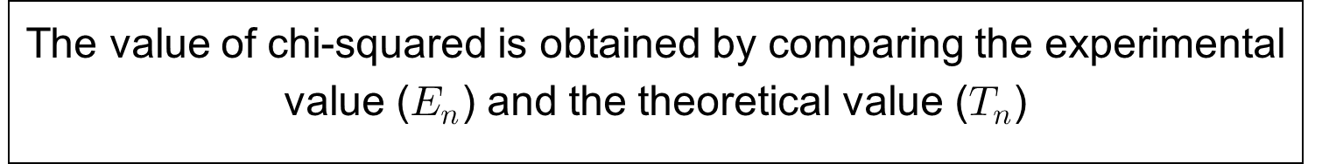
CHI-SQUARED TEST
The value of chi-squared is obtained by comparing the experimental value ($E_{n}$) and the theoretical value ($T_{n}$)

Slide 9
METHODOLOGY

Slide 10
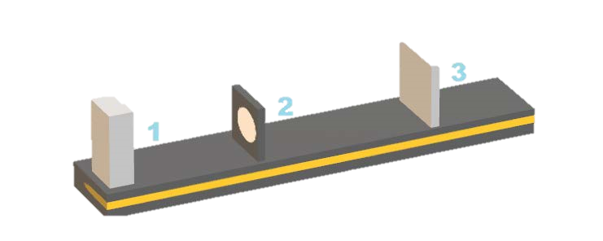
EXPERIMENTAL SETUP

Slide 11
YOU CAN ALSO SPLIT YOUR CONTENT
White
Is the color of milk and fresh snow, the color produced by the combination of all the colors of the visible spectrum.
Black
Is the color of coal, ebony, and of outer space. It is the darkest color, the result of the absence of or complete absorption of light.

Slide 12
IN TWO OR THREE COLUMNS
Yellow
Is the color of gold, butter and ripe lemons. In the spectrum of visible light, yellow is found between green and orange.
Blue
Is the color of the clear sky and the deep sea. It is located between violet and green on the optical spectrum.
Red
Is the color of blood, and because of this it has historically been associated with sacrifice, danger and courage.

Slide 13
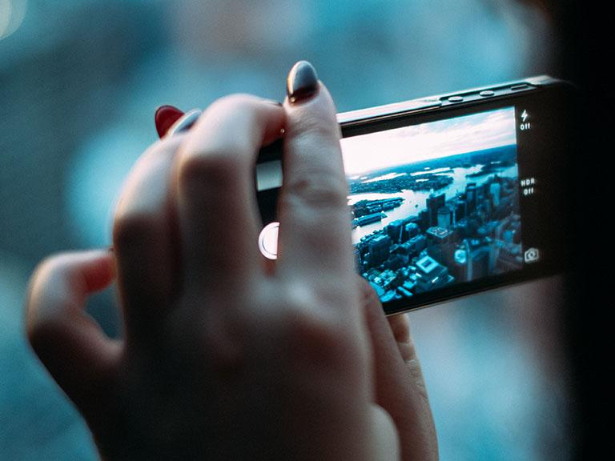
WANT BIG IMPACT?
Use big image

Slide 14
USE CHARTS TO EXPLAIN YOUR IDEAS
White
Gray
Black

Slide 15
AND TABLES TO COMPARE DATA
 | A | B | C
Yellow | 10 | 20 | 7
Blue | 30 | 15 | 10
Orange | 5 | 24 | 16

Slide 16
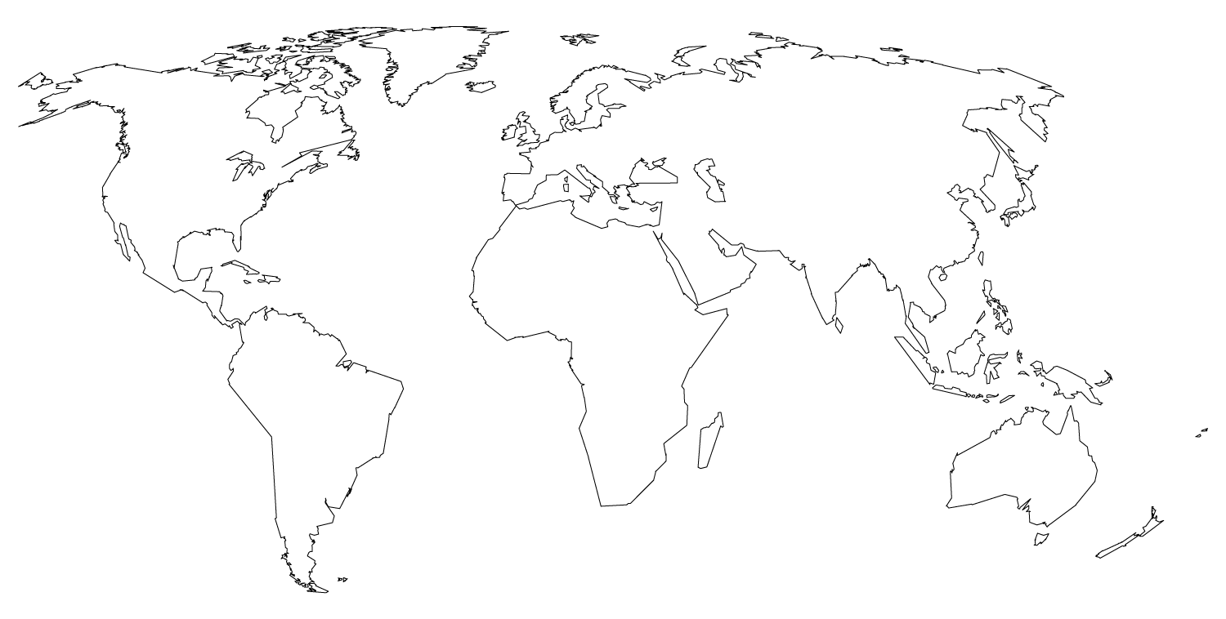
MAPS
our office

Slide 17
89,526,124
Whoa! That’s a big number, aren’t you proud?

Slide 19
89,526,124$
That’s a lot of money
185,244 users
And a lot of users
100%
Total success!

Slide 20
OUR PROCESS IS EASY
first
second
last

Slide 21
LETS REVIEW SOME CONCEPTS
Yellow
Is the color of gold, butter and ripe lemons. In the spectrum of visible light, yellow is found between green and orange.
Blue
Is the colour of the clear sky and the deep sea. It is located between violet and green on the optical spectrum.
Red
Is the color of blood, and because of this it has historically been associated with sacrifice, danger and courage.
Yellow
Is the color of gold, butter and ripe lemons. In the spectrum of visible light, yellow is found between green and orange.
Blue
Is the colour of the clear sky and the deep sea. It is located between violet and green on the optical spectrum.
Red
Is the color of blood, and because of this it has historically been associated with sacrifice, danger and courage.

Slide 22
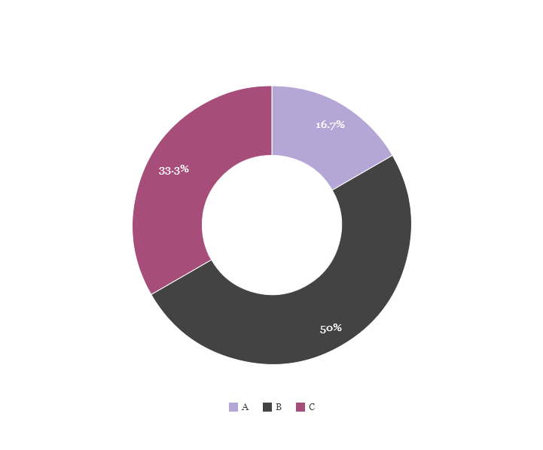
You can copy&paste graphs from Google Sheets

Slide 23
ANDROID PROJECT
Show and explain your web, app or software projects using these gadget templates.
Place your screenshot here

Slide 24
IPHONE PROJECT
Show and explain your web, app or software projects using these gadget templates.
Place your screenshot here

Slide 25
TABLET PROJECT
Show and explain your web, app or software projects using these gadget templates.
Place your screenshot here

Slide 26
Place your screenshot here
DESKTOP PROJECT
Show and explain your web, app or software projects using these gadget templates.

Slide 27
THANKS!
Any questions?
You can find me at:
@username
user@mail.me

Slide 28
CREDITS
Special thanks to all the people who made and released these awesome resources for free:
Presentation template by SlidesCarnival
Photographs by Unsplash
Backgrounds by SubtlePatterns

Slide 29
PRESENTATION DESIGN
This presentations uses the following typographies and colors:
Titles: Montserrat
Body copy: PT Serif
You can download the fonts on these pages:
https://www.fontsquirrel.com/fonts/montserrat
https://www.fontsquirrel.com/fonts/pt-serif
Cream #f3efea
Plum #8f7b87
Black #000000
You don’t need to keep this slide in your presentation. It’s only here to serve you as a design guide if you need to create new slides or download the fonts to edit the presentation in PowerPoint®

Slide 30
SlidesCarnival icons are editable shapes.
This means that you can:
Resize them without losing quality.
Change line color, width and style.
Isn’t that nice? :)
Examples:

Slide 31
😉
Now you can use any emoji as an icon!
And of course it resizes without losing quality and you can change the color.
How? Follow Google instructions https://twitter.com/googledocs/status/730087240156643328
✋👆👉👍👤👦👧👨👩👪💃🏃💑❤😂😉😋😒😭👶😸🐟🍒🍔💣📌📖🔨🎃🎈🎨🏈🏰🌏🔌🔑 and many more...

