Slide 1
ANALYZING THE AGREEMENT OF THE THIN LENS EQUATION WITH CONVEX LENSES USING THE CHI-SQUARED TEST
ANCHETA, DOMINGO, LAZARO, ONG
PHYSICS 192
NATIONAL INSTITUTE OF PHYSICS

Slide 2
INTRODUCTION
Lenses, Thin lens equation, Chi-squared test

Slide 3
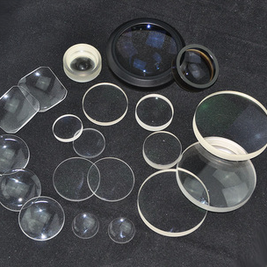
LENSES
refracting optical devices that focuses or disperses light
usually made with glass and normally has a spherical surface

Slide 4
Thin lenses
thickness of the lens appears to be negligible in comparison to the radius of curvature of the lens

Slide 5
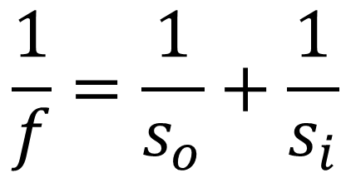
THIN LENS EQUATION
$$\frac{1}{f}=\frac{1}{s_{o}}+\frac{1}{s_{i}}$$
f - the focal length of the lens used
s_{o} - distance of the object from the lens
s_{i} - distance of the image formed from the lens

Slide 6
CHI-SQUARED TEST
To determine whether there is a significant association between the two variables

Slide 7
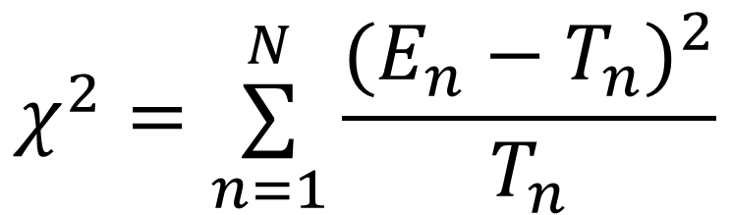
CHI-SQUARED TEST
The value of chi-squared is obtained by comparing the experimental value (E_{n}) and the theoretical value (T_{n})
$$χ^{2}=\overset{N}{\underset{n=1}{∑}}\frac{(E_{n}−T_{n})^{2}}{T_{n}}$$

Slide 8
METHODOLOGY
Experimental setup and parameters

Slide 9
EXPERIMENTAL SETUP & PARAMETERS
GRID
VARIABLE APERTURE
VIEWING SCREEN
LENS
LIGHT SOURCE
OPTICAL BENCH
Figure 1. Thin Lens Setup consisting of an incandescent bulb as a light source projected onto a viewing screen with a variable aperture and a converging thin lens placed in between.
Light source: incandescent lamp
Lenses: +200 mm & +250 mm
Grid spacing: 2.00 mm x 2.00 mm

Slide 10
EXPERIMENTAL SETUP
White
Is the color of milk and fresh snow, the color produced by the combination of all the colors of the visible spectrum.
Black
Is the color of coal, ebony, and of outer space. It is the darkest color, the result of the absence of or complete absorption of light.

Slide 11
IN TWO OR THREE COLUMNS
Yellow
Is the color of gold, butter and ripe lemons. In the spectrum of visible light, yellow is found between green and orange.
Blue
Is the colour of the clear sky and the deep sea. It is located between violet and green on the optical spectrum.
Red
Is the color of blood, and because of this it has historically been associated with sacrifice, danger and courage.

Slide 12
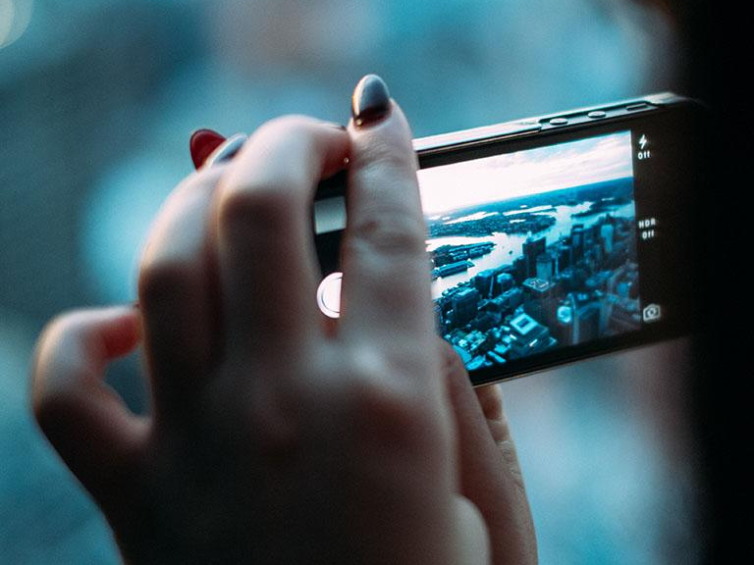
WANT BIG IMPACT?
Use big image

Slide 13
USE CHARTS TO EXPLAIN YOUR IDEAS
White
Gray
Black

Slide 14
AND TABLES TO COMPARE DATA
 | A | B | C
Yellow | 10 | 20 | 7
Blue | 30 | 15 | 10
Orange | 5 | 24 | 16

Slide 15
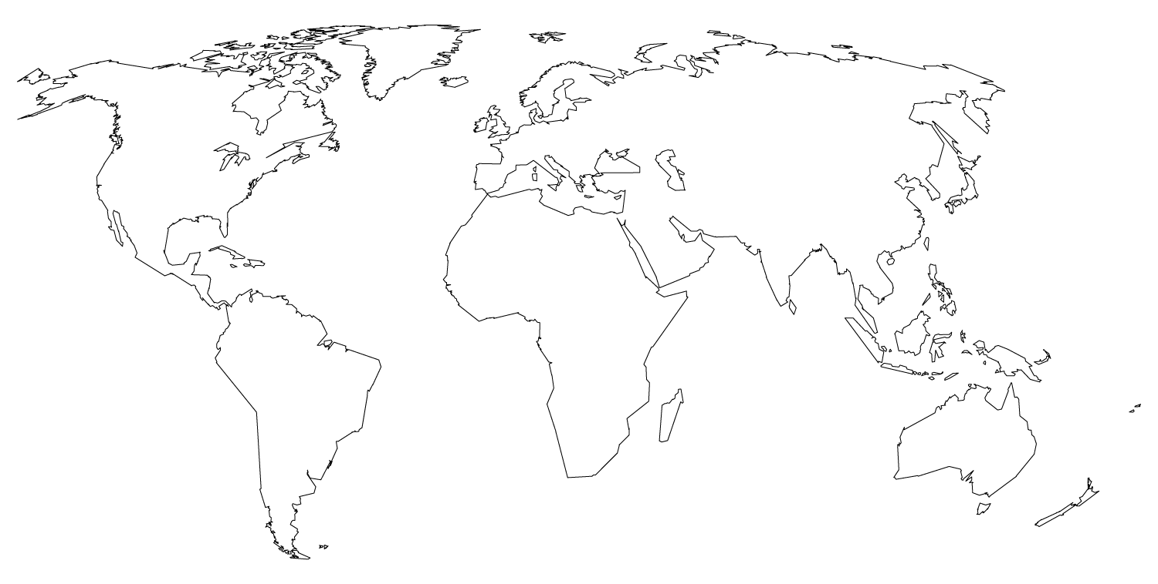
MAPS
our office

Slide 16
89,526,124
Whoa! That’s a big number, aren’t you proud?

Slide 18
89,526,124$
That’s a lot of money
185,244 users
And a lot of users
100%
Total success!

Slide 19
OUR PROCESS IS EASY
first
second
last

Slide 20
LETS REVIEW SOME CONCEPTS
Yellow
Is the color of gold, butter and ripe lemons. In the spectrum of visible light, yellow is found between green and orange.
Blue
Is the colour of the clear sky and the deep sea. It is located between violet and green on the optical spectrum.
Red
Is the color of blood, and because of this it has historically been associated with sacrifice, danger and courage.
Yellow
Is the color of gold, butter and ripe lemons. In the spectrum of visible light, yellow is found between green and orange.
Blue
Is the colour of the clear sky and the deep sea. It is located between violet and green on the optical spectrum.
Red
Is the color of blood, and because of this it has historically been associated with sacrifice, danger and courage.

Slide 21
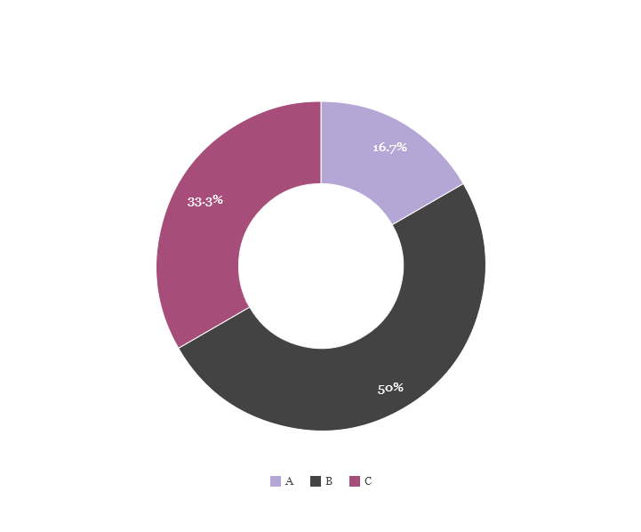
You can copy&paste graphs from Google Sheets

Slide 22
ANDROID PROJECT
Show and explain your web, app or software projects using these gadget templates.
Place your screenshot here

Slide 23
IPHONE PROJECT
Show and explain your web, app or software projects using these gadget templates.
Place your screenshot here

Slide 24
TABLET PROJECT
Show and explain your web, app or software projects using these gadget templates.
Place your screenshot here

Slide 25
Place your screenshot here
DESKTOP PROJECT
Show and explain your web, app or software projects using these gadget templates.

Slide 26
THANKS!
Any questions?
You can find me at:
@username
user@mail.me

Slide 27
CREDITS
Special thanks to all the people who made and released these awesome resources for free:
Presentation template by SlidesCarnival
Photographs by Unsplash
Backgrounds by SubtlePatterns

Slide 28
PRESENTATION DESIGN
This presentations uses the following typographies and colors:
Titles: Montserrat
Body copy: PT Serif
You can download the fonts on these pages:
https://www.fontsquirrel.com/fonts/montserrat
https://www.fontsquirrel.com/fonts/pt-serif
Cream #f3efea
Plum #8f7b87
Black #000000
You don’t need to keep this slide in your presentation. It’s only here to serve you as a design guide if you need to create new slides or download the fonts to edit the presentation in PowerPoint®

Slide 29
SlidesCarnival icons are editable shapes.
This means that you can:
Resize them without losing quality.
Change line color, width and style.
Isn’t that nice? :)
Examples:

Slide 30
😉
Now you can use any emoji as an icon!
And of course it resizes without losing quality and you can change the color.
How? Follow Google instructions https://twitter.com/googledocs/status/730087240156643328
✋👆👉👍👤👦👧👨👩👪💃🏃💑❤😂😉😋😒😭👶😸🐟🍒🍔💣📌📖🔨🎃🎈🎨🏈🏰🌏🔌🔑 and many more...

