Slide 1
Compressively sampled speech: How good is the recovery?
Kenneth V. Domingo, and Maricor N. Soriano
National Institute of Physics, University of the Philippines Diliman
SPP-2020-4C-04
22 October 2020

Slide 2
Contents
01.
02.
03.
04.
Abstract &
Introduction
Dataset &
Methodology
Results & Discussion
Conclusions & Recommendations

Slide 3
Abstract
Modern signal acquisition technologies are made possible by the Nyquist-Shannon sampling theorem (NST). However, this paradigm is extremely wasteful as the signal is compressed before storing it by systematically discarding imperceptible information. Compressive sensing (CS) aims to directly sense the relevant information. Current literature focus either on formulating more computationally-efficient algorithms, or methods which improve the reconstruction quality. In this paper, we quantify the reconstruction quality of compressively sampled speech with a perceptually intuitive metric—the Perceptual Evaluation of Speech Quality (PESQ)—and with the standard average segmental SNR (SNR_{seg}). The quality of recovery of compressively sampled speech evaluated using PESQ is dependent on the compression ratio, and independent of the number of subbands used to represent the signal in the spectrogram domain.

Slide 4
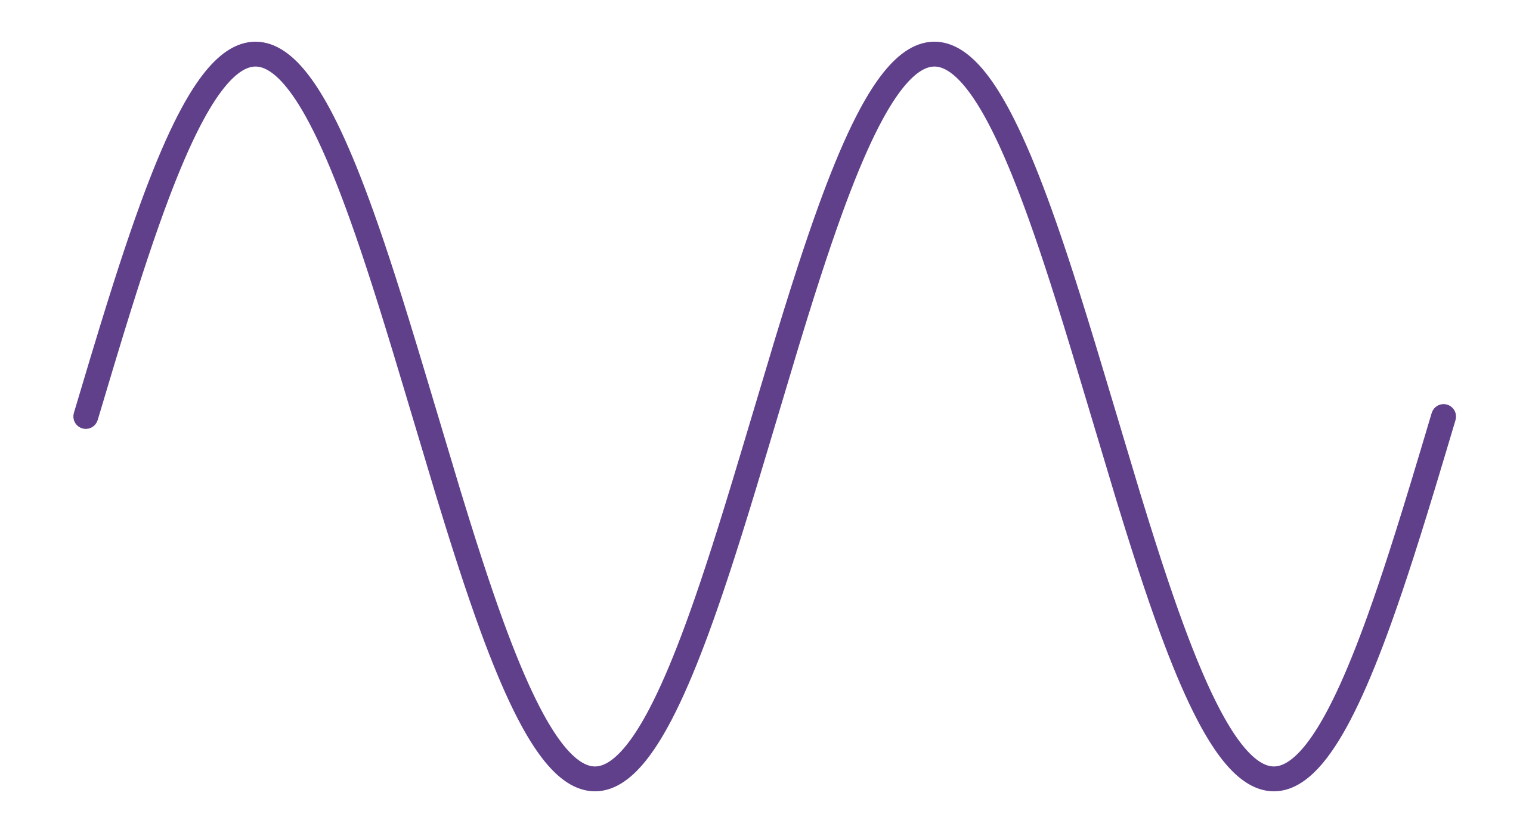
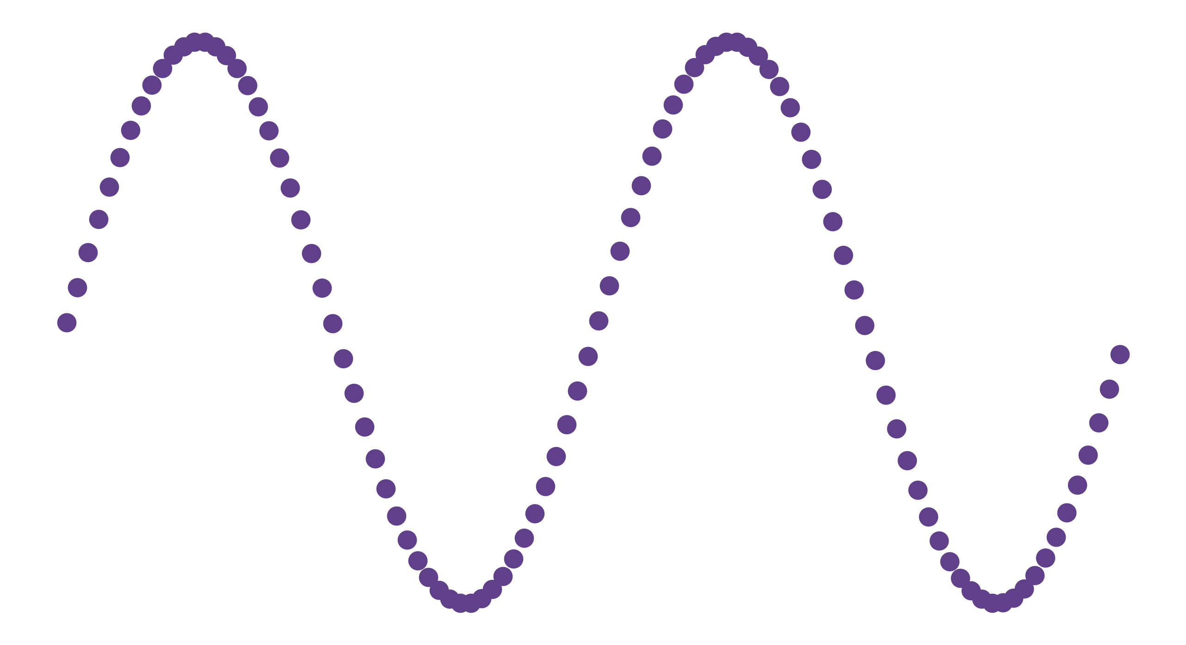
Nyquist-Shannon sampling
f_{B}
sampling
interpolation
Real signal, continuous
Sampled signal, discrete
Reconstructed signal, continuous
Notes:
Signals are sampled discretely at a fixed rate over time
Video – image snapshots at 30 images (frames) per second (fps)
Audio – amplitude snapshots at 44,100 times per second (Hz)

Slide 5
Nyquist-Shannon sampling
f_{S} > 2f_{B}
f_{B}
sampling
interpolation
Real signal, continuous
Sampled signal, discrete
Reconstructed signal, continuous

Slide 6
Compressive sampling
sampling
minimization
Real signal, continuous
Sampled signal, discrete
Reconstructed signal, continuous

Slide 7
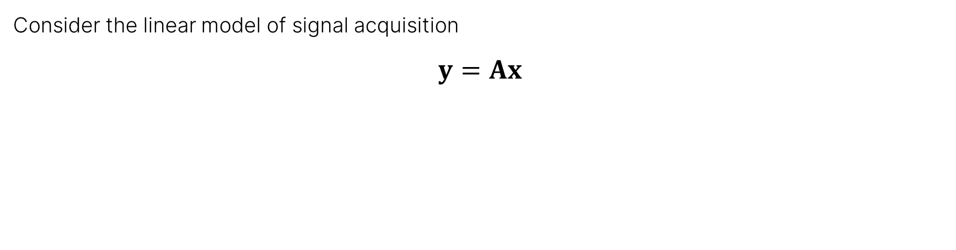
Compressive sampling
Consider the linear model of signal acquisition
$$y=Ax$$

Slide 8
Compressive sampling
Consider the linear model of signal acquisition
$$y=Ax$$
sampled signal
original signal
sensing matrix

Slide 9

Compressive sampling
$$A=ΦΨ$$
sensing matrix
sparsifying basis
measurement basis

Slide 10
Sensing matrix constraints
Incoherence
Measurement basis should have low mutual coherence with the sparsifying basis
Sparsity
Signal must be represented in some domain where most of its coefficients are approximately zero

Slide 11
Previously (SPP 2019)
Compressive sampling of relatively simple signals
Recorded guitar signal playing one note
One base frequency + harmonics
Error measured in terms of cosine similarity [0, 1]
Compares similarity of original & recovered frequencies, ignores magnitude

Slide 12
Objectives
Quantify signal reconstruction error with perceptually-intuitive metrics
Compare both magnitudes and frequencies
Perform CS on complex signals (i.e., speech)

Slide 13




Methodology
Pre-processing
Sparse transformation
Compressive sampling
Reconstruction evaluation

Slide 14
Dataset
TIMIT Acoustic-Phonetic Continuous Speech Corpus (Garafolo et al., 1993)
Format: .WAV, 16 kHz sampling rate, 3 seconds average duration
6300 sentences (10 sentences spoken by 630 people)
File structure: <dialect-region>/<sex><speakerId>/<sentenceId>.wav
8 dialect regions corresponding to US region where the speakers grew up
DR1: New England
DR2: Northern
DR3: North Midland
DR4: South Midland
DR5: Southern
DR6: NYC
DR7: Western
DR8: Army Brat (nomadic)

Slide 15
Dataset
Sentences consist of:
2 dialect “shibboleth” sentences (SRI)
450 phonetically-compact sentences (MIT)
1890 phonetically-diverse sentences (TI)

Slide 16
Preprocessing
All test signals were obtained from the TIMIT Acoustic-Phonetic Continuous Speech Corpus
Format: .WAV, 16 kHz sampling rate, 3 seconds long on average
Grouped by spoken sentence, region & sex
Downsampled first to 8 kHz

Slide 17
Sparse transformation
Images, simple audio → Fourier/frequency domain
Speech audio → modulation/spectrogram domain

Slide 18
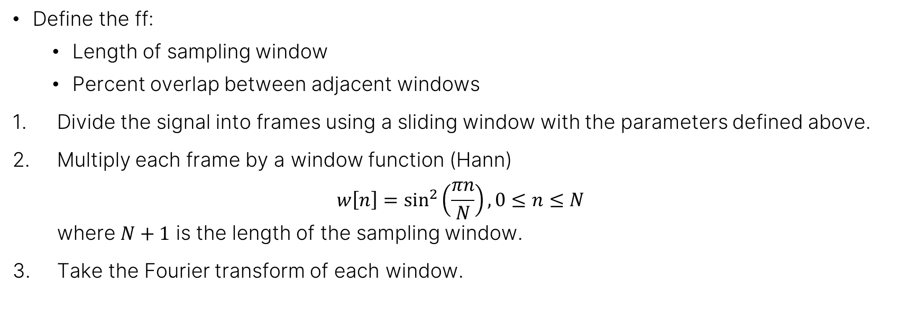
Sparse transformation
Define the ff:
Length of sampling window
Percent overlap between adjacent windows
Divide the signal into frames using a sliding window with the parameters defined above.
Multiply each frame by a window function (Hann) $w\left[n\right]=\sin^{2}\left(\frac{πn}{N}\right), 0≤n≤N$ where $N+1$ is the length of the sampling window.
Take the Fourier transform of each window.

Slide 19

Sparse transformation
The defined steps can be summarized as a short-term Fourier transform (STFT): $X\left(ω,p\right)=\sum_{p=0}^{P−1}{x\left[p\right]w\left[p−kR\right]e^{−iωp}}$ where $x[p]$ indicates the $p$th signal frame, $w[n−k]$ is the window function with hop size $R$, $k$ is the time index, and $ω$ is the frequency.

Slide 20
Reconstruction evaluation
Perceptual Evaluation of Speech Quality (PESQ)
Prediction of perceived quality that would be given to a received signal by subjects in a subjective listening test
Complex series of scaling, transforming, filtering, windowing, and more
We refer to PESQ manual (ITU, 2001) for a detailed overview
PESQ value | 1 | 2 | 3 | 4 | 5
Qualitative description | bad | below average | average | good | perfect

Slide 21
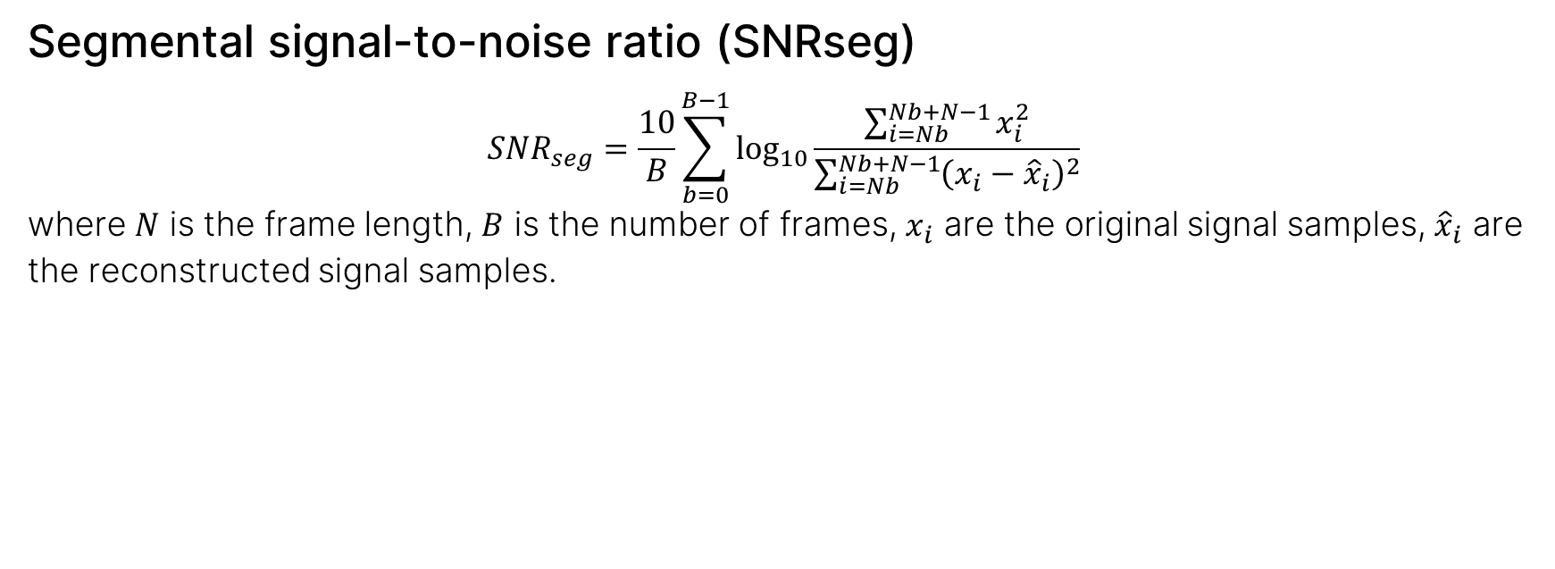
Reconstruction evaluation
Segmental signal-to-noise ratio (SNRseg) $$SNR_{seg}=\frac{10}{B}\sum_{b=0}^{B−1}{\log_{10}{\frac{\sum_{i=Nb}^{Nb+N−1}{x_{i}^{2}}}{\sum_{i=Nb}^{Nb+N−1}{{\left(x_{i}−{\hat{x}}_{i}\right)}^{2}}}}}$$ where $N$ is the frame length, $B$ is the number of frames, $x_{i}$ are the original signal samples, ${\hat{x}}_{i}$ are the reconstructed signal samples.

Slide 22
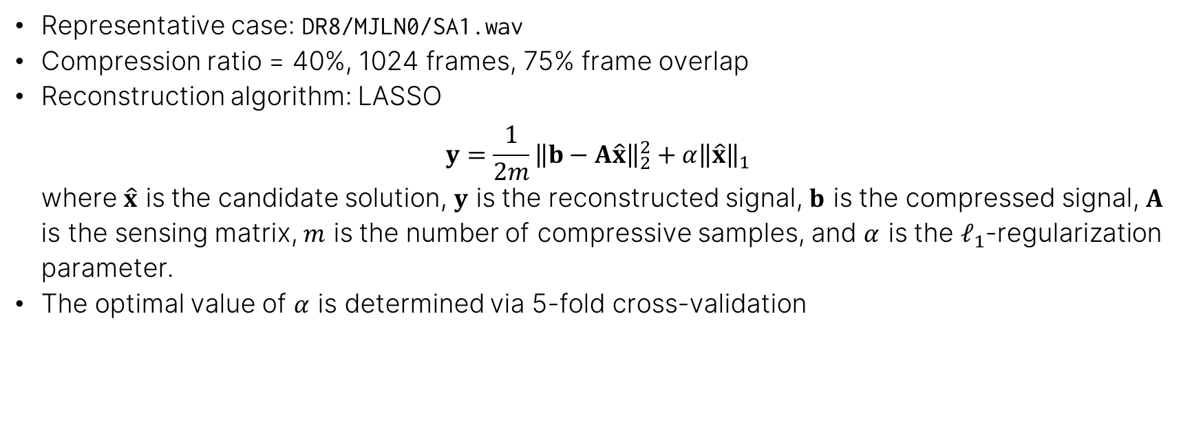
Results & Discussion: Representative case
Representative case: DR8/MJLN0/SA1.wav
Compression ratio = 40%, 1024 frames, 75% frame overlap
Reconstruction algorithm: LASSO $y=\frac{1}{2m}{\left\|b−A\hat{x}\right\|}_{2}^{2}+α{\left\|\hat{x}\right\|}_{1}$ where $\hat{x}$ is the candidate solution, $y$ is the reconstructed signal, $b$ is the compressed signal, $A$ is the sensing matrix, $m$ is the number of compressive samples, and $α$ is the $ℓ_{1}$-regularization parameter.
The optimal value of $α$ is determined via 5-fold cross-validation

Slide 23
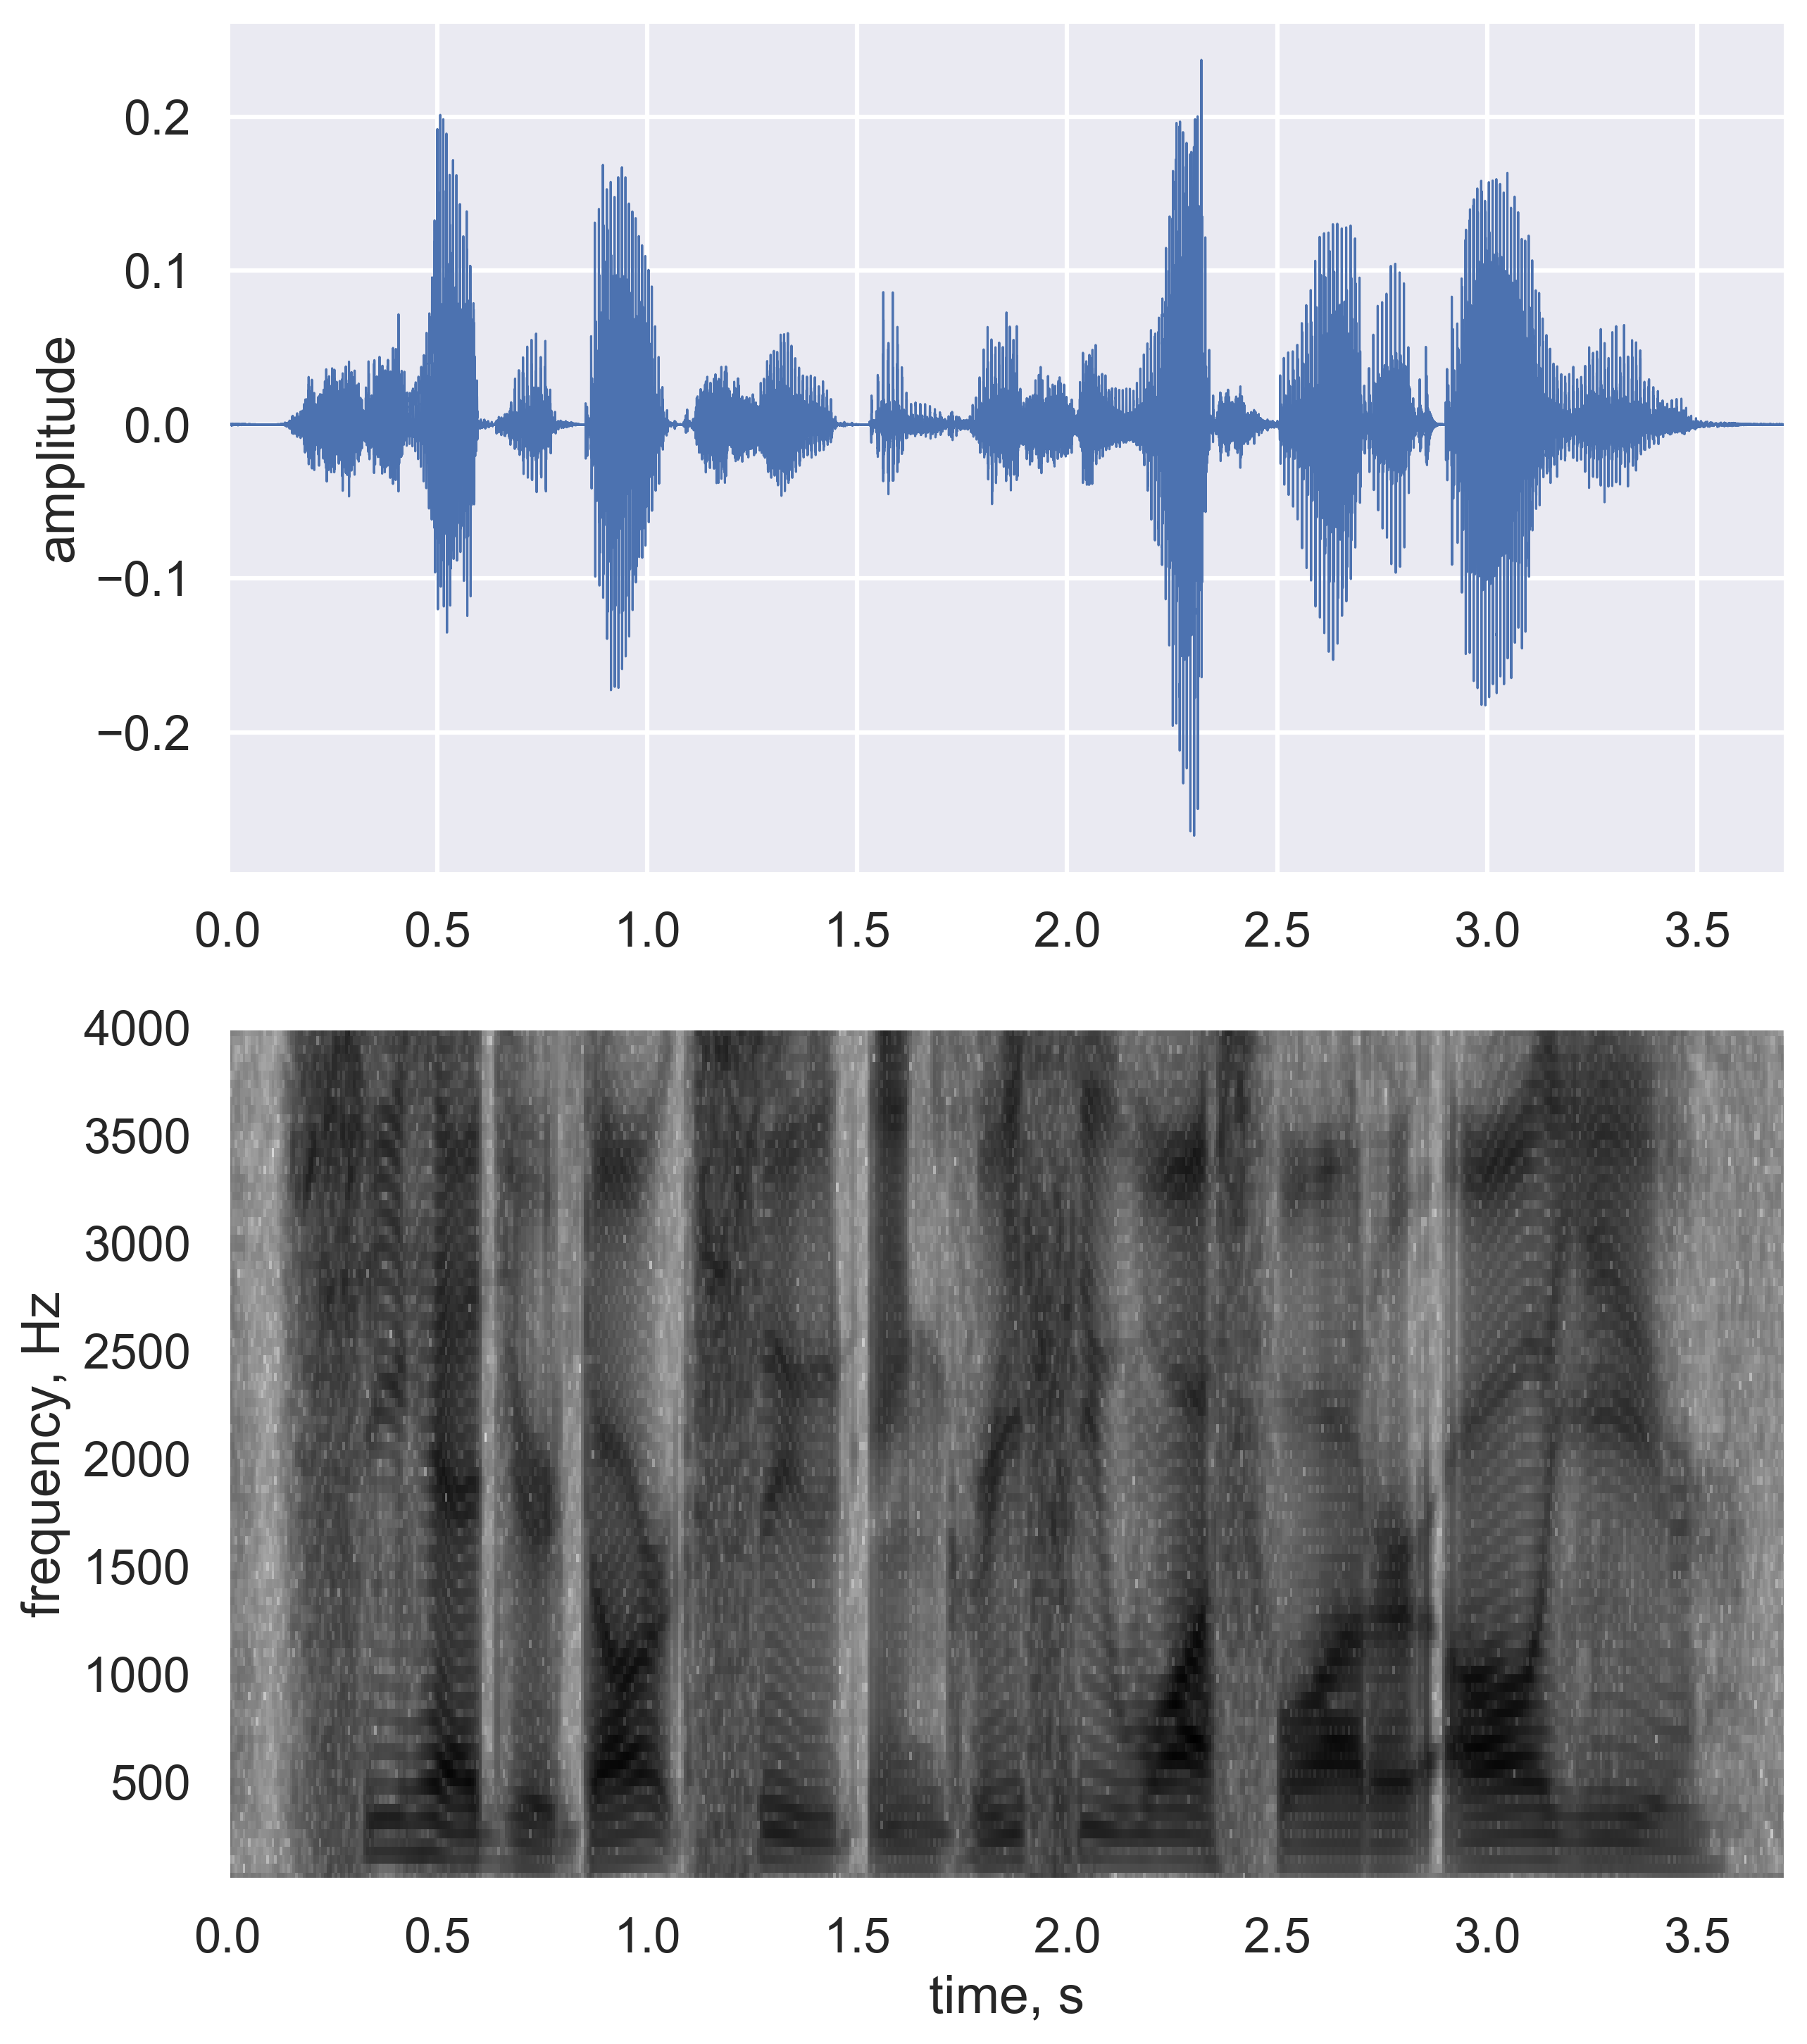
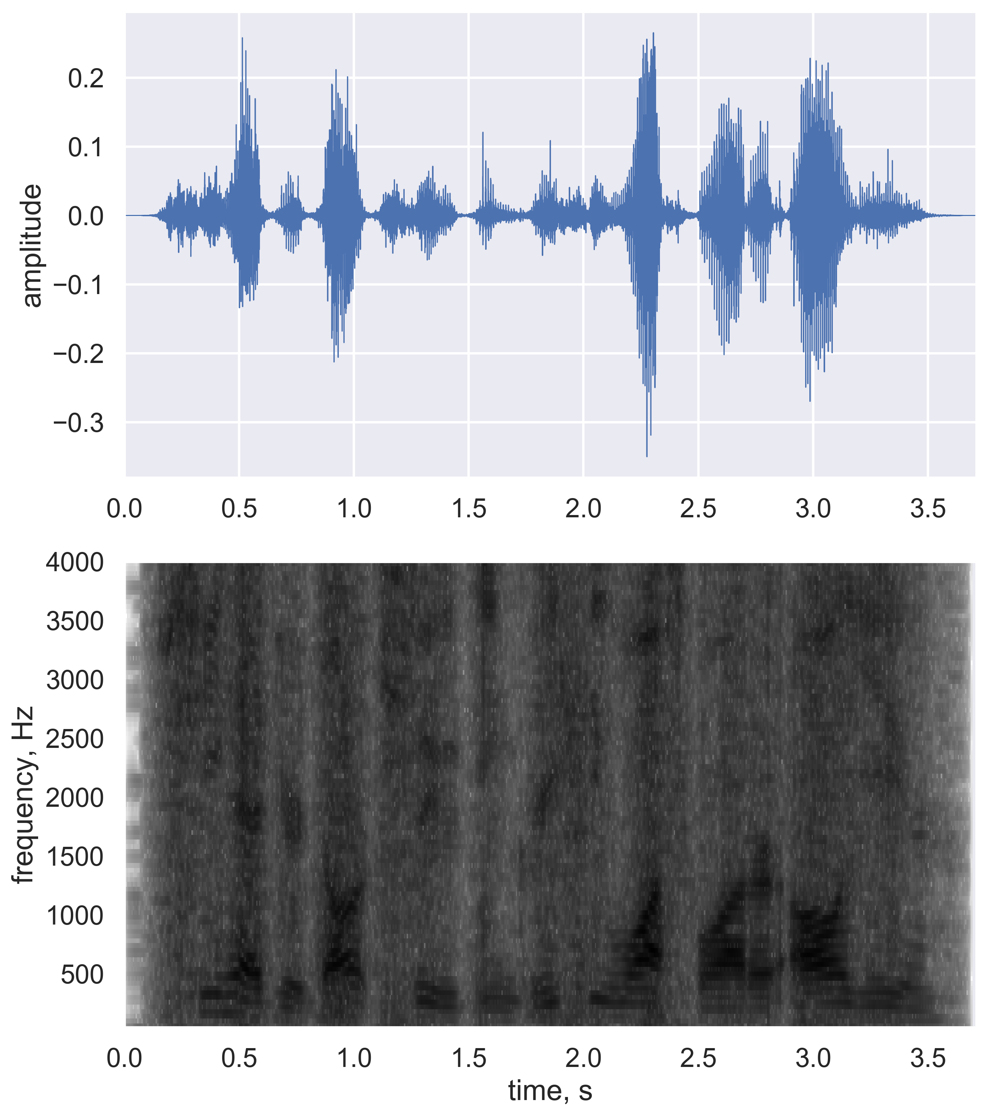
Representative case

Slide 24

Results & Discussion: Error maps
Error maps generated by compressively sensing the signal & evaluating the metrics for:
Compression ratio $m/n$ $∈[0.1, 0.9]$ in increments of 0.1
Number of frames $∈\{128, 256, 512, 1024\}$
Frame overlap constant at 75%

Slide 25
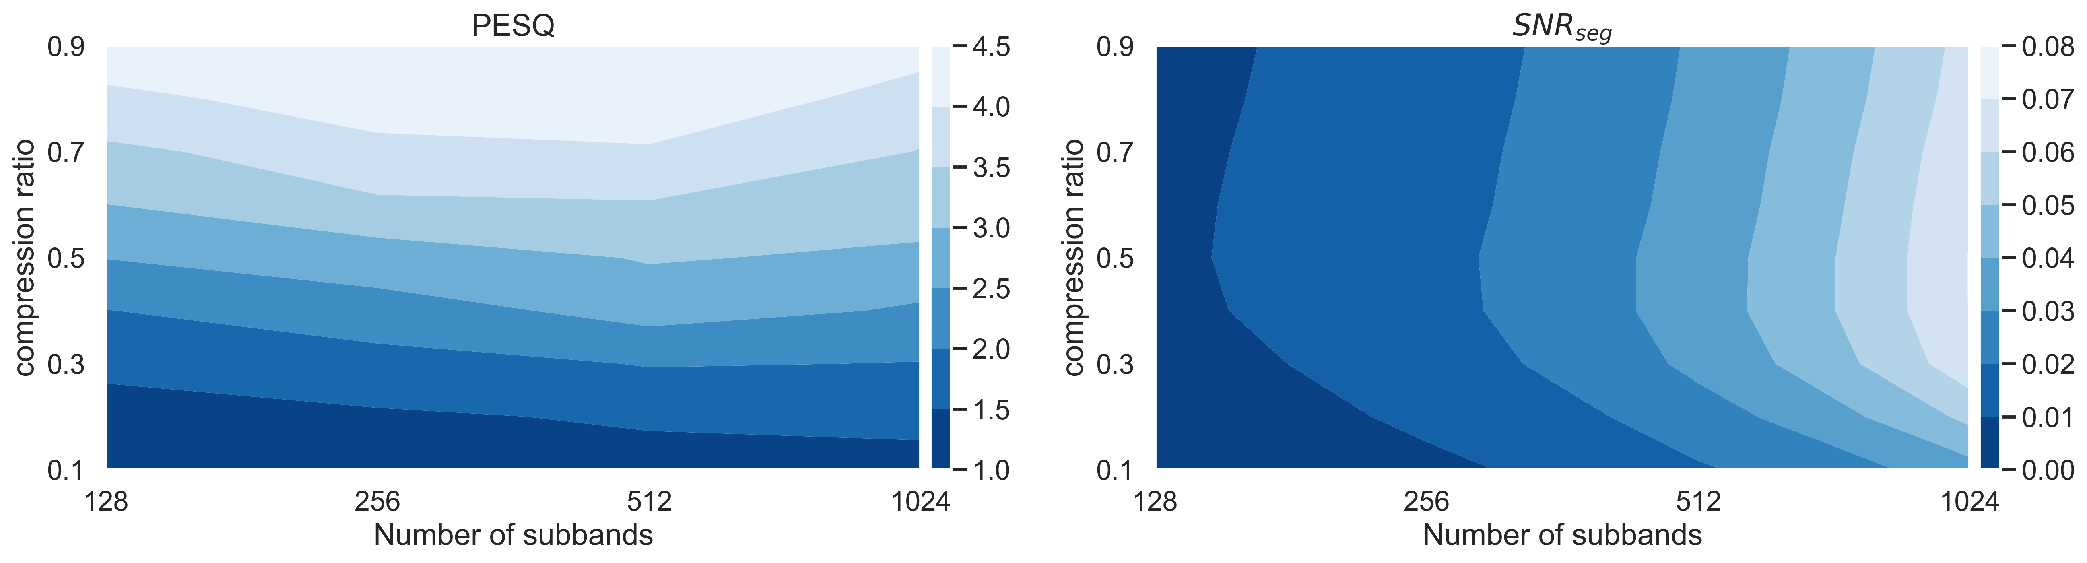
Error maps

Slide 26
Conclusions
Reconstruction quality of compressively sampled speech was quantified by compression ratio & number of frames
Evaluation of a perceptually-intuitive metric (PESQ) shows that it is sensitive only to changes in compression
Evaluation of a statistical metric (SNR_{seg}) shows that it is sensitive only to the number of frames
Depending on the use case, the reconstruction quality of a speech signal can be described as a function solely of a relevant metric

Slide 27
Recommendations
Test on locally-acquired speech recordings
Test on higher-sample rate signals
Test on adaptive reconstruction algorithms

Slide 28
References
J. S. Garafolo, L. F. Lamel, W. M. Fisher, J. G. Fiscus, D. S. Pallett, N. L. Dahlgren, and V. Zue, TIMIT acoustic-phonetic continuous speech corpus LDC93S1 (Linguistic Data Consortium, 1993).
Telecommunication Standardization Sector of ITU, Perceptual Evaluation for Speech Quality (PESQ): An objective method for end-to-end speech quality assessment of narrow-band telephone networks and speech codecs, ITU-T Recommendation P.862 (02/01) (2001).

Slide 29
Compressively sampled speech: How good is the recovery?
Kenneth V. Domingo, and Maricor N. Soriano
National Institute of Physics, University of the Philippines Diliman
SPP-2020-4C-04
22 October 2020

