Slide 2
Why Angular?
Angular is one of the most modern, performance-efficient and powerful frontend frameworks
The powerful features and capabilities of Angular allow you to create complex, customizable, modern, responsive and user friendly web applications.
Angular is faster than Angular 1 and offers a much more flexible and modular development approach
Speed
Developing the SPA(Single page Application)
High Performance
Better support for Mobile App Development
Angular 8 simply is the latest version of the Angular framework and simply an update to Angular 2.

Slide 3
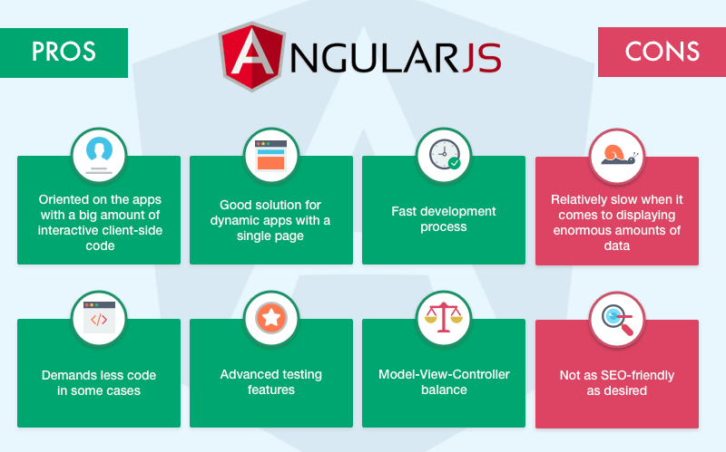
Advantage of Angular

Slide 4
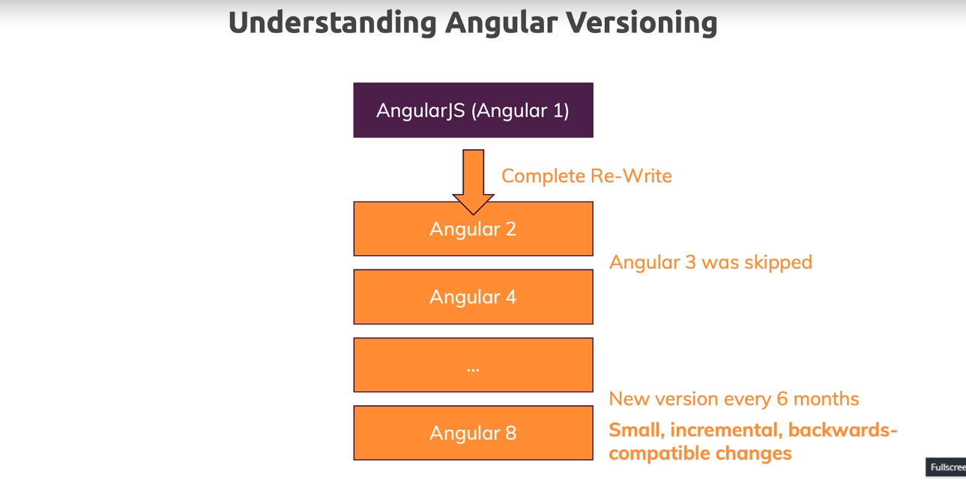
Angular Versions

Slide 5
Project Setup(Windows)
Best way to create the Angular Application Using Angular Cli (Command line Interface)
Download Node from (https://nodejs.org/en/) → Recommended Users
npm install -g @angular/cli
npm install -g @angular/cli
ng new my-dream-app
cd my-dream-app
ng serve
my-app (Creating the Angular Application).
Go to the relevant path ex: cd my-app
ng serve (Running the Angular Application)
Download the visual studio code(IDE for Angular Development)

Slide 6
First Angular App.

Slide 7
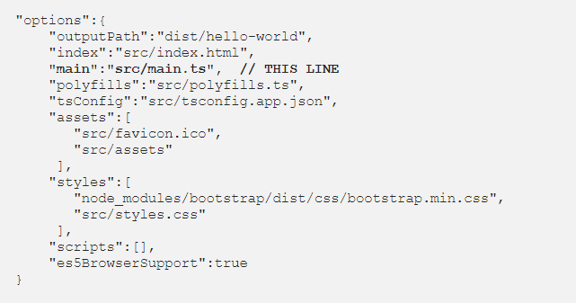
I mean how the files are called and in which sequence of files the app gets executed when we are developing it.(Angular Flow)
ANGULAR.JSON File : you can see the options object as follows
It has a reference to the main.ts file which tells the builder to start the app from there.

Slide 8
Angular Flow:
2. MAIN.TS :
This file acts as the entry point of the application. This entry point is defined in the internals of webpack that is used by Angular to support the modular functionality. The path/name of the main file can be changed but it should also be changed in angular.json file. Main.ts helps in creating the browser environment for the application to run. This is done by:
After this, main.ts file calls the function bootstrapModule(AppModule) which tells the builder to bootstrap the app.
3. APP.MODULE.TS
From the main.ts file, it is very clear that we are bootstrapping the app with AppModule. This AppModule is defined in APP.MODULE.TS file which is found in

Slide 9
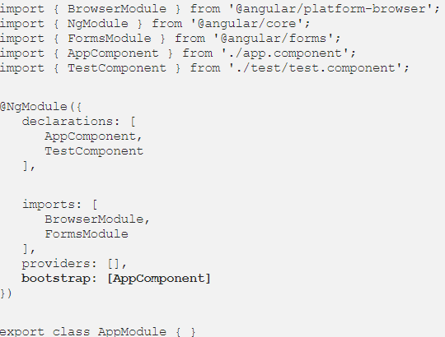
3. APP.MODULE.TS
4. APP.COMPONENT.TS:
From the app.module.ts file above, we can clearly see that the module asks to bootstrap the app component. This app component is in app.component.ts file. This is the file which interacts with the html of the webpage and serves it with the data. The component is made by using @Component decorator which is imported from @angular/core. The component has a selector, which is like a custom html tag which we can use to call that component. It then has template or templateUrl which contains the html of the page to be displayed. It also has the styleUrls array where component specific style sheets can be placed. This is how a component file looks

Slide 10
5. INDEX.HTML
Now, since angular is well aware of the modules, components, styles, scripts etc. which are required to display the page, it’s show time!
Here, the index.html file is called. It is found in the src folder of the app. Compiler dynamically adds all the javascript files at the end of this file. Since all the components are now known, the html file calls the root component that is app-root. The root component is defined in app.components.ts which targets app.component.html. This is how index.html file looks like in the coding environment:
<!doctype html> <html lang="en"> <head> <meta charset="utf-8"> <title>My Hello World App!</title> <base href="/"> <meta name="viewport" content="width=device-width, initial-scale=1"> <link rel="icon" type="image/x-icon" href="favicon.ico"> </head> <body> <app-root></app-root> </body> </html>

Slide 11
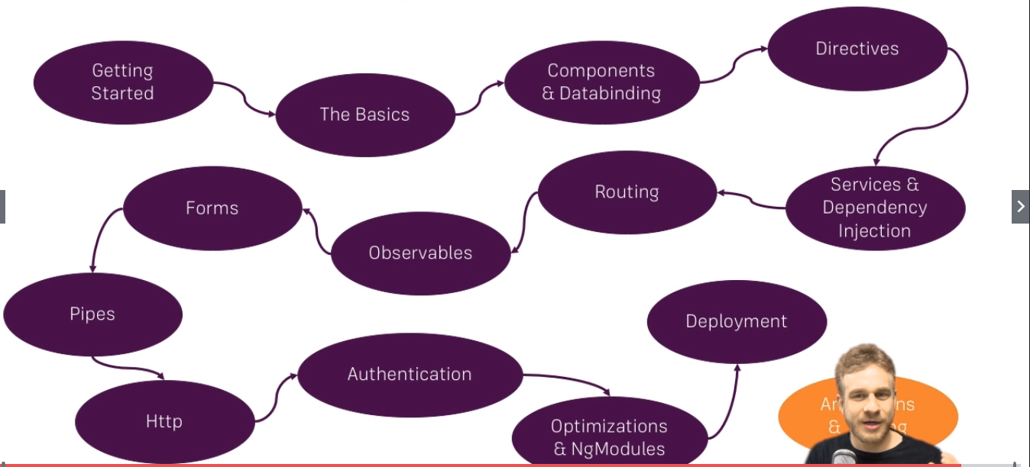
Course Structure
Course Structure

Slide 12
TypeScript:
TypeScript is a primary language for Angular application development. It is a superset of JavaScript with design-time support for type safety and tooling.
Browsers can't execute TypeScript directly. Typescript must be "transpiled" into JavaScript using the tsc compiler, which requires some configuration.
tsconfig.json—TypeScript compiler configuration.
typings—TypesScript declaration files.
Url : https://www.tutorialspoint.com/typescript/index.htm

Slide 13
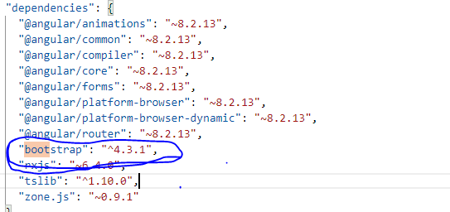
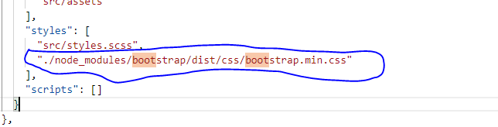
3rd party Styles Added in Angular Application
1) npm install bootstrap@4
Check package.josn file :
Bootstap package is added in node_modules (Folder)
Then go to angular.json file: paste it

Slide 14
Creating Component
ng g c servers
Various Type of Selectors
1)
@component({
selector : [app-servers],
templateUrl :’xyz.html’,
})
Usage: <div app-servers></div> // This content is displayed in the html.
2)
@component({
selector : .app-servers],
templateUrl :’xyz.html’,
})
Usage: <div class=“app-servers “></div> // This content is displayed in the html.

Slide 15
Databinding:
Communication between your component (that is typescript file , your logic) and view(that is html).
Various types of Databinding
string interpolation {{}}
Property binding
Event binding
Two Way Data binding (that is [ngModel] → banana box syntax)

Slide 16
Event binding:
<button class="btn btn-success" [disabled]="!buttonClick" (click)="changeStatus()">Myclisdsck</button>
changeStatus() {
this.serverStatus = 'the server is online'
}

