Slide 2
Objects
Objects are collection of methods and properties.
Example : In real life, a car is an object.
Some properties:
car.weight = 850kg car.name = Fiat car.model = 500 Methods : car.start() car.drive()

Slide 3
JavaScript Objects
Objects are variables too. But objects can contain many values.
var car = {type:"Fiat", model:"500", color:"white"};
var person = { firstName: "John", lastName: "Doe", age: 50, eyeColor: "blue" };
Calling Object Properties : person.lastName; person["lastName"];

Slide 4
JavaScript Objects
var person = { firstName: "John", lastName : "Doe", id : 5566, fullName : function() { return this.firstName + " " + this.lastName; } };

Slide 5
This KeyWord
In a function definition, this refers to the "owner" of the function.
var person = { firstName: "John", lastName : "Doe", id : 5566, fullName : function() { return this.firstName + " " + this.lastName; } }
The JavaScript this keyword refers to the object it belongs to.

Slide 6
WhyTHis
In a method, this refers to the owner object.
Methods like call(), and apply() can refer this to any object. (Explan Later)
this in a Function (Default)
fullName = function() { return this; // Global }
‘use strict’; So, when used in a function, in strict mode, this is undefined.

Slide 7
<!DOCTYPE html>
<html>
<body>
<h2>The JavaScript <i>this</i> Keyword</h2>
<button onclick="this.style.display='none'">Click to Remove Me!</button>
</body>
</html>

Slide 8
Explicit Function Binding:
The call() and apply() methods are predefined JavaScript methods.
They can both be used to call an object method with another object as argument.
Ex:
var person1 = { fullName: function() { return this.firstName + " " + this.lastName; } }

Slide 9
This KeyWord
var person2 = { firstName:"John", lastName: "Doe", }
person1.fullName.call(person2); // Will return "John Doe"

Slide 10
"use strict";
The "use strict" directive was new in ECMAScript version 5.
"use strict"; x = 3.14; // This will cause an error because x is not declared
myFunction(); function myFunction() { y = 3.14; // This will also cause an error because y is not declared }
x = 3.14; // This will not cause an error. myFunction(); function myFunction() { "use strict"; y = 3.14; // This will cause an error }

Slide 11
Why Strict Mode?
Strict mode makes it easier to write "secure" JavaScript.
As an example, in normal JavaScript, mistyping a variable name creates a new global variable. In strict mode, this will throw an error, making it impossible to accidentally create a global variable.
Objects are variables too.
"use strict"; x = {p1:10, p2:20}; // This will cause an error

Slide 12
JavaScript Objects
Creating a JavaScript Object : 3 types
1) using an object literal.
2) keyword new
3)Object.create
1) Object Literal
var person = {firstName:"John", lastName:"Doe", age:50, eyeColor:"blue"};

Slide 13
New KeyWord
var person = new Object();
person.firstName = "John";
person.lastName = "Doe";
person.age = 50;
person.eyeColor = "blue";

Slide 14
JavaScript Objects are Mutable:
Objects are mutable: They are addressed by reference, not by value.
If person is an object, the following statement will not create a copy of person
var person = {firstName:"John", lastName:"Doe", age:50, eyeColor:"blue"} var x = person; x.age = 10;

Slide 15
JavaScript for...in Loop
var person = {fname:"John", lname:"Doe", age:25};
for(var x in person) {
console.log(x) // return keys
}

Slide 16
JavaScript Object Prototypes
All JavaScript objects inherit properties and methods from a prototype.
function Person(first, last, age, eyecolor) { this.firstName = first; this.lastName = last; this.age = age; this.eyeColor = eyecolor; } var myFather = new Person("John", "Doe", 50, "blue"); var myMother = new Person("Sally", "Rally", 48, "green");

Slide 17
function Person(first, last, age, eyecolor) { this.firstName = first; this.lastName = last; this.age = age; this.eyeColor = eyecolor; } Person.prototype.name = function() { return this.firstName + " " + this.lastName; };

Slide 18
Arrays:
Array is a single variable that is used to store different elements. It is often used when we want to store list of elements and access them by a single variable. Unlike most languages where array is a reference to the multiple variable, in JavaScript array is a single variable that stores multiple elements.
var House = [ ]; // method 1 var House = new array(); // method 2
var house = ["1BHK", 25000, "2BHK", 50000, "Rent", true];

Slide 19
New Methods
Pop() // Removing the last element
Push() // pushing the element into Array
Shift()
Unshift()
forEach()
Map()
Reduce()
Length
indexOf(), lastindexOf()

Slide 20
Splicing an Array:
The splice() method can be used to add new items to an array:
var fruits = ["Banana", "Orange", "Apple", "Mango"]; fruits.splice(2, 0, "Lemon", "Kiwi");
The first parameter (2) defines the position where new elements should be added (spliced in).
The second parameter (0) defines how many elements should be removed.

Slide 21
Array Methods
var fruits = ["Banana", "Orange", "Apple", "Mango"];
fruits.splice(2, 2, "Lemon", "Kiwi"); return removied elememts that is an array ["Apple", "Mango"]
fruits // values are added in Original Array ["Banana", "Orange", "Lemon", "Kiwi"]
Merging (Concatenating) Arrays:
var myGirls = ["Cecilie", "Lone"];
var myBoys = ["Emil", "Tobias", "Linus"];
var myChildren = myGirls.concat(myBoys); // Concatenates (joins) myGirls and myBoys

Slide 22
ES 6
Let,const,ArrowFunctions, Template Literals in ES6
Destructuring Assignment in ES6 :
http://es6-features.org/#Constants
https://medium.com/dailyjs/how-to-remove-array-duplicates-in-es6-5daa8789641c

Slide 23
var arr1 = ["Cecilie", "Lone"];
var arr2 = ["Emil", "Tobias", "Linus"];
var arr3 = ["Robin", "Morgan"];
var myChildren = arr1.concat(arr2, arr3); // Concatenates arr1 with arr2 and arr3

Slide 24
Slicing an Array
The slice() method creates a new array. It does not remove any elements from the source array
var fruits = ["Banana", "Orange", "Lemon", "Apple", "Mango"];
var citrus = fruits.slice(3);
var fruits = ["Banana", "Orange", "Lemon", "Apple", "Mango"]; var citrus = fruits.slice(1, 3);

Slide 25
Looping Elements:
function fnCheckDatatype_loop(arr. sDatatype){
for(var i = 0 ; i < arr.length; i ++){
if(typeof(arr[i]) !== sDatatype){
return false;
}
fnCheckDatatype_loop(["Geeks","for","Geeks"],"string")
fnCheckDatatype_loop(["Geeks",4,"Geeks"],"string")

Slide 26
function fnIsEven_loop(arr){
for(var i = 0 ; i < arr.length; i ++){
if(arr[i] % 2 === 0){
return true;
}
}
return false;
}
fnIsEven_loop([1,3,5]);
fnIsEven_loop([1,3,5,6]);

Slide 27
RealTime Example
function fnFilterStudents_loop(aStudent){
var tempArr = [];
for(var i = 0 ; i< aStudent.length; i ++){
if(aStudent[i].fPercentage > 80.0){ tempArr.push(aStudent[i]);}
}
return tempArr;
}
aStudent = [
{sStudentId : "001" , fPercentage : 91.2},
{sStudentId : "002" , fPercentage : 78.7},
{sStudentId : "003" , fPercentage : 62.9},
{sStudentId : "004" , fPercentage : 81.4}];
console.log(fnFilterStudents_loop(aStudent));

Slide 28
["1","2","3"].map(function(val{return parseInt(val,10)});
// output : [1, 2, 3]
var arr = [1,2,3,4,5,6,7,8,9,10];
arr.reverse();

Slide 29
Dates
var d = new Date();
Ex: var d = new Date("October 13, 2014 11:13:00");

Slide 30
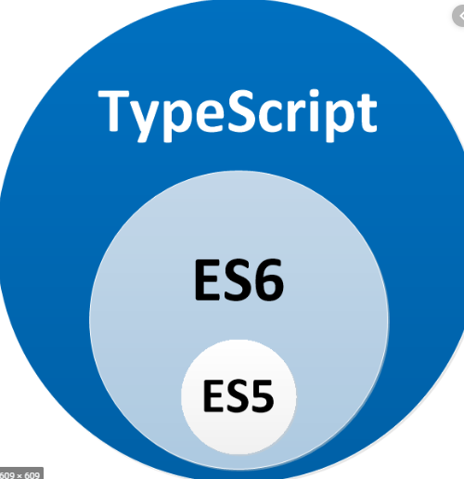
ES 6

Slide 31
ES6
Default Parameters in ES6
Template Literals in ES6
Multi-line Strings in ES6
Destructuring Assignment in ES6
Enhanced Object Literals in ES6
Arrow Functions in ES6
Promises in ES6
Block-Scoped Constructs Let and Const
Classes in ES6
Modules in ES6

Slide 32
Default Value
var link = function(height = 50, color = 'red', url = 'http://azat.co’)
{
Console.log(height);
}

Slide 33
Template Literals in ES6
Es 5 :
var name = 'Your name is ' + first + ' ' + last + '.' var url = 'http://localhost:3000/api/messages/' + id
Es 6:
var name = `Your name is ${first} ${last}.` var url = `http://localhost:3000/api/messages/${id}`

Slide 34
3. Multi-line Strings in ES6
Es 5:
var roadPoem = 'Then took the other, as just as fair,\n\t' + 'And having perhaps the better claim\n\t' + 'Because it was grassy and wanted wear,\n\t' + 'Though as for that the passing there\n\t' + 'Had worn them really about the same,\n\t' var fourAgreements = 'You have the right to be you.\n\ You can only be you when you do your best.’
Es 6:
var roadPoem =`hello world`

Slide 35
4. Destructuring Assignment in ES6
Es 5: Var x = [10, 20, 30, 40, 50];
Console.log(x[0])
Es 6:
[a, b, ...rest] = [10, 20, 30, 40, 50];
Console.log(a), console.log(rest)
Ex :2
const o = {p: 42, q: true};
const {p, q} = o;
console.log(p); // 42
console.log(q); // true

Slide 36
Arrow Functions in ES6
var ids =['5632953c4e345e145fdf2df8','563295464e345e145fdf2df9']var messages = ids.map(value => `ID is ${value}`) // implicit return
Es 5:
var wait1000 = new Promise(function(resolve, reject) { setTimeout(resolve, 1000) }).then(function() { console.log('Yay!') })
Es 6:
var wait1000 = new Promise((resolve, reject)=> { setTimeout(resolve, 1000) }).then(()=> { console.log('Yay!') })

Slide 37
Block-Scoped Constructs Let and Const
Let and const
const` means that the identifier can’t be reassigned
Hoisting is not supported , Let is block scope, var is global scope
Ex :typeof bar; let bar = ‘baz’;

Slide 38
Classes in ES6
http://es6-features.org/#BlockScopedVariables
https://www.w3schools.com/js/js_classes.asp

Slide 39
ES6 in your Node.js or Babel
ES6 (ECMAScript 2015) is the latest stable version of JavaScript. It includes new language syntaxes and implementations for the language. Three years later implementation of these new features in JavaScript engines is still ongoing but you'd still like to write your code in ES6 because who wants to stay behind in this industry.
using Babel or Node.js here to convert our ES6 code that can be understood by the existing JavaScript engines

Slide 40
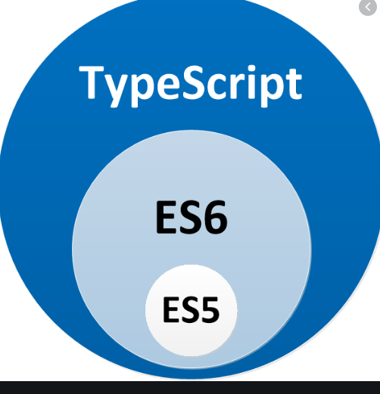
Typescript

Slide 41
What is Typescrpt
Parameter | Typescript | JavaScript
What is | Powerful type system, including generics & JS features | Lightweight, interpreted, object-oriented language with first-class functions
Data Binding | TypeScript uses concepts like types and interfaces to describe data being used. | No such concept is available with JavaScript.

Slide 42
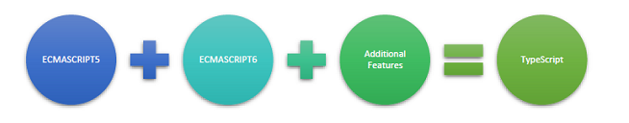
TypeScript supports other JS libraries. Compiled TypeScript can be consumed from any JavaScript code. TypeScript-generated JavaScript can reuse all of the existing JavaScript frameworks, tools, and libraries.

Slide 43
Why We use TypeScript
TypeScript is an object-oriented programming language developed and maintained by the Microsoft Corporation.
TypeScript totally follows the OOPS concept and with the help of TSC (TypeScript Compiler), we can convert Typescript code (.ts file) to JavaScript (.js file)
TypeScript simplifies JavaScript code, making it easier to read and debug.
TypeScript is open source.
TypeScript makes code easier to read and understand.

Slide 44
Why we use Typescript
With TypeScript, we can make a huge improvement over plain JavaScript.
TypeScript can help us to avoid painful bugs that developers commonly run into when writing JavaScript by type checking the code.

Slide 45
Variable Declaration
Typescript
var message:string = "Hello World"
console.log(message)
JS :
//Generated by typescript 1.8.10
var message = "Hello World";
console.log(message);

Slide 46
var name:string = "John";
var score1:number = 50;
var score2:number = 42.50
var sum = score1 + score2
console.log("name"+name)
console.log("first score: "+score1)
console.log("second score: "+score2)
console.log("sum of the scores: "+sum) var num:number = "hello" // will result in a compilation error

Slide 47
Scopes
Example: Variable Scope
var global_num = 12 //global variable
class Numbers {
num_val = 13; //class variable
static sval = 10; //static field
storeNum():void {
var local_num = 14; //local variable
}
}
console.log("Global num: "+global_num)
console.log(Numbers.sval) //static variable
var obj = new Numbers();
console.log("Global num: "+obj.num_val)

Slide 48
Ternary Operator
var num:number = -2
var result = num > 0 ?"positive":"non-positive"
console.log(result)

Slide 49
TypeChecking
interface LabeledValue {
label: string;
}
function printLabel(labeledObj: LabeledValue) {
console.log(labeledObj.label);
}
let myObj = {size: 10, label: "Size 10 Object"};
printLabel(myObj);

Slide 50
Real time example
interface SquareConfig {
color?: string;
width?: number;
}
function createSquare(config: SquareConfig) {
let newSquare = {color: "white", area: 100};
if (config.color) {
newSquare.color = config.color;
}
if (config.width) {
newSquare.area = config.width * config.width;
}
return newSquare;
}
let mySquare = createSquare({color: "black"});

Slide 51
ReadOnly
interface Point {
readonly x: number;
readonly y: number;
}
O/p :
let p1: Point = { x: 10, y: 20 }; p1.x = 5; // error!

Slide 52
Classes
class Greeter {
greeting: string;
constructor(message: string) {
this.greeting = message;
}
greet() {
return "Hello, " + this.greeting;
}
}
let greeter = new Greeter("world");

Slide 53
class Animal {
move(distanceInMeters: number = 0) {
console.log(`Animal moved ${distanceInMeters}m.`);
}
}
class Dog extends Animal {
bark() {
console.log('Woof! Woof!');
}
}
const dog = new Dog();
console.log(dog.bark());
console.log(dog.move(10));
dog.bark();

