Slide 1
Welcome to the Kiro
Duck Generator Challenge
AI-Powered Development Workshop
Build. Generate. Quack.

Slide 2
Challenge Overview
Duration
25-30 minutes
Level
200 - Beginner Friendly
What You'll Build
An AI-powered duck image generator using Amazon Bedrock Nova Canvas

Slide 3
Before You Start
Requirements
What's Included
Python 3.9+
Node.js 18+
Chrome browser
Git installed
uv and uvx tools
Kiro IDE
Amazon Bedrock access
6 MCP servers
Pre-configured backend
23 fallback duck images

Slide 4
No Amazon Bedrock Charges?
23 Sample Duck Images Included!
Don't want to incur Amazon Bedrock charges? No problem!
The backend API automatically uses pre-generated fallback duck images when generation fails or if you prefer not to use Bedrock.
You can still complete the entire challenge and build a working duck generator without any AWS costs.

Slide 5
Step 1: Get the Code
Clone the GitHub Repository
Clone the repo to your machine:
git clone https://github.com/aws-banjo/riv25_duck_game
Navigate and open README:
cd riv25_duck_game && cat README.md

Slide 6
Step 2: Connect MCP Servers
Add MCP Servers to Kiro IDE
1
Open .kiro/settings/mcp.json in the repo
2
Copy the MCP server configurations
3
Add them to your Kiro IDE settings

Slide 7
6 Pre-Configured MCP Servers
See .kiro/settings/mcp.json in the repo to add these to your Kiro IDE
Nova Canvas
AWS Docs
Generate duck images with Amazon Bedrock
Access AWS documentation
Frontend MCP
Code Doc Gen
Build React components
Generate documentation
Strands Agents
Chrome DevTools
Multi-agent workflows
Browser automation and testing

Slide 8
Four Simple Tasks
1
2
3
4
Start Backend & Test MCP
Create Coding Standards
Build Duck Generator
Test with DevTools
10 minutes
5 minutes
5 minutes
5 minutes

Slide 9
Task 1: Start Backend & Test MCP (5 min)
What You'll Do
Example Prompts
Start the backend server
Explore MCP servers
Generate test duck
Prompt 1:
What MCP servers are available?
Prompt 2:
Use Nova Canvas MCP to generate a test duck image

Slide 10
Task 2: Create Coding Standards (5 min)
What You'll Do
Example Prompt
Create steering document
Define naming rules
Set error handling
Add duck theme
Prompt:
Create a steering doc with duck-themed coding standards including naming conventions and error handling

Slide 11
Task 3: Build Duck Generator (10 min)
Features to Build
Using Spec Mode
Input field for description
Generate button
Loading state
Image display
Error handling
Key Concept
Write specifications instead of code. Kiro IDE uses AI to implement your features based on your specs.

Slide 12
What is Spec Mode?
Provide high-level guidance of what you want to build. Kiro automatically generates detailed requirements, design, and tasks.
How It Works:
1. You write a spec describing your feature
2. → Kiro generates requirements document
3. → Kiro generates design document
4. → Kiro generates tasks to implement it

Slide 13
Task 4: Test with Chrome DevTools (5 min)
What You'll Do
Example Prompt
Use DevTools MCP
Automate testing
Verify functionality
Generate final duck
Prompt:
Use Chrome DevTools MCP to test the duck generator by entering a description and clicking generate

Slide 14
Pro Tips
Be Specific
Experiment
Describe exactly what you want
Use clear, simple language
Break down complex tasks
Try different duck descriptions
Ask Kiro for suggestions
Have fun with it!

Slide 15

Ready to Start?
Let's Build Something Quacktastic!
Open Kiro IDE and begin your journey
into AI-powered development

Slide 16
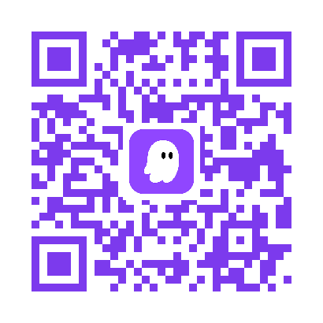
Ready for More?
You just completed the code challenge. Now dive deeper.
Join Kiroween 2025
Our first Halloween hackathon where creative ideas come to life
$100,000 in Total Prizes
1st Place: $30,000
12 Prize Categories
66 Winners
Scan the QR code or visit kiroween.devpost.com

