Slide 1
CS546
Parallel and Distributing Processing
Using blackboard (http://blackboard.iit.edu)
– Class: 11:25am-12:40pm Tu. & Th., SB #111
Instructor: Zhiling Lan
Email: lan@iit.edu, Phone: (312)5675710
Office: SB #226D
Office hours: 10:20am-11:20am(Tu. & Th.) or by appointment
TA: Xu Yang
Email: xyang56@hawk.iit.edu
Office: SB #012
Office hours: 10:00am-11:30am (Mon. & Wed.) or by appointment

Slide 2
Self Intro
Research interests: Parallel and Distributed Systems
Current projects:
SPEaR: Scheduling for Performance, Energy, and Resilience efficiency
COTA: a COoperative Framework for Topology Awareness
HPC Analytics for Extreme Scale Computing
Intelligent Storage Resource Services for the RAINS Project
CUDA Teaching and Research Center
Research Experiences for Undergraduates
Research website: http://www.cs.iit.edu/~lan
Interested in joining my research group?
Core courses: CS546 & CS550 & CS451
Group seminars

Slide 3
Course Objectives
Fundamentals of parallel and distributed computing (an extensive and broad topic)
Parallel & distributed architectures
Parallel programming approaches, paradigms, tools, …
Principles of parallel algorithm design
Parallel programming skills
Shared memory programming: openMP and Pthreads
Message passing interface: MPI
GPU programming: CUDA
Data parallelism: HPF
Performance analysis and tuning
Performance metrics & evaluation techniques
Machine-independent optimization
Machine-dependent optimization

Slide 4
Prerequisite
CS450 “Operating Systems”
Familiar with
Programming in C/C++
Linux tools and development environment
Command
Editors, compilers (gcc), makefiles (GNU make)
Basic concepts of computer architecture
Computing platforms:
Jarvis at IIT: our 19-node GPU-enabled cluster
Stampede at XSEDE (https://portal.xsede.org/tacc-stampede )

Slide 5
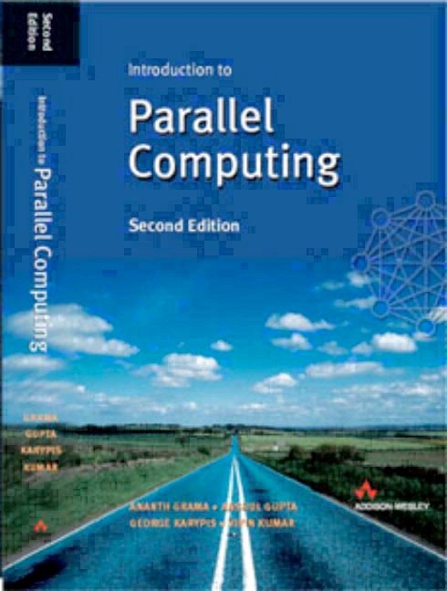
Course Materials
Required:
– lecture notes will be put online
Recommended textbooks:
A. Grama, V. Kumar et al., “Introduction to Parallel Computing”, Addison Wesley, 2003. ISBN 0-201-64865-2
I. Foster, “Design and Building Parallel Programs”, Addison Wesley, 1995. ISBN 0-201-57594-9
http://www.mcs.anl.gov/dbpp
W. Gropp et al, “Using MPI: Portable Parallel Programming with the Message Passing Interface”, MIT Press, 1994. ISBN 0-262- 57132-3
http://www.mcs.anl.gov/mpi/index.html
David Kirk and Wen-Wei Hwu, “Programming Massively Parallel Processors”, Morgan Kaufmann (2nd Edition), 2012.
Several books are available for loan

Slide 6
Course Slides
Available on Blackboard (CS546)
Adapted slides from Manish Parashar (Rutgers)
Adapted slides from Ananth Grama
Adapted slides from Kathy Yelick (Berkeley)
Adapted slides from LLNL’s tutorial
Adapted slides from John Mellor-Crummey (Rice)
Adapted slides from Jack Dongarra (Tennessee)

Slide 7
Tentative Schedule
Week 1: Overview
Week 2: Parallel platforms and programming models
Week 3-4: Performance analysis and tuning
Week 5-7: Shared memory architecture & programming
Week 8: midterm
Week 9-11: Distributed memory architecture & programming
Week 12: GPU architecture & programming
Week 13-14: Data parallel programming
Week 15: final exam

Slide 8
Misc. Course Details
You are expected to attend all of the lectures
Grading
Two written and three programming assignments (2*8%+3*10%=46%)
Two exams (2*20%)
One final programming project (14%)
Assignment late penalty:
There is a late penalty of 20% per day
Use the course blackboard (http://blackboard.iit.edu)
Announcements
Lecture notes
Assignments
Discussion

Slide 9
Policies
Collaboration policy
Encouraged for high level concepts and understanding the courses materials
but …..
Cheating policy
Copying all or part of another student's homework
Allowing another student to copy all or part of your homework
Copying all or part of code found in a book, magazine, the Internet, or other resource

Slide 10
Policies
IIT Code of Academic Honesty [link]
All violations of academic integrity will be reported to academichonesty@iit.edu
Sanctions for violations of academic integrity
Expulsion from a course. The student is assigned a punitive failing grade of ‘E’ for the course and can no longer participate in the course or receive evaluation of coursework from the instructor.
Suspension. Suspension is a status assigned for various periods of time in which a student’s enrollment is interrupted. A suspended student may not attend day or evening classes, participate in student activities, or live in campus housing. A suspended student may apply for reinstatement at the end of the period of suspension. If reinstated, the student may be placed on disciplinary probation for a period of time designated by the Dean for Academic Discipline.
Expulsion. Expulsion is the complete severance of association with the University. Notation of the violation of the Code is made on the student’s transcript

Slide 11
Work Opportunities
Student introduction
Research opportunities for graduate students:
Always look for self-motivated and hard-working grad students
Ph.D. students: CS597 and CS691
MS students: CS591 “Research and Thesis for MS Degree”
Take CS546 & CS550, check my research projects, send me your CV
Research opportunities for undergrad students:
NSF REU (Research Experiences for Undergraduates) with Prof.
Zhiling Lan
Various project topics, including development of scheduling simulator, analysis of system logs, ….
$10-$15 per hour
If interested, contact Prof. Lan (lan@iit.edu)

Slide 12
Any Questions?

Slide 13
Introduction

Slide 14
Outline
What is parallel computing
Why parallel computing
Application pull
Technology push
Distributed and cloud computing
Reading:
Kumar – ch 1; Foster – ch 1

Slide 15
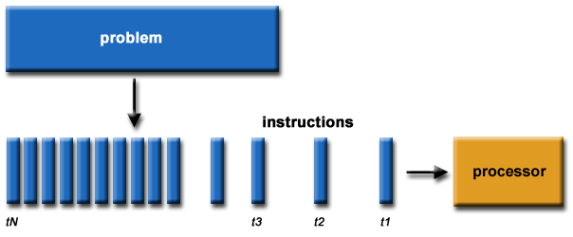
Serial Computing
Traditional, software has been written for serial computation
A problem is broken into a discrete series of inst.
Inst. are executed sequentially (one after another)
Executed on a single processor
Only one inst. executes at any moment in time

Slide 16
What is Parallel Computing
Simultaneous use of multiple compute resources to solve a problem
A problem is broken into discrete parts that can be solve concurrently
Each part is further broken down to a series of inst.
Inst. from each part execution simultaneously on different processors
An overall control/coordination mechanism is employed
Examples of parallel machines:
A cluster computer
A shared memory multiprocessor (SMP*)
A Chip Multi-Processor (CMP)
Daily life example: stacking a set of library books

Slide 17
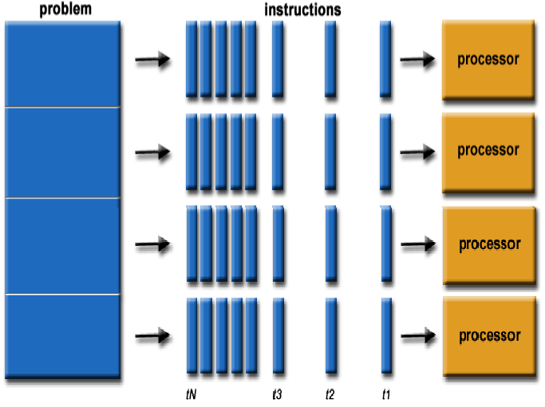
What is Parallel Computing

Slide 18
Who is Using Parallel Computing
Science and engineering
Historically, it has been considered to be “the high end of computing”, and has been used to model difficult problems in many areas of science and engineering
Industrial and commercial
Today, commercial applications provide an equal or greater driving force in the development of faster computers
These applications require the processing of large amount of data in sophisticated ways

Slide 19
Why Parallel Computing
Application pull
Desire to solve bigger and more realistic applications
Technology push
Fundamental limits are being approached

Slide 20
Application Drivers for Change
Continued exponential increase in computational speed → simulation is becoming third pillar of science, complementing theory and experiment
Continued exponential increase in experimental data
→ techniques and technology in data analysis, visualization, analytics, networking, and collaboration tools are becoming essential in all data rich scientific applications

Slide 21
Application Pull
“Computational modeling and simulation are among the most significant developments in the practice of scientific inquiry in the 20th century.
Within the last two decades, scientific computing has become an important contributor to all scientific disciplines.
It is particularly important for the solution of research problems that are insoluble by traditional scientific theoretical and experimental approaches, hazardous to study in the laboratory, or time consuming or expensive to solve by traditional means”
— “Scientific Discovery through Advanced Computing” DOE Office of Science, 2000

Slide 22




Simulation: 3rd Pillar of Science
Traditional scientific and engineering method:
Do theory or paper design
(2) Perform experiments or build system
Theory
Experiment
Limitations:
–Too difficult
–Too expensive
–Too slow
–Too dangerous
Simulation
Computational science and engineering paradigm
What is it?
Based on known physical laws and efficient numerical methods
Analyze simulation results with computational tools and methods beyond what is possible manually

Slide 23
Challenging Computations
Science
Global climate modeling
Biology: genomics; protein folding; drug design
Astrophysical modeling
Computational Chemistry
Computational Material Sciences and Nanosciences
Engineering
Semiconductor design
Earthquake and structural modeling
Computation fluid dynamics (airplane design)
Combustion (engine design)
Crash simulation
Business
Financial and economic modeling
Transaction processing, web services and search engines
Defense
Nuclear weapons -- test by simulations
Cryptography

Slide 24
Parallel Computing in Web Search
Functional parallelism: crawling, indexing, sorting
Parallelism between queries: multiple users
Finding information amidst junk
Preprocessing of the web data to help find information
General themes of sifting through large, unstructured data sets:
When to put white socks on sale
What advertisements should you receive
Finding medical problems in a community

Slide 25
Economic Impact of HPC
Airlines:
System-wide logistics optimization systems on parallel systems.
Savings: approx. $100 million per airline per year.
Automotive design:
Major automotive companies use large systems (500+ CPUs) for:
CAD-CAM, crash testing, structural integrity and aerodynamics.
One company has 500+ CPU parallel system.
Savings: approx. $1 billion per company per year.
Semiconductor industry:
Semiconductor firms use large systems (500+ CPUs) for
device electronics simulation and logic validation
Savings: approx. $1 billion per company per year.
Energy
Computational modeling improved performance of current nuclear power plants, equivalent to building two new power plants.

Slide 26
Summary of Application Pull
Save time and/or money
Solve larger or more complex problems
Provide concurrency
Take advantage of non-local resources
Make better user of underlying parallel hardware

