Slide 1
Parallel Platforms & Programming Models

Slide 2
Outline
Parallel platforms (~hardware) and programming models (~software)
– Note: Parallel machine may or may not be tightly coupled to programming model
Data dependence
Reading: Kumar – ch 1; Hwang – ch1; Foster
– ch 1

Slide 3
Flavors of Parallelism
Data parallelism:
Definition?
Task parallelism:
Definition?

Slide 4
Data and Task Parallelization
Data parallel:
for (i=0;i<1000;i++) a[i]=b[i]+c[i];
Task parallel:
for (i=0;i<1000;i++) /*block 1 */ b[i+1]=b[i]+c[i]
…
for (j=0;j<5;j++) /*block 2*/ a[j+1]=a[j]+d[j];

Slide 5
Parallel Platforms
Basic components of any architecture:
Processors and memory (processing units)
Interconnect network
Logic classification based on:
Control mechanism (Flynn’s Taxonomy)
SISD (Single Instruction Single Datastream)
SIMD (Single Instruction Multiple Datastream)
MISD (Multiple Instruction Single Datastream)
MIMD (Multiple Instruction Multiple Datastream)
Address space organization
Shared Address Space
Distributed Address Space

Slide 6
Parallel Platforms based on Flynn’s Taxonomy

Slide 7
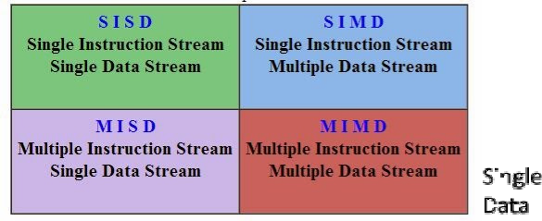


Flynn’s Taxonomy

Slide 8

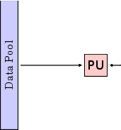
SISD Architecture
Model of serial Von Neumann machine
Logically, single control processor
Includes some supercomputers, such as the 1963 CDC6600 (perhaps the first supercomputer)

Slide 9
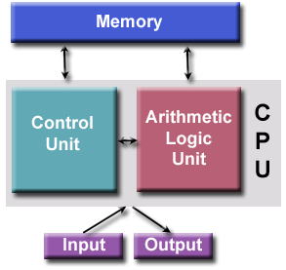
Von Neumann Architecture
John von Neumann first authored the general requirements for an electronic computer in 1945
Aka “stored-program computer”
– Both program inst. and data are kept in electronic memory
Since then, all computers have followed this basic design
Four main components: memory, control unit, ALU, I/O

Slide 10


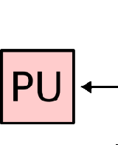
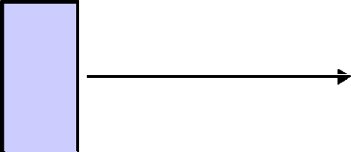
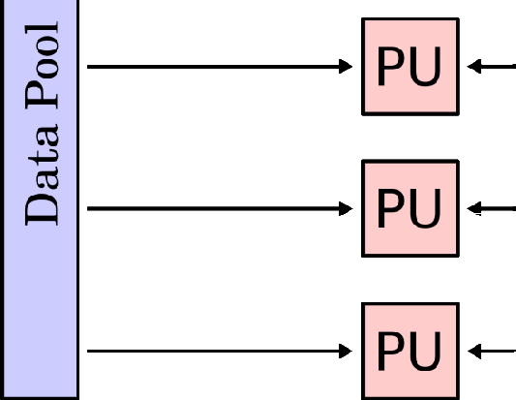
SIMD Architecture
Parallelism achieved by dividing data among the processors
Multiple processors execute the same instruction
Data that each processor sees may be different
Individual processors can be turned on/off at each cycle (“masking”)
Examples:
Many early parallel computers like Illiac IV, Thinking Machines’CM-2, …
Today, GPU, vector units, and co- processors

Slide 11
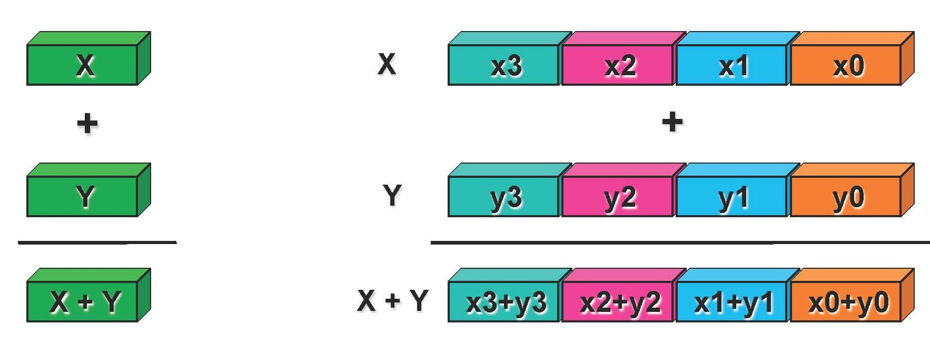
Example of SIMD Vector Units
Scalar processing
Traditional mode
One operation produces one result
SIMD vector units
One operation produces multiple results

Slide 12
SIMD Drawbacks
Discussion?

Slide 13
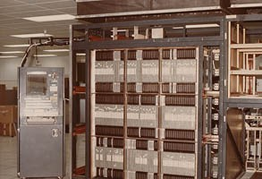
The ill-fated Illiac IV
Project started in 1965, predicted to cost $8M and provide 1000 MFLOP/S.
Delivered to NASA Ames in 1972, cost $31M, ran first application in 1976, performed 15 MFLOP/S.
64 processors, 13-MHz clock, 1MB memory

Slide 14
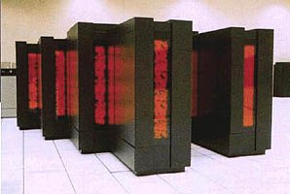
Thinking Machine CM2
CM2 (1990, built by Thinking Machines Corp) had 8,192 to 65,536 one-bit processors, plus one floating- point unit.
Data Vault provides peripheral mass storage
Single program - all unmasked operations happened in parallel.

Slide 15
Vector Processors
Operate on arrays or vectors of data, while conventional CPU’s operate on individual data elements or scalars
Vector registers
Capable of storing a vector of operands and operating simultaneously on their contents
Vectorized and pipelined functional units
The same operation is applied to each element in the vector
Examples:
Cray supercomputers (X-MP, Y-MP, C90, T90, SV1, ...), Fujitsu (VPPxxx), NEC, Hitachi
Earth Simulator from Japan (on the TOP500 list)
many of these have multiple vector processors, but typically separate processors are used for separate jobs.

Slide 16
Vector Processors – Pros & Cons
Discussion?

Slide 17
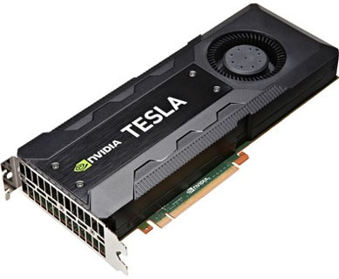
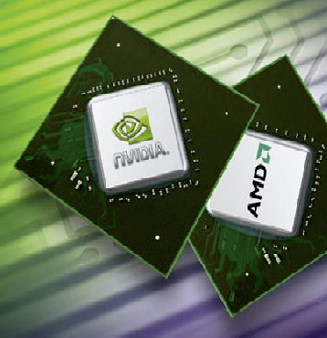
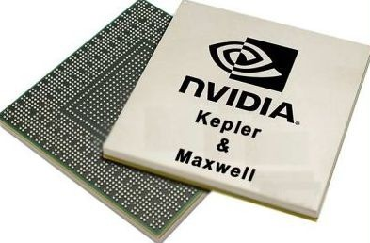
Graphic Processing Units (GPU)
Real time graphics application programming interfaces or API’s use points, lines, and triangles to internally represent the surface of an object
A graphics processing pipeline converts the internal representation into an array of pixels that can be sent to a computer screen
Several stages of this pipeline (called shader functions) are programmable
– Typically just a few lines of C code

Slide 18




MIMD Architecture
Supports multiple simultaneous instruction streams operating on multiple data streams
Each processor executes program independent of other processors
Processors operate on separate data streams
Typically consist of a collection of fully independent PUs or cores, each of which has its own control unit and its own ALU.
Examples:
Current generation systems
Lectu

Slide 19
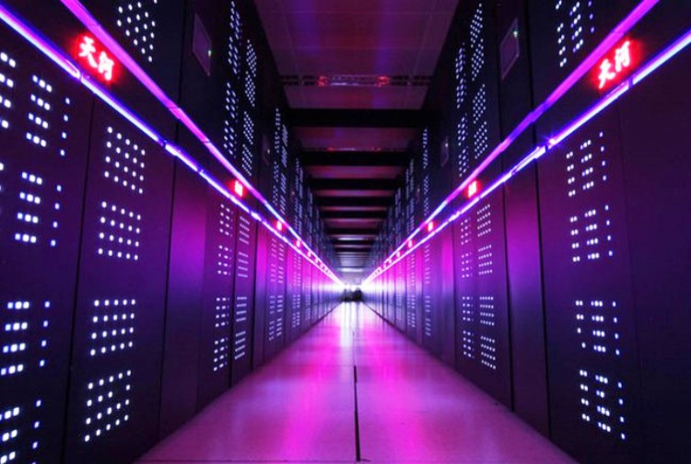
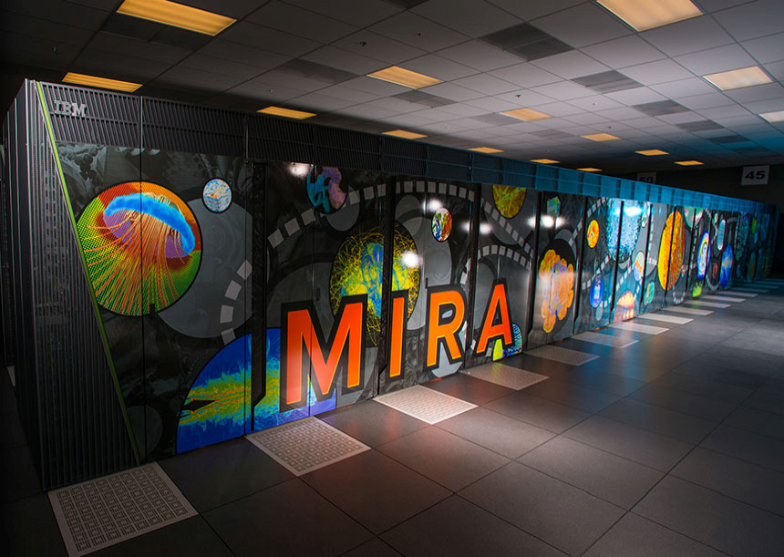
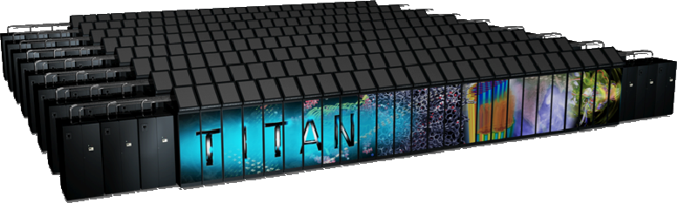
Examples
Tianhe-2
Mira
Titan

Slide 20
MISD Architectures
Multiple Instruction Single Data
Few (if any) actual examples of this class of parallel computer have ever existed.
The term isn’t used (except when discussing the Flynn taxonomy) .
Perhaps applies to pipelined computation,
e.g. sonar data passing through sequence of special-purpose signal processors.

Slide 21
SIMD vs MIMD
SIMD platforms
– ???
MIMD platforms
– ???

Slide 22
Parallel Platforms based on Address Space Organization

Slide 23
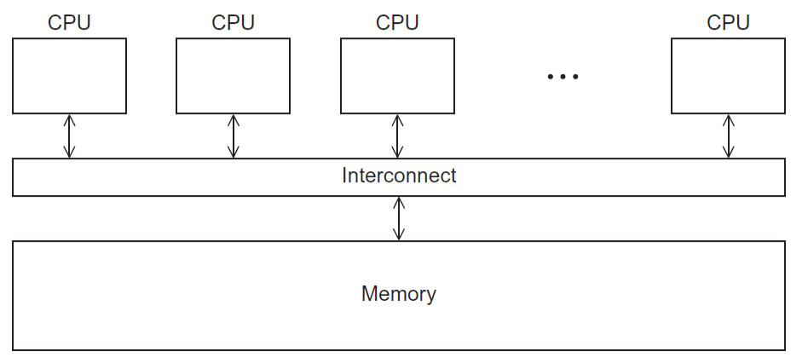
Shared Address Space
Aka shared memory system
Shared address space:
Processors can directly access all the data in the system
Inter-processor interaction ?
Example: multi-core processors

Slide 24
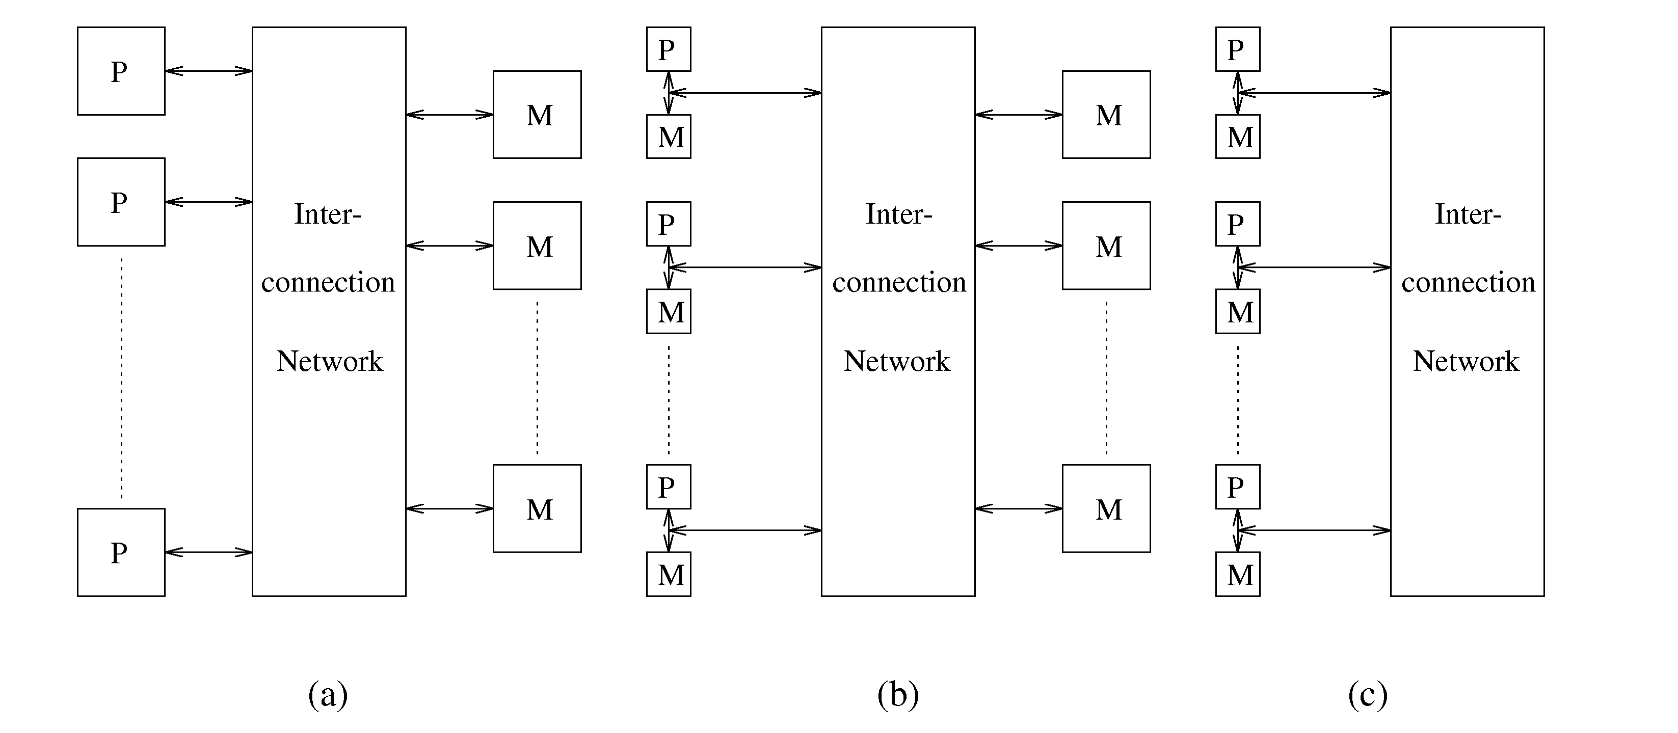
Shared Address Space
Uniform Memory Access (UMA)
NonUniform Memory Access(NUMA)

Slide 25
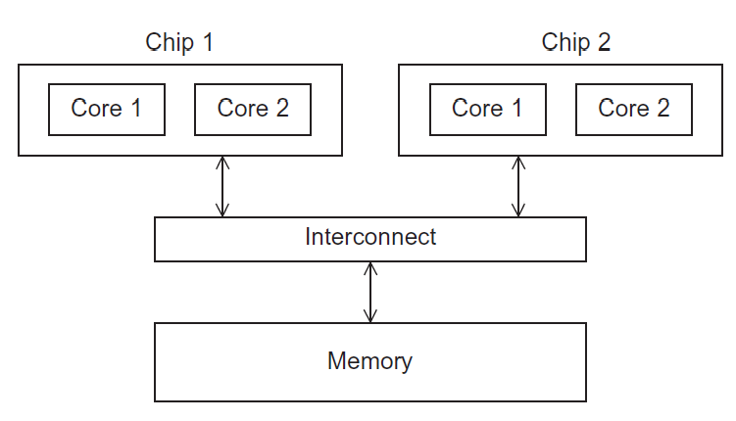
UMA Multicore System
Time to access all the shared memory locations are the same for all the cores

Slide 26
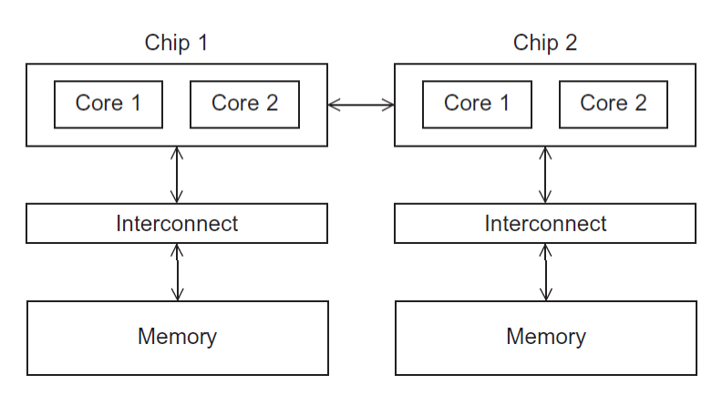
NUMA Multicore System
A memory location a core is directly connected to can be accessed faster

Slide 27
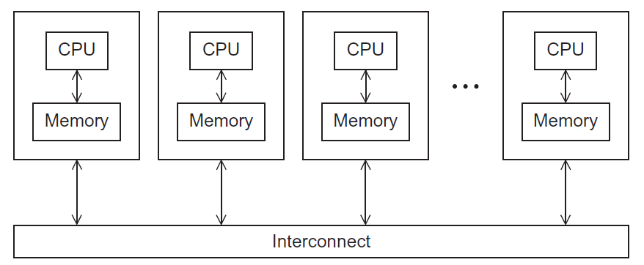
Distributed Address Space
Aka distributed memory system
Distributed address space:
“Shared nothing:” each processor has a private memory
Processors can directly access only local data
Inter-processor interaction ?

Slide 28
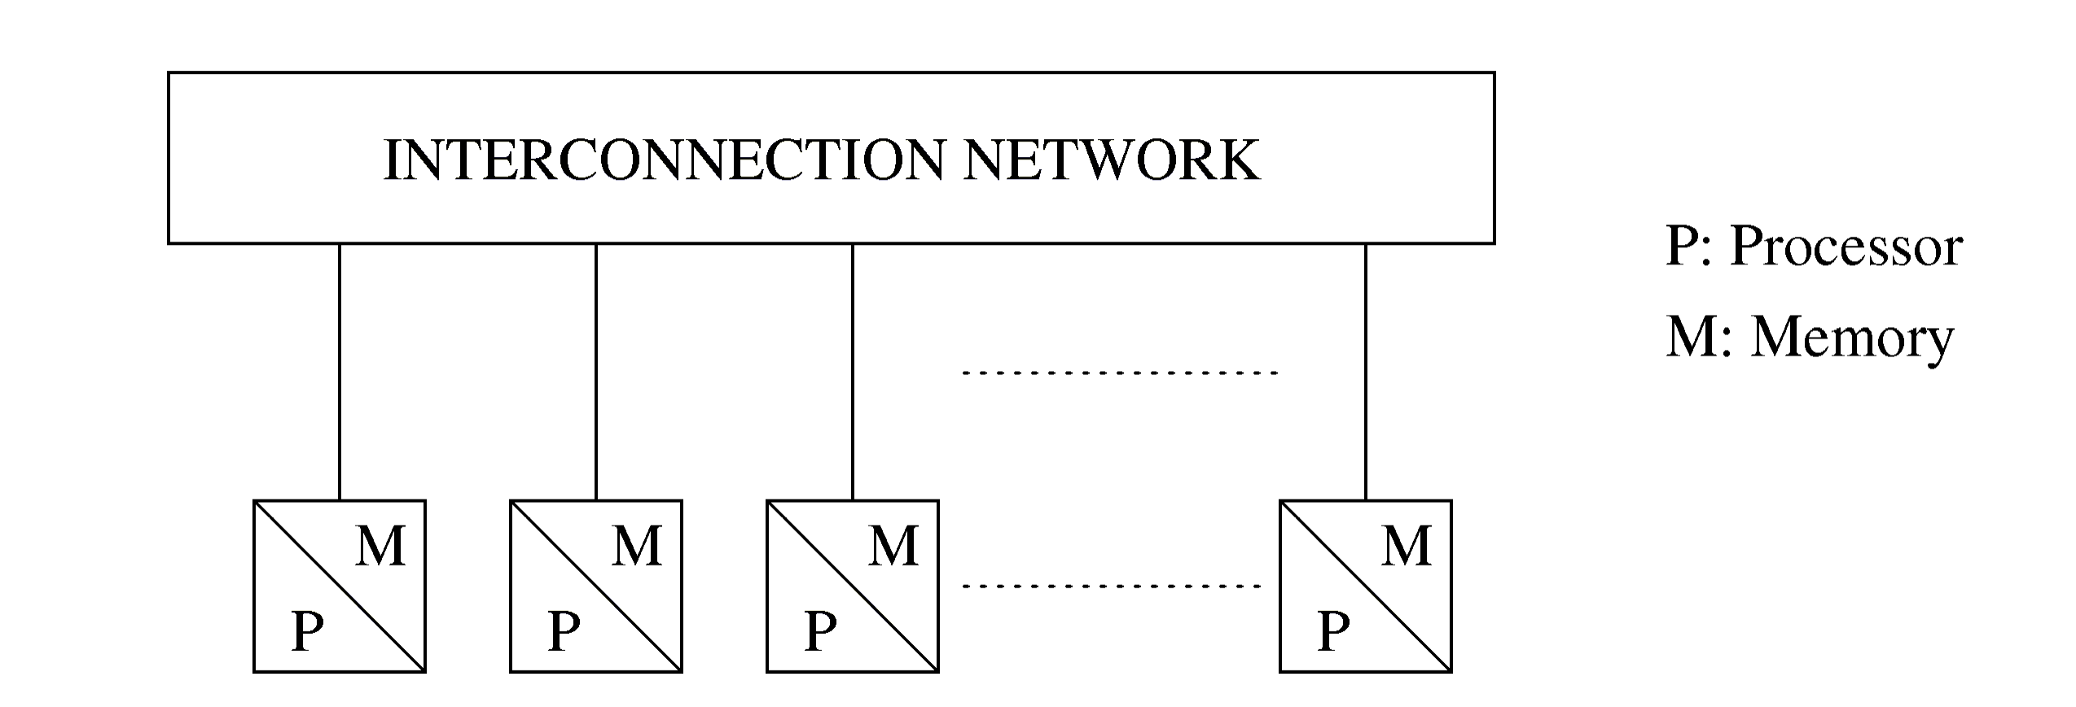
Distributed Address Space

Slide 29
Clusters
A type of distributed address space machines
A collection of commodity systems
Connected by a commodity interconnection network
Nodes of a cluster are individual computation units joined by a communication network

Slide 30
Shared vs. Distributed Address
Shared address:
Pro. Vs Con.?
Distributed address:
Pro. Vs. Con.?

