Slide 1
“Performance & Evaluation”

Slide 2
Outline
Performance metrics
Speedup
Efficiency
Scalability
Examples
Reading: Kumar – ch 5; Foster – ch 2

Slide 3
Speedup
T_{s} =time for the best serial algorithm
T_{p}=time for parallel algorithm using p processors
S = ^{Ts}
p
T
p

Slide 4
Example
100
time
35 35 35 35
time
1 2 3 4
(c)
S = ¹⁰⁰ = 2.85,
time 25 25 25 25
Processor 1
(a)
1 2 3 4
(b)
S = ¹⁰⁰ = 4.0,
p
35
p
25
perfect load balancing but synch cost is 10
perfect parallelization

Slide 5



Example (cont.)
30 20 40 10
50 50 50 50
time
time
1 2 3 4
(d)
1 2 3 4
(e)
S = ¹⁰⁰ = 2.5,
S = ¹⁰⁰ = 2.0,
p
40
p
50
no synch
but load imbalance
load imbalance and synch cost

Slide 6
What Is “Good” Speedup?
Linear speedup:
Superlinear speedup
Sub-linear speedup:

Slide 7
Speedup
speedup
p

Slide 8
Sources of Parallel Overheads
Interprocessor communication
Data movement costs
Load imbalance
Synchronization
Extra computation
Computation not performed by serial version, e.g., partially-replicated computation to reduce communication
Contention
Memory
Network

Slide 9
Amdahl’s Law
The performance improvement that can be gained by a parallel implementation is limited by ?
Then, parallel run time can be written as?

Slide 10
Fixed-Sized Speedup Amdahl’s Law
Fixed-Size Speedup (Amdahl’s law)
Emphasis on turnaround time
Problem size, W, is fixed
₌ Uniprocessor Execution Time Parallel Execution Time
S
p
₌ Uniprocessor Time of Solving W ParallelTime of Solving W
S
p

Slide 11
Amdahl’s Law
Amdahl’s law gives a limit on speedup in terms of α

Slide 12
Fixed-Size Speedup (Amdahl Law, ‘67)
Amount of Work
Elapsed Time
W₁ W₁ W₁ W₁ W₁
T₁
T₁
T₁
W_{p} W_{p} W_{p} W_{p} W_{p}
T_{p}
T₁
T₁
T_{p}
T_{p}
T
p T_{p}
1 2 3 4 5
Number of Processors (p)
1 2 3 4 5
Number of Processors (p)

Slide 13
Amdahl’s Law
The speedup that is achievable on p processors is ?
If we assume that the serial fraction is fixed, then ?
For example, if α=10%, then ?

Slide 14
Comments on Amdahl’s Law
The Amdahl’s fraction α in practice depends on the problem size n and the number of processors p
What is an effective parallel algorithm?
Can we get linear speedup with an effective parallel algorithm?

Slide 15
Efficiency
S
₌ p
p
E
p
Bounds:
Theoretically: between [0,1]
In practice, may be greater than 1 if superlinear speedup
The fraction of total potential processing power that is actually used.
A program with linear speedup is 100% efficient

Slide 16
Scalability
fixed W
E
fixed P
E
Definition?
Can keep efficiency constant by
increasing the problem size
Proportionally increasing the number of processors
Such systems are called scalable parallel systems
P
W

Slide 17
Scalability
Efficiency of adding n numbers in parallel
Efficiency for Various Data Sizes
1
n=64 n=192 n=320 n=512
0.8
Efficiency
0.6
0.4
E=1/(1+2plogp/n)
0.2
0
1
4 8 16
number of processors
32
For an efficiency of 0.80 on 4 procs, n=64
For an efficiency of 0.80 on 8 procs, n=192
For an efficiency of 0.80 on 16 procs, n=512

Slide 18
Isoefficiency Scalability
Dictates the growth rate of problem size required to keep the efficiency fixed as the number of processing units increases
W = KT₀ (W , p)
For a desired value E
( K be constant)
_{E =} 1 1+ T₀ (W , p) /W T₀ (W , p) ₌ 1− E
E T₀ (W , p)
W E
W =
1− E

Slide 19
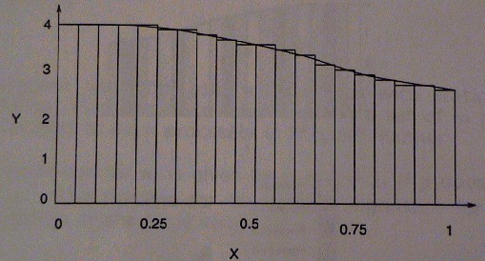
Compute π: Problem
Consider parallel algorithm for computing the value of
π=3.1415…through the following numerical integration
π = ∫
1
4
dx
4
⁰ 1+ x²
1+ x²

Slide 20
Compute π: Sequential Algorithm
computepi()
{
h=1.0/n; sum =0.0;
for (i=0;i<n;i++) {
x=h*(i+0.5); sum=sum+4.0/(1+x*x);
}
pi=h*sum;
}

Slide 21
Compute π: Parallel Algorithm
Each processor computes on a set of about n/p points which are allocated to each processor in a cyclic manner
Finally, we assume that the local values of π are accumulated among the p processors under synchronization
0
1 2 3
1 2 3
1 2 3
0
0
0
1 2 3
1 2 3
0

Slide 22
Compute π: Parallel Algorithm
computepi()
{
id=my_proc_id(); nprocs=number_of_procs(): h=1.0/n;
sum=0.0; for(i=id;i<n;i=i+nprocs) {
x=h*(i+0.5); sum=sum+4.0/(1+x*x);
}
localpi=sum*h; use_tree_based_combining_for_critical_section();
pi=pi+localpi; end_critical_section();
}

Slide 23
Compute π: Sequential Analysis
Assume that the computation of π is performed over n points
For n points, the number of operations executed in the sequential algorithm is:

Slide 24
Compute π: Parallel Analysis
The parallel algorithm uses p processors. Each processor computes on a set of m points which are allocated to each process in a cyclic manner
n p
The expression for m is given by
m ≤
+ 1
if p
does not exactly divide n. The runtime for the parallel algorithm for the parallel computation of the local values of π is:

Slide 25
Compute π: Parallel Analysis
The accumulation of the local values of π using a tree-based combining can be optimally performed in log₂(p) steps
The total runtime for the parallel algorithm for the computation of π is:
The speedup of the parallel algorithm is:

Slide 26
Compute π: Parallel Analysis
The Amdahl’s fraction α is:
The parallel algorithm is effective or not?

Slide 27
Finite Differences: Problem
Consider a finite difference iterative method applied to a 2D grid where:
t +1
= ω ⋅ ( X
t t
i, j −1
t
i−1, j
t
i+1, j
) + (1− ω ) ⋅ X
t
i, j
^{X}i, j
+ X + X
X
i, j +1

Slide 28
Finite Differences: Serial Algorithm
finitediff()
{
for (t=0;t<T;t++) {
for (i=0;i<n;i++) {
for (j=0;j<n;j++) {
x[i,j]=w_1*(x[i,j-1]+x[i,j+1]+x[i-1,j]+x[i+1,j]+w_2*x[i,j];
}
}
}
}

Slide 29

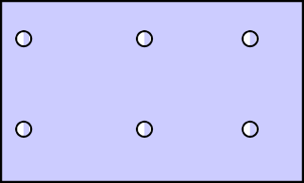
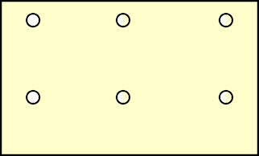
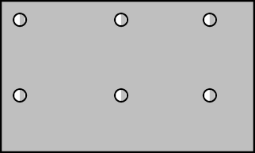
Finite Differences: Parallel Algorithm
Each processor computes on a sub-grid of ^{n} × ^{n}
points
p p
Synch between processors after every iteration ensures correct values being used for subsequent iterations
n
p

Slide 30
Finite Differences: Parallel Algorithm
finitediff()
{
row_id=my_processor_row_id(); col_id=my_processor_col_id(); p=numbre_of_processors(); sp=sqrt(p); rows=cols=ceil(n/sp); row_start=row_id*rows; col_start=col_id*cols;
for (t=0;t<T;t++) {
for (i=row_start;i<min(row_start+rows,n);i++) { for (j=col_start;j<min(col_start+cols,n);j++) {
x[i,j]=w_1*(x[i,j-1]+x[i,j+1]+x[i-1,j]+x[i+1,j]+w_2*x[i,j];
}
barrier();
}
}
}

Slide 31
Finite Differences: Analysis
For an n*n grid and T iterations, the number of operations executed in the sequential algorithm is:

Slide 32
Finite Differences: Analysis
The parallel algorithm uses p processors. Each processor computes on an m*m sub-grid allocated to each processor in a blockwise manner
⎡ _{n} ⎤
m ≤ ⎢
⎢ ⎥
The expression for m is given by
⎥
p
The
runtime for the parallel algorithm is:

Slide 33
Finite Differences: Analysis
The barrier synch needed for each iteration can be optimally performed in log(p) steps
The total runtime for the parallel algorithm for the computation is:
The speedup of the parallel algorithm is:

Slide 34
Finite Differences: Analysis
The Amdahl’s fraction is:
The parallel algorithm is effective or not?

Slide 35
Fixed-Time Speedup Gustafson Law
Fixed-Time Speedup (Gustafson, ‘88)
° Emphasis on work finished in a fixed time
° Problem size is scaled from W to W'
° W': Work finished within the fixed time with parallel processing
_{S ' p =} Uniprocessor Timeof SolvingW ' ParallelTimeof SolvingW '
₌ Uniprocessor Timeof SolvingW ' Uniprocessor Timeof SolvingW
₌ W '
W

Slide 36
Gustafson’s Law (Without Overhead)
p
(1-a)p
a
1-a
time
₌ Work( p) ₌ αW + (1− α ) pW _{= α + (1− α ) p} Work(1) W
Speedup
FT

Slide 37
Fixed-Time Speedup (Gustafson)
W₁
Amount of Work
Elapsed Time
W₁
W₁
W_{p}
W
W_{p}
1
T T T T T
W
W
1 1 1 1 1
1
W
p
W_{p}
p
T_{p} T_{p} T_{p} T_{p} T_{p}
1 2 3 4 5
Number of Processors (p)
1 2 3 4 5
Number of Processors (p)

Slide 38
Converting α’s between Amdahl’s and Gustafon’s laws
p
αA( p −1) +1
= αG + (1− αG ) p
1
αA =
₁₊ (1− αG ).p
αG

